Slide 2
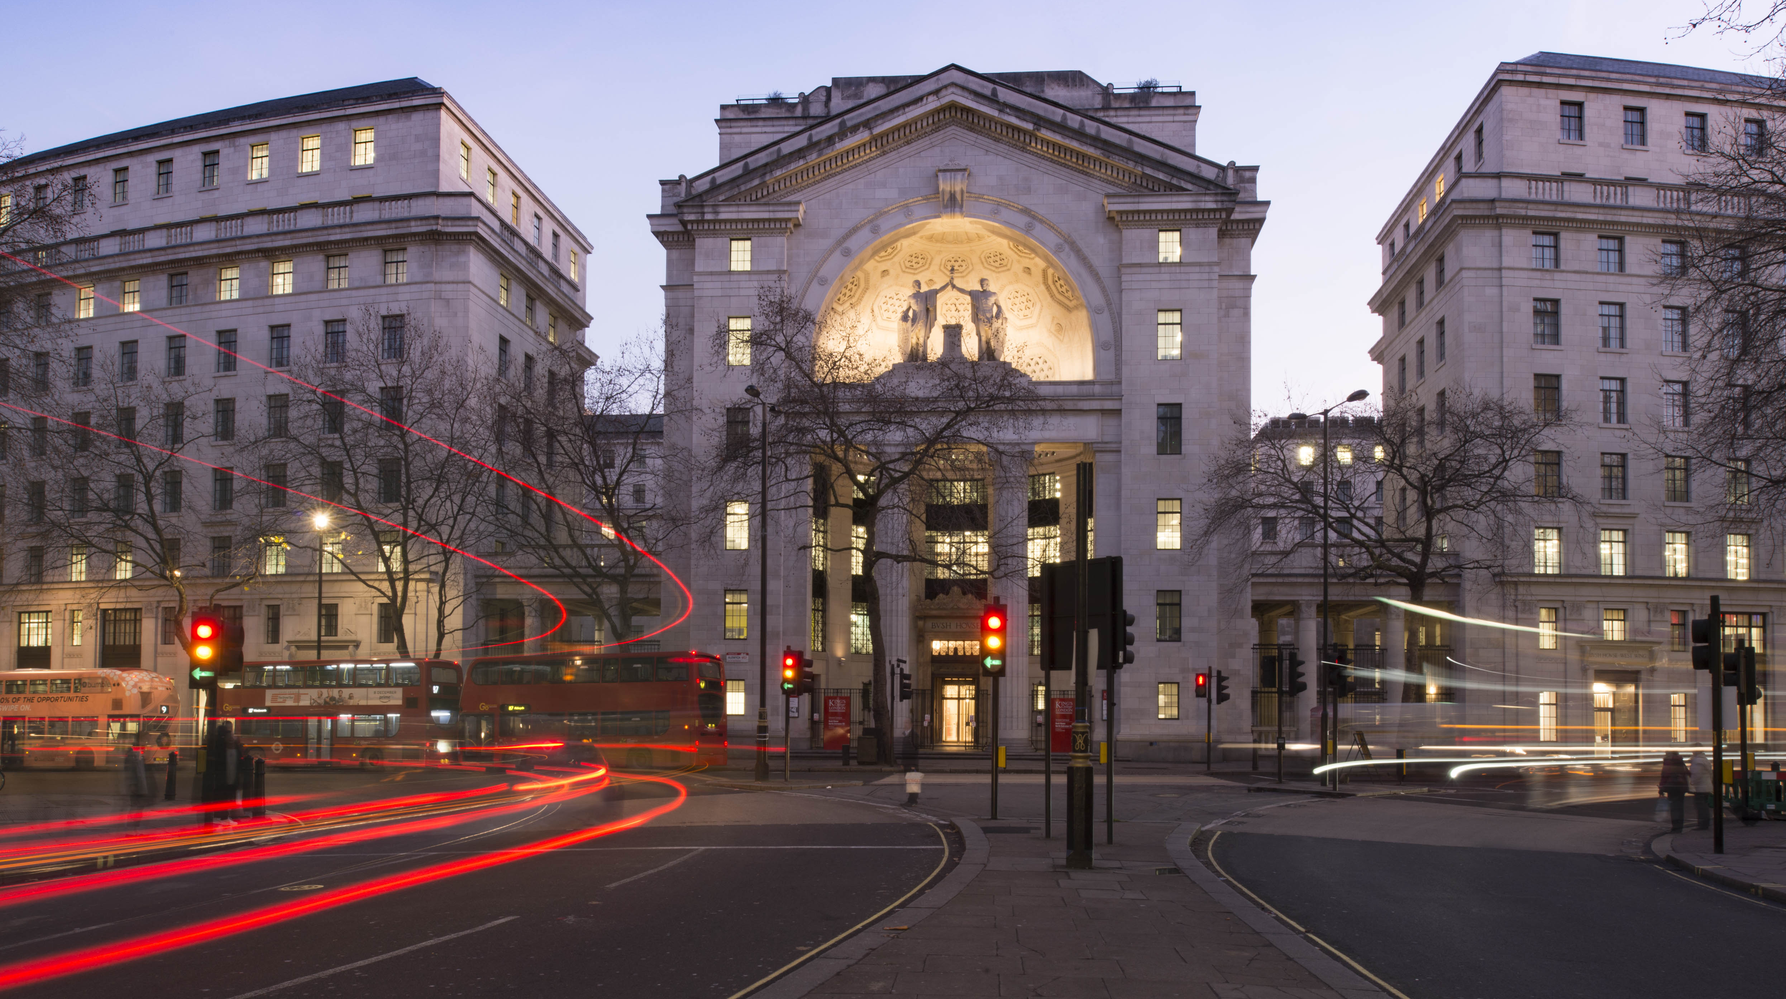

Choices of a programmer
MSc Microbiome in Health and Disease | Module 2
Simon Lam, Xiya Song

Slide 3
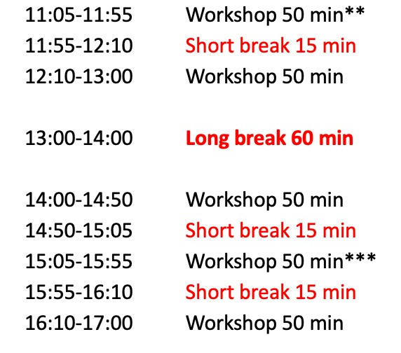
Programming choices: Contents
Reading and writing data to/from file
Data types in R
Subsetting data I: base R
Subsetting data II: dplyr
Operators and control structures
Error handling
Extension: regular expressions, dplyr advanced

Slide 4
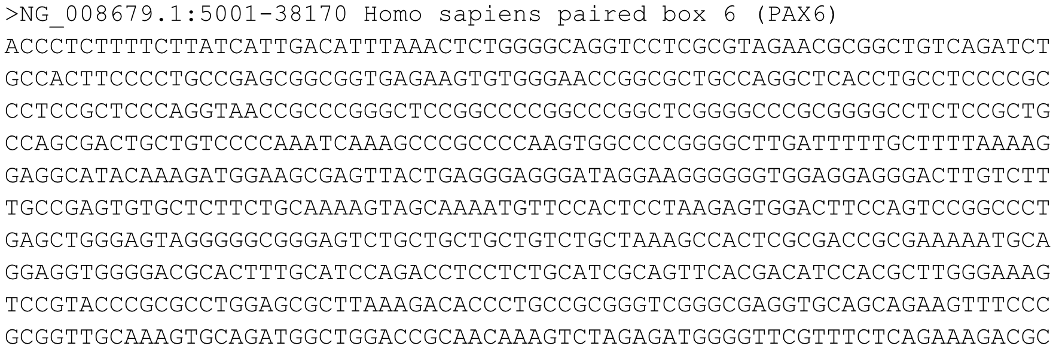
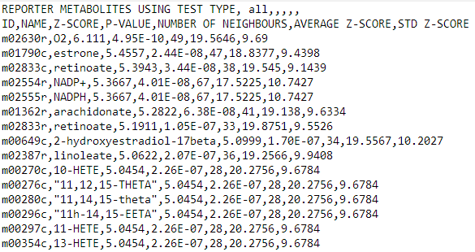
Reading and writing data to/from file
We need to make choices when we share files with other people.
Plaintext
Easy to open
Fast to open
Machine-readable*
Large filesize (unless compressed)
Not always human-readable
Limited range of data types
Notes:
*Software has to make assumptions regarding the format and data types in plaintext files

Slide 5
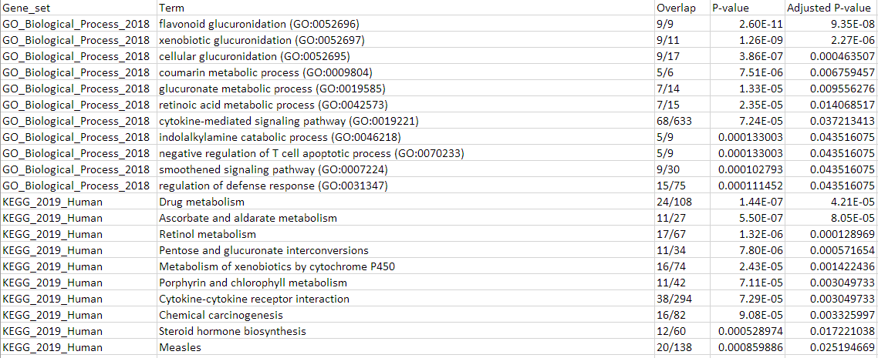
Reading and writing data to/from file
We need to make choices when we share files with other people.
Plaintext
Excel
Easy to open
Machine-readable
Slower to work with
Has autocorrect issues[1]
[1] https://doi.org/10.1038/d41586-021-02211-4

Slide 6
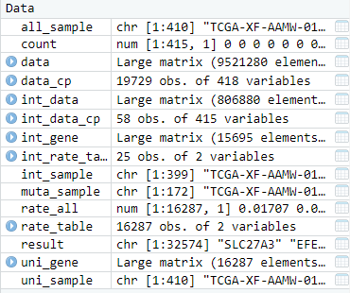
Reading and writing data to/from file
We need to make choices when we share files with other people.
Plaintext
Excel
RData
Smaller filesize
Supports specialist data types
Only works in R

Slide 7
Exercise 1
To read plaintext files, use read.csv(). To read Excel files, use read_excel() from the readxl package. To read RData files, use load(). TIP: Press Tab while your cursor is between the brackets of any function to see its usage.
To write plaintext files, use write.csv(). To write Excel files, use write_xlsx() from the writexl package. To write RData files, use save(). Complete the code to save the my_plaintext, my_excel, and my_rdata objects to the files my_plaintext.csv, my_excel.xlsx, and my_rdata.RData, respectively. EXTENSION: What factors will influence which file you'll choose to share with other people? Which is the best choice for 1) an R statistician? 2) an Python statistician? 3) a non-statistician?

Slide 8
Data types in R
We need to make sure that our data are stored as the correct data type.
Numeric
Integer:<int>
Double (floating point number): <dbl>
Matrix
Logical (boolean)
Character (string): <chr>
Factor
List
Data frame
Check data types using the glimpse() function from the dplyr package
What operations can we only do with certain data types?
What are the consequences of storing numerics as characters?
Notes:
e.g. Maths operators only work on numeric classes
Plotting functions won’t work because R doesn’t know to treat the data as numbers

Slide 9
Data types in R
We need to be able to convert data into a different type.
as.numeric()
as.integer()
as.double()
as.matrix()
as.logical()
as.character()
as.list()
as.data.frame()
Can we always convert characters to numerics?
Notes:
We can only convert characters to numerics if it’s obvious to R that it should be a number

Slide 10
Exercise 2
Use glimpse() from the dplyr package to check the data types of each of the columns in my_plaintext, my_excel, and my_rdata. Do the data types make sense?
In my_excel, the Odds Ratio and Combined Score columns are numbers stored as characters. Complete the code to convert these columns into numeric data types using as.numeric().

Slide 11
Subsetting data I: base R
We need to know how to choose the data we’re actually interested in.
Selecting data of interest is called subsetting.
In base R, we can subset by column name or by index.
Subsetting by column name is done by using the $ operator.
Subsetting by index is done by using the [i,j] operator.

Slide 12
Subsetting data I: base R
Subsetting by column name is done by using the $ operator.
my_plaintext$Term gives us the Term column
Subsetting by index is done by using the [i,j] operator.
my_plaintext[3,2] gives us the element in the 3rd row and 2nd column
my_plaintext[3, ] gives us the entire 3rd row
my_plaintext[ ,2] gives us the entire 2nd column
my_plaintext[1:3,1:3] What does this do?
Using both $ and [i] operators is possible.
my_plaintext$Term[2] What does this do?

Slide 13
Subsetting data I: base R
The @ operator helps us access slots in objects with formal classes such as phyloseq objects.
These objects are special, so you should not attempt to manually edit slots that you access with @.
Subsetting by column name is done by using the $ operator.
my_plaintext$Term gives us the Term column
Subsetting by index is done by using the [i,j] operator.
my_plaintext[3,2] gives us the element in the 3rd row and 2nd column
my_plaintext[3, ] gives us the entire 3rd row
my_plaintext[ ,2] gives us the entire 2nd column
my_plaintext[1:3,1:3] What does this do?
Using both $ and [i] operators is possible.
my_plaintext$Term[2] What does this do?
Notes:
https://stackoverflow.com/questions/61016049/meaning-of-operator-in-r-language

Slide 14
Subsetting data I: base R
It is possible to specify i using rules rather than numbers.
Use which() to specify the indices of interest using numeric rules.
idx <- which(my_plaintext$Adjusted.P.value < 1e-9) stores the indices with adjusted p-value less than 10⁻⁹ in a variable called idx
my_plaintext[idx, ] returns entire rows for which adjusted p-value is less than 10⁻⁹

Slide 15
Subsetting data I: base R
It is possible to specify i using rules rather than numbers.
Use grep() to specify the indices of interest by matching text.
idx2 <- grep(“neuron”, my_plaintext$Term) stores the indices of the terms containing “neuron” in a variable called idx2
my_plaintext[idx2, ] returns entire rows in which the terms contain “neuron”

Slide 16
Exercise 3
Use base R functions to extract the rows in my_excel which have Odds Ratio greater than 200.
Use base R functions to extract the rows in my_excel in which Term contains the text "membrane".

Slide 17
Subsetting data II: dplyr
We can use dplyr to subset data in a more readable way.
dplyr features the pipe operator %>%. This is a binary operator that takes the output of the left-hand side and uses it as the input for the right-hand side.
Use the pipe operator %>% to use glimpse() on my_plaintext.
my_plaintext %>% glimpse()

Slide 18
Subsetting data II: dplyr
We can use dplyr to subset data in a more readable way.
dplyr features the select() verb. This allows you to subset entire columns by name or by number.
my_plaintext %>% select(Term, 3, Odds.Ratio)
Notes:
Combines the function of $ and [i, ]

Slide 19
Subsetting data II: dplyr
We can use dplyr to subset data in a more readable way.
dplyr features the filter() verb. This allows you to subset rows according to numeric or character rules.
my_plaintext %>% filter(Combined.Score> 1000)
Notes:
Supports any kind of subsetting using a logical vector

Slide 20
Exercise 4
Use dplyr functions to extract the rows in my_excel which have Odds Ratio greater than 200.
Use dplyr functions to extract the rows in my_excel in which Term contains the text "membrane".
Free practice: write code to extract all Terms in my_excel containing the text "neuron" for which P-value us less than 10⁻⁴. It's your choice whether you use base R functions or dplyr functions!

Slide 21
Operators and control structures
Binary operators
+, -, *, /, ^ – standard maths operators
%% – modulo (remainder after a division) (eg. 75%%4 = 3)
%in% – element matching
== – comparison
Conditionals
if() – run different code depending on specific conditions
else() – useful for chaining multiple if() statements
Loops
for() – iterate over a list
while() – iterate until a condition is satisfied
Notes:
X %in% Y - which elements of X are in Y? Returns a logical vector of length X
X == Y – is X the same as Y? Returns a logical of length one

Slide 22
Exercise 5
Is there a term in my_plaintext called "Chemical carcinogenesis"? How about "Chronic inflammation"?

Slide 23
if() and else()
Run a different code block with if() depending on conditions you set.
Use else() after the closing brace to specify alternative code to run if the condition is not met.
if(my_pvalue < 10e-9) { # specify the condition
... # do this if the condition is met
} else {
... # otherwise this
}

Slide 24
if() and else()
Run a different code block with if() depending on conditions you set.
Use else if() after the closing brace to specify an alternative if() statement.
if(my_pvalue < 10e-9) { # if 1
... # then 1
} else if(my_pvalue < 10e-4 { # else 1 / if 2
... # then 2
} else { # else 2
...
}

Slide 25
Exercise 6
Change the code to print significance stars to the screen: “***” for p-values better than 0.001, “**” for p-values better than 0.01, “*” for p-values better than 0.05, and “n.s.” for p-values worse or equal to 0.05. Change the value of my_pvalue2 to test your code.

Slide 26
for() loop
We need to be able to repetitively perform a set of actions for each subset of interest. This is called iterating over a list. We use a for() loop to do this.
First, initialise a list containing the subsets of interest.
my_interest <- c("neuron", "membrane", "development")
The basic for() loop performs its actions once per list item.
for(item in my_interest) {
cat("I am interested in", item, "\n")
cat(toupper(item), "IS NOW IN UPPERCASE\n")
}
When we are inside the loop, we use the item variable to access the list item we’re on. This is called the counter variable. We define its name inside the for() loop call.

Slide 27
for() loop
We need to be able to repetitively perform a set of actions for each subset of interest. This is called iterating over a list. We use a for() loop to do this.
We can iterate over a numerical range
for(i in 1:10) {
cat("I am thinking of the number", i, "\n")
}
We can use the counter i as an index to subset data
for(i in 1:10) {
cat("The", i, "th column in my_plaintext is called", names(my_plaintext)[i], "\n")
}

Slide 28
for() loop
Use a while() loop if you want to iterate until a condition is met.
my_term <- "" # initialise a test variable
i <- 1 # initialise a counter
while(!grepl("retinoic", my_term)) { # iterate until we find “retinoic”:
my_term <- my_plaintext$Term[i] # update the test variable
cat(my_term, "\n") # print to the screen
i <- i + 1 # increment counter
}
We need to be able to repetitively perform a set of actions for each subset of interest. This is called iterating over a list. We use a for() loop to do this.
We can iterate over a numerical range
for(i in 1:10) {
cat("I am thinking of the number", i, "\n")
}
We can use the counter i as an index to subset data
for(i in 1:10) {
cat("The", i, "th column in my_plaintext is called", names(my_plaintext)[i], "\n")
}
Notes:
my_term <- ""
i <- 1
while(!grepl("retinoic", my_term)) {
my_term <- my_plaintext$Term[i]
cat(my_term, "\n")
i <- i + 1
}

Slide 29
Exercise 7
Use a for() loop to find all of the Terms in my_excel which contain: a) "neuron", b) "membrane", c) "development". It's your choice whether you want to use base R functions or dplyr for the subsetting!

Slide 30
Error handling
Programmers encounter more errors than outputs!
We need to be able to understand errors when we encounter them.
read.csv(file = "non_existent_file.csv")
Error in file(file, "rt") : cannot open the connection
In addition: Warning message:
In file(file, "rt") :
cannot open file 'non_existent_file.csv': No such file or directory
Why did this happen?
Notes:
No such file or directory. Check that we typed the filename correctly and that R knows where to look for it

Slide 31
Error handling
We need to be able to understand warnings when we encounter them.
my_warning <- c("hello", 1, 3e-9, FALSE)
as.integer(my_warning)
[1] NA 1 0 NA
Warning message:
NAs introduced by coercion
Why did this happen?
Can we ignore this warning?
Notes:
Some items in the list can’t be converted to integer
We probably can’t ignore this warning because we have lost data

Slide 32
Error handling
We need to be able to understand warnings when we encounter them.
library(ggpubr)
Loading required package: magrittr
Warning message:
package ‘ggpubr’ was built under R version 3.6.3
Why did this happen?
Can we ignore this warning?
How are warnings different from errors?
my_excel[100]
Error in my_excel[100] : Can't subset columns past the end.
Notes:
R is giving information about the package and other packages that are being loaded by it
We are safe to ignore this warning. But always make sure that the output is sensible when using the package functions
Code can still run with a warning. We saw an output. With an error, execution stops and there is no output.

Slide 33
Error handling
We need to know how to search for fixes for errors we aren’t sure about.
Useful resources:
https://stackoverflow.com/
https://community.rstudio.com/
We can use some debugging skills
try()
http://adv-r.had.co.nz/Exceptions-Debugging.html

Slide 34
Exercise 8
Run the following commands, which will throw warnings or errors. Reason with yourself or check online to understand what happened. Change the code to clear the error.
log(-1)
library(ggplto2)
my_excel %>% filter(c(TRUE, TRUE, TRUE))
Notes:
Log of a negative number is undefined, so R will warn you and return NaN
ggplot2 is misspelled
dplyr filter verb received a logical array of the wrong length

Slide 35
Extension: regular expressions
Say we want to filter for terms containing “synapse”. But then we’ll miss the terms containing “synaptic”. How can we deal with this?
my_excel %>% filter(grepl("synap", Term)) %>% select(Term)
The pattern = argument in the grepl() call supports regular expressions (regex). Try this:
my_excel %>% filter(grepl("regulation.+synap", Term)) %>% select(Term)
What does this do?

Slide 36
Extension: regular expressions
We use different characters in our regex to match special characters or sets of characters in our input string.
. matches any character
\\w matches any word character (A-Z, a-z, 0-9, _)
\\d matches any digit
\t matches the tab character
\n matches the newline character
^ matches the start of a string
$ matches the end of a string
+ matches at least once
* matches at least zero times
{n} matches exactly n times
{n,} matches at least n times
{n,m} matches between n and m times
\\+ regex escape. This matches a literal “+” rather than interpreting it as regex.
Notes:
In RegEx, {i,f} means "between i to f matches". Let's take a look at the following examples:
{3,7} means between 3 to 7 matches
+ is the shorthand for {1,}
* is the shorthand for {,}
Which means + requires at least 1 match while * accepts any number of matches or no matches at all

Slide 37
Free practice
Find all of the terms in my_excel for which Overlap contains two digits, followed by a slash, followed by three digits.
For the first 20 terms in my_excel, check if the GO tag is there, and if it is, print the term to the screen. If the term doesn't have a GO tag, print "uninteresting" to the screen instead.
The given code is intended to extract rows 2 to 1000 in my_excel, filter those rows for those with Odds Ratio above 100, and return the sum of all values in the Odds Ratio column for each gene set. Fix the errors in the given code.

Slide 38
Extension: dplyr functions
https://cran.r-project.org/web/packages/dplyr/vignettes/dplyr.html
dplyr aims to provide a function for each basic verb of data manipulation. These verbs can be organised into three categories based on the component of the dataset that they work with:
Rows:
filter() chooses rows based on column values.
slice() chooses rows based on location.
slice_min(), slice_max(), slice_sample()
arrange() changes the order of the rows.
Columns:
select() changes whether or not a column is included.
rename() changes the name of columns.
mutate() changes the values of columns and creates new columns.
relocate() changes the order of the columns.
Groups of rows:
summarise() collapses a group into a single row.
group_by() combines with summarise() to calculate statistics by groups

Slide 39
Free practice
Using slice() to select the fifth to eleventh rows in my_plaintext and show the results. Using slice_max() and slice_min() to select the first 5 rows with highest Odds.Ratio and lowest Adjusted.P.value, separately. Note that we need to ensure there are not NA exists in the values.
Using mutate() to create a new column in my_plaintext, which named “New_column” and equals to the 10 folds of Odds.Ratio. Print the “New_column” and all other precvious columns.
Calculate the mean Odds.Ratio group by the Gene_set in my_plaintext (No biological meaning, just for practice).

