Slide 1
Drug target identification for kidney cancer (KIRC)
Update 20201013

Slide 2
Main aim
Target identification
Drug identification
Data
1. More than 700 cell lines (CCLE project: tumor + normal cells)
RNA-seq data (https://portals.broadinstitute.org/ccle/data)
Essential score (ES ) is based on the measurement of cell proliferation after CRISPR-cas9 knock-out a specific gene (https://depmap.org/portal/download/)
Human kidney renal clear cell carcinoma (KIRC)
TCGA KIRC expression profile (530 samples, RNA-seq)
Japanese KIRC expression profiles(100 samples, RNA-seq)
cMap data: RNA-seq, drug treated cell line vs control (GEO, GSE70138, https://www.ncbi.nlm.nih.gov/geo/query/acc.cgi?acc=GSE70138)

Slide 3
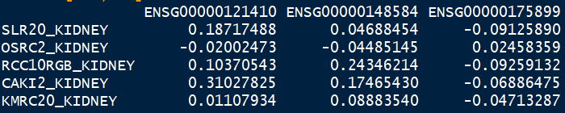
Drug target discovery (main idea)
Essential score (ES) matrix
Knock-out Gene1 (G1) ... Knock-out Gn
Cell 1 (C1)
C2
...
Cn
Lower ES score : more essential
ES score (outcome): effect of many other genes regulated by / associated with the specific knock-out gene.
Extract the effect from each regulated gene (linear regression analysis: ES score~gene expression)
Extend to kidney tumor expression profiles
Sensitivity score (new score) = (exp*coef+intercept)*R²

Slide 4
16 kidney cell line
Mean coef: 0.88

Slide 5
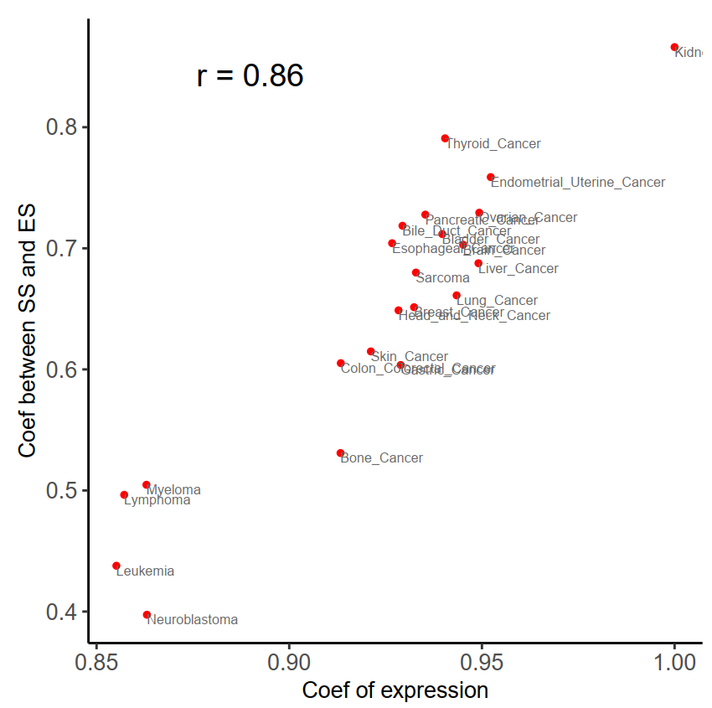
Apply kidney cancer model to other cancer cells
Kidney cancer
X axis is the correlation of expression between kidney cancer with other cancers;
y axis is the correlation between SS and ES for each cancer type
Conclusion: Sensitiviey score similarity is associated with expression similarity.

Slide 6
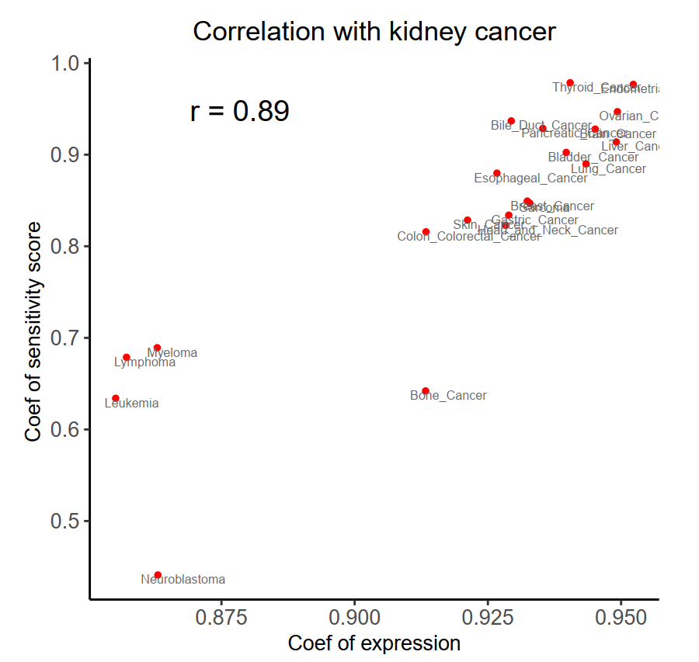
X axis is the correlation of expression between kidney cancer with other cancers;
y axis is the correlation of sensitivity score between kidney cancer and other cancers
Conclusion: Sensitiviey score similarity is associated with expression similarity.

Slide 7
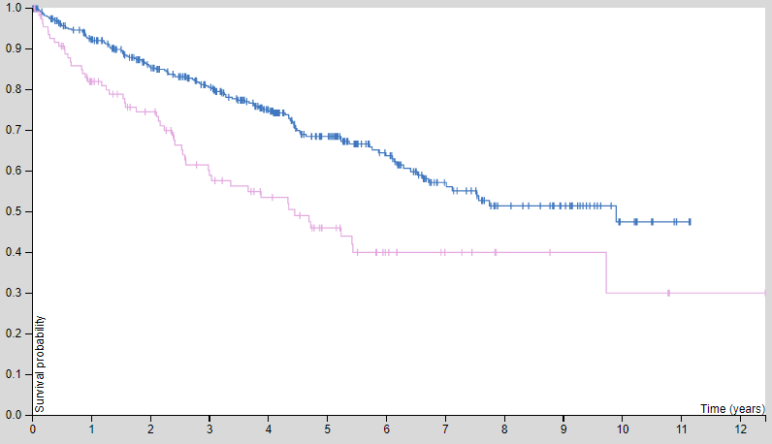
16 kidney cell line
530 TCGA KIRC
100 Japanese KIRC
Targets | coverage
EEF2 | 16
NPIPB6 | 16
PSMA3 | 16
PSMD7 | 16
RAN | 16
SNRNP200 | 16
YRDC | 16
PSMA1 | 15
PSMD14 | 15
RPL12 | 15
RPS11 | 15
POLR2L | 14
SARS | 14
UBA1 | 14
BUB3 | 12
RRM2 | 12
SS18L2 | 12
DTYMK | 11
Targets | coverage
MYRF | 410
C17orf50 | 402
FAM50A | 396
STRAP | 362
SRBD1 | 295
HRAS | 261
FAM111B | 228
NFYC | 227
CDIP1 | 226
HSD11B1L | 213
TSSK6 | 212
SLC25A23 | 208
SMC2 | 207
DENND1C | 203
SRRM2 | 197
VHL | 190
Targets | coverage
MYRF | 82
C17orf50 | 77
FAM50A | 74
VHL | 67
STRAP | 62
SRBD1 | 59
HNF1B | 57
CDIP1 | 44
NFYC | 41
CMPK1 | 40
CENPC | 39
FAM111B | 39
TSSK6 | 39
FAM50A
P=0.000035
Notes:
FAM50A family with sequence similarity 50 member A [ Homo sapiens (human) ]: t is a basic protein containing a nuclear localization signal, and may function as a DNA-binding protein or a transcriptional factor. [provided by RefSeq, Sep 2009]
MYRF myelin regulatory factor [ Homo sapiens (human) ]: This gene encodes a transcription factor that is required for central nervous system myelination and may regulate oligodendrocyte differentiation.

Slide 8
Next
1. Validate the model (sensitivity score) in human tumor sample
Method 1: TCGA sample using a single target drug treatment and than calculate sensitivity score for the targets of this drugs. Then, check whethter the sensitivity score is associated with patients’ outcomes. Problems: sample size is small
2. Validate the targets of kidney cancer
In vivo/vitro experiments
3. Drug discovery of tragets

