Slide 1
Mancala
Project in Systems Modeling
Mari Rüütli
Peeter Jürviste
Martin Loginov
Hans Mäesalu
Sven Aller

Slide 2
Project overview
Objects First method: user stories -> object diagrams -> class diagram -> implementation -> testing
Java
Fujaba
Revision control in GIT (repository in GitHub)
Eclipse with Visual Editor, Visual Studio, Google Docs…

Slide 3
Architecture
Patterns:
  Singleton
  Strategy
  Visitor
  MVC
GUI in Swing

Slide 4
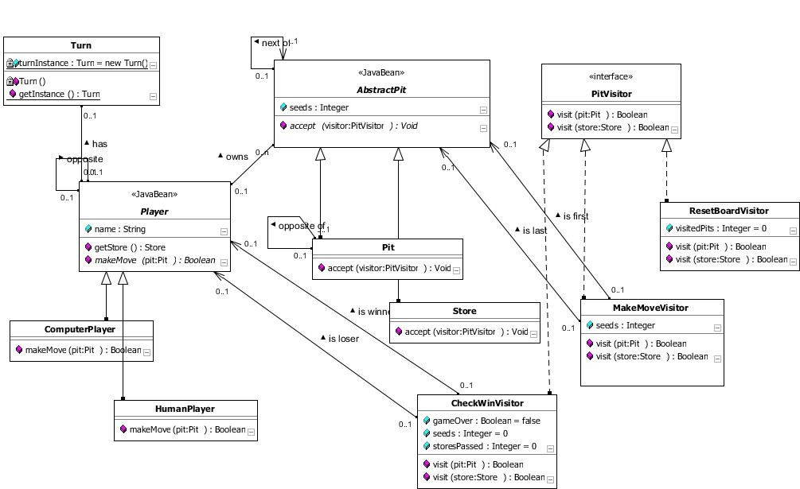
Class diagram

Slide 5
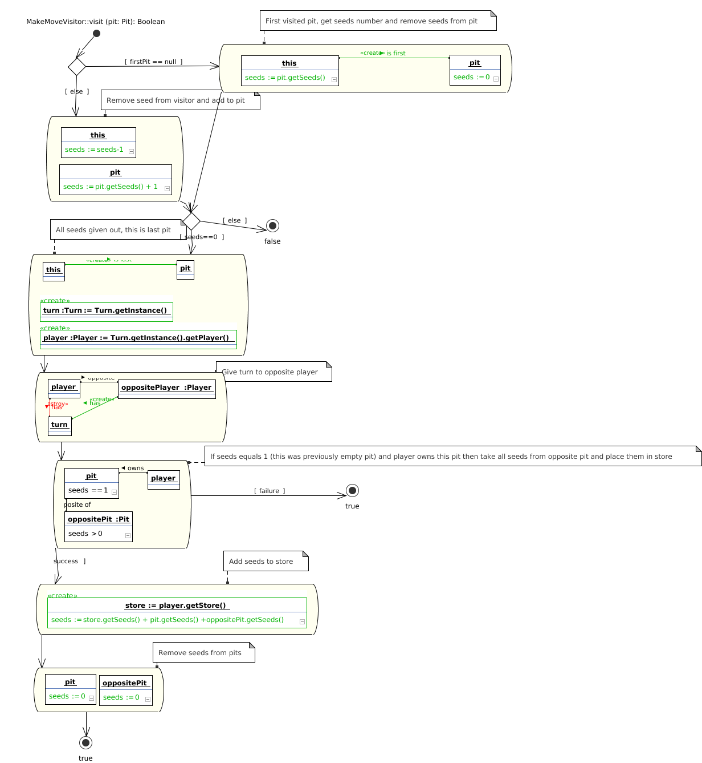

Slide 6
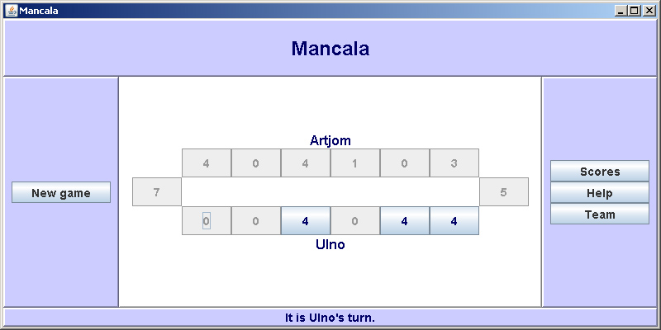
Screenshot: gameboard

Slide 7
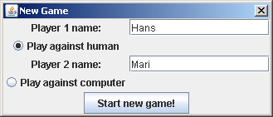
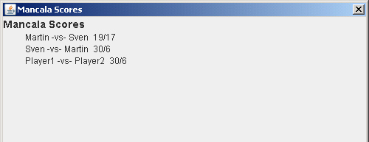
Screenshot: new game & scores

Slide 8
Thank you!

