Slide 1
Mancala
Project in Systems Modeling
Mari Rüütli
Peeter Jürviste
Martin Loginov
Hans Mäesalu
Sven Aller

Slide 2
Project overview
Java
Fujaba
Patterns: Singleton, Strategy, Visitor, MCV
GUI in Swing
Revision control in GIT (repository in GitHub)
Eclipse with Visual Editor, Visual Studio, Google Docs…

Slide 3
Architecture

Slide 4
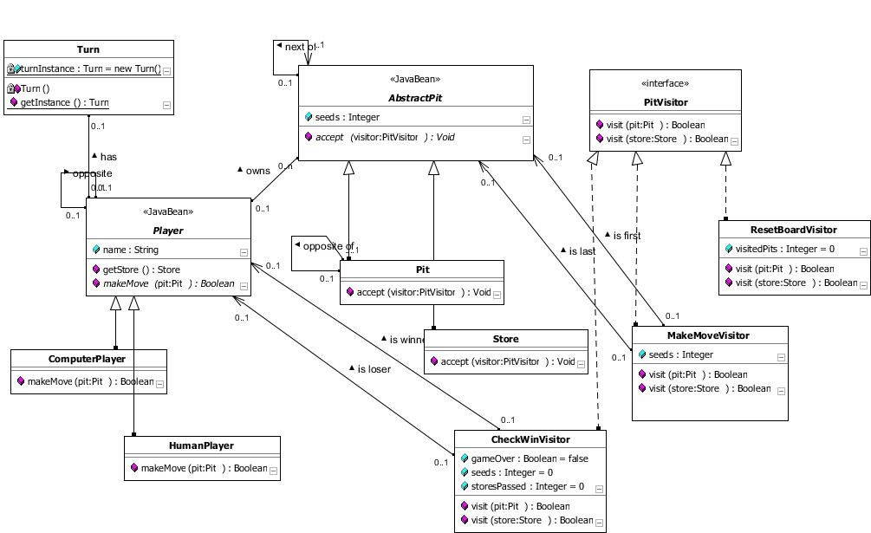
Class diagram

Slide 5
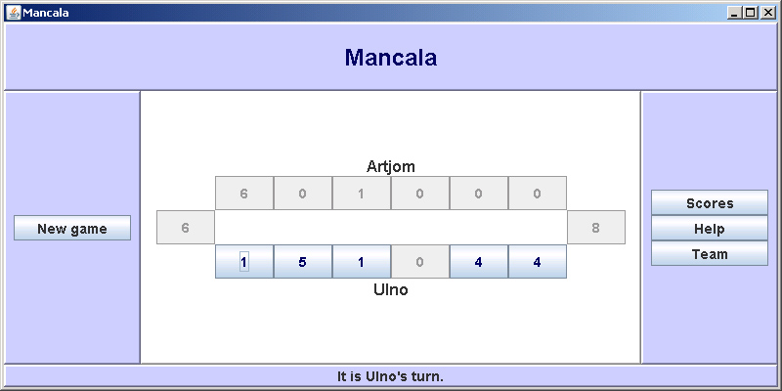
Screenshot: gameboard

Slide 6
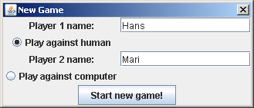
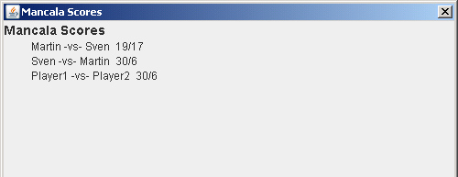
Screenshot: new game & scores

Slide 7
Thank you!

