Slide 1

PV181 Laboratory of security and applied cryptography
Public key crypto
Common math operations
Marek Sýs
syso@mail.muni.cz, A404

Slide 2
You will learn
How to generate public/private key pair.
Formats of cryptographic data
  Base64,
  ASN1 (PEM, DER)
Mathematical operations used in public-key cryptography
  Modular operations
  Operations with points on Elliptic curve

Slide 3
Public key operations
Modular operations:
  Addition
  Multiplication
  Exponentiation
  Inversion (uses Extended Euclid alg.)
Elliptic curve operations:
  Point addition
  Point multiplication (e.g. point doubling 2*P = P+P)

Slide 4
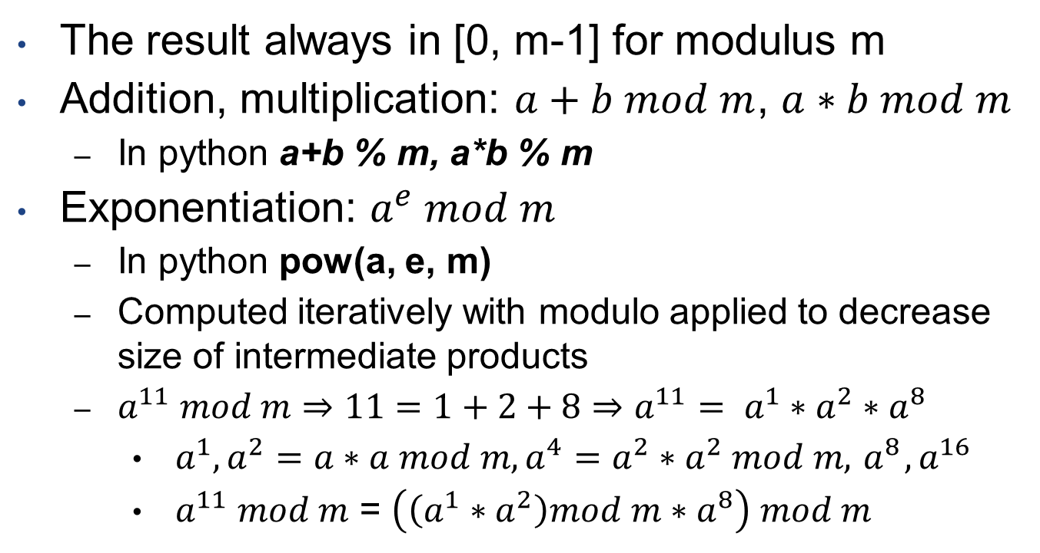
Modular operations
The result always in [0, m-1] for modulus m
Addition, multiplication: $a+b mod m$, $a∗b mod m$
  In python a+b % m, a*b % m
Exponentiation: $a^{e} mod m$
  In python pow(a, e, m)
  Computed iteratively with modulo applied to decrease size of intermediate products
  $a^{11} mod m⇒11=1+2+8⇒a^{11}= a^{1}∗a^{2}∗a^{8}$
    $a^{1},a^{2}=a∗a mod m,a^{4}=a^{2}∗a^{2} mod m,{ a}^{8},a^{16}$
    $a^{11} mod m$ = $\left(\left(a^{1}∗a^{2}\right)mod m∗a^{8}\right) mod m$

Slide 5
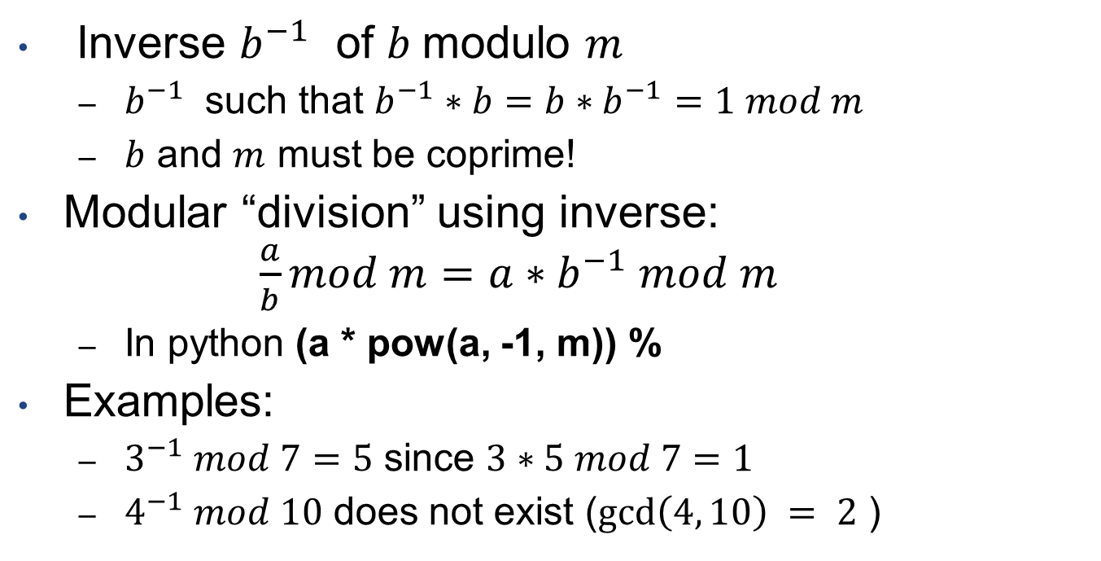
Modular inversion
Inverse $b^{−1}$ of $b$modulo $m$
  $b^{−1}$ such that $b^{−1}∗b=b∗b^{−1}=1 mod m$
  $b$ and $m$ must be coprime!
Modular “division” using inverse:
$\frac{a}{b}mod m=a∗b^{−1} mod m$
  In python (a * pow(a, -1, m)) %
Examples:
  $3^{−1} mod 7=5$ since $3∗5 mod 7=1$
  $4^{−1} mod 10$ does not exist ($gcd\left(4, 10\right) = 2$ )

Slide 6
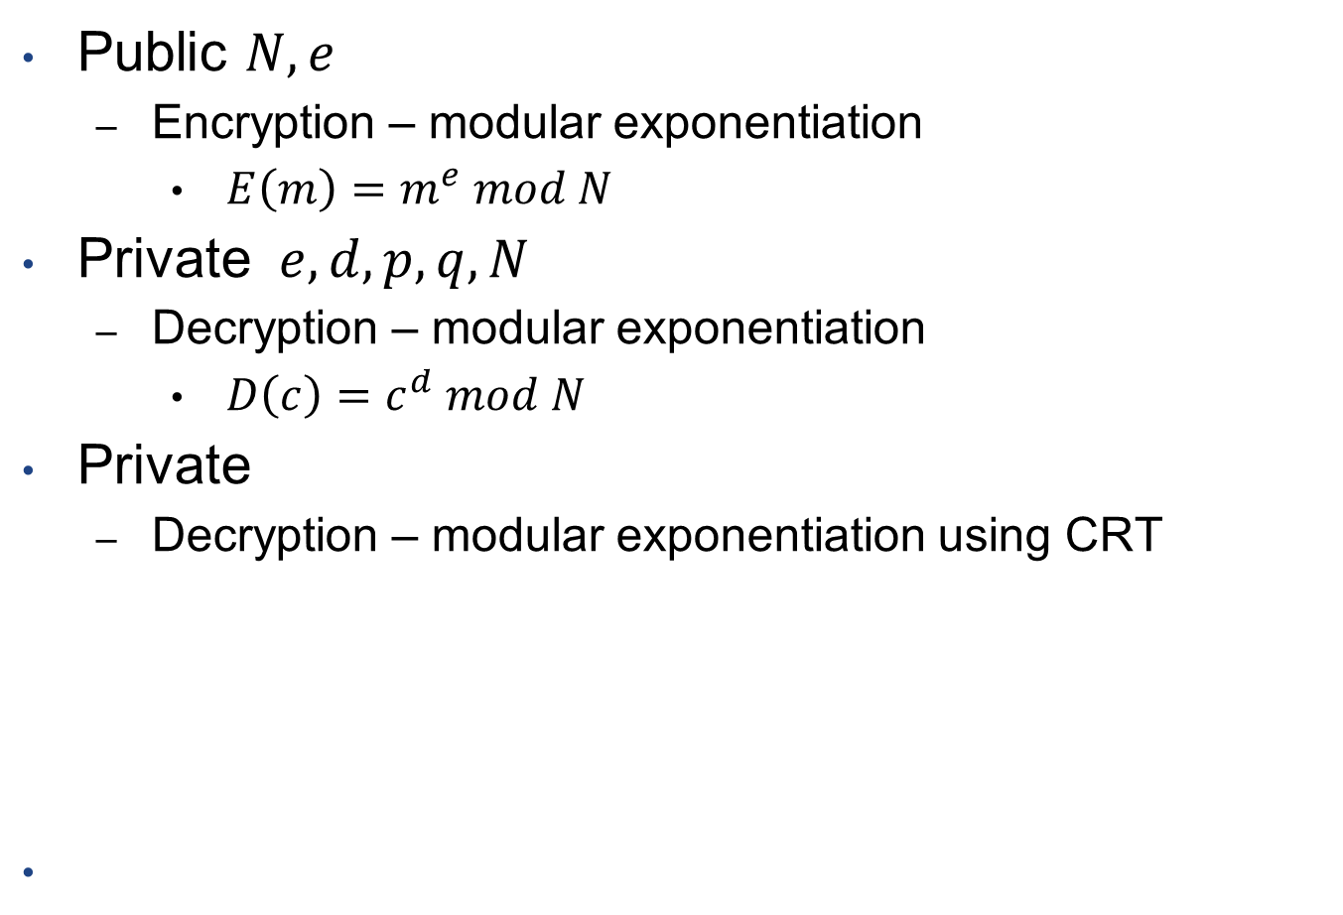
RSA
Public $N, e$
  Encryption – modular exponentiation
    $E\left(m\right)=m^{e} mod N$
Private $e, d, p, q, N$
  Decryption – modular exponentiation
    $D\left(c\right)=c^{d} mod N$
Private
  Decryption – modular exponentiation using CRT

Slide 7
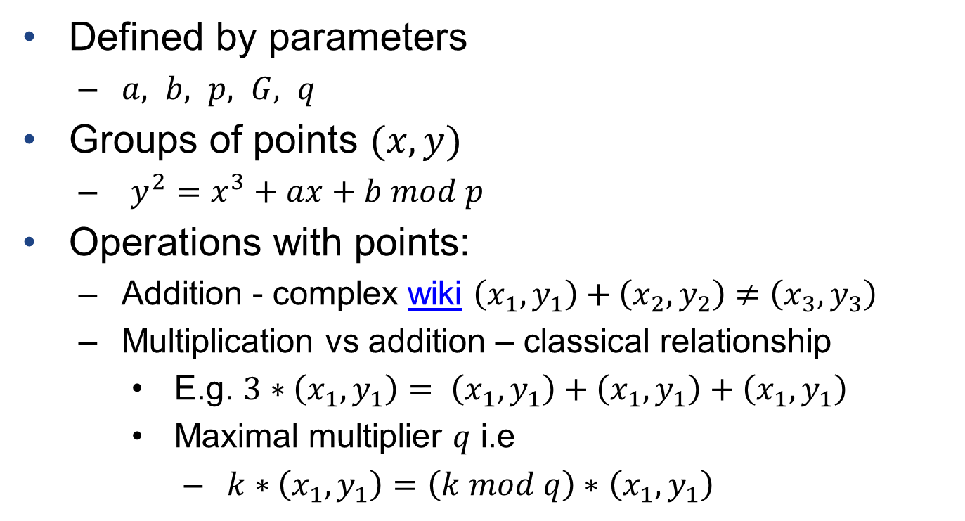
Elliptic curve cryptography (ECC)
Defined by parameters
  $a, b, p, G, q$
Groups of points $(x,y)$
  $y^{2}=x^{3}+ax+b mod p$
Operations with points:
  Addition - complex wiki $\left(x_{1},y_{1}\right)+\left(x_{2},y_{2}\right)≠\left(x_{3},y_{3}\right)$
  Multiplication vs addition – classical relationship
    E.g. $3∗\left(x_{1},y_{1}\right)= \left(x_{1},y_{1}\right)+\left(x_{1},y_{1}\right)+\left(x_{1},y_{1}\right)$
    Maximal multiplier $q$ i.e
      $k∗\left(x_{1},y_{1}\right)=\left(k mod q\right)∗$ $\left(x_{1},y_{1}\right)$

