Slide 1
SIFT: A Tool for Property Directed Selective Scheduling in Symbolic Execution
Tuba Yavuz
Assistant Professor
ECE Department
University of Florida
15th IEEE International Conference on Testing, Verification, and Validation (ICST) 2022
Notes:
I will present, SIFT, a tool for symbolic execution of multithreaded code.

Slide 2
Outline
Motivation
Approach
SIFT Implementation
Results
Conclusions
Notes:
I’ll start with our motivation for developing SIFT, then I’ll introduce our approach and how we dealt with various challenges.
I’ll explain how we extended the KLEE symbolic execution engine to add multithreading support and to generate property relevant thread schedules.. I’ll briefly mention our experimental results and conclude with directions for future work and a demo of SIFT.

Slide 3
Motivation
Detecting memory vulnerabilities in multithreaded code is challenging
Existing work use various heuristics such as context bounding or schedule variation w.r.t. some interference points
Existing property directed scheduling approaches handle assertions only and rely on an offline static analysis
Symbolic execution is effective in memory vulnerabilities
The path explosion in symbolic execution gets exacerbated for multithreaded code
Notes:
Detecting memory vulnerabilities in multithreaded code is challenging due to exponential number of thread interleavings.
To deal with this problem, existing work use heuristics such as context bounding or scheduling at interference points. Existing property directed scheduling approaches rely on an offline static analysis and focus on explicitly specified assertions. Symbolic execution is effective in detecting memory vulnerabilities but it has the path explosion problem. For detecting concurrency related memory vulnerabilities using symbolic execution property directed thread scheduling is needed to deal with the path explosion problem.

Slide 4
Approach
Compute data-flow facts for property relevant code locations based on explored symbolic execution paths
Memory deallocations, memory accesses based on pointer arithmetic, assertion checks
Identify instructions or Interleaving Points (context-switch points)
Impact property relevant code locations
Interference points of multiple threads
As new paths get explored, update the interleaving points
Until the property violation is detected or a timeout is reached
Notes:
Our approach generates thread schedules in a way that the context switches occur at program locations that impact some property relevant code location. Our approach handles both memory safety properties and explicitly specified assertions. Unlike existing work on property directed scheduling approaches, SIFT infers property relevant data-flow and control-flow dependencies on the explored symbolic execution paths, to guide thread scheduling choices. Specifically, SIFT infers a set of program locations called Interleaving Points at which thread context switches may be triggered.

Slide 5
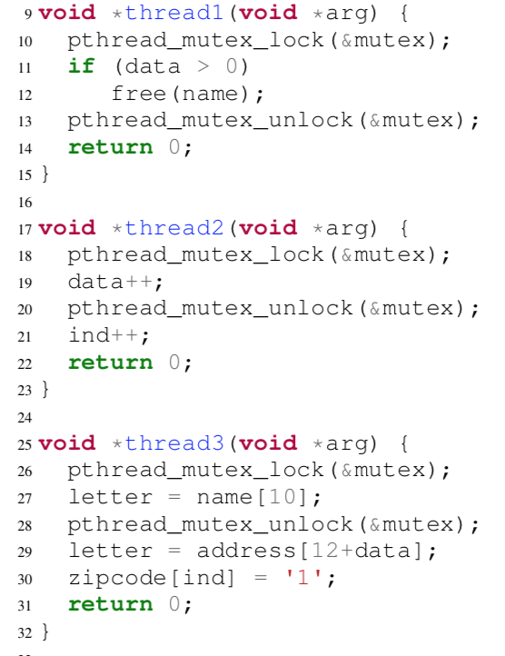
An Example Multithreaded Code
Notes:
Let me explain our approach with a simple example with three threads that are created to run concurrently.
These threads access shared data and in some cases they perform the accesses in a mutually exclusive way and in some cases
not. Our goal is to detect property violations that get manifested on specific thread schedules and the violation
may or may not be related to a data race.

Slide 6
One Type of Property: Memory Safety
Property: Memory Safety
Are there any accesses
to deallocated memory?
Are there any memory
that get deallocated twice?
Are there any NULL pointer
dereferences?
Are there any out of bounds
memory accesses?
Notes:
In this example, we will focus on the memory safety as the property. We would like to be able to detect memory out of bound accesses, use-after-frees, double-frees, and NULL pointer dereferences. Here we show the statements that may potentially manifest a use-after-free or out-of-bounds accesses. The question is would these program locations actually manifest such bugs on some input and thread schedule?

Slide 7
Identifying Property Relevant Memory Objects & Instructions
Objects accessed for read/write and write
by different threads that may
run concurrently
Notes:
To answer this question, we would like to use the data-flow and control-flow facts available on a symbolic execution path and identify property relevant memory objects and instructions. So, we use a set of rules to find them. Obviously, objects that are globally visible and can potentially run concurrently are property relevant. An example is the data variable that is read by all the threads and written by thread2.

Slide 8
Identifying Property Relevant Memory Objects & Instructions
Objects accessed for read/write and write
by different threads that may
run concurrently
Notes:
Another obvious property relevant object is the ind variable that is written by thread 2 and read by thread 3.

Slide 9
Identifying Property Relevant Memory Objects & Instructions
Static analysis for identifying target function callsites reachable from untaken branches
makes the branch instruction as property relevant even if data was not global
Used as an argument (name) of a
target function (free)
Objects accessed for read/write and write
by different threads that may
run concurrently
Notes:
Since our per path analysis may not reveal all the dependencies, we resort to light-weight static analysis for the unreached branch targets. For instance, if this if statement fails, with the help of static analysis we are able to find out property relevant instructions such as the memory deallocation statements. SIFT allows users to define such target functions. On a path that is explored later and takes this branch would also reveal
the read/write interference between the free instruction and the read instruction, which may help delay the read instruction to allow the deallocation to happen first.

Slide 10
Identifying Property Relevant Memory Objects & Instructions
Lock acquire & release instructions that enclose interfering instructions
using a common lock
Objects accessed for read/write and write
by different threads that may
run concurrently
Notes:
When the interfering instructions are enclosed by lock acquire and release instructions on a common lock object, we also consider those
Instructions as property relevant. This is to ensure that the context switches would be feasible.

Slide 11
Identifying Property Relevant Memory Objects & Instructions
Instructions that define
objects (data and ind) accessed in memory
access index expressions
become property relevant
Used in memory access index
expressions: data and ind
Notes:
Since we would like to be able to detect out of bounds accesses, any instructions that define objects that get used in an index expression are also considered property relevant. For instance, the increment statements on data and ind are relevant because these variables are used in array index expressions.

Slide 12
Identifying Property Relevant Memory Objects & Instructions
Other rules:
Global or leaked pointers that get initialized by malloc
Notes:
There are some other rules such as marking globally visible pointers that get assigned addresses returned by malloc.

Slide 13
Buggy Thread Schedules Detected by SIFT
Thread Schedule 1
Thread Schedule 2
1
2
Interleaving
Points
(IPs)
2
1
3
3
Use-after-free
Memory overflow
Notes:
So by marking these property relevant statements and using them as interleaving points, SIFT was able to detect two bugs. While one particular thread schedule leads to a memory overflow another leads to a use after free.

Slide 14
Optimizations
Three modes for grouping the interleaving points (IPs)
One: Put all in a single set and generate schedules by considering every IP in this set
More likely to detect the error
May lead to too many thread interleaving scenarios
Common: Create partitions by grouping IPs that access common memory objects
May detect errors that involve scheduling decisions over a single memory object
Fewer scheduling scenarios than the One mode
Single: Create a separate partition for each IP
May detect errors that require a single error relevant context switch
May generate the least number of scheduling scenarios
Notes:
SIFT supports three modes for grouping the interleaving points. In mode one all IPs are kept in one set and treated equally. This mode has the the highest probability of detecting the error but also the highest cost. The second mode, partitions the IPS by grouping them based on the shared memory object. Expected to perform better than mode One possibly missing some of the errors. In the third mode each interleaving point is considered separately, and it is likely to find the error fastest as long as the thread schedule requires at most a single context switch.

Slide 15
SIFT Implementation
LLVM
Bitcode
Error Report
(Thread Schedule,
Thread states)
and statistics
Thread
Scheduler
Data-flow
Analysis
IPs
Configuration options
(mode=One, Common, Single)
KLEE extended with
Multithreaded
Execution State
Paths
Path
Conditions/
Tests
Extensions are shown in blue
Notes:
We extended the KLEE symbolic execution engine by adding multithreading to the ExecutionState class and by implementing data-flow dependence analysis, and implementing the three modes of selective thread scheduling. We also extended the test case report files to provide thread scheduling information.

Slide 16
SIFT’s Exploration Steps
Conservative thread scheduling,
i.e., when a thread blocks schedule another
Step 1
Path scheduling
(DFS, Random+coverage)
IP₁
New thread scheduling scenarios due to
interleaving points in IP₁
Step 2
Path scheduling
(DFS, Random+coverage)
IP₂
New thread scheduling scenarios due to
interleaving points in IP₂ \ IP₁
Step 3
Path scheduling
(DFS, Random+coverage)
.
.
.
Notes:
SIFT works in an iterative manner. It starts with a very conservative scheduling, where a context switch happens only if the current thread is blocked and only one interleaving scenario is considered using the round-robin scheduling. When this stage terminates the generated paths are analyzed to infer some interleaving points, IP_1. In step 2, when an instruction in the IP set is reached, SIFT generates new states to consider alternative thread schedules. These paths are explored based on one of the path scheduling algorithms provided by the symbolic execution engine such as Depth-first search or a combination of Random and coverage based. When this step ends SIFT performs additional data-flow analysis to infer additional IPS and so on.

Slide 17
Results on 10 CVE + 10 Svcomp benchmarks
Single | Common | One
> 0.07s < 19.96s | >0.07s <52.09s | >0.07s <24.62s
Number of bugs detected
Number of bugs detected
Timeout=500secs
SIFT can detect the bugs in all 10 CVE benchmarks whereas ConVul can detect in only 9 of them.
ConVul paper:
Yan Cai, Biyun Zhu, Ruijie Meng, Hao Yun, Liang He, Purui Su, Bin Liang: Detecting concurrency memory corruption vulnerabilities.
ESEC/SIGSOFT FSE 2019: 706-717
Notes:
We have applied SIFT to 20 benchmarks some of them from SVComp and some of them from a recent work ConVul. SIFT detects all the bugs. Compared to ConVul it detects one additional bug.
The vertical axis shows the number of bugs detected. Our evaluation shows that mode One, which is more comprehensive, performs better
With the Depth-first search scheduling policy and increasing the depth improves effectiveness of both mode common and mode one. Also, turns out that most of the vulnerabilities need just one context switch.

Slide 18
Conclusion
SIFT performs on-the-fly data-flow analysis to steer the thread schedule towards property violation
Memory safety + Custom assertions
https://github.com/sysrel/SIFT
Improving scalability:
Integrate SIFT into dynamic analysis
Apply SIFT at the component-level similar to under-constrained symbolic execution
Notes:
Motivated by SIFT’s ability to generate property relevant thread schedules, we are planning to incorporate dynamic analysis and component level analysis to improve its scalability.

Slide 19
THANK YOU!
Questions?

Slide 20
SIFT DEMO

