Slide 1
GPT Caddy
A personal project to make GPT Golf easier.
See inside the run. Decide what to change next.
I built it for myself — every GPT Golf run goes through it.
LIVE DEMO
REAL RUN
~18 MIN + Q&A
Launch
Monitor
Diagnose
Compare
Decide
Driven against a real run
Notes:
TARGET: Stellar Science hiring panel — mixed C++ / Python / PhD / non-technical, some attendees on Teams. 18 min presentation + 12 min Q&A. Opening intent: establish the product benefit before architecture. The live pod is pre-warmed and off the critical path. Earned impressions: turns a need into a deliverable service; owns quality; can solve a hard systems problem.

Slide 2
NEED
Every GPT Golf run is guess-and-check.
Tweak
→
wait
→
inspect loss
→
guess again
A LOSS CURVE
tells me what happened
— not why.
So I built the instrument I wanted.
See why. Decide in minutes.
GPT Caddy · Stellar Science demo
1
Notes:
TIMING: 0:00–2:00 OPENER: “Most of training a small GPT is guess-and-check. You tweak something, wait, stare at a loss curve, and still can’t answer the one question that matters: why is it doing what it’s doing. So I built the instrument I wanted. GPT Caddy rents a GPU by the minute, runs the training, gives me live X-ray vision into the run, and grades the model’s health off the training GPU — so I can see why and decide what to change next in minutes, not hours.” ACTION: quietly kick a fresh live launch here as the ‘it’s really running’ tease. Keep it off the critical path; if it fails, nobody notices.

Slide 3
SYSTEM
This loop is the whole tool.
01
02
03
04
05
Launch
Monitor
Diagnose
Compare
Decide
rent + start
live state
model health
run vs run
next change
Every pass through the loop should reduce uncertainty.
Slides for the how. The live app for the proof.
A pod is training right now.
GPT Caddy · Stellar Science demo
2
Notes:
TIMING: 2:00–3:00 “That loop is the whole tool. Everything I show you is one lap around it.” Diagnose is highlighted because it is the part most tools skip and the payoff of the origin story.

Slide 4
SYSTEM
Ephemeral GPU. Durable control plane.
RUNPOD GPU POD
GPT CADDY · LAPTOP
launch / control
Ephemeral compute
Durable control
clone gpt-golf · pull data
train · snapshot
stop itself
launch · monitor · diagnose
local SQLite run history
comparison + decisions
events · logs · snapshots
Stateless by design
Persistent by design
The pod can disappear. The durable run history survives.
GPT Caddy · Stellar Science demo
3
Notes:
TIMING: 3:00–4:20 “GPT Caddy is deliberately small — a control plane on my laptop. The heavy lifting runs on the pod, from a sibling repo, gpt-golf.” Frame the architecture as cattle, not pets. The pod is disposable; durable state is local. Avoid saying “lose nothing” absolutely — the precise claim is that durable run history and returned artifacts survive pod loss.

Slide 5
SYSTEM
The build gets faster by removing the wrong work.
6×+ faster
CUDA / LOADER
C++ SENTENCEPIECE FORK
700+ MB removed
tokenization
from the image
10B tokens
>1 hour → <10 minutes
16 KB stubs satisfy the loader
~50% less memory
~500 MB FFT / sparse + ~206 MB NCCL
Parallel buffering + divide-and-conquer over the corpus.
Derived from the installed Torch binary. Multi-GPU restore fails loudly.
Bake Torch / CUDA once. Rebuild application code in seconds.
GPT Caddy · Stellar Science demo
4
Notes:
TIMING: 4:20–5:25 SENTENCEPIECE: “Tokenizing the corpus was the bottleneck, so I forked SentencePiece to use multiple cores with smart buffering — divide-and-conquer over the corpus. Ten billion tokens went from over an hour to under ten minutes, at roughly half the memory.” Q&A bait: chunk sizing to avoid overflow and removal of cross-thread contention. CUDA: Torch DT_NEEDED entries force the loader to map FFT / sparse libraries at import even though this model never calls them. Deleting them causes ImportError; empty stubs fail the version check. A 16 KB no-op stub exporting exactly the referenced, versioned symbols satisfies the loader. Symbols are generated from the installed Torch binary, so dependency updates self-correct. NCCL is stubbed for single-GPU runs; bootstrap restores the real wheel for torchrun and fails loudly if it cannot. RIGOR BEAT: none of this is guesswork. Stubs are derived from Torch; restore is fail-loud. Prefer a broken build to silent numerical error.

Slide 6
SYSTEM
A small event path keeps the live view honest.
POD
WIRE
LAPTOP
BROWSER
Event daemon
Authenticated JSONL
Event pipeline
Live view
events · logs
snapshots
HTTPS proxy
per-run token
persist · fan-out
diagnose
charts · cards
status
Boots before dependencies
Every event is durable
One stream, three uses
stdlib-only daemon
persisted to SQLite
browser · history · diagnostics
Pod → authenticated JSONL → laptop pipeline → browser / SQLite / diagnostics
GPT Caddy · Stellar Science demo
5
Notes:
TIMING: 5:25–6:15 Keep this crisp. pod_eventd.py serves JSONL events, raw logs, snapshots, and a small snapshot acknowledgement. The daemon is stdlib-only so it starts before the environment is installed. Q&A details: service-singleton DAG (SSEHub ← EventPipeline ← PodManager), ordered shutdown, idempotent finalize, two-confirm “pod gone,” backpressure, redaction, and a boot panel that parses machine logs through a short-lived console token. Transition: architecture is done; get to the live app next.

Slide 7
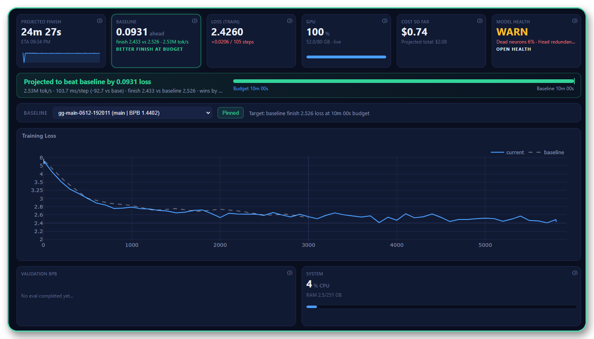
LIVE
Watch three things move.
01
Race vs baseline
Ahead or behind at the same budget?
02
Cost in real time
Meter ticks; the pod stops itself.
03
Model health
Metrics live; the verdict runs off-GPU.
A real run, updating now. The slide is only the map.
GPT Caddy · Stellar Science demo
6
Notes:
TIMING: 6:15–11:30 SWITCH TO THE APP. Use the pre-warmed pod, already training. Lead with the race bar — the feature to be proudest of. It is client-side derived from EMA step time, ETA, throughput, and projected finish loss. Then show KPI cards and cost ticking. Say: “All of this is updating right now.” Avoid asking a mixed audience to parse “SSE” on screen; explain the live stream only if asked. BACKUP: if the pod misbehaves, use the static live-run backup slide or a completed historical run from SQLite.

Slide 8
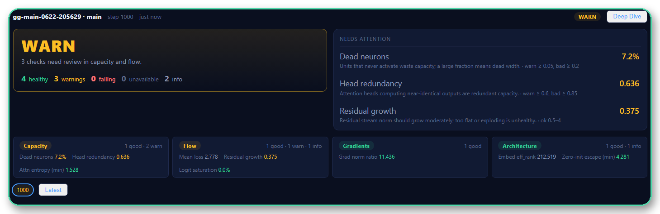
DIAGNOSE
The diagnostics check their own arithmetic.
01
RECOMPUTE
layer outputs
02
RE-DERIVE
loss independently
03
CROSS-CHECK
BPB vs on-pod eval
GPU trains. Laptop audits. Anything unverified is flagged.
GPT Caddy · Stellar Science demo
7
Notes:
TIMING: 11:30–15:30 KEYSTONE: “The diagnostics check their own arithmetic. The off-pod forward pass recomputes each layer from its parts, re-derives the loss independently, and reconciles bits-per-byte against the on-pod evaluation — across different hardware. Anything it can’t verify is flagged.” Show Model Health verdict and the deep dive first. Translate technical metrics into plain-English questions: capacity used? signal flow? gradients healthy? attention focused? Credibility line: most tools report a result; GPT Caddy cross-checks it. Avoid the absolute claim “proves it.”

Slide 9
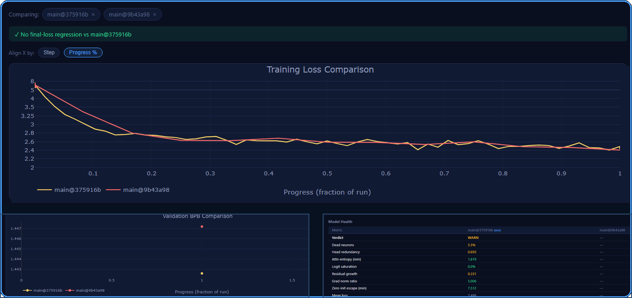
COMPARE
Did my change help?
01
Did loss improve?
curves + no-regression banner
02
Did validation improve?
BPB at equal progress
03
Did model health improve?
verdict + headline metrics
Compare at equal step or equal progress. Then decide what to change next.
Launch → Monitor → Diagnose → Compare → Decide ↺
GPT Caddy · Stellar Science demo
8
Notes:
TIMING: 15:30–17:30
History → select two runs → Compare. Ask the three questions on the slide, then show overlays, regression banners, and the model-health diff.
Key line: “Compare at equal step or equal progress.”
Close the loop: this is what the system is for — decide what to change next.
ON-SLIDE: this is the real run-vs-run Compare screen. Read it top-to-bottom: no-regression banner, loss curves, validation BPB, then model health.

Slide 10
CLOSE
From an unmet need to a tool I use every day.
I found the need, built the tool,
and made it trustworthy enough to run on every GPT Golf experiment.
need
→
tool
→
evidence
→
decision
The GPU stops itself. The run history and diagnosis remain.
GPT Caddy · Stellar Science demo
9
Notes:
TIMING: 17:30–18:00 LANDING: “This started because I had a need I couldn’t meet. I found the need, built the tool, and made it trustworthy enough to use every day.” Do not promise that the top-of-show pod has already stopped. Verify in the app first; show the actual bill only if the run is complete. Otherwise use the durable-history line on the slide and move to Q&A.

Slide 11
Appendix / backup
Static live-demo fallbacks · rigor · deeper technical discussion
PULL UP ON DEMAND
GPT Caddy · Stellar Science demo
A
Notes:
Backup slides only. The audience-segmentation map and internal Q&A coaching have been removed from projected slides. Presenter-only Q&A map: • C++ / systems — SentencePiece threading; symbol stubs; loader behavior. • Python / platform — event pipeline; lifecycle; ordered shutdown; SQLite. • Physics / PhD — self-verifying diagnostics; BPB reconciliation; controlled comparisons. • CEO / non-technical — need-first story; cost; faster decisions; visible ownership. Know cold: chunk sizing vs overflow, contention removal, DT_NEEDED and version nodes, fail-loud NCCL restore, service DAG, idempotent finalize, two-confirm pod-gone, metrics batching, SSE backpressure, redaction, runtime anatomy probe, additive schema, per-pod serialization. Multi-GPU is not demoed; describe NCCL restore and torchrun, and state that it is not yet stress-tested.

Slide 12
BACKUP · LIVE RUN
STATIC FALLBACK VIEW
Static fallback: the run at a glance.
GPT Caddy / training run
RUNNING
Loss vs baseline
live run
baseline
Race
Cost
ahead / behind
ticks live
ETA
Health
derived
pending verdict
live events / logs
Starting training
step events → metrics → snapshot → diagnostics
GPT Caddy · Stellar Science demo
10
Notes:
Use only if the live pod is unavailable. This is a designed static fallback, not a literal product screenshot, because the source deck did not include application captures. Replace with a real captured screen before the final interview if one is available. Narrate the same three live beats: race, cost, model-health state. Historical completed runs remain fully replayable from SQLite.

Slide 13
BACKUP · DIAGNOSTICS
STATIC FALLBACK VIEW
Static fallback: the verdict and its checks.
MODEL HEALTH
✓
Recompute
layer outputs from components
✓
Re-derive
loss independently
CROSS-CHECKED
No result is silently trusted.
✓
Cross-check
BPB vs on-pod evaluation
GPU trains
Laptop audits
Thresholds come from one backend metric registry.
GPT Caddy · Stellar Science demo
11
Notes:
Use if the live diagnostics screen is unavailable. This is a designed static fallback rather than a literal product screenshot. Replace with a real captured diagnostic verdict when available. The speaking sequence is unchanged: recompute, re-derive, cross-check; then explain that anything unverified is flagged.

Slide 14
BACKUP · COMPARE
STATIC FALLBACK VIEW
Static fallback: did the change help?
RUN A
RUN B
EQUAL PROGRESS
Loss overlay
Run B
Run A
LOSS
lower / higher
HEALTH
verdict + headlines
INTERNALS
which blocks moved
Compare at equal step or equal progress.
Decide what to change next.
GPT Caddy · Stellar Science demo
12
Notes:
Use if the live comparison screen is unavailable. This is a designed static fallback rather than a literal product screenshot. Replace with a real captured comparison view when available. Keep the narration in plain English: did loss improve, did health improve, what changed internally?

Slide 15
BACKUP
Built to be trusted.
01
02
03
Build integrity
Data-path integrity
Diagnostic integrity
Torch-derived stubs
Fail-loud restore
Schema contract
Persistence + redaction
Self-checking math
BPB cross-check
Automated checks
pytest: health verdicts · compare diffs · schema · golden end-to-end diagnostics · DB / pipeline / routes · secret redaction
frontend node --test: derived metrics + diagnostics logic · CI: Python, frontend, and image tests on every push
Next hardening: static typing · coverage floor · failure injection at thread / SQLite / subprocess seams · dependency scanning
Technical proof: github.com/sysreq/sentencepiece_parallel
GPT Caddy · Stellar Science demo
13
Notes:
Use when the panel probes production readiness. Testing detail: Python pytest covers health verdicts, compare diffs, schema, a golden end-to-end diagnostics test, database / pipeline / poller / routes, and secret redaction. Frontend node --test covers derived metrics and diagnostics logic. CI runs Python, frontend, and image checks on every push. Next hardening: static type checker, coverage floor, failure-injection tests around thread / SQLite / subprocess seams, and dependency / vulnerability scanning.

