Slide 1
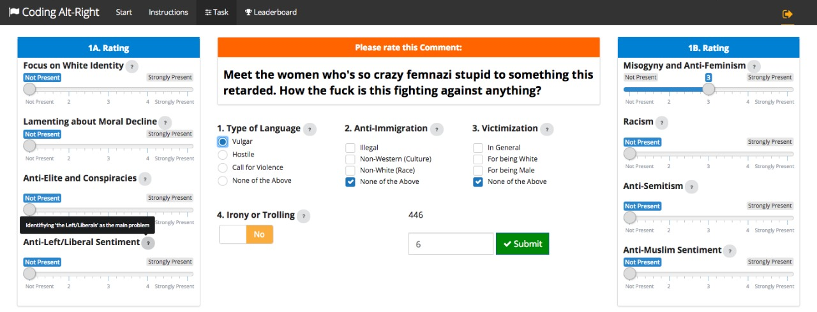
Detailed Coding Instructions
Code here!
User Statistics (just for fun ☺)
Log Out
When you are done,
Submit here
c
Hover over (?) for
short definitions
Please set the sliders
to the appropriate value

