Slide 1
BillForge KUET Teachers’ Edition
(An automatic bill generator from docx file)
Supervisor: Dr. Sheikh Imran Hossain
Developed by:
Chinmoy Modak Turjo
Roll: 1907003
Year: 3rd
Term: 2nd
Swaraj Chandra Biswas
Roll: 1907069
Year: 3rd
Term: 2nd
Department of Computer Science and Engineering
Khulna University of Engineering & Technology

Slide 2

Contents:
Objectives
Technologies Used
System Diagram
UI Mockup
Flask API
Constraints
Future Plan
Reference

Slide 3
Objectives:
To automate the process of creating bills and sending emails.
To facilitates the work of office executives of different departments of KUET.
To save work hours of office executives of different departments offices of KUET.
To increase the work efficiency of office executives thus they can manage their workflow in the limited time window.
To reduce the chance of human error while creating bills for teachers.
To take a step forward of implementing the vision of ‘DIGITAL KUET’.

Slide 4
Introduction
BillForge KUET Teachers' Edition streamlines bill generation for KUET teachers.
Users authenticate and provide a doc file containing teacher information.
BillForge automatically extracts teacher data, generates bills, and sends emails.
BillForge enhances billing efficiency, accuracy, and teacher communication.
It integrates seamlessly with existing KUET systems and safeguards data.
BillForge contributes to KUET's digital transformation initiative.

Slide 5
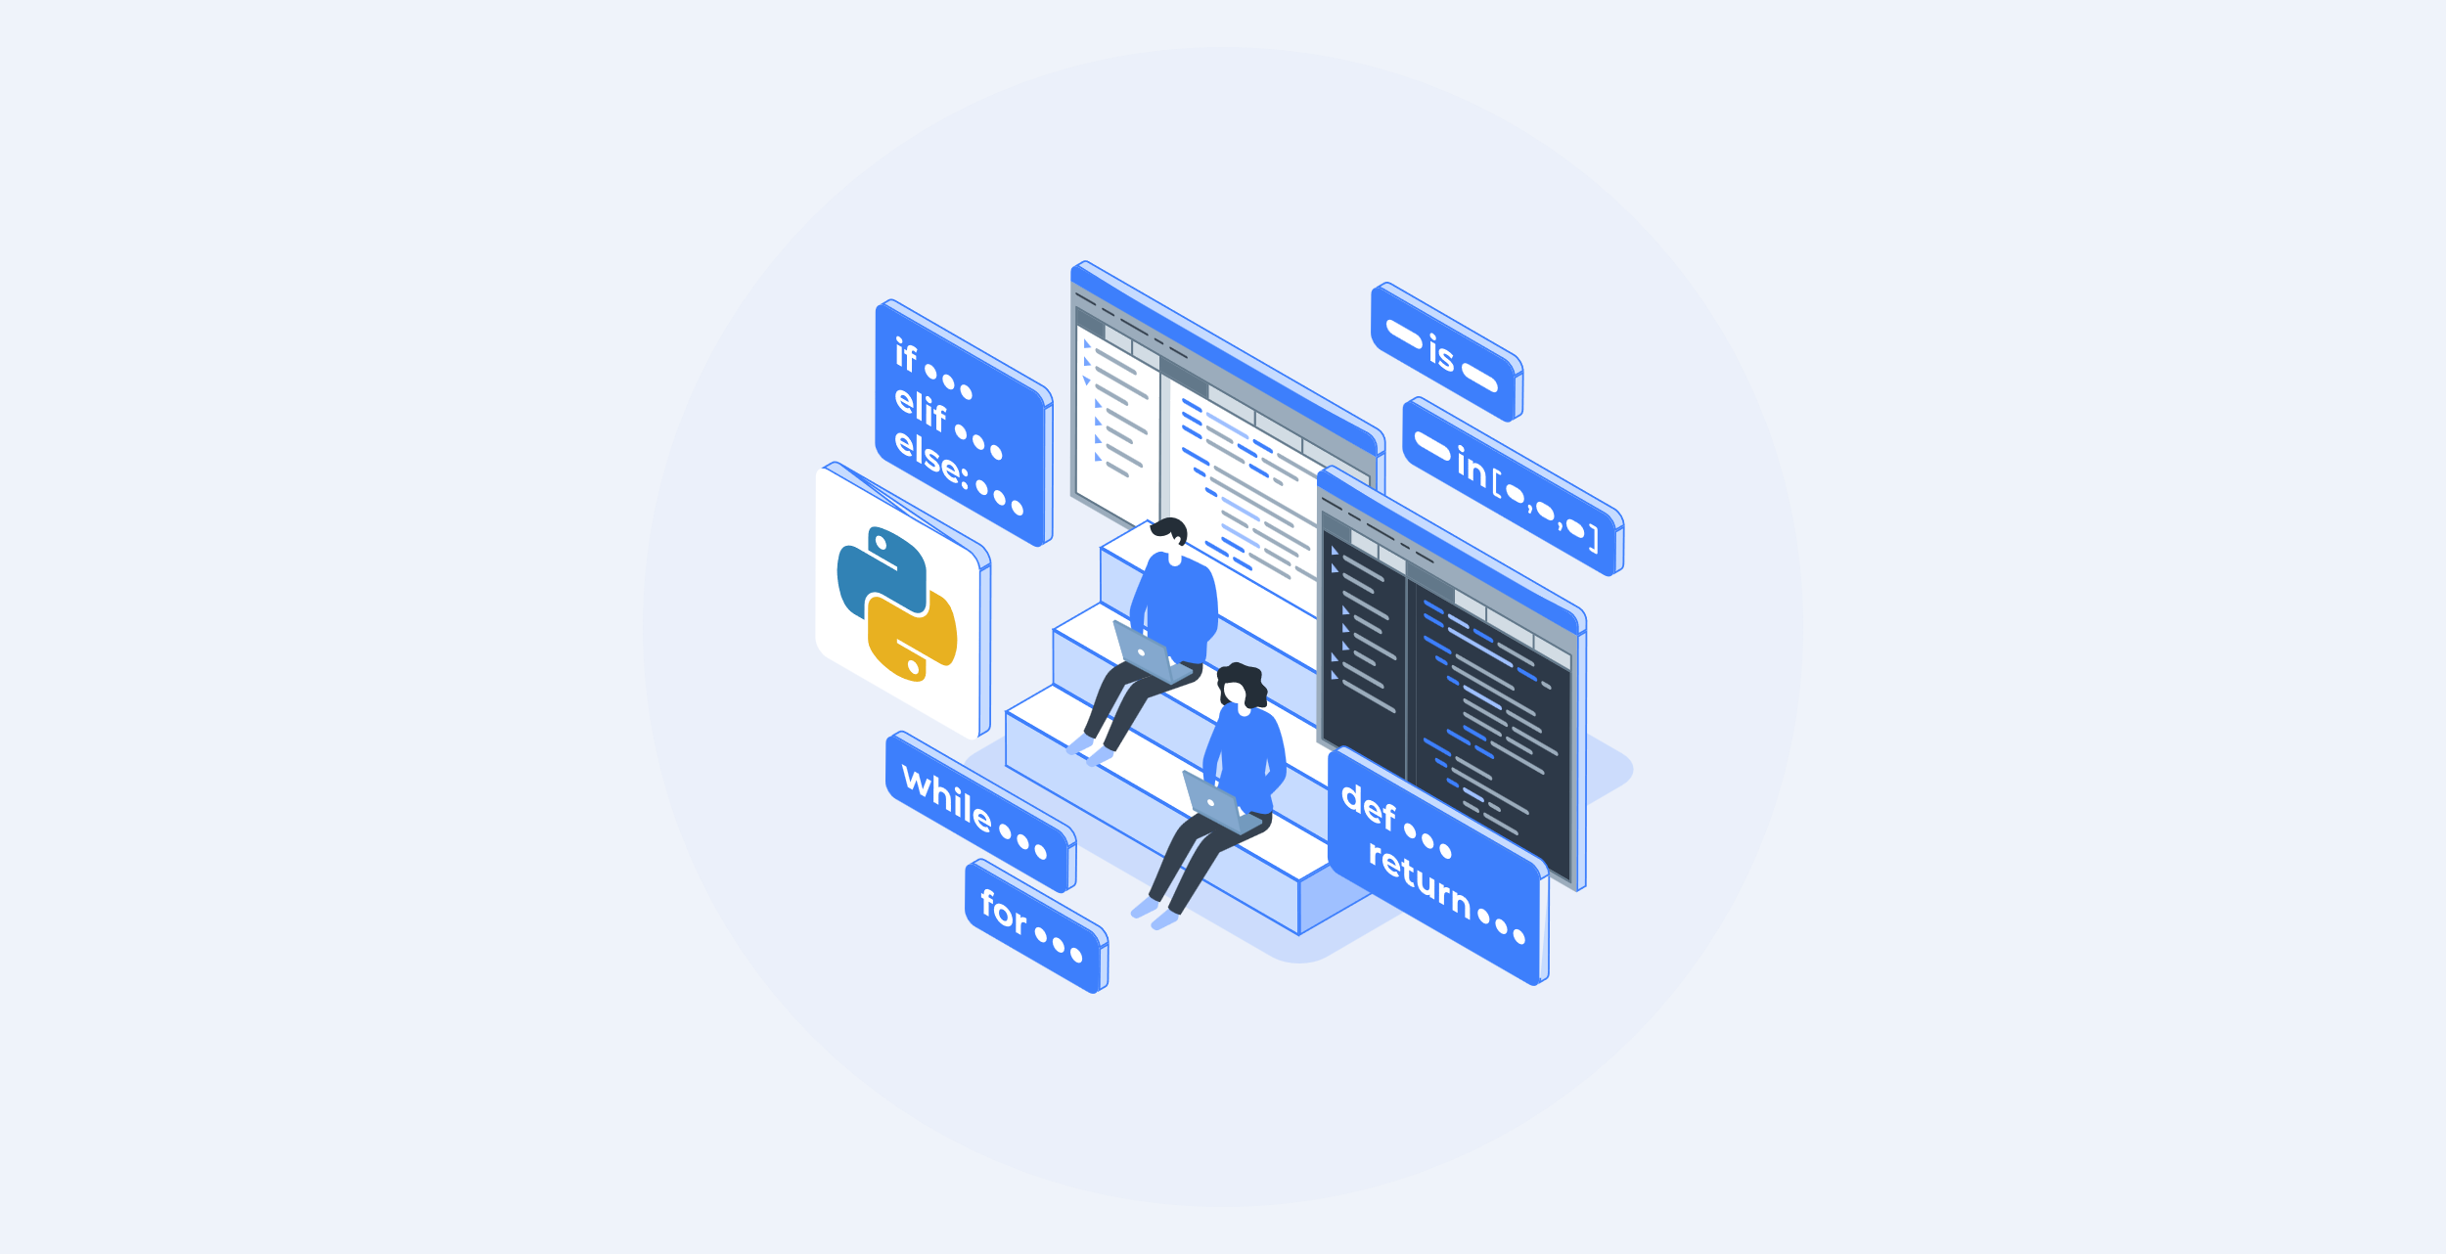
Technologies Used
Python OOP
SQLite Database
Python-docx Library
OpenPyXL Library
Tkinter Library
Doc2txt Library
Figma
Custom Build Flask API
Google Translator API
Figma API
Modularization
SMTP Library Module
Various other modules and libraries

Slide 6
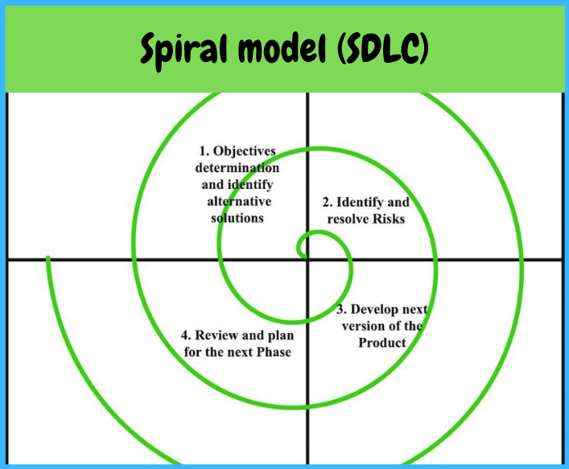
System Design
The Spiral Model is a Software Development Life Cycle (SDLC) model that provides a systematic and iterative approach to software development .It is based on the idea of a spiral, with each iteration of the spiral representing a complete software development cycle. The phases of Spiral Model are:
Planning
Risk Analysis
Engineering
Evaluation
Planning
Ref: https://www.itaims.com/blog/software-development-life-cycle

Slide 7
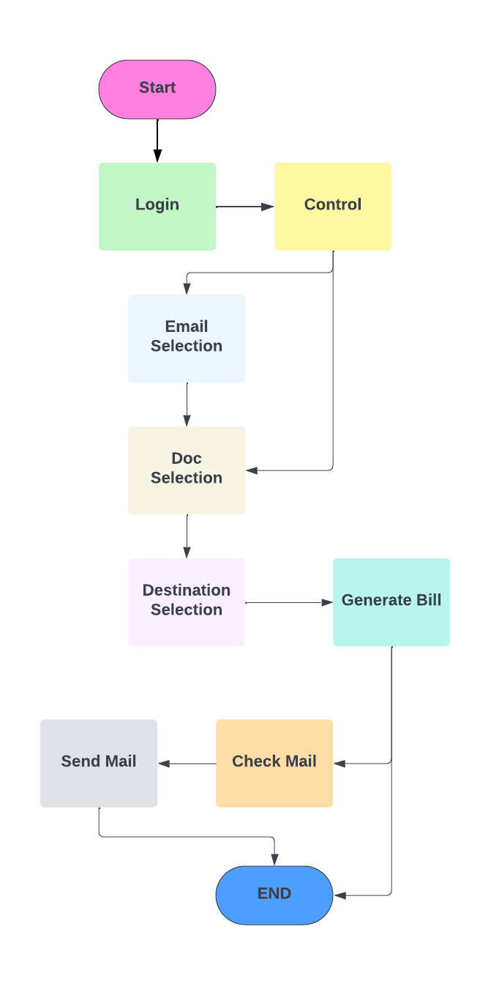
System Flow Diagram

Slide 8
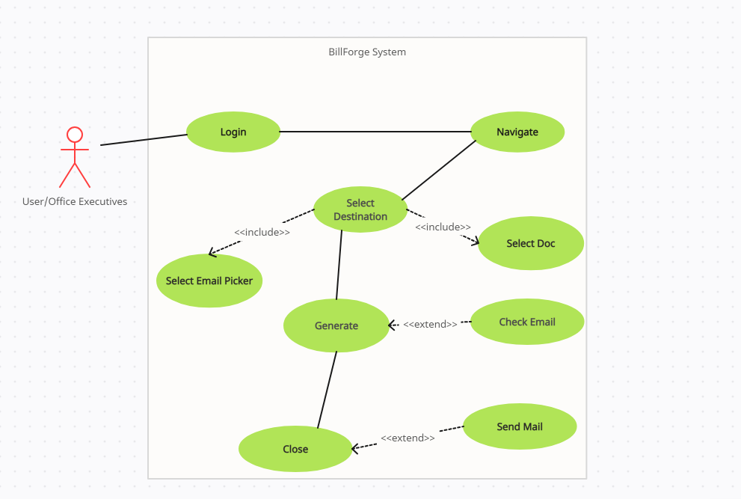
Use Case Diagram

Slide 9
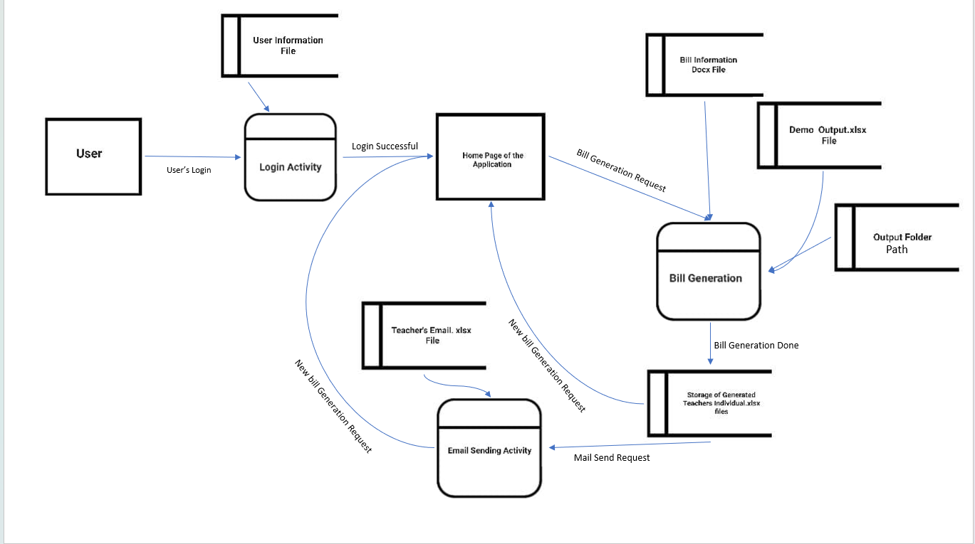
Data Flow Diagram

Slide 10
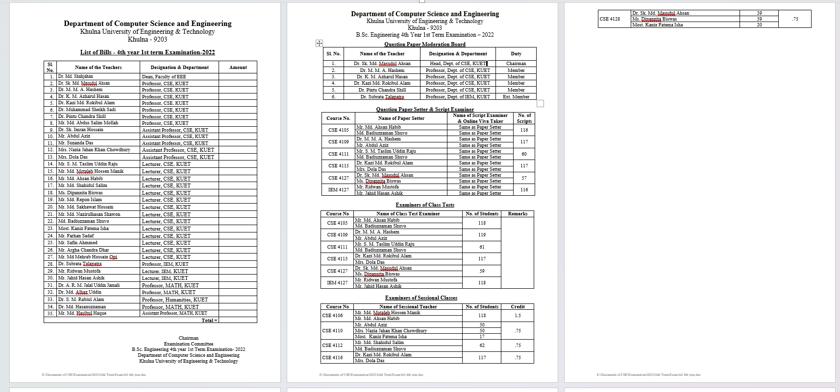
UI Mockup Input Doc

Slide 11
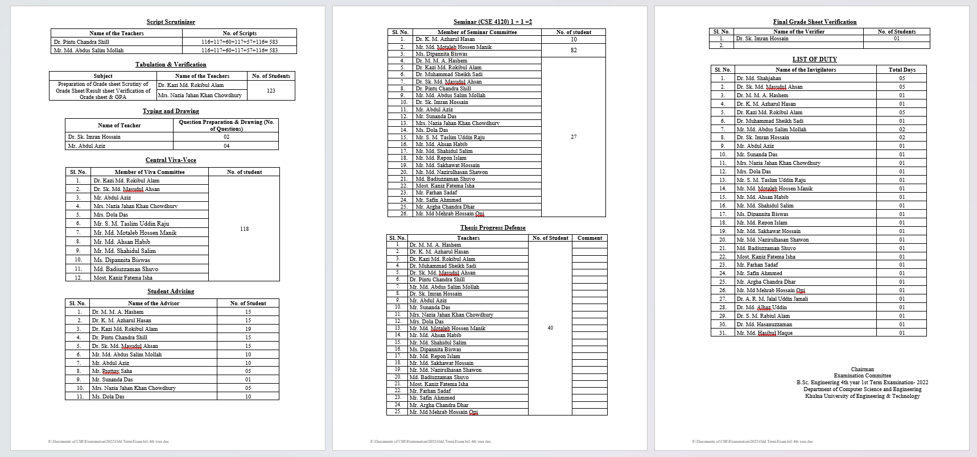
UI Mockup Input Doc

Slide 12
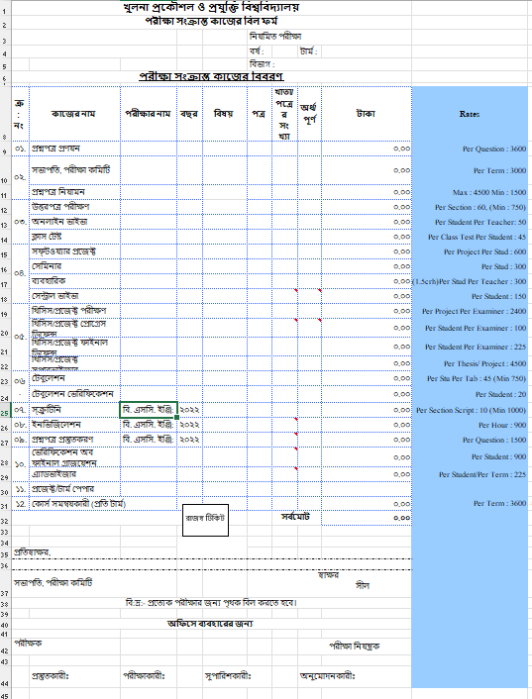
UI Mockup Input Doc

Slide 13
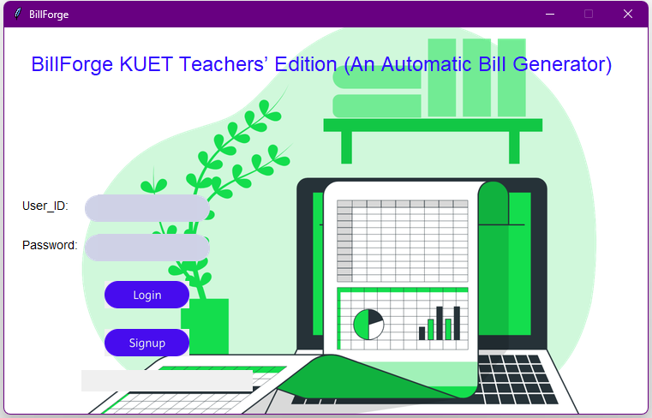
UI Mockup

Slide 14
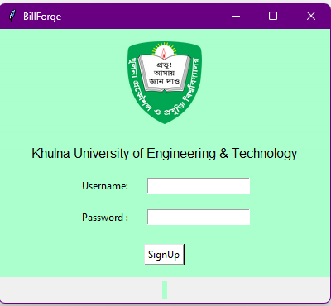
UI Mockup

Slide 15
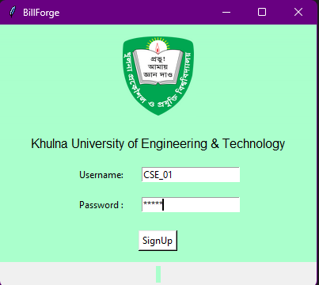
UI Mockup

Slide 16
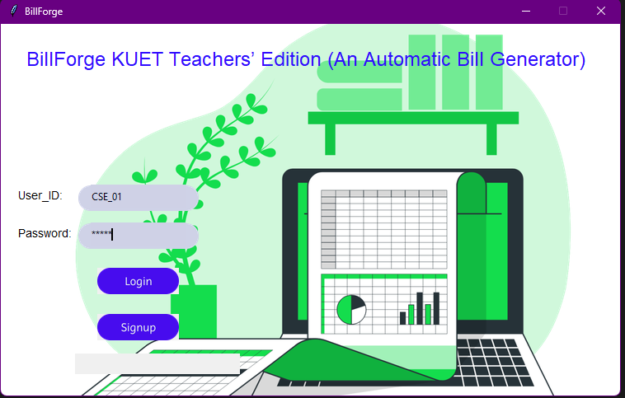
UI Mockup

Slide 17
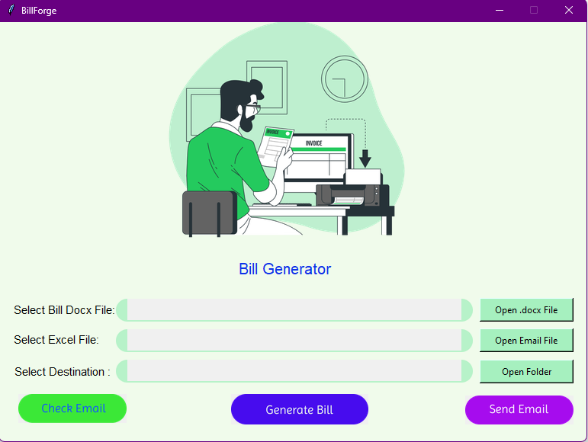
UI Mockup

Slide 18
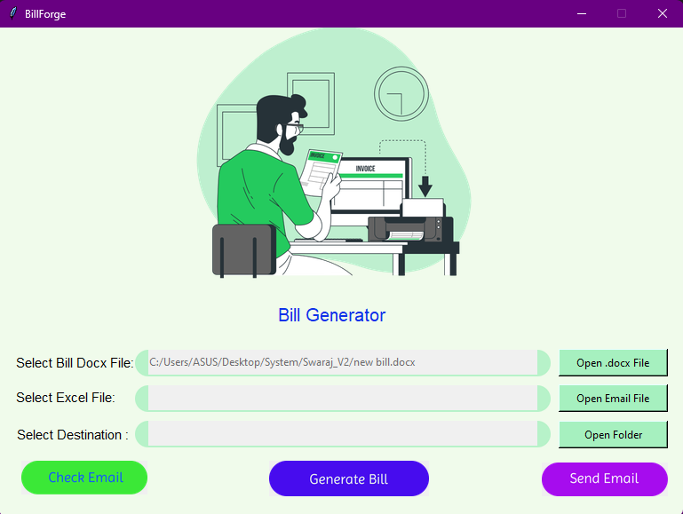
UI Mockup
Doc Picker

Slide 19
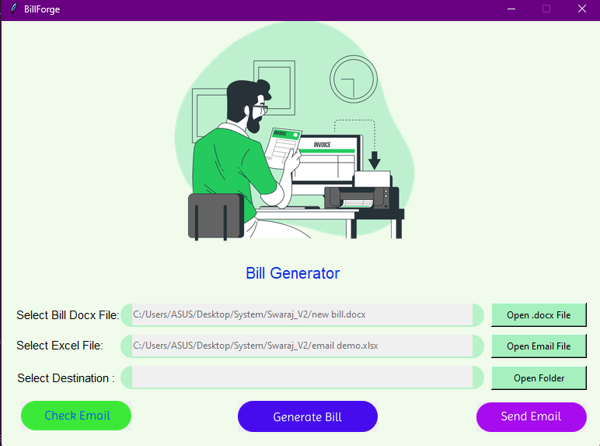
UI Mockup
Email Picker

Slide 20
UI Mockup
Destination Selection

Slide 21
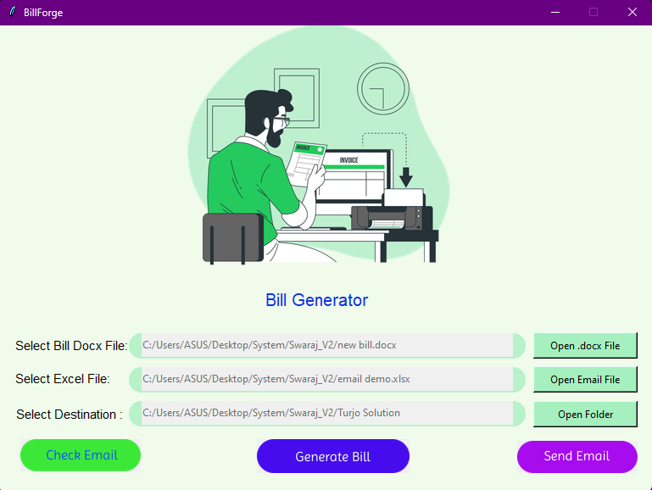
UI Mockup

Slide 22
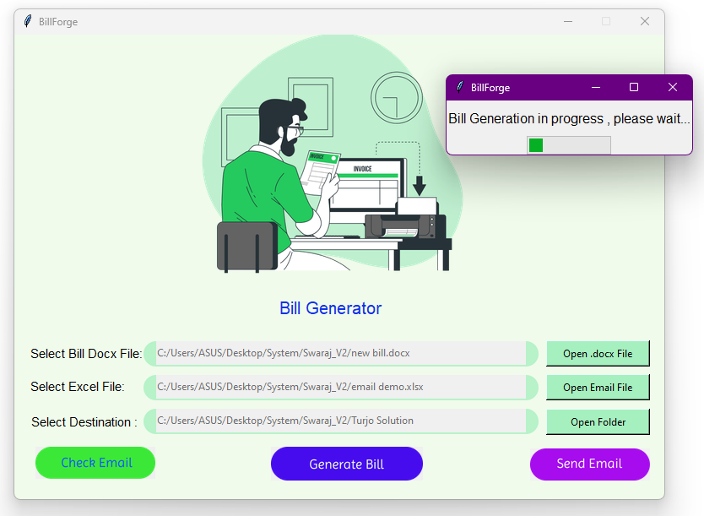
UI Mockup

Slide 23
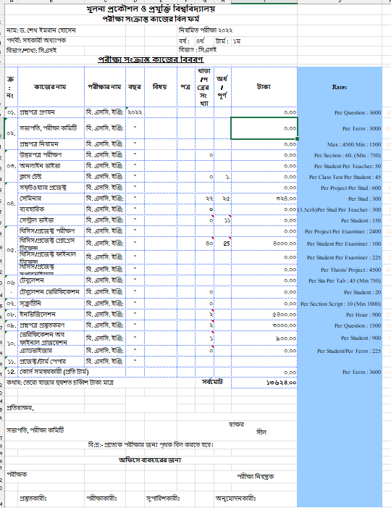
UI Mockup

Slide 24
UI Mockup

Slide 25
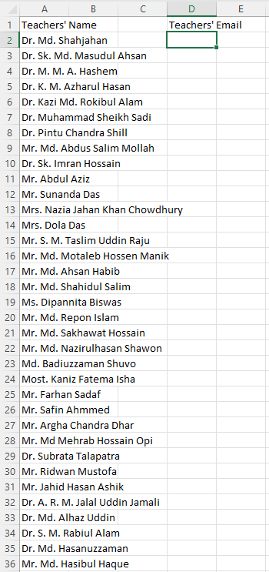
UI Mockup

Slide 26
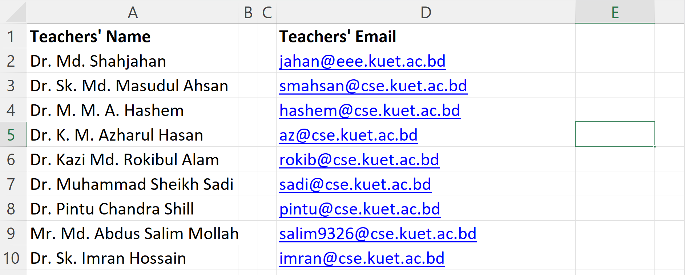
UI Mockup

Slide 27
UI Mockup

Slide 28
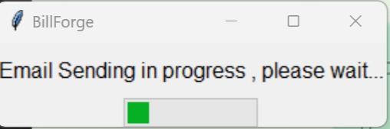
UI Mockup

Slide 29
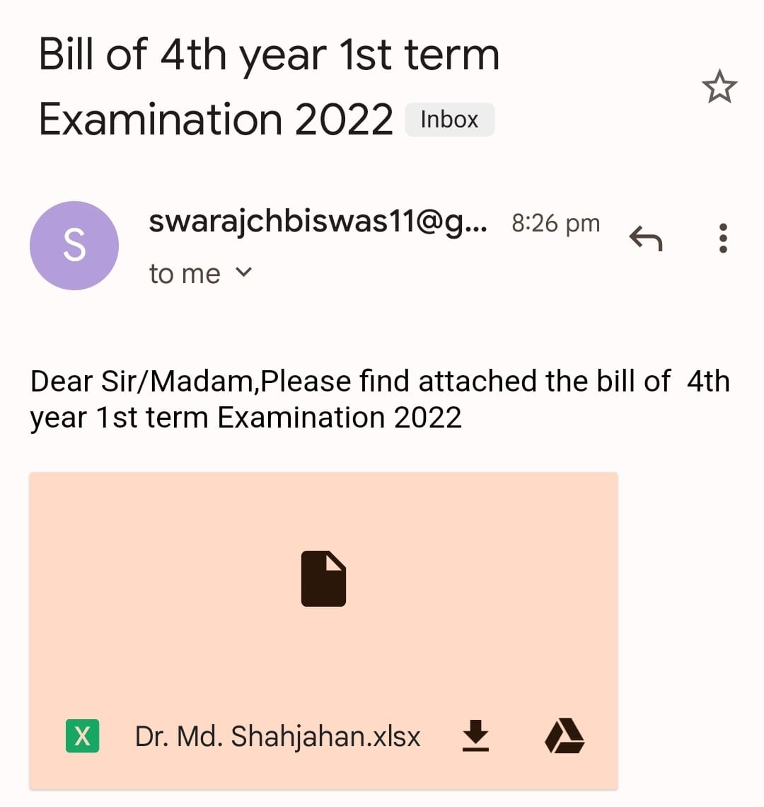
UI Mockup
Email Received

Slide 30
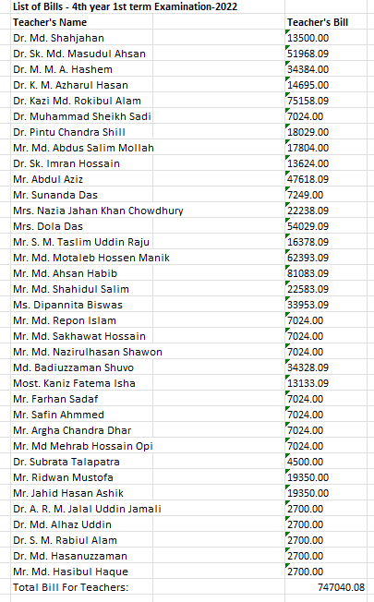
Bill Summary

Slide 31
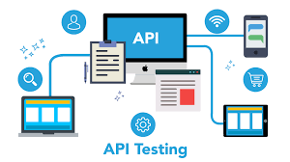
Flask API
Ref: https://flask.palletsprojects.com/en/3.0.x/api/
13500.00
Flask API
কথায়: তেরো হাজার পাঁচশত টাকা মাত্র

Slide 32
Constraints
Scope: Teacher-centric, semester focused
Data Reliance: Pre-formatted files, manual entry
Integration Hurdles: Requires development, potential compatibility issues (version based)
Adoption Challenges: Training demands
Technical constraints: Desktop-only, maintenance dependence, uncertain funding
Ethical Concerns: Data privacy & security for sensitive teacher information

Slide 33
Future Plans
Beyond Teachers: Expand to specific exam types
Smarter Data: Automate extraction, handle diverse formats
Flexible & Adaptable: Allow customization for departments and workflows
Seamless Integration: Integrate with KUET’s financial systems, data flows freely
User Preference: Train, address concerns, offer ongoing support and feedback loops.
Tech Evolution: Explore web/mobile apps, cloud storage, user-friendly interfaces
Secure & Sustainable: Long-term funding, dedicated team, regular updates, ethical data practices.

Slide 34
References:
AI Sweigart, “Automate Boring Stuff with Python: Practical Programming for Total Beginners 1st Edition”
Python Automation Projects Scripts You Should Know- https://www.freecodecamp.org/news/python-automation-scripts/
Automating with Python: A Developer’s Guide For 2023-https://www.learnenough.com/blog/automating-with-python
Figma to Tkinter Designer API- https://github.com/ParthJadhav/Tkinter-Designer
OpenPyXL documentation -https://openpyxl.readthedocs.io/en/stable/editing_worksheets.html
Python-docx documentation -https://www.learnenough.com/blog/automating-with-python

Slide 35
Source Code:
https://github.com/system0369/BillForge-KUET-Teachers-Edition/tree/main/System%20Project

Slide 36
Thank You

