Slide 1
“big” cores cluster
(Cortex-A15, 2.8GHz)
“LITTLE” cores cluster
(Cortex-A7, 1.8GHz)
big
Core
big
Core
LITTLE
Core
LITTLE
Core
GPU
big
Core
big
Core
NPU
LITTLE
Core
LITTLE
Core
L2 Cache
L2 Cache
Cache Coherent Interconnect

Slide 2
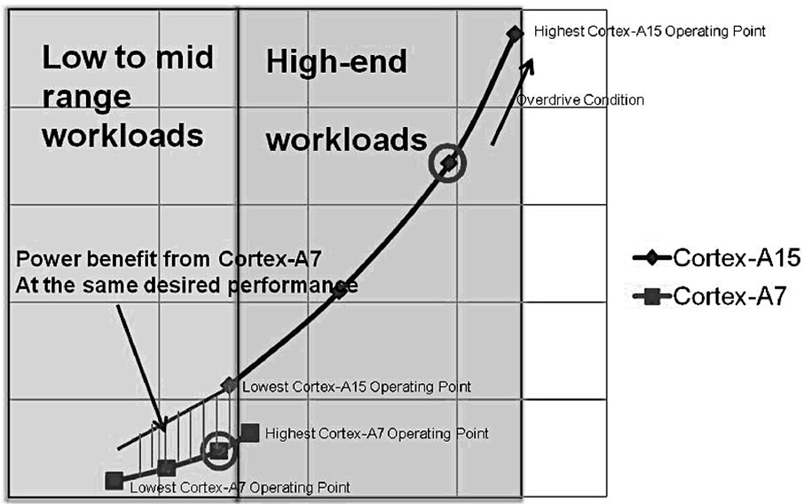
Low-end workload
High-end workload
Cortex-A15
Cortex-A7
Power
Power benefit at the same performance
Lowest and
Highest operating points
Performance

Slide 3
Traditional Scheduling
Extensition to Proposed Compiler-Assisted Scheduling
Source Code 1
Source Code N
…
Compiler + Static Analyser
Machine Code 1
+instrumentation code
Machine Code N +instrumentation code
Static Exec. Tree 1
+other compiler
collected data
Static Exec. Tree N
+other compiler
collected data
…
…
Programs Execution Stats (incl. data collected by instr. code)
OS Scheduler
Tree+ Exec. Stats Analyzer
Joint Execution Tree
+ Other Compiler-Assisted Data
HW Config Allocation 1
HW Config Allocation N
…

Slide 4
Source Code 1
Source Code N
…
Compiler + Static Analyser
STG1
+other compiler data
STGN
+other compiler data
…
STG(N)+ Exec. Stats Analyzer
Programs Execution Statistics (incl. data collected by instr. code)
jSTG(N)
OS Scheduler
HW Config Allocation 1
HW Config Allocation N
…

Slide 5
Synchronous program arrival
Stages
Source Code 1
Source Code N
…
A compiler generates programs State-Transition Graphs (STGs) (Section V-A)
Compiler + Static Analyser
STG1
+other compiler data
STGN
+other compiler data
…
A scheduler merges STGs into a joint-STG of programs to be concurrently executed (Section V-B)
Programs Execution Statistics
OS Scheduler
jSTG(N)
The scheduler allocates processing units (PUs) to programs (Section V-C)
PU Allocation 1
PU Allocation N
…

Slide 6
Asynchronous program arrival
Stages
Source Code 1
Source Code 2
Source Code N
…
Compiler generates programs State-Transition Graphs
(Section V-A)
Compiler + Static Analyser
Prog. 2 arrived
Prog. N arrived
Compiler + Static Analyser
STG2
+other compiler data
STGN
+other compiler data
Prog. 1 arrived
…
OS Scheduler merges
(Section V-B)
STG1
+other compiler data
Programs Execution Statistics
OS Scheduler
jSTG(N-1)
OS Scheduler allocates configs to Programs
(Section V-C)
merge
HW Config Allocation 1
HW Config Allocation N
…

Slide 7
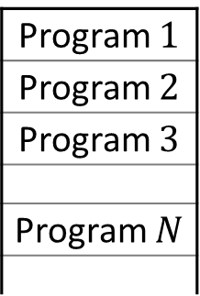
Heterogeneous Cores
Core Type 2
Core Type 1
…
…
Hardware Platform
Heterogeneous Scheduler
Workload
Pending queue
Program $1$
Program $2$
Program $3$
Program $N$
…
…

Slide 8
Heterogeneous Platform
Core 2
Core 1
Heterogeneous Scheduler
Program 1
Program 2
Program 3
Block 1
Block 1
Block 1
Block 2
Block 2
Block 3
High-level scheduling of 3 programs of several blocks to be executed over a heterogeneous platform of 2 cores.

Slide 9
Sample execution requirements of program blocks of 3 programs for 2 heterogeneous cores.
EDP,
mJ*ms
Programs /Blocks |  | Execution time, ms |  | Energy use, mJ
 |  | Core 1 (slow) | Core 2 (fast) | Core 1 | Core 2
P1 | B1 | 4 | 3 | 8 | 9
 | B2 | 5 | 3 | 3 | 4
P2 | B1 | 5 | 4 | 6 | 10
 | B2 | 3 | 2 | 3 | 7
 | B3 | 3 | 2 | 3 | 6
P3 | B1 | 3 | 2 | 6 | 7
253
200
+92%
Schedule S1
Schedules S2
104
132
100
-8%
96
24
Programs | Execution time, ms |  | Energy use, mJ
 | Core (no DVFS) | Core (slower) | Core (no DVFS) | Core (slower)
P1 | 5 | 7 | 9 | 8
P2 | 4 | 5 | 10 | 6
P3 | 2 | 3 | 7 | 6
20
+71%
14
Prog. P1
Prog. P2
Prog. P3
Prog. №

Slide 10
mW
Core 1
20
Core 2
Sum
16
12
8
4
0
2
4
6
8
10
t

Slide 11
mW
Core 1
Sched. S1
20
Core 1
Sched. S2
15
Core 2
15
Core 2
10
Sum
Sum
10
5
5
0
2
4
6
8
10
t
0
2
4
6
8
10
t
Power
%
30
100
24
80
18
60
12
40
6
20
0
2
4
6
8
10
t
0
2
4
6
8
10
t

Slide 12
Power
30
S1 consumed 37.5% more
power than S2
24
Schedule S1
18
Same consumption
12
Schedule S2
Power
6
23% more progress
30
0
25
50
75
%
24
100
Average programs completion
18
12
6
0
25
50
75
%
100
Total programs completion

Slide 13

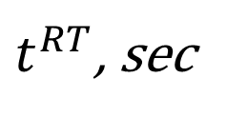
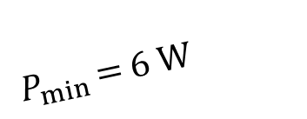

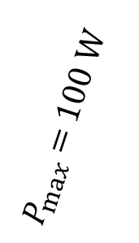


Energy efficiency
E, Joules
Sched.
$$t^{RT}$$
$$E$$
1
2
150
$P_{max}$ = 100 W
$$\text{ρ}∗1.5$$
2
3
50
150
3
2
75
120
100
$$\text{ρ}÷3$$
75
ρ= 300 J*s
Same EDP
50
ρ= 150 J*s
Optimal
$P_{min}$ = 6 W
25
0
1
2
3
4
5
6
$t^{RT}$, sec

Slide 14
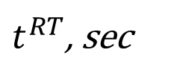


Energy efficiency
E, Joules
Sched.
$$t^{RT}$$
$$E$$
180
1
2
150
2
3
50
150
Worst
1
3
1.5
100
120
$$\frac{t_{2}}{t_{1}}<\frac{E_{1}}{E_{2}}$$
100
3
75
Optimal
$$\frac{t_{2}}{t_{3}}=\frac{E_{3}}{E_{2}}$$
ρ= 300 J*s
50
2
25
ρ= 150 J*s
0
1
2
3
4
5
6
$t^{RT}$, sec

Slide 15
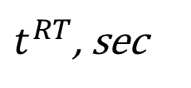




Energy efficiency
E,
Joules
Sched.
$$t^{RT}$$
$$E$$
1
5
120
180
Optimal
Worst
2
6
50
3
3
100
150
120
1
$$\frac{t_{2}}{t_{1}}<\frac{E_{1}}{E_{2}}$$
100
3
75
$ρ_{1}=600$J*s
50
$$\frac{t_{2}}{t_{3}}=\frac{E_{3}}{E_{2}}$$
2
25
$ρ_{2}=300$J*s
0
1
2
3
4
5
6
7
8
$t^{RT}$, sec

Slide 16
Experiments
0
0 | 0
0 | 0 | 0.1
0 | 0.1 | 0.2 | 0.3
0.1 | 0.2 | 0.4 | 0.8 | 2.2
0.2 | 0.3 | 0.8 | 1.6 | 4.3 | 8
0.3 | 0.7 | 1.6 | 3.3 | 8.4 | 17 | 34
0.6 | 1.4 | 3.2 | 6.6 | 17 | 33 | 69 | 137
1.4 | 3.2 | 7.2 | 14.7 | 34.8 | 71.4 | 146 | 294 | 647
3 | 6.6 | 14 | 29 | 71 | 143 | 294 | 598 | 1365 | 2780
0
1
2
5
10
30
200
800
1500
3000
1
2
3
4
5
Number of Prog. 1 blocks
Runtime, ms
6
7
8
9
10
1
2
3
4
5
6
7
8
9
10
Number of Prog. 2 blocks

Slide 17
Notation: - program release - program completion - resource allocation
S1 – Cores Load
Core 1
P1B1
P3B2
P3B3
Core 2
P2B1
P3B1
P1B2
0
2
4
6
8
10
t
S1 – Programs Arrival and Completion
Program 1
Program 2
Program 3
0
2
4
6
8
10
t
S2 – Cores Load
Core 1
P2B1
P3B1
Core 2
P1B1
P1B2
P3B2
P3B3
0
2
4
6
8
10
t
S2 – Programs Arrival and Completion
Program 1
Program 2
Program 3
0
2
4
6
8
10
t

Slide 18
program release
program completion
resource allocation
Notation:
-
-
-
S1 – Cores Load
Core 1
P1B1
P3B1
Core 2
P2B1
P1B2
P2B2
P2B3
0
2
4
6
8
10
12
t
S1 – Programs Arrival
Prog. 1
Prog. 2
Prog. 3
0
2
4
6
8
10
12
t
S2 – Cores Load
Core 1
P2B1
P2B2
Core 2
P1B1
P3B1
P1B2
P2B3
0
2
4
6
8
10
12
t
S2 – Programs Arrival
Prog. 1
Prog. 2
Prog. 3
0
2
4
6
8
10
12
t

Slide 19

































$$Δt^{RT}$$
убрать нагромождение, может убрать некоторые лейблы
$$Δt^{l}$$
$$Δt_{B_{1}}^{exec}$$
$$Δt_{B_{2}}^{exec}$$
$$Δt_{B_{N}}^{exec}$$
B1
B2
BN=B3
=0
=2
=6
=9
=12
t
$$t^{r}$$
$$t_{}^{s}$$
$$t_{B_{2}}^{s}$$
$$t_{B_{2}}^{c}$$
$$t^{c}$$
$$Δt^{RT}$$
$$Δt^{l}$$
$$Δt_{B_{1}}^{exec}$$
$$Δt_{B_{1}}^{pm}$$
$$Δt_{B_{2}}^{exec}$$
$$Δt_{B_{N}}^{exec}$$
B1
B2
BN=B3
=6
=10
t
=0
=2
$$t_{B_{1}}^{c}$$
$$t_{B_{2}}^{s}$$
$$t_{B_{2}}^{c}$$
$$t_{B_{N}}^{s}$$
=15
$$t^{r}$$
$$t_{}^{s}$$
$$t^{c}$$
$$Δt_{}^{sched}$$
$$Δt_{}^{pm}$$
$$Δt_{}^{migr}$$
Context switches
Prog. 1
Core 1
Prog. 2
Core 1
Core 2
$$0$$
$$t_{1}^{}$$
$$t_{2}^{}$$
$$t_{3}^{}$$
$$t_{4}^{}$$
$$t_{5}^{}$$
$$t_{6}^{}$$
t

Slide 20



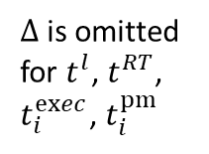








$Δ$is omitted
for $t^{l}$, $t^{RT}$, $t_{i}^{exec}$, $t_{i}^{pm}$
$$t^{RT}$$
$$t^{l}$$
$$t_{1}^{exec}$$
$$t_{2}^{exec}$$
$$t_{3}^{exec}$$
B1
B2
B3
=0
2
6
9
=12
t
$$t^{r}$$
$$t^{c}$$
$$t^{RT}$$
$$t_{1}^{exec}$$
$$t_{2}^{pm}$$
$$t^{l}$$
B1
B2
B3
=0
2
6
7
10
12
=15
t
$$t^{r}$$
$$t^{c}$$
$$Δt_{}^{sched}$$
$$Δt_{}^{pm}$$
$$Δt_{}^{migr}$$
Context switches
Prog. 1
Core 1
Prog. 2
Core 1
Core 2
$$0$$
$$t_{1}^{}$$
$$t_{2}^{}$$
$$t_{3}^{}$$
$$t_{4}^{}$$
$$t_{5}^{}$$
$$t_{6}^{}$$
t

Slide 21
Program | Schedule | Scheduling Objective to Minimize
 |  | Latency | Execution Time | Response Time
Prog. 1 | S1 | 0 | 7 | 8
 | S2 | 0 | 6 | 8
Prog. 2 | S1 | 0 | 8 | 11
 | S2 | 0 | 10 | 10
Prog. 3 | S1 | 1 | 3 | 4
 | S2 | 0 | 2 | 2
Average | S1 | 0.33 | 6 | 7.67
 | S2 | 0 | 6 | 6.67

Slide 22
Schedule | Program | Latency | Execution Time | Response Time | Average Execution Time | Average Response Time
S1 | P1 | 0 | 7 | 8 | 6 | 7.67
 | P2 | 0 | 8 | 11
 | P3 | 1 | 3 | 4
S2 | P1 | 0 | 6 | 8 | 6.33 | 7
 | P2 | 0 | 11 | 11
 | P3 | 0 | 2 | 2
Schedule | Program | Latency | Execution Time | Response Time | Average Execution Time | Average Response Time
S2 | P1 | 0 | 6 | 8 | 6.33 | 7
 | P2 | 0 | 11 | 11
 | P3 | 0 | 2 | 2

Slide 23
Heterogeneous Platform
Core 1
Core L
Core 1
Core M
…
…
Heterogeneous Scheduler
Program 1
Program 2
…
Program N
Block 1
Block 1
Block 1
Block 2
Block 2
Block 2
…
…
…
Block K1
Block K2
Block K3

Slide 24
Algorithm | Block № | Config 1 | Config 2
Winograd | 1 | 71 | 75
 | 2 | 5 | 5
 | 3 | 1813 | 2240
 | 4 | 1717 | 1985
 | 5 | 1773 | 1736
 | 6 | 1773 | 1802
 | 7 | 1781 | 917
 | 8 | 1616 | 755
 | 9 | 1775 | 757
 | 10 | 7 | 3
LZ4 | 1 | 40 | 35
 | 2 | 26 | 20
 | 3 | 50 | 46
 | 4 | 74 | 52
 | 5 | 31 | 26
 | 6 | 19736 | 9808
 | 7 | 965 | 311
 | 8 | 1 | 1
 | 9 | 15 | 5
Comparison point | Winograd | LZ4
Purpose | Matrix multiplication algorithm (for large matrices) | High-speed lossless data compression
Number of blocks | 10 | 9
Improvement from switching to Config 2 | x1.2 | X2
Memory usage | High (depends on matrix size) | Low
Cache utilization | Inefficient (matrices are larger than cache) | Efficiently utilizes caches (64KB window)
Main block type | Recursive calls | Loops
Practical usage | Rarely used due to high constant factors | Extensively used in production
Main performance issues | Disk swapping, page faults | Slow memory access

