Slide 1
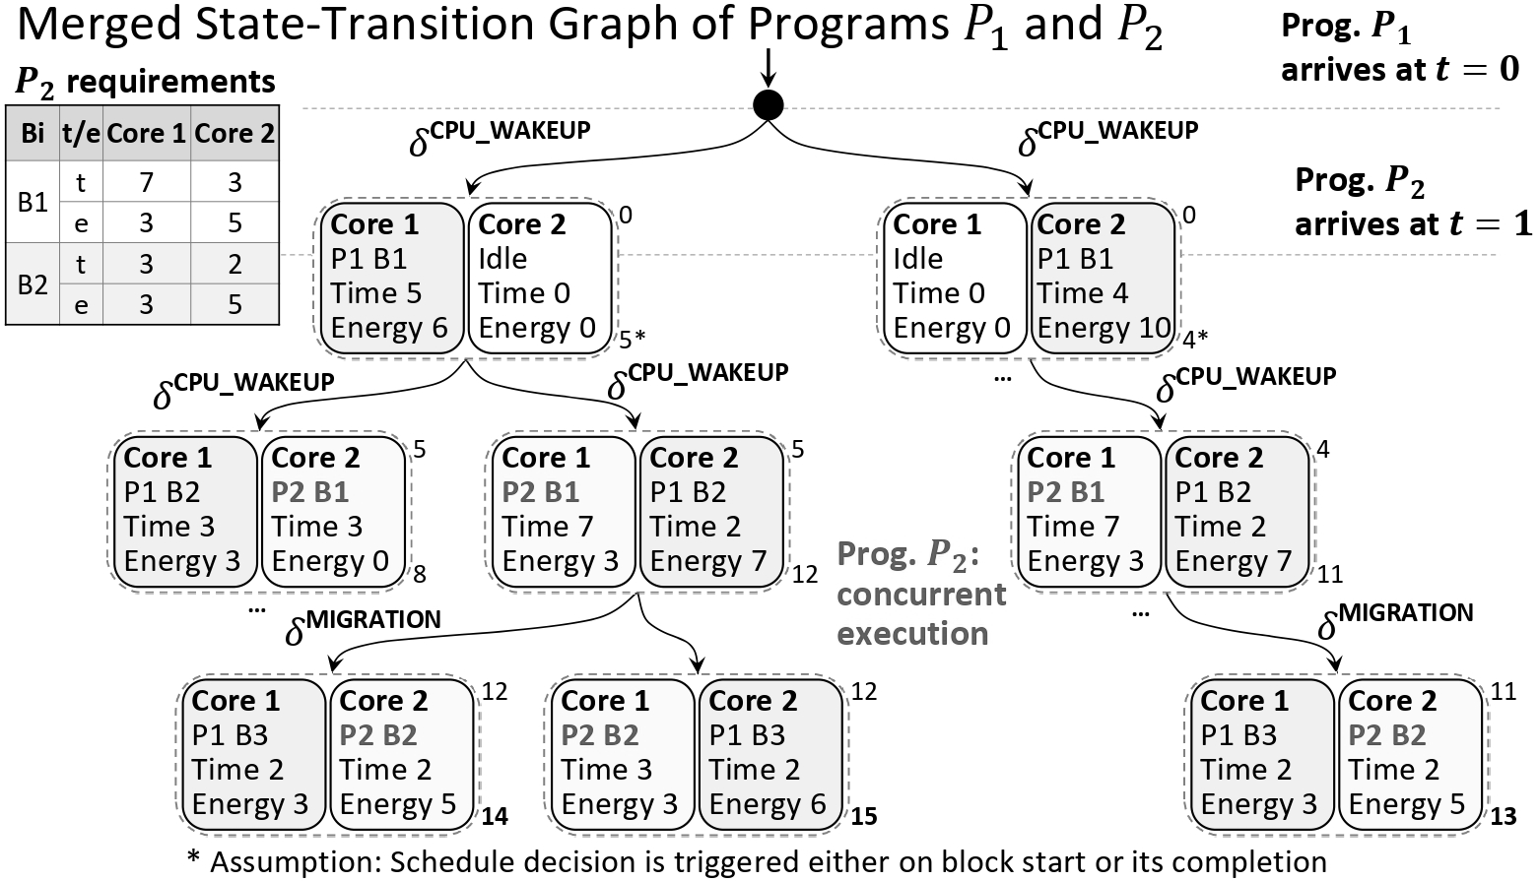

Thesis Research Presentation for Huawei Technologies
Application of State-Transition Graphs for
Optimized Heterogeneous Scheduling
Arsen Mutalapov
Supervised by Artem Burmyakov
May 22, 2025

Slide 2
Heterogeneous Platform Example: ARM big.LITTLE
“big” cores
Fast, but energy-hungry
Trade-off
“LITTLE” cores
Slow but energy-efficient
big
Core
big
Core
LITTLE
Core
LITTLE
Core
big
Core
big
Core
LITTLE
Core
LITTLE
Core
“big”
“LITTLE”
L2 Cache
L2 Cache
Power
Power benefit at the same performance
Cache Coherent Interconnect
Lowest and
Highest operating points
A chosen scheduling policy significantly affects
the runtime and energy efficiency;
Essential for mobile devices with autonomous power supply.
Performance

Slide 3








Examples of Heterogeneous Schedules for Programs $A$, $B$
big
Core
LITTLE
Core
Objective: optimize trade-off between Response Time and Energy
Prog. | RT | E
A | 7 | 4
B | 9 | 4
L2 Cache
Case 1: Worse Average RT
Oversimplified ARM big.LITTLE
big
$$B$$
$$A$$
LITTLE
$$A$$
$$B$$
0
2
4
6
8
t
Case 2: Better Average RT
Prog. | RT | E
A | 7 | 4
B | 6 | 5
big
$$A$$
$$B$$
LITTLE
$$B$$
$$A$$
(cores)
Schedulers affect the efficiency of hardware utilization

Slide 4
Existing Heterogeneous Schedulers
Schedulers:
“big” cores
Fast, but energy-hungry
- HEFT: Heterogeneous Earliest Finish Time;
- HASS: Heterogeneity-Aware Signature-Supported.
“LITTLE” cores
Slow but energy-efficient
big
Core
big
Core
LITTLE
Core
LITTLE
Core
big
Core
big
Core
LITTLE
Core
LITTLE
Core
Property | Description
Objective | to minimize programs response times;
Principle | heuristic and greedy based
Key limitations | suboptimal scheduling decisions; no optimization of energy consumption.
L2 Cache
L2 Cache
Cache Coherent Interconnect

Slide 5
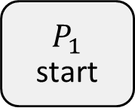

State-Transition Graph for a Solo Program $P_{1}$
$P_{1}$ requirements
$$P_{1}$$
start
Block | Param | Core 1 | Core 2
Block 1 | Time | 5 | 4
 | Energy | 6 | 10
Block 2 | Time | 3 | 2
 | Energy | 3 | 7
Block 3 | Time | 2 | 2
 | Energy | 3 | 6

Slide 6


State-Transition Graph for a Solo Program $P_{1}$
$P_{1}$ requirements
$$P_{1}$$
start
Block | Param | Core 1 | Core 2
Block 1 | Time | 5 | 4
 | Energy | 6 | 10
Block 2 | Time | 3 | 2
 | Energy | 3 | 7
Block 3 | Time | 2 | 2
 | Energy | 3 | 6
CPU_WAKEUP
Overhead
$$δ$$
Core 1
Block 1
Time 5
Energy 6
0
Transition
State example
5
…
Block 1 execution over Core 1

Slide 7



State-Transition Graph for a Solo Program $P_{1}$
$P_{1}$ requirements
$$P_{1}$$
start
Block | Param | Core 1 | Core 2
Block 1 | Time | 5 | 4
 | Energy | 6 | 10
Block 2 | Time | 3 | 2
 | Energy | 3 | 7
Block 3 | Time | 2 | 2
 | Energy | 3 | 6
CPU_WAKEUP
CPU_WAKEUP
$$δ$$
$$δ$$
Core 1
Block 1
Time 5
Energy 6
0
Core 2
Block 1
Time 4
Energy 10
0
Block 1: two alternative executions
5
4
…
…

Slide 8






State-Transition Graph for a Solo Program $P_{1}$
$P_{1}$ requirements
$$P_{1}$$
start
Block | Param | Core 1 | Core 2
Block 1 | Time | 5 | 4
 | Energy | 6 | 10
Block 2 | Time | 3 | 2
 | Energy | 3 | 7
Block 3 | Time | 2 | 2
 | Energy | 3 | 6
CPU_WAKEUP
CPU_WAKEUP
$$δ$$
$$δ$$
Core 1
Block 1
Time 5
Energy 6
0
Core 2
Block 1
Time 4
Energy 10
0
5
MIGR
4
$$δ$$
MIGR
$$δ$$
Core 1
Block 2
Time 3
Energy 3
5
Core 2
Block 2
Time 2
Energy 7
5*
Core 1
Block 2
Time 3
Energy 3
4
Core 2
Block 2
Time 2
Energy 7
4
8
7
7
6
MIGR
…
…
MIGR
$$δ$$
$$δ$$
Core 1
Block 3
Time 2
Energy 3
8
Core 2
Block 3
Time 2
Energy 6
8
Core 1
Block 3
Time 2
Energy 3
6
Core 2
Block 3
Time 2
Energy 6
6
* For simplicity, overheads are
ignored in the explanation
10
10
8
8

Slide 9
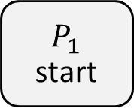
State-Transition Graph for a Solo Program $P_{1}$
$P_{1}$ requirements
$$P_{1}$$
start
Block | Param | Core 1 | Core 2
Block 1 | Time | 5 | 4
 | Energy | 6 | 10
Block 2 | Time | 3 | 2
 | Energy | 3 | 7
Block 3 | Time | 2 | 2
 | Energy | 3 | 6
CPU_WAKEUP
CPU_WAKEUP
$$δ$$
$$δ$$
Core 1
Block 1
Time 5
Energy 6
0
Core 2
Block 1
Time 4
Energy 10
0
5
MIGR
4
$$δ$$
MIGR
$$δ$$
Core 1
Block 2
Time 3
Energy 3
5
Core 2
Block 2
Time 2
Energy 7
5
Core 1
Block 2
Time 3
Energy 3
4
Core 2
Block 2
Time 2
Energy 7
4
8
7
7
6
MIGR
…
…
MIGR
$$δ$$
$$δ$$
Core 1
Block 3
Time 2
Energy 3
8
Core 2
Block 3
Time 2
Energy 6
8
Core 1
Block 3
Time 2
Energy 3
6
Core 2
Block 3
Time 2
Energy 6
6
Minimized RT: 8
High energy use: 20
10
10
8
8

Slide 10

State-Transition Graph for a Solo Program $P_{1}$
$P_{1}$ requirements
$$P_{1}$$
start
Block | Param | Core 1 | Core 2
Block 1 | Time | 5 | 4
 | Energy | 6 | 10
Block 2 | Time | 3 | 2
 | Energy | 3 | 7
Block 3 | Time | 2 | 2
 | Energy | 3 | 6
CPU_WAKEUP
CPU_WAKEUP
$$δ$$
$$δ$$
Core 1
Block 1
Time 5
Energy 6
0
Core 2
Block 1
Time 4
Energy 10
0
5
MIGR
4
$$δ$$
MIGR
$$δ$$
Core 1
Block 2
Time 3
Energy 3
5
Core 2
Block 2
Time 2
Energy 7
5
Core 1
Block 2
Time 3
Energy 3
4
Core 2
Block 2
Time 2
Energy 7
4
8
7
7
6
MIGR
…
…
MIGR
$$δ$$
$$δ$$
Core 1
Block 3
Time 2
Energy 3
8
Core 2
Block 3
Time 2
Energy 6
8
Core 1
Block 3
Time 2
Energy 3
6
Core 2
Block 3
Time 2
Energy 6
6
High RT: 10
Min. Energy: 12
RT: 8
Energy: 20
10
10
8
8

Slide 11









Merged State-Transition Graph of Programs $P_{1}$ and $P_{2}$
$P_{1}$ arrives
CPU_WAKEUP
CPU_WAKEUP
$$δ$$
$$δ$$
Core 1
P1 B1
Time 5
Energy 6
Core 2
Idle
0
Core 1
Idle
Core 2
P1 B1
Time 4 Energy 10
0
$P_{2}$ arrives
5
4
CPU_WAKEUP
CPU_WAKEUP
…
CPU_WAKEUP
$$δ$$
$$δ$$
$$δ$$
Core 1
P1 B2
Time 3
Energy 3
Core 2
Idle
5
Core 1
Idle
Core 2
P1 B2
Time 2 Energy 7
5
Core 1
Idle
Core 2
P1 B2
Time 2 Energy 7
4
8
7
6
…
…
MIGRATION
MIGRATION
$$δ$$
$$δ$$
Core 1
P1 B3
Time 2
Energy 3
Core 2
Idle
7
Core 1
Idle
Core 2
P1 B3
Time 2 Energy 6
7
Core 1
P1 B3
Time 2
Energy 3
Core 2
Idle
6
9
9
8
Notes:
Make deltas less in fonts

Slide 12


Merged State-Transition Graph of Programs $P_{1}$ and $P_{2}$
$P_{1}$ arrives
CPU_WAKEUP
CPU_WAKEUP
$$δ$$
$$δ$$
Core 1
P1 B1
Time 5
Energy 6
Core 2
Idle
0
Core 1
Idle
Core 2
P1 B1
Time 4 Energy 10
0
$P_{2}$ arrives
5*
4*
CPU_WAKEUP
CPU_WAKEUP
…
CPU_WAKEUP
$$δ$$
$$δ$$
$$δ$$
Core 1
P1 B2
Time 3
Energy 3
Core 2
P2 B1
Time 3 Energy 0
5
Core 1
P2 B1
Time 7
Energy 3
Core 2
P1 B2
Time 2 Energy 7
5
Core 1
P2 B1
Time 7
Energy 3
Core 2
P1 B2
Time 2 Energy 7
4
8
12
11
…
…
MIGRATION
MIGRATION
$$δ$$
$$δ$$
Core 1
P1 B3
Time 2
Energy 3
Core 2
P2 B2
Time 2 Energy 5
12
Core 1
P2 B2
Time 3
Energy 3
Core 2
P1 B3
Time 2 Energy 6
12
Core 1
P1 B3
Time 2
Energy 3
Core 2
P2 B2
Time 2 Energy 5
11
14
15
13

Slide 13
Merged State-Transition Graph of Programs $P_{1}$ and $P_{2}$
$P_{1}$ arrives
CPU_WAKEUP
CPU_WAKEUP
$$δ$$
$$δ$$
Core 1
P1 B1
Time 5
Energy 6
Core 2
Idle
Time 0 Energy 0
0
Core 1
Idle
Time 0
Energy 0
Core 2
P1 B1
Time 4 Energy 10
0
$P_{2}$ arrives
5
4
CPU_WAKEUP
CPU_WAKEUP
…
CPU_WAKEUP
$$δ$$
$$δ$$
$$δ$$
Core 1
P1 B2
Time 3
Energy 3
Core 2
P2 B1
Time 3 Energy 0
5
Core 1
P2 B1
Time 7
Energy 3
Core 2
P1 B2
Time 2 Energy 7
5
Core 1
P2 B1
Time 7
Energy 3
Core 2
P1 B2
Time 2 Energy 7
4
8
12
11
…
…
MIGRATION
MIGRATION
$$δ$$
$$δ$$
Core 1
P1 B3
Time 2
Energy 3
Core 2
P2 B2
Time 2 Energy 5
12
Core 1
P2 B2
Time 3
Energy 3
Core 2
P1 B3
Time 2 Energy 6
12
Core 1
P1 B3
Time 2
Energy 3
Core 2
P2 B2
Time 2 Energy 5
11
Avg. RT: 11
Energy: 28
14
15
13
Notes:
Make red line outside the graph, not from inside

Slide 14
Merged State-Transition Graph of Programs $P_{1}$ and $P_{2}$
$P_{1}$ arrives
CPU_WAKEUP
CPU_WAKEUP
$$δ$$
$$δ$$
Core 1
P1 B1
Time 5
Energy 6
Core 2
Idle
Time 0 Energy 0
0
Core 1
Idle
Time 0
Energy 0
Core 2
P1 B1
Time 4 Energy 10
0
$P_{2}$ arrives
5
4
CPU_WAKEUP
CPU_WAKEUP
…
CPU_WAKEUP
$$δ$$
$$δ$$
$$δ$$
Core 1
P1 B2
Time 3
Energy 3
Core 2
P2 B1
Time 3 Energy 0
5
Core 1
P2 B1
Time 7
Energy 3
Core 2
P1 B2
Time 2 Energy 7
5
Core 1
P2 B1
Time 7
Energy 3
Core 2
P1 B2
Time 2 Energy 7
4
8
12
11
…
…
MIGRATION
MIGRATION
$$δ$$
$$δ$$
Core 1
P1 B3
Time 2
Energy 3
Core 2
P2 B2
Time 2 Energy 5
12
Core 1
P2 B2
Time 3
Energy 3
Core 2
P1 B3
Time 2 Energy 6
12
Core 1
P1 B3
Time 2
Energy 3
Core 2
P2 B2
Time 2 Energy 5
11
Avg. RT: 13 vs 11
Energy: 24 vs 28
14
15
13
Notes:
Add previous line gray

Slide 15
Status: Ongoing Thesis Work
State-Transition Graph is an appropriate starting point for deriving optimal and suboptimal scheduling techniques;
Potential pruning rules allow to control the analysis runtime making it more tractable for large systems;
This methodology triggered a potential collaboration with Huawei but for now the submitted research proposal to the CSTT grant committee was not approved.
Notes:
Background as on the title page

Slide 16








Examples of Heterogeneous Schedules
big
Core
LITTLE
Core
Objective: minimized average Response Time for programs
L2 Cache
Prog. | RT
A | 7
B | 9
Schedule 1: Worse Average RT
Oversimplified ARM big.LITTLE
big
Prog. $B$
Prog. $A$
LITTLE
Prog. $A$
Prog. $B$
0
2
4
6
8
t
Schedule 2: Better Average RT
Prog. | RT
A | 7
B | 6
big
Prog. $A$
Prog. $B$
LITTLE
Prog. $B$
Prog. $A$
(cores)
Notes:
Schedule larger, big.LITTLE smaller, increase gap between S1 and S2, increase focus of tables, thickness of outside borders == inside

Slide 17



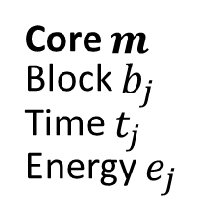
State-Transition Graph: Solo Program Execution
$$P_{1}$$
start
Notation
CPU_WAKEUP
OVERHEAD_TYPE
$$δ$$
$$δ$$
START
Core 1
Block 1
Time 5
Energy 6
0
Core $m$
Block $b_{j}$
Time $t_{j}$
Energy $e_{j}$
$$t_{j}$$
Required
execution
time and
energy use
END
5
$$t_{j}$$
…
…

Slide 18

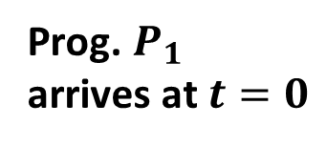

State-Transition Graph of Programs $P_{1}$
Prog. $P_{1}$
arrives at $t=0$
CPU_WAKEUP
CPU_WAKEUP
$$δ$$
$$δ$$
Core 1
P1 B1
Time 5
Energy 6
Core 2
Idle
0
Core 1
Idle
Core 2
P1 B1
Time 4 Energy 10
0
5
4
…
…

Slide 19





State-Transition Graph of Programs $P_{1}$
Prog. $P_{1}$
arrives at $t=0$
CPU_WAKEUP
CPU_WAKEUP
$$δ$$
$$δ$$
Core 1
P1 B1
Time 5
Energy 6
Core 2
Idle
Time 0 Energy 0
0
Core 1
Idle
Time 0
Energy 0
Core 2
P1 B1
Time 4 Energy 10
0
5
4
CPU_WAKEUP
CPU_WAKEUP
…
CPU_WAKEUP
$$δ$$
$$δ$$
$$δ$$
Core 1
P1 B2
Time 3
Energy 3
Core 2
Idle
Time 0 Energy 0
5
Core 1
Idle
Time 0 Energy 0
Core 2
P1 B2
Time 2 Energy 7
5
Core 1
Idle
Time 0 Energy 0
Core 2
P1 B2
Time 2 Energy 7
4
8
7
6
…
…
MIGRATION
MIGRATION
$$δ$$
$$δ$$
Core 1
P1 B3
Time 2
Energy 3
Core 2
Idle
Time 0 Energy 0
7
Core 1
Idle
Time 0 Energy 0
Core 2
P1 B3
Time 2 Energy 6
7
Core 1
P1 B3
Time 2
Energy 3
Core 2
Idle
Time 0 Energy 0
6
9
9
8

Slide 20

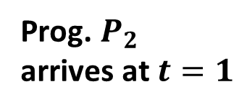
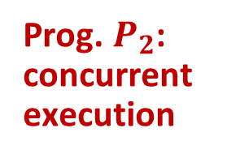
Merged State-Transition Graph of Programs $P_{1}$ and $P_{2}$
Prog. $P_{1}$
arrives at $t=0$
$P_{2}$ requirements
Bi | t/e | Core 1 | Core 2
B1 | t | 7 | 3
 | e | 3 | 5
B2 | t | 3 | 2
 | e | 3 | 5
CPU_WAKEUP
CPU_WAKEUP
$$δ$$
$$δ$$
Prog. $P_{2}$
arrives at $t=1$
Core 1
P1 B1
Time 5
Energy 6
Core 2
Idle
Time 0 Energy 0
0
Core 1
Idle
Time 0
Energy 0
Core 2
P1 B1
Time 4 Energy 10
0
5*
4*
CPU_WAKEUP
CPU_WAKEUP
…
CPU_WAKEUP
$$δ$$
$$δ$$
$$δ$$
Core 1
P1 B2
Time 3
Energy 3
Core 2
P2 B1
Time 3 Energy 0
5
Core 1
P2 B1
Time 7
Energy 3
Core 2
P1 B2
Time 2 Energy 7
5
Core 1
P2 B1
Time 7
Energy 3
Core 2
P1 B2
Time 2 Energy 7
4
Prog. $P_{2}$: concurrent execution
8
12
11
…
…
MIGRATION
MIGRATION
$$δ$$
$$δ$$
Core 1
P1 B3
Time 2
Energy 3
Core 2
P2 B2
Time 2 Energy 5
12
Core 1
P2 B2
Time 3
Energy 3
Core 2
P1 B3
Time 2 Energy 6
12
Core 1
P1 B3
Time 2
Energy 3
Core 2
P2 B2
Time 2 Energy 5
11
14
15
13
* Assumption: Schedule decision is triggered either on block start or its completion

Slide 21
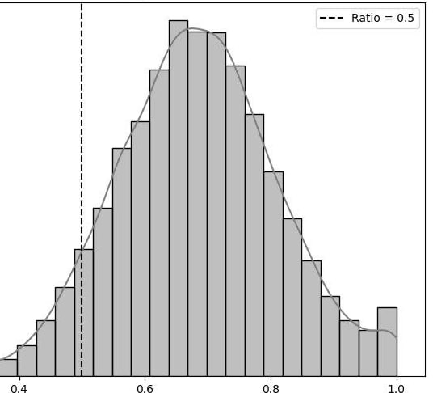

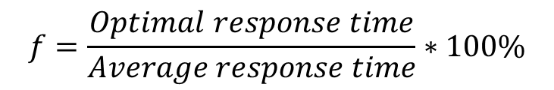

Conclusion and Potential Improvements
$$f=\frac{Optimal response time}{Average response time}∗100\%$$
State-Transition Graph is a flexible way to model execution;
It provides optimal schedule decisions;
Optimal response time is 30% less than average response time in median case;
Future Work: Improving performance by pruning graph states
$$f=50\%$$
2 4 6 8 10
Probability, %
$$f=$$
40 60 80 100
Optimal to Average Schedule Response Time, %

