Slide 1

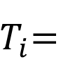

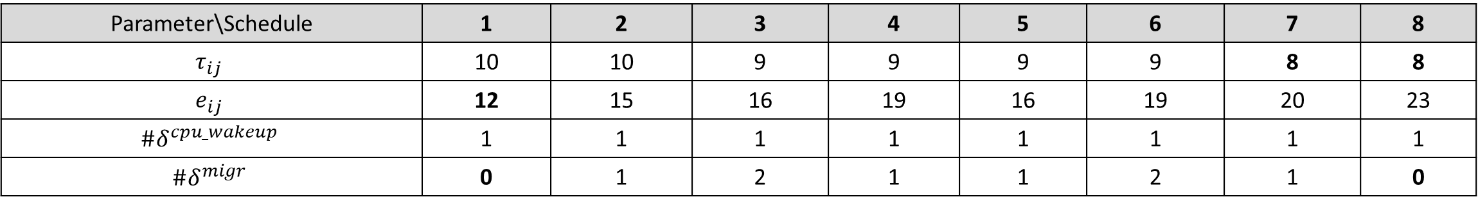



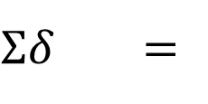




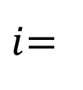


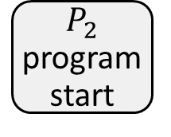

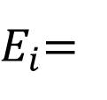
Notation
OVERHEAD_TYPE
$$δ$$
START
$$P_{2}$$
program start
Core $m_{j}$
Block $b_{j}$
Time $t_{j}$
Energy $e_{j}$
$$t_{j}$$
END
CPU_WAKEUP
CPU_WAKEUP
$$t_{j}$$
$$δ$$
$$δ$$
…
Core 1
Block 1
Time 5
Energy 6
0
Core 2
Block 1
Time 4
Energy 10
0
5
MIGR
MIGR
4
$$δ$$
$$δ$$
Core 1
Block 2
Time 3
Energy 3
5
Core 2
Block 2
Time 2
Energy 7
5
Core 1
Block 2
Time 3
Energy 3
4
Core 2
Block 2
Time 2
Energy 7
4
8
MIGR
MIGR
7
7
MIGR
MIGR
6
$$δ$$
$$δ$$
$$δ$$
$$δ$$
Core 1
Block 3
Time 2
Energy 3
8
Core 2
Block 3
Time 2
Energy 6
8
Core 1
Block 3
Time 2
Energy 3
7
Core 2
Block 3
Time 2
Energy 6
7
Core 1
Block 3
Time 2
Energy 3
7
Core 2
Block 3
Time 2
Energy 6
7
Core 1
Block 3
Time 2
Energy 3
6
Core 2
Block 3
Time 2
Energy 6
6
$i$=
1
10
2
10
3
9
4
9
5
9
6
9
7
8
8
8
$T_{i}$=
10
10
9
9
9
9
8
8
$E_{i}$=
12
15
16
19
16
19
20
23
MIGR
0
$Σδ$ =
0
1
2
1
1
2
1
Schedules
Minimum values
Parameter\Schedule | 1 | 2 | 3 | 4 | 5 | 6 | 7 | 8
$$τ_{ij}$$ | 10 | 10 | 9 | 9 | 9 | 9 | 8 | 8
$$e_{ij}$$ | 12 | 15 | 16 | 19 | 16 | 19 | 20 | 23
$$\#δ^{cpu_wakeup}$$ | 1 | 1 | 1 | 1 | 1 | 1 | 1 | 1
$$\#δ^{migr}$$ | 0 | 1 | 2 | 1 | 1 | 2 | 1 | 0
Minimum in a row
Minimum in a row

Slide 2

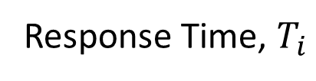

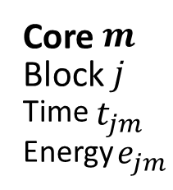
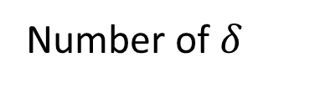
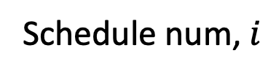

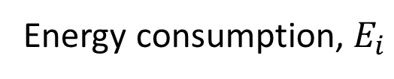
Notation
$$P_{2}$$
program start
OVERHEAD_TYPE
$$δ$$
CPU_WAKEUP
CPU_WAKEUP
START
$$δ$$
$$δ$$
Core $m$
Block $j$
Time $t_{jm}$
Energy $e_{jm}$
$$t$$
0
END
Core 1
Block 1
Time 5
Energy 6
Core 2
Block 1
Time 4
Energy 10
0
…
$$t$$
5
4
MIGR
MIGR
$$δ$$
$$δ$$
Core 1
Block 2
Time 3
Energy 3
5
Core 2
Block 2
Time 2
Energy 7
5
Core 1
Block 2
Time 3
Energy 3
4
Core 2
Block 2
Time 2
Energy 7
4
8
MIGR
MIGR
7
7
MIGR
MIGR
6
$$δ$$
$$δ$$
$$δ$$
$$δ$$
Core 1
Block 3
Time 2
Energy 3
8
Core 2
Block 3
Time 2
Energy 6
8
Core 1
Block 3
Time 2
Energy 3
7
Core 2
Block 3
Time 2
Energy 6
7
Core 1
Block 3
Time 2
Energy 3
7
Core 2
Block 3
Time 2
Energy 6
7
Core 1
Block 3
Time 2
Energy 3
6
Core 2
Block 3
Time 2
Energy 6
6
10
10
9
9
9
9
8
8
Schedule num, $i$
1
2
3
4
5
6
7
8
MIGR
0
1
2
1
1
2
0
Number of $δ$
1
Response Time, $T_{i}$
10
10
9
9
9
9
8
8
Energy consumption, $E_{i}$
12
15
16
19
16
19
20
23
Minimum values
Parameter\Schedule | 1 | 2 | 3 | 4 | 5 | 6 | 7 | 8
$$τ_{ij}$$ | 10 | 10 | 9 | 9 | 9 | 9 | 8 | 8
$$e_{ij}$$ | 12 | 15 | 16 | 19 | 16 | 19 | 20 | 23
$$\#δ^{cpu_wakeup}$$ | 1 | 1 | 1 | 1 | 1 | 1 | 1 | 1
$$\#δ^{migr}$$ | 0 | 1 | 2 | 1 | 1 | 2 | 1 | 0
Minimum in a row
Minimum in a row

Slide 3
Core 1 Block 2
Core 1 Block 1
Core 2 Block 2
Program 1
0
1
2
3
4
5
6
7
MAX
MIN
8
9
Core 2 Block 2
Core 2 Block 1
Core 1 Block 2

Slide 4
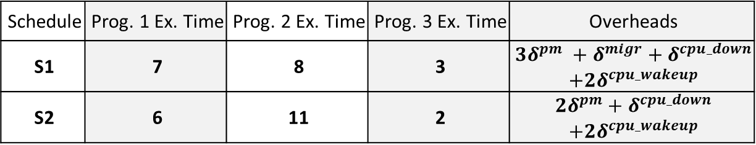
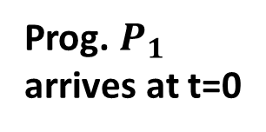
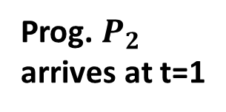
Prog. $P_{1}$
arrives at t=0
CPU_WAKEUP
CPU_WAKEUP
$$δ$$
0
Core 1
Idle | 24+500
Time: | 0
$$δ$$
0
Prog. $P_{2}$
arrives at t=1
Core 1
P1B1 | 24+500
Time: | 4
Core 2
Idle | 1.5 GHz
Time: | 0
Core 2
P1B1 | 1.5 GHz
Time: | 3
1
1
CPU_WAKEUP
CPU_WAKEUP
Core 1
P1B1 | 24+500
Time: | 3
$$δ$$
1
$$δ$$
Core 1
P2B1 | 24+500
Time: | 2
Core 2
P1B1 | 1.5 GHz
Time: | 2
1
Core 2
P2B1 | 1.5 GHz
Time: | 4
4
PM
3
PM
$$δ$$
…
Core 1
Idle | 1.5 GHz
Time: | 0
$$δ$$
7
Core 1
P2B2 | 24+500
Time: | 3
Core 2
P1B2 | 1.5 GHz
Time: | 2
6
…
Core 2
P1B2 | 1.5 GHz
Time: | 1
PM
8
CPU_DOWN
8
P1 ends
$$δ$$
8
$$δ$$
8
Core 1
Idle | 1.5 GHz
Time: | 0
Core 2
P2B2,3 | 1.5 GHz
Time: | 4
Core 1
P2B2,3 | 24+500
Time: | 4
Core 2
Idle | 1.5 GHz
Time: | 0
12
P2 ends
12
P2 ends
Schedule S1
Schedule S2
Summary
Schedule | Prog. 1 Ex. Time | Prog. 2 Ex. Time | Prog. 3 Ex. Time | Overheads
S1 | 7 | 8 | 3 | $${3δ}^{pm} +δ^{migr}+δ^{cpu_down}$$ $$+{2δ}^{cpu_wakeup}$$
S2 | 6 | 11 | 2 | $${2δ}^{pm}+δ^{cpu_down}$$ $$+{2δ}^{cpu_wakeup}$$

Slide 5




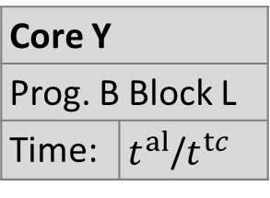





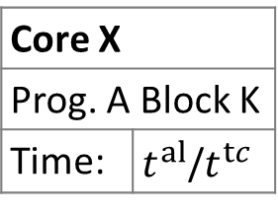


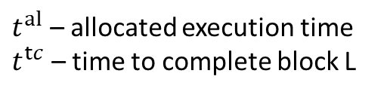






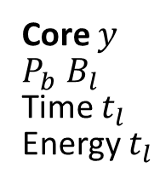









Non-Preemptive Scheduling Case
Programs arrivals
$P_{1}$at $t=0$
CPU_WAKEUP
CPU_WAKEUP
$$δ$$
0
$$δ$$
0
Core 1
P1 B1
Time 4
Energy 8
Core 2
Idle
Core 1
Idle
Core 2
P1 B1
Time 3
Energy 9
$P_{2}$at $t=1$
1
CPU_WAKEUP
1
CPU_WAKEUP
$$δ$$
Core 1
P1 B1
Time 3
Energy 6
$$δ$$
1
Core 1
P2 B1
Time 5
Energy 6
Core 2
P1 B1
Time 2
Energy 6
1
$P_{3}$at $t=3$
Core 2
P2 B1
Time 4
Energy 10
4
PM
3
PM
$$δ$$
Core 1
P1 B2
Time 5
Energy 3
4
Core 1
P3 B1
Time 3
Energy 6
$$δ$$
4
Core 1
P2 B1
Time 3
Energy 4
3
Core 2
P2 B1
Time 1
Energy 3
Core 2
P2 B1
Time 1
Energy 3
Core 2
P3 B1
Time 2
Energy 7
Core 1
P2 B1
Time 3
Energy 2
Core 2
P1 B2
Time 3
Energy 4
3
…
5
MIGR
5
PM
5
6
$$δ +$$
PM
$$δ$$
P3 ends
Core 1
P3 B1
Time 2
Energy 4
Core 2
P2 B2
Time 2
Energy 7
5
$$δ$$
5
…
Core 1
P3 B1
Time 2
Energy 4
Core 2
P1 B2
Time 3
Energy 4
5
Core 1
P2 B1
Time 1
Energy 1
Core 2
P1 B2
Time 3
Energy 4
Notation
General state representation:
OVERHEAD_TYPE
Allocated core to Program A
Block of Prog. B
executed on Core Y
$P_{3}$ ends
7
7
6
$$δ$$
$P_{3}$ ends
CPU_DOWN
START
…
Core 1
Idle
$$δ$$
7
Core 1
P2 B2
Time 3
Energy 3
6
Core $x$
$P_{a} B_{k}$
Time $t_{k}$
Energy $t_{k}$
Core $y$
$P_{b} B_{l}$
Time $t_{l}$
Energy $t_{l}$
$$t$$
Core X
Prog. A Block K | 24+500
Time: | $t^{al}$/$t^{tc}$
Core Y
Prog. B Block L | 1.5 GHz
Time: | $t^{al}$/$t^{tc}$
$$t^{start}$$
Execution time slice
relative to a system start
Core 2
P1 B2
Time 1
Energy 1
Core 2
P1 B2
Time 2
Energy 3
END
PM
$P_{1}$ ends
8
CPU_DOWN
$P_{1}$ ends
8
…
$$t$$
$$t^{end}$$
$$δ$$
8
$$δ$$
8
Core 1
Idle
Core 1
P2 B2,3
Time 4
Energy 13
Core 1
P2 B2,3
Time 4
Energy 4
Core 2
Idle
Individual programs states
$t^{al}$ – allocated execution time
$t^{tc}$ – time to complete block L
$P_{2}$ ends
12
$P_{2}$ ends
12
Schedule S1
Schedule S2
Energy is scaled by time
For example, if parent state requires 3 energy and 5 time, allocates 4 units of time. Then, remaining energy requirement will be 1/5 * 3 = 1 rounded

Slide 6




Non-Preemptive Scheduling Case
Programs arrivals
$P_{1}$at $t=0$
Greedy Energy consumption
Random walk
CPU_WAKEUP
CPU_WAKEUP
$$δ$$
0
$$δ$$
0
Core 1
P1 B1
Time 4
Energy 8
Core 2
Idle
Core 1
Idle
Core 2
P1 B1
Time 3
Energy 9
$P_{2}$at $t=1$
1
CPU_WAKEUP
1
CPU_WAKEUP
$$δ$$
Core 1
P1 B1
Time 3
Energy 6
$$δ$$
1
Energy
currently
used: 16
Core 1
P2 B1
Time 5
Energy 6
Core 2
P1 B1
Time 2
Energy 6
1
$P_{3}$at $t=3$
Core 2
P2 B1
Time 4
Energy 10
4
PM
3
PM
$$δ$$
Energy currently
used: 6
4
$$δ$$
4
Energy
currently
used: 9
Core 1
P1 B2
Time 5
Energy 3
Core 2
P2 B1
Time 1
Energy 3
Core 1
P3 B1
Time 3
Energy 6
Core 2
P2 B1
Time 1
Energy 3
Core 1
P2 B1
Time 3
Energy 4
Core 2
P3 B1
Time 2
Energy 7
3
Core 1
P2 B1
Time 3
Energy 2
Core 2
P1 B2
Time 3
Energy 4
3
…
5
MIGR
5
5
6
$$δ +$$
PM
PM
Core 1
P3 B1
Time 2
Energy 4
Core 2
P2 B2
Time 2
Energy 7
5
…
$$δ$$
$$δ$$
P3 ends
…
PM
$P_{1}$ ends
CPU_DOWN
…
General state representation:
7
$$δ$$
8
$$δ$$
$P_{1}$ ends
Allocated core to Program A
Block of Prog. B
executed on Core Y
$P_{3}$ ends
…
Core 1
Idle
Core 1
P2 B2,3
Time 4
Energy 13
Core 1
P2 B2,3
Time 4
Energy 4
Core 2
Idle
8
$$t^{start}$$
Execution time slice
relative to a system start
$P_{2}$ ends
12
$P_{2}$ ends
12
Core X
Prog. A Block K | 24+500
Time: | $t^{al}$/$t^{tc}$
Core Y
Prog. B Block L | 1.5 GHz
Time: | $t^{al}$/$t^{tc}$
$$t^{end}$$
Individual programs states
$t^{al}$ – allocated execution time
$t^{tc}$ – time to complete block L
Energy is scaled by time
For example, if parent state requires 3 energy and 5 time, allocates 4 units of time. Then, remaining energy requirement will be 1/5 * 3 = 1 rounded

Slide 7
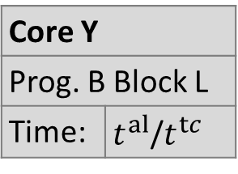

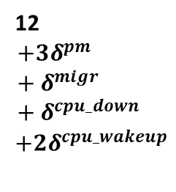

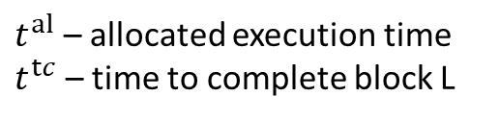

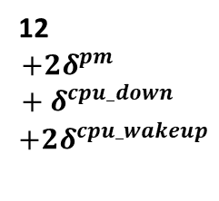

Non-Preemptive Scheduling Case
Prog. P1 arrives at t=0
CPU_WAKEUP
CPU_WAKEUP
$$δ$$
0
Core 1
Idle | 24+500
Time: | 0
$$δ$$
0
Core 1
P1B1 | 24+500
Time: | 4
Core 2
Idle | 1.5 GHz
Time: | 0
Core 2
P1B1 | 1.5 GHz
Time: | 3
Prog. P2 arrives at t=1
1
CPU_WAKEUP
1
CPU_WAKEUP
$$δ$$
Core 1
P1B1 | 24+500
Time: | 3
$$δ$$
1
Core 1
P2B1 | 24+500
Time: | 2
Core 2
P1B1 | 1.5 GHz
Time: | 2
1
Prog. P3 arrives at t=3
Core 2
P2B1 | 1.5 GHz
Time: | 4
3
PM
4
PM
4
Core 1
P3B1 | 1.5 GHz
Time: | 1/3
$$δ$$
4
$$δ$$
3
3
Core 1
P1B2 | 24+500
Time: | 1
Core 2
P2B1 | 1.5 GHz
Time: | 1
Core 2
P2B1 | 1.5 GHz
Time: | 1/1
Core 1
P2B1 | 24+500
Time: | 3
Core 2
P3B1 | 1.5 GHz
Time: | 2
Core 1
P2B1 | 24+500
Time: | 3
Core 2
P1B2 | 1.5 GHz
Time: | 2
…
5
MIGR
5
PM
5
5
$$δ +$$
PM
$$δ$$
P3 ends
…
5
Core 1
P3B1 | 1.5 GHz
Time: | 2
$$δ$$
5
Core 1
P2B1 | 24+500
Time: | 1
Core 2
P1B2 | 1.5 GHz
Time: | 3
5
Core 1
P3B1 | 24+500
Time: | 2
Core 2
P2B2 | 1.5 GHz
Time: | 2
Core 2
P1B2 | 1.5 GHz
Time: | 3
General state representation:
…
7
P3 ends
7
6
Allocated core to Program A
Block of Prog. B
executed on Core Y
CPU_DOWN
Core 1
Idle | 1.5 GHz
Time: | 0
$$δ$$
7
Core 1
P2B2 | 24+500
Time: | 3
Core 2
P1B2 | 1.5 GHz
Time: | 2
6
Core X
Prog. A Block K | 24+500
Time: | $t^{al}$/$t^{tc}$
Core Y
Prog. B Block L | 1.5 GHz
Time: | $t^{al}$/$t^{tc}$
$$t^{start}$$
Execution time slice
relative to a system start
Core 2
P1B2 | 1.5 GHz
Time: | 1
PM
8
8
$$t^{end}$$
$$δ$$
P1 ends
CPU_DOWN
P1 ends
8
$$δ$$
8
Core 1
Idle | 1.5 GHz
Time: | 0
Core 2
P2B2,3 | 1.5 GHz
Time: | 4
Core 1
P2B2,3 | 24+500
Time: | 4
Core 2
Idle | 1.5 GHz
Time: | 0
Individual programs states
$t^{al}$ – allocated execution time
$t^{tc}$ – time to complete block L
12
$$+{3δ}^{pm}+δ^{migr}+δ^{cpu_down}$$
$$+{2δ}^{cpu_wakeup}$$
P2 ends
12
$$+{2δ}^{pm}+δ^{cpu_down}$$
$$+{2δ}^{cpu_wakeup}$$
P2 ends
Schedule S1
Schedule S2
Summary
Schedule | Prog. 1 Ex. Time | Prog. 2 Ex. Time | Prog. 3 Ex. Time | Overheads
S1 | 7 | 8 | 3 | $${3δ}^{pm} +δ^{migr}+δ^{cpu_down}$$ $$+{2δ}^{cpu_wakeup}$$
S2 | 6 | 11 | 2 | $${2δ}^{pm}+δ^{cpu_down}$$ $$+{2δ}^{cpu_wakeup}$$

Slide 8
Non-Preemptive Scheduling Case
Program P1
t=0
Core 1
P1B1 | 24+500
Time: | 1/4
Core 2
Idle | 1.5 GHz
Time: | 0
0
Program P2
t=1
Core 1
Idle | 24+500
Time: | 0
Core 2
P1B1 | 1.5 GHz
Time: | 1/3
0
1
1
Core 1
P1B1 | 24+500
Time: | 3/3
Core 2
P2B1 | 1.5 GHz
Time: | 3/4
1
Program P3
t=3
Core 1
P2B1 | 24+500
Time: | 2/5
Core 2
P1B1 | 1.5 GHz
Time: | 2/2
1
4
3
Core 1
P1B2 | 24+500
Time: | 1/5
Core 2
P2B1 | 1.5 GHz
Time: | 1/1
4
Core 1
P3B1 | 1.5 GHz
Time: | 1/3
Core 2
P2B1 | 1.5 GHz
Time: | 1/1
4
Core 1
P2B1 | 24+500
Time: | 2/3
Core 2
P3B1 | 1.5 GHz
Time: | 2/2
3
Core 1
P2B1 | 24+500
Time: | 2/3
Core 2
P2B2 | 1.5 GHz
Time: | 2/2
3
…
5
5
5
…
5
Core 1
P3B1 | 24+500
Time: | 2/2
Core 2
P2B2 | 1.5 GHz
Time: | 2/2
5
Core 1
P3B1 | 1.5 GHz
Time: | 2/2
Core 2
P1B2 | 1.5 GHz
Time: | 2/3
5
Core 1
P2B1 | 24+500
Time: | 1/1
Core 2
P1B2 | 1.5 GHz
Time: | 1/3
5
General state representation:
…
7
7
6
Allocated core to program A
Executed block on Core Y
Core 1
Idle | 1.5 GHz
Time: | 0
Core 2
P1B2 | 1.5 GHz
Time: | 1/1
7
Core 1
P2B2 | 24+500
Time: | 2/3
Core 2
P1B2 | 1.5 GHz
Time: | 2/2
6
Core X
Prog. A Block K | 24+500
Time: | $t^{al}$/$t^{tc}$
Core Y
Prog. B Block L | 1.5 GHz
Time: | $t^{al}$/$t^{tc}$
$$t^{start}$$
Execution timeslice
relative to the first program arrival
8
8
$$t^{end}$$
Core 1
Idle | 1.5 GHz
Time: | 0
Core 2
P2B2,3 | 1.5 GHz
Time: | 4/4
8
Core 1
P2B2,3 | 24+500
Time: | 4/4
Core 2
Idle | 1.5 GHz
Time: | 0
8
Individual programs states
$t^{al}$ – allocated execution time
$t^{tc}$ – time to complete block L
Schedule S1
12
Schedule S2
12
Summary
Schedule | Prog. 1 Ex. Time | Prog. 2 Ex. Time | Prog. 3 Ex. Time
S1 | 7 | 8 | 3
S2 | 6 | 11 | 2

Slide 9


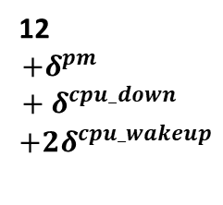
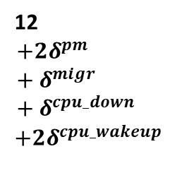








Non-Preemptive Scheduling Case
Program P1
t=0
$$δ^{cpu_wakeup}$$
$$δ^{cpu_wakeup}$$
Core 1
P1B1 | 24+500
Time: | 1/4
Core 2
Idle | 1.5 GHz
Time: | 0
0
Prog. P2
t=1
Core 1
Idle | 24+500
Time: | 0
Core 2
P1B1 | 1.5 GHz
Time: | 1/3
0
1
$$δ^{cpu_wakeup}$$
1
$$δ^{cpu_wakeup}$$
Prog. P3
t=3
Core 1
P2B1 | 24+500
Time: | 2/5
Core 2
P1B1 | 1.5 GHz
Time: | 2/2
1
Core 1
P1B1 | 24+500
Time: | 3/3
Core 2
P2B1 | 1.5 GHz
Time: | 3/4
1
4
3
4
Core 1
P3B1 | 1.5 GHz
Time: | 1/3
$$δ^{pm}$$
4
$$δ^{pm}$$
3
3
Core 1
P1B2 | 24+500
Time: | 1/5
Core 2
P2B1 | 1.5 GHz
Time: | 1/1
Core 2
P2B1 | 1.5 GHz
Time: | 1/1
Core 1
P2B1 | 24+500
Time: | 2/3
Core 2
P3B1 | 1.5 GHz
Time: | 2/2
Core 1
P2B1 | 24+500
Time: | 2/3
Core 2
P1B2 | 1.5 GHz
Time: | 2/2
…
5
5
5
5
$$δ^{migr}+δ^{pm}$$
P3 ends
…
Core 1
P3B1 | 24+500
Time: | 2/2
Core 2
P2B2 | 1.5 GHz
Time: | 2/2
5
Core 1
P3B1 | 1.5 GHz
Time: | 2/2
Core 2
P1B2 | 1.5 GHz
Time: | 2/3
5
Core 1
P2B1 | 24+500
Time: | 1/1
Core 2
P1B2 | 1.5 GHz
Time: | 1/3
5
General state representation:
…
7
P3 ends
7
6
Allocated core to Program A
Block of Prog. B
executed on Core Y
$$δ^{cpu_down}$$
6
$$t^{start}$$
Execution time slice
relative to a system start
Core 1
Idle | 1.5 GHz
Time: | 0
Core 2
P1B2 | 1.5 GHz
Time: | 1/1
7
Core 1
P2B2 | 24+500
Time: | 2/3
Core 2
P1B2 | 1.5 GHz
Time: | 2/2
Core X
Prog. A Block K | 24+500
Time: | $t^{al}$/$t^{tc}$
Core Y
Prog. B Block L | 1.5 GHz
Time: | $t^{al}$/$t^{tc}$
8
8
$$t^{end}$$
P1 ends
$$δ^{cpu_down}$$
P1 ends
Core 1
Idle | 1.5 GHz
Time: | 0
Core 2
P2B2,3 | 1.5 GHz
Time: | 4/4
8
Core 1
P2B2,3 | 24+500
Time: | 4/4
Core 2
Idle | 1.5 GHz
Time: | 0
8
Individual programs states
$t^{al}$ – allocated execution time
$t^{tc}$ – time to complete block L
12
$$+{2δ}^{pm}+δ^{migr}+δ^{cpu_down}$$
$$+{2δ}^{cpu_wakeup}$$
P2 ends
12
$$+δ^{pm}+δ^{cpu_down}$$
$$+{2δ}^{cpu_wakeup}$$
P2 ends
Schedule S1
Schedule S2
Summary
Schedule | Prog. 1 Ex. Time | Prog. 2 Ex. Time | Prog. 3 Ex. Time | Overheads
S1 | 7 | 8 | 3 | $${2δ}^{pm} +δ^{migr}+δ^{cpu_down}$$ $$+{2δ}^{cpu_wakeup}$$
S2 | 6 | 11 | 2 | $$δ^{pm}+δ^{cpu_down}$$ $$+{2δ}^{cpu_wakeup}$$

Slide 10













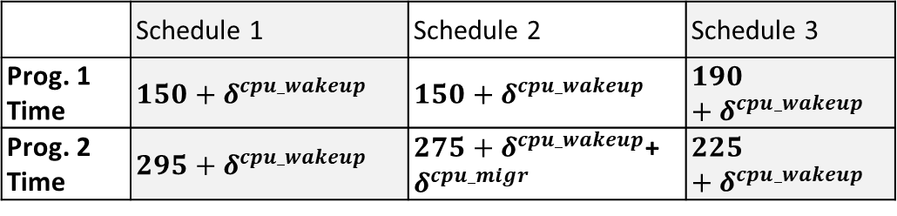













Non-Preemptive Scheduling Case
Program 1
Program 2
$$δ^{cpu_wakeup}$$
$$δ^{cpu_wakeup}$$
$$δ^{cpu_wakeup}$$
$$δ^{cpu_wakeup}$$
0+$δ^{∗}$
Config. 1
Prog. 1 Block 1 | 24+500
Time: | 100/100
Config. 2
Prog. 2 Block 1 | 1.5 GHz
Time: | 100/200
0+$δ^{∗}$
Config. 1
Prog. 2 Block 1 | 24+500
Time: | 130/150
Config. 2
Prog. 1 Block 1 | 1.5 GHz
Time: | 130/130
100+$δ^{∗}$
130+$δ^{∗}$
Config. 1
Prog. 1 Block 2 | 24+500
Time: | 50/50
Config. 2
Prog. 2 Block 1 | 1.5 GHz
Time: | 50/100
100+$δ^{∗}$
Config. 1
Prog. 2 Block 1 | 24+500
Time: | 20/20
Config. 2
Prog. 1 Block 2 | 1.5 GHz
Time: | 20/60
130+$δ^{∗}$
P2 B1 is not completed
150+$δ^{∗}$
150+$δ^{∗}$
Config. 1
Prog. 2 Block 1 | 24+500
Time:
Config. 2
Idle | 1.5 GHz
Time:
150+$δ^{∗}$
Config. 1
Idle | 24+500
Time: | 50
Config. 2
Prog. 2 Block 1 | 1.5 GHz
Time: | 50/50
150+$δ^{∗}$
Config. 1
Prog. 2 Block 2 | 24+500
Time: | 40/75
Config. 2
Prog. 1 Block 2 | 1.5 GHz
Time: | 40/40
150+$δ^{∗}$
200+$δ^{∗}$
200+$δ^{∗}$
190+$δ^{∗}$
Config. 1
Idle | 24+500
Time: | 50
Config. 2
Prog. 2 Block 2 | 1.5 GHz
Time: | 95/95
200+$δ^{∗}$
$$δ^{cpu_migr}$$
200+$δ^{∗}$
190+$δ^{∗}$
…
Config. 1
Prog. 2 Block 2 | 24+500
Time: | 75/75
Config. 2
Idle | 1.5 GHz
Time: | 75
Config. 1
Prog. 2 Block 2 | 24+500
Time: | 35/35
Config. 2
Idle | 1.5 GHz
Time: | 35
Schedule 1
295+$δ^{∗}$
Schedule 2
275+$δ^{∗}$
Schedule 3
225+$δ^{∗}$
Summary
OPTIMAL 1
OPTIMAL 2
-
Infeasible state due to non-preemptive execution
 | Schedule 1 | Schedule 2 | Schedule 3
Prog. 1 Time | $$150+δ^{cpu_wakeup}$$ | $$150+δ^{cpu_wakeup}$$ | $$190+δ^{cpu_wakeup}$$
Prog. 2 Time | $${295+δ}^{cpu_wakeup}$$ | ${275+δ}^{cpu_wakeup}$+$δ^{cpu_migr}$ | $$225+δ^{cpu_wakeup}$$
Cumulative overhead calculated as sum of overheads from states that lead to the current state
$δ^{∗}$
-

Slide 11


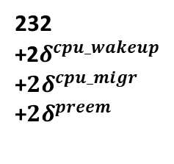
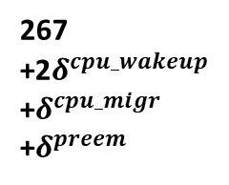









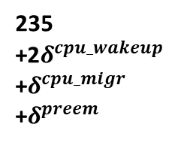
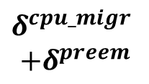





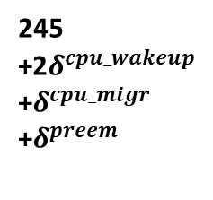
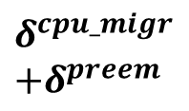
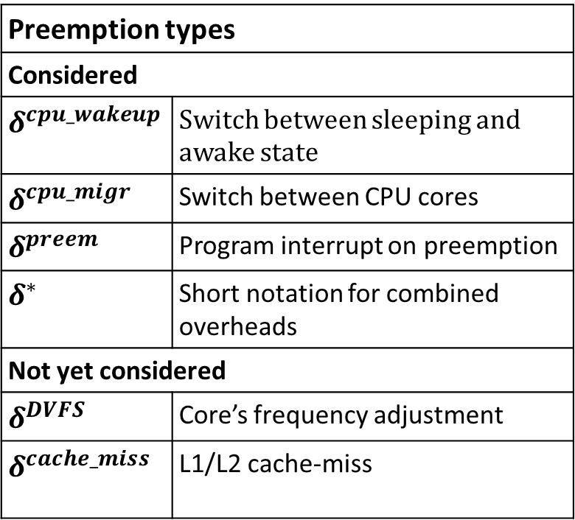



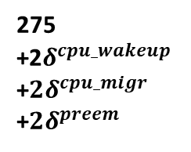
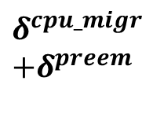




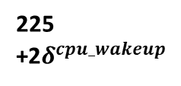

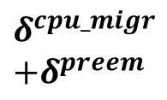
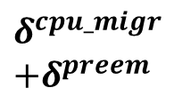

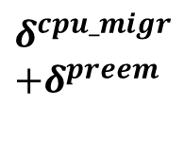




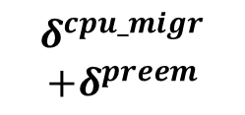
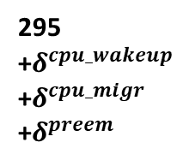

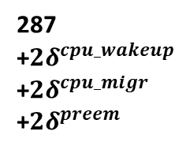

Function | Config. 1 | Config. 2 | Coef. 1->2 | Coef. 2->1
Prog 1, Block 1 | 100 | 130 | 1.3 | 0.77
Prog 1, Block 2 | 50 | 60 | 1.2 | 0.84
Prog 2, Block 1 | 150 | 200 | 1.34 | 0.75
Prog 2, Block 2 | 75 | 95 | 1.27 | 0.79
Preemptive Scheduling Case
Preemption types
Considered
$δ^{cpu_wakeup}$ | Switch between sleeping and awake state
$δ^{cpu_migr}$ | Switch between CPU cores
$δ^{preem}$ | Program interrupt on preemption
$δ^{∗}$ | Short notation for combined overheads
Not yet considered
$δ^{DVFS}$ | Core’s frequency adjustment
$$δ^{cache_miss}$$ | L1/L2 cache-miss
PROGRAM 1 START
PROGRAM 2 START
2$δ^{cpu_wakeup}$
0+$δ^{∗}$
2$δ^{cpu_wakeup}$
0+$δ^{∗}$
Config. 1
Prog. 1 Block 1 | 24+500
Time: | 100/100
Config. 2
Prog. 2 Block 1 | 1.5 GHz
Time: | 100/200
Config. 2
Prog. 1 Block 1 | 24+500
Time: | 130
Config. 1
Prog. 2 Block 1 | 1.5 GHz
Time: | 130/150
100+$δ^{∗}$
130+$δ^{∗}$
$$δ^{cpu_migr}$$
$$+δ^{preem}$$
$$δ^{cpu_migr}$$
$$+δ^{preem}$$
Config. 2
Prog. 1 Block 2 | 24+500
Time: | 60/60
Config. 1
Prog. 2 Block 1 | 1.5 GHz
Time: | 60/75
100+$δ^{∗}$
Config. 1
Prog. 1 Block 2 | 24+500
Time: | 50/50
Config. 2
Prog. 2 Block 1 | 1.5 GHz
Time: | 50/100
100+$δ^{∗}$
Config. 1
Prog. 1 Block 2 | 24+500
Time: | 27/50
Config. 2
Prog. 2 Block 1 | 1.5 GHz
Time: | 27/27
130+$δ^{∗}$
Config. 2
Prog. 1 Block 2 | 24+500
Time: | 20/60
Config. 1
Prog. 2 Block 1 | 1.5 GHz
Time: | 20/20
130+$δ^{∗}$
completed
160+$δ^{∗}$
completed
150+$δ^{∗}$
completed
157+$δ^{∗}$
150+$δ^{∗}$
…
$$δ^{cpu_migr}$$
$$+δ^{preem}$$
…
$$δ^{cpu_migr}$$
$$+δ^{preem}$$
Config. 1
Prog. 2 Block 1 | 1.5 GHz
Time: | 42/42
150+$δ^{∗}$
Config. 2
Prog. 2 Block 1 | 1.5 GHz
Time: | 50/50
150+$δ^{∗}$
Config. 1
Prog. 1 Block 2 | 24+500
Time: | 34/34
Config. 2
Prog. 2 Block 2 | 1.5 GHz
Time: | 34/95
150+$δ^{∗}$
Config. 2
Prog. 1 Block 2 | 24+500
Time: | 40/40
Config. 1
Prog. 2 Block 2 | 1.5 GHz
Time: | 40/75
150+$δ^{∗}$
192+$δ^{∗}$
200+$δ^{∗}$
completed
184+$δ^{∗}$
completed
190+$δ^{∗}$
$δ^{cpu_migr}$
$$+δ^{preem}$$
$δ^{cpu_migr}$
$$+δ^{preem}$$
$δ^{cpu_migr}$
$$+δ^{preem}$$
$$δ^{cpu_migr}$$
$$+δ^{preem}$$
Config. 1
Prog. 2 Block 2 | 1.5 GHz
Time: | 75/75
192+$δ^{∗}$
Config. 2
Prog. 2 Block 2 | 1.5 GHz
Time: | 95/95
192+$δ^{∗}$
Config. 1
Prog. 2 Block 2 | 1.5 GHz
Time: | 75/75
200+$δ^{∗}$
Config. 2
Prog. 2 Block 2 | 1.5 GHz
Time: | 95/95
200+$δ^{∗}$
Config. 1
Prog. 2 Block 2 | 1.5 GHz
Time: | 48/48
184+$δ^{∗}$
Config. 2
Prog. 2 Block 2 | 1.5 GHz
Time: | 61/61
184+$δ^{∗}$
Config. 1
Prog. 2 Block 2 | 1.5 GHz
Time: | 35/35
190+$δ^{∗}$
Config. 2
Prog. 2 Block 2 | 1.5 GHz
Time: | 45/45
190+$δ^{∗}$
267
+2$δ^{cpu_wakeup}$
+$δ^{cpu_migr}$
+$δ^{preem}$
287
+$2δ^{cpu_wakeup}$
+${2δ}^{cpu_migr}$
+${2δ}^{preem}$
275
+2$δ^{cpu_wakeup}$
+${2δ}^{cpu_migr}$
+${2δ}^{preem}$
295
+$δ^{cpu_wakeup}$
+$δ^{cpu_migr}$
+$δ^{preem}$
232
+2$δ^{cpu_wakeup}$
+${2δ}^{cpu_migr}$
+${2δ}^{preem}$
245
+2$δ^{cpu_wakeup}$
+$δ^{cpu_migr}$
+$δ^{preem}$
225
+2$δ^{cpu_wakeup}$
235
+2$δ^{cpu_wakeup}$
+$δ^{cpu_migr}$
+$δ^{preem}$
Memory-intensive blocks indicate an active work with L1 or L2 cache. Thus, the switching of the configs may lead to cache-miss overhead. The scheduler can identify this scenario traversing the state transition graph.
The main purpose of the graph is to make scheduling decision, specifically, to distribute configs between pending programs.
We assume an idealistic scenario where all programs’ executions are predictable and deterministic To make the decisions after any of block the children of the blocks should be recalculated. In practical case, a block might not execute as expected requiring different amount of time than determined in advance
The preemption cost should be incorporated in the model as following:
Instead of having and analyzing all the costs separately from the programs, we can assign each overhead to the required execution time of every program that caused it.
For example, the program "wants" to switch a config on a faster one to execute 42 units instead of 50. However, this will lead to additional overheads. We suggest to simply add the overhead to the considered "42" having a greater number for analysis. In this case, the compiler will less likely give a faster config for the program as it is less comparable with the execution time on the current config (which is 50) OR it will definitely reject the setup since the overhead added to 42 may be even greater than 50.
proportional independently on the total time. Meaning, if the block requires 100 time units on the Config 1 and 200 on the Config 2, it will require 10 and 20, 50 and 100 correspondingly. Rephrased: Time to execute a block on different configs is proportional on these configs
Without other costs: seems greedy algorithms is working -> in each scheduling instant give better config for heavier block (semi-block/part of program)
With cost: the program should pay additional time for switching a config/dvfs level and mb preemption
Still, it depends on “the goal of scheduling” – maybe the first program should be executed as fast as possible and the total duration should not be minimized
Seems there is no need in 2 types of arrows (solid and dashed) since all the states are grouped by the SUPER-config – a combination of configs allocated to the programs(blocks) for the execution after the scheduling decision is done
Note: on the right Prog 1 finishes 5 units later but the total execution of the set finishes 5 units earlier (so, trivial pruning by time is bad)
This diagram is for the case when n==m
What if we should not wake some processors and just execute tasks on others (Case m>n)
Case n>m: super-sets should somehow reflect the state of unexecuted program. Suppose, we have program 3, what would the joint state look like?
Assumptions:
CPU wake down time is insignificant compared to the time a program block executes
The block is evenly executed along its required time, and the time on different configs is proportional independently on the total time. Meaning, if the block requires 100 time units on the Config 1 and 200 on the Config 2, it will require 10 and 20, 50 and 100 correspondingly. Rephrased: Time to execute a block on different configs is proportional on these configs.
The idealistic scenario is drawn: the time for a block is known before and after any time interval.

