Slide 1
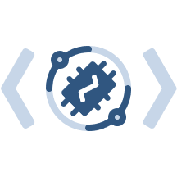
Server
ThingsBoard
Visualization Persistence
Device twin
websocket / REST
tb-utils-based IoT App
Data processing
ThingsBoard config
REST
telemetry, attributes, alarms
Device
Device
Device
Device
tb-utils-based Device Client
ThingsBoard communication
tbu Client
tbu Client
tbu Client
…

