Slide 1
Rinnai Taiwan Corporation
Company profile
2016

Slide 2
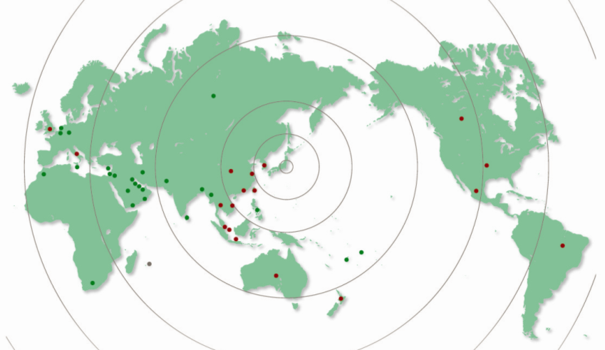
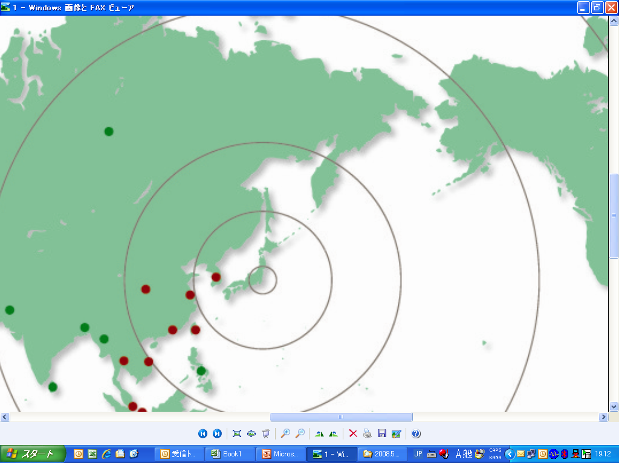
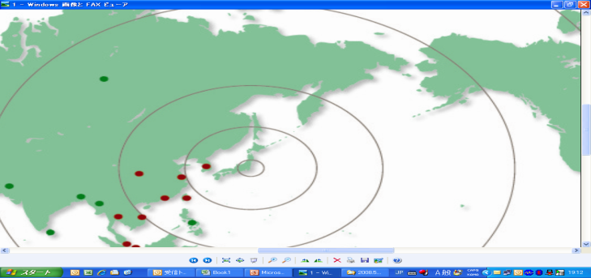

Rinnai group
◆Expand group company in 18 countries
Russia
Canada
UK
China
Hong Kong
Italy
Taiwan
America
Korea
Japan
Thailand
Brazil
Singapore
Malaysia
Vietnam
Indonesia
Australia
New Zealand

Slide 3


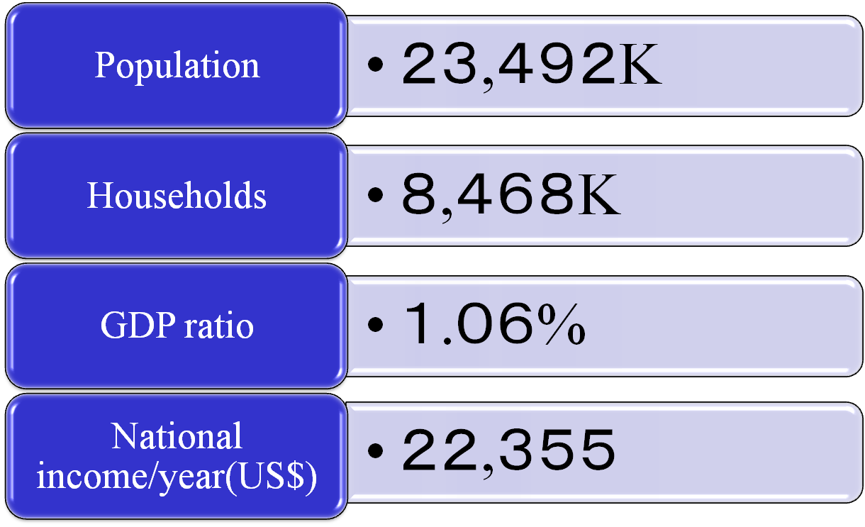
Taiwan outline

Slide 4



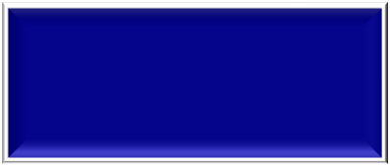
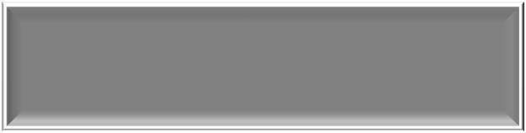
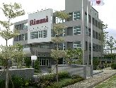










Company profile
Company name
Rinnai Taiwan Corporation
Location
No.577,Sec.2,Mei-Shih Rd.,Yang-Mei,
Tao-yuan,Taiwan,R.O.C
Established
1970
President
Hayao Nishizawa
Capital
NT$62,000K(US$1,849K)
Sales
NT$2,031,111K (US$60,576K)(2015)
Land area
20,630㎡
Number of employees
415 (Before 2015.12.31)
Products
・Cooker
・Water heater
・Commercial rice cooker

Slide 5
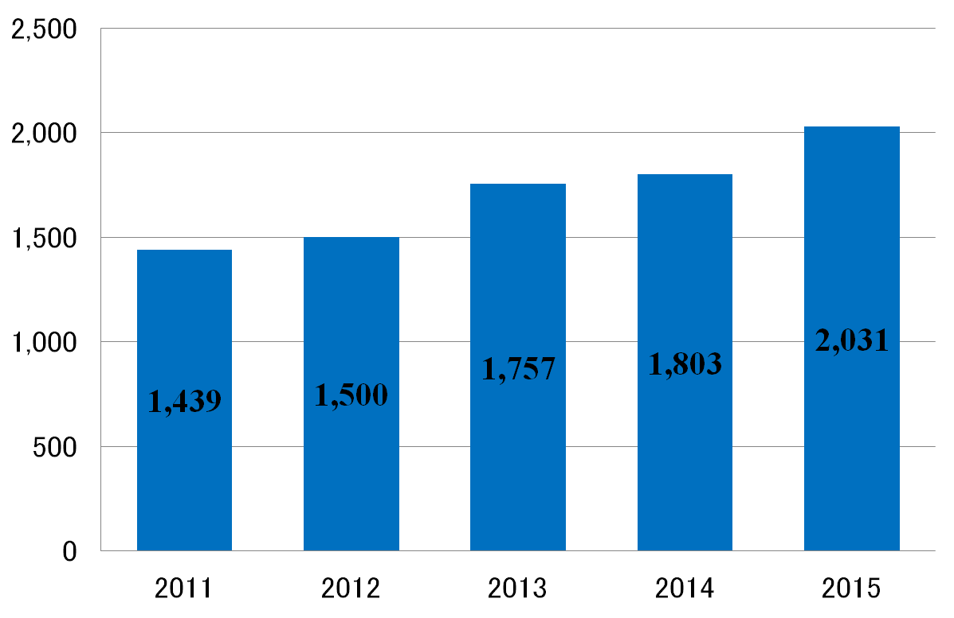
Sales Result
Unit（million）

Slide 6
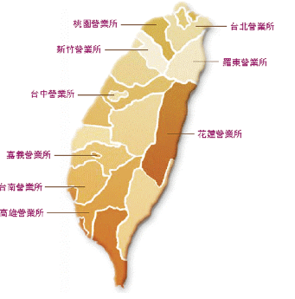
Domestic sales&A/S channel
Taoyuan
Taipei
Hsinchu
Head Office
Factory
Luotong
Taichung
Hualien
Chiai
Tainan
★Head office/Factory：
Yangmei, Taoyuan
★Sales&A/S office：
Taipei/Taichung/Kaohsiung etc
Total 9 offices
Kaohsiung

Slide 7
Factory layout
Quality audit
RF W/H assembling
HEX
Products/Parts warehouse
FE W/H assembling
W/H machining
Die casting
Parts place
Cooker assembling
Valve assembling/machining
Casing place
Pipe welding
Molding
Painting
Pressing
In-take inspection for supplying parts
Factory area：6,180㎡
３

Slide 8
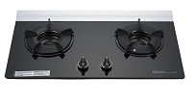
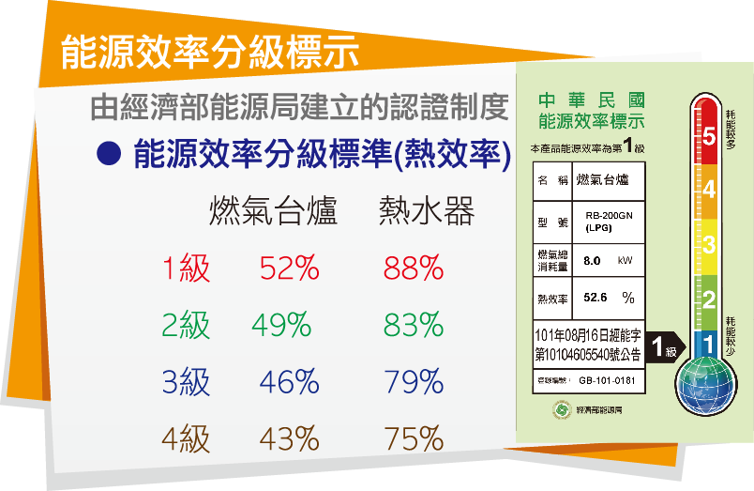
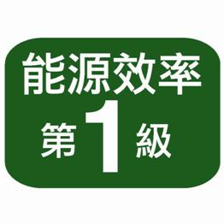
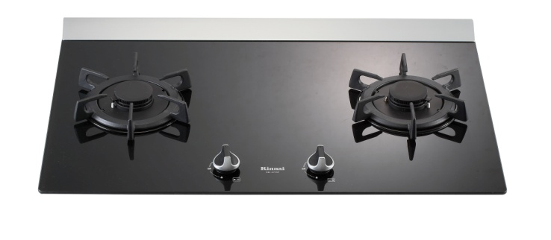
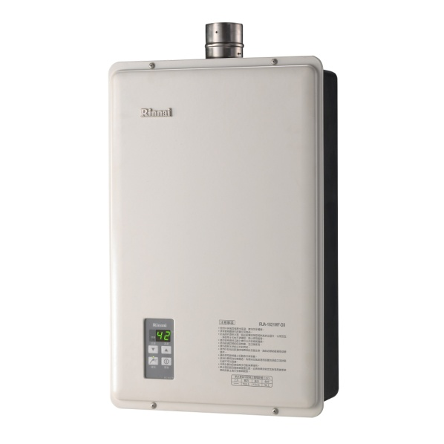
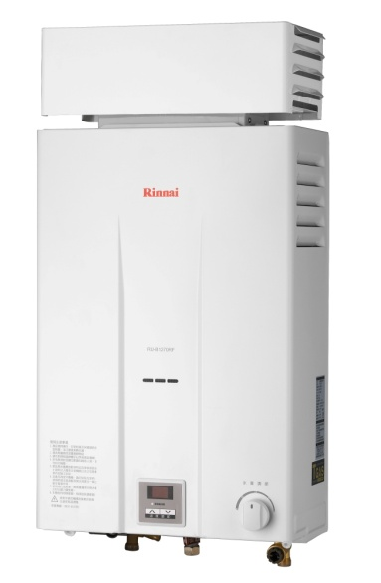
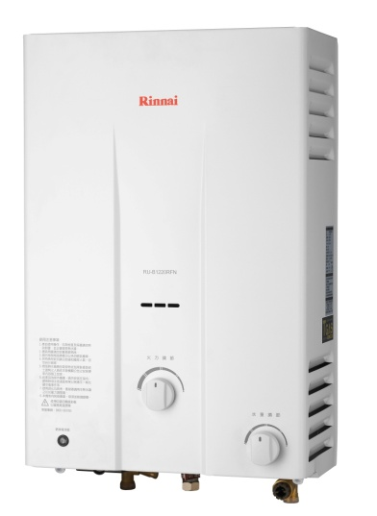
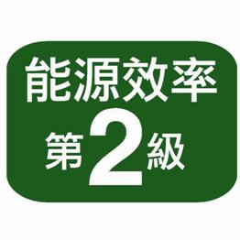
Products line-up
≪Taiwan made≫
RB-201GN
RB-27GF
(NG)
(NG)
RUA-1621WF-DX
RU-B1270RF
RU-B1220RFN

Slide 9
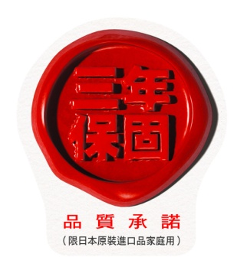
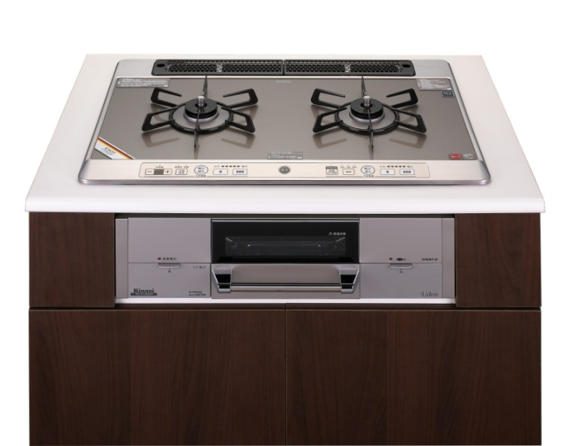
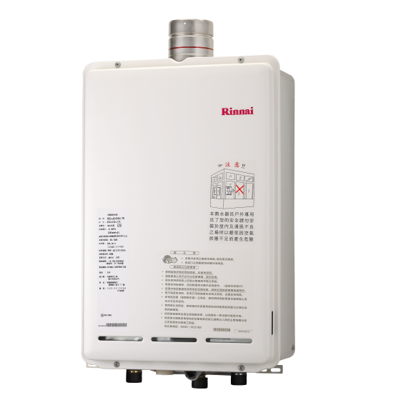
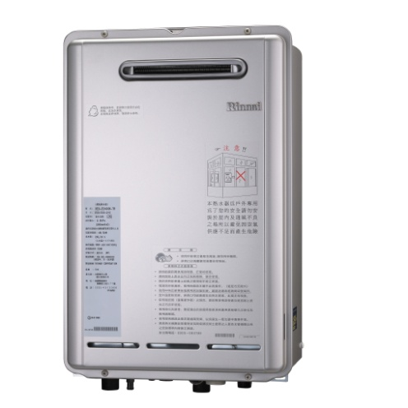
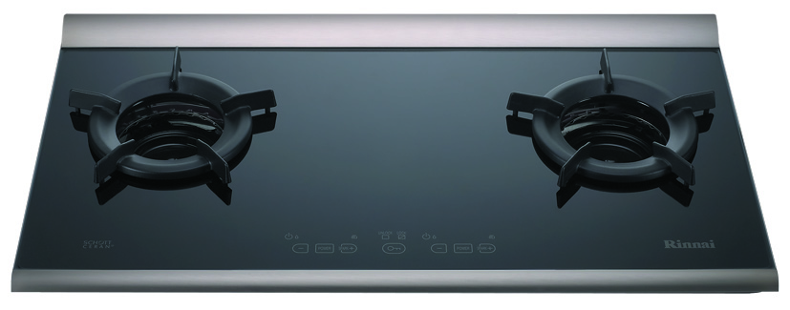
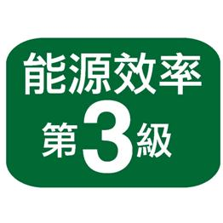
Products line-up≪Japan made≫
RS721W9S8R-VR-TR
REU-E2400W-TR
REU-A2400U-TR
RB-2CGS(B)

Slide 10


