Slide 1
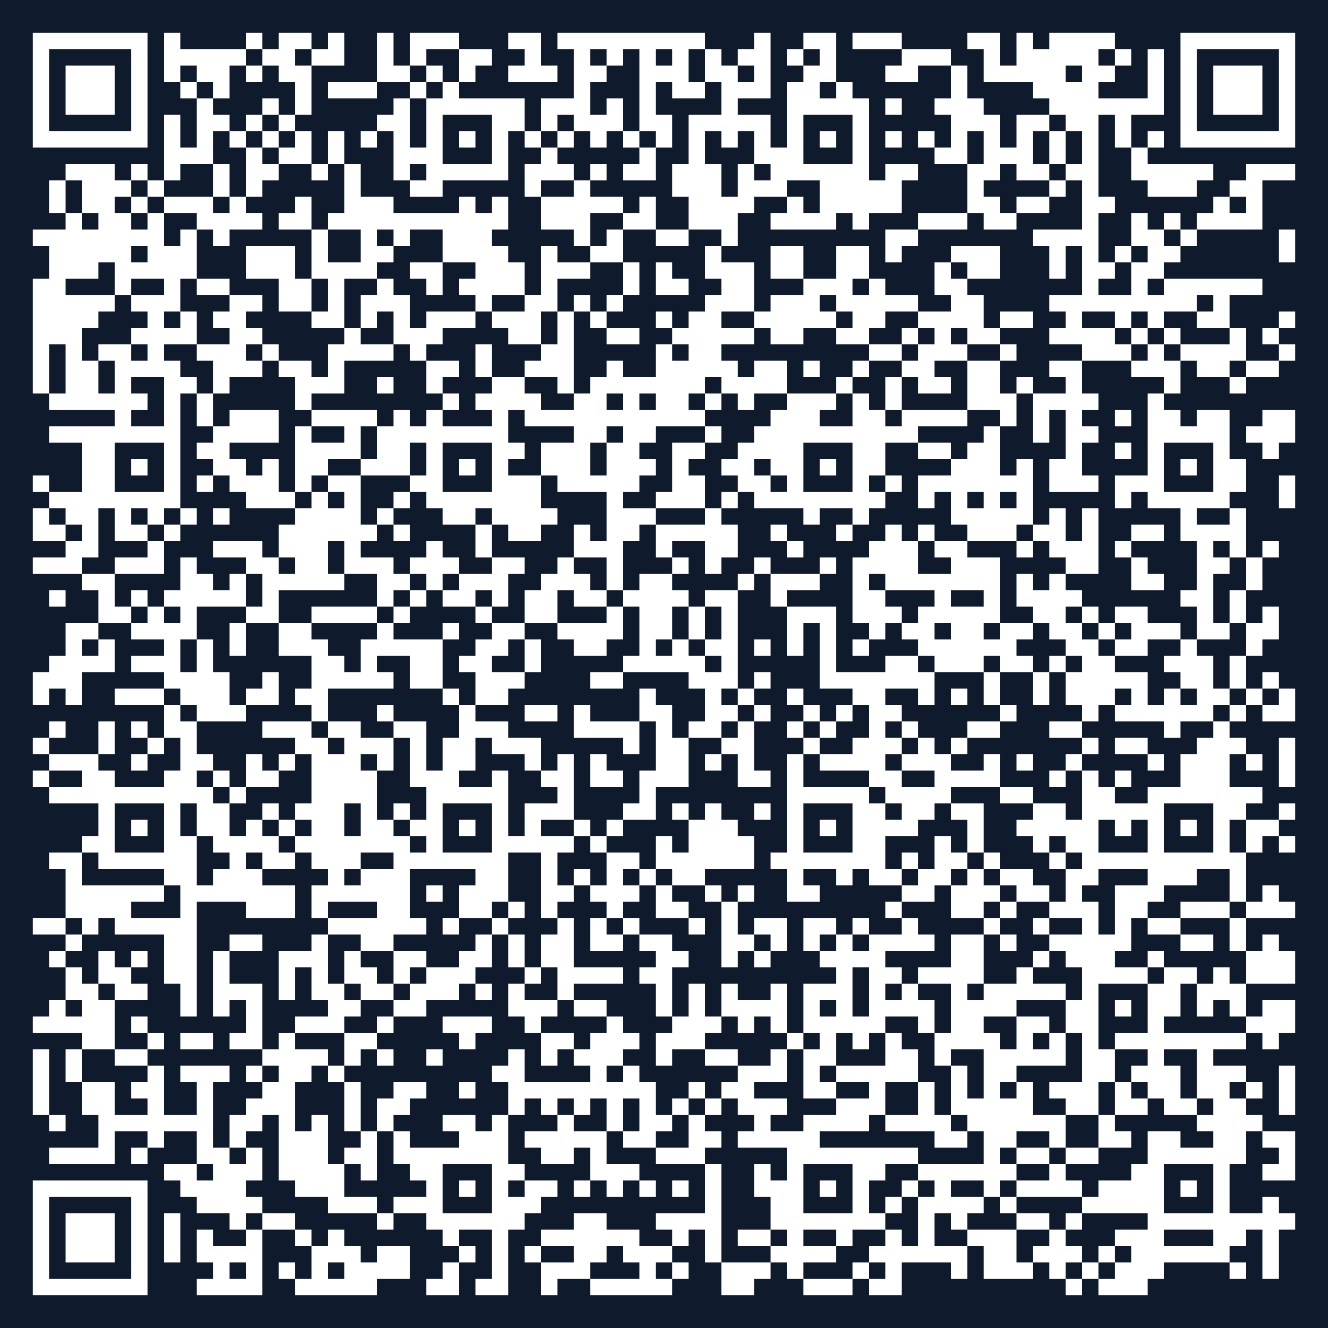
AI Pilots: How We Got Here
UNIVERSITY OF
BIRMINGHAM
Setting the context for your VS Code session
WHY WE COULDN'T WAIT
WHAT WE BUILT
3.6M
visits to public AI sites on our network in 10 days
Microsoft 365 Copilot AI in everyday tools
ELM (Edinburgh) Multi-model, education
Standing still is the biggest risk
NebulaONE Agents on UoB data
Equity gap for students without access
Unmanaged licences risk data exposure
API Gateway Bespoke AI development
Register your interest in the AI pilot
Scan →

