Slide 1
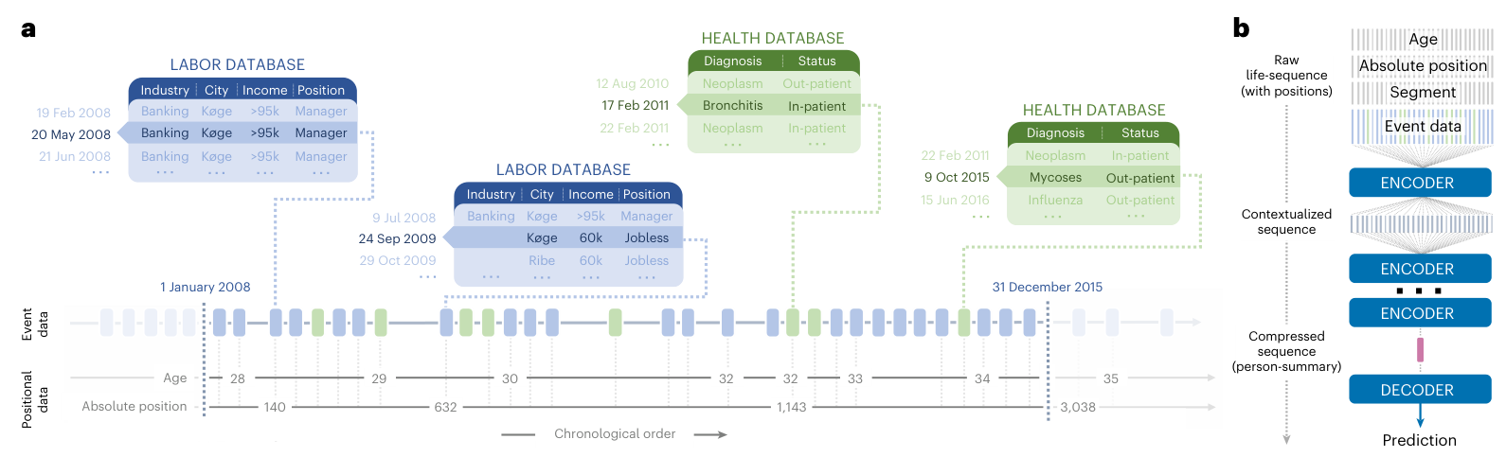
Data scale: one country, linked national registers
Events share one timeline. The encoder turns histories into predictions.
~6 million in the source registers; 3.25 million in the filtered dataset.
Eight years of linked health and work histories make population-scale learning possible.
Mortality: 2.30 million eligible people. Personality: 9,794 linked survey participants.
Fig. 1 and Methods. Savcisens et al., Nature Computational Science (2024). doi:10.1038/s43588-023-00573-5
01
Notes:
Start with the actual data design. This is one national setting, Denmark, with linked administrative sources rather than several independent national cohorts. The two main sources are the Labour Market Account and the National Patient Registry. The underlying registers cover about six million residents, but eligibility filters leave 3,252,086 people for the study dataset. Histories cover 2008–2015. The mortality task narrows eligibility to 2,301,993 people aged 35–65. The separate personality analysis links 9,794 eligible POSAP survey respondents to their register histories. These are nested or linked subsets, not independent countries.
Figure logic: panel a joins work and health events on a personal timeline and encodes what happened, age and calendar time. Panel b compresses the history through a transformer and uses it for prediction. The major data strength is longitudinal linkage across health and socioeconomic domains, alongside population scale. The study provides no validation in another country.
Discussion: If another dataset had more people but only diagnoses, would it answer the same scientific question?
Source: Savcisens et al., Using sequences of life-events to predict human lives. Nature Computational Science 4, 43–56 (2024). https://doi.org/10.1038/s43588-023-00573-5
Published PDF: https://dlab.epfl.ch/teaching/spring2024/cs727/papers/savcisens2023using.pdf
Figures are original article crops. All main figures (1–5) appear in this deck. Supplementary figures are not included. Publication-value judgments are our assessment of the paper, not private editorial reasoning.

Slide 2
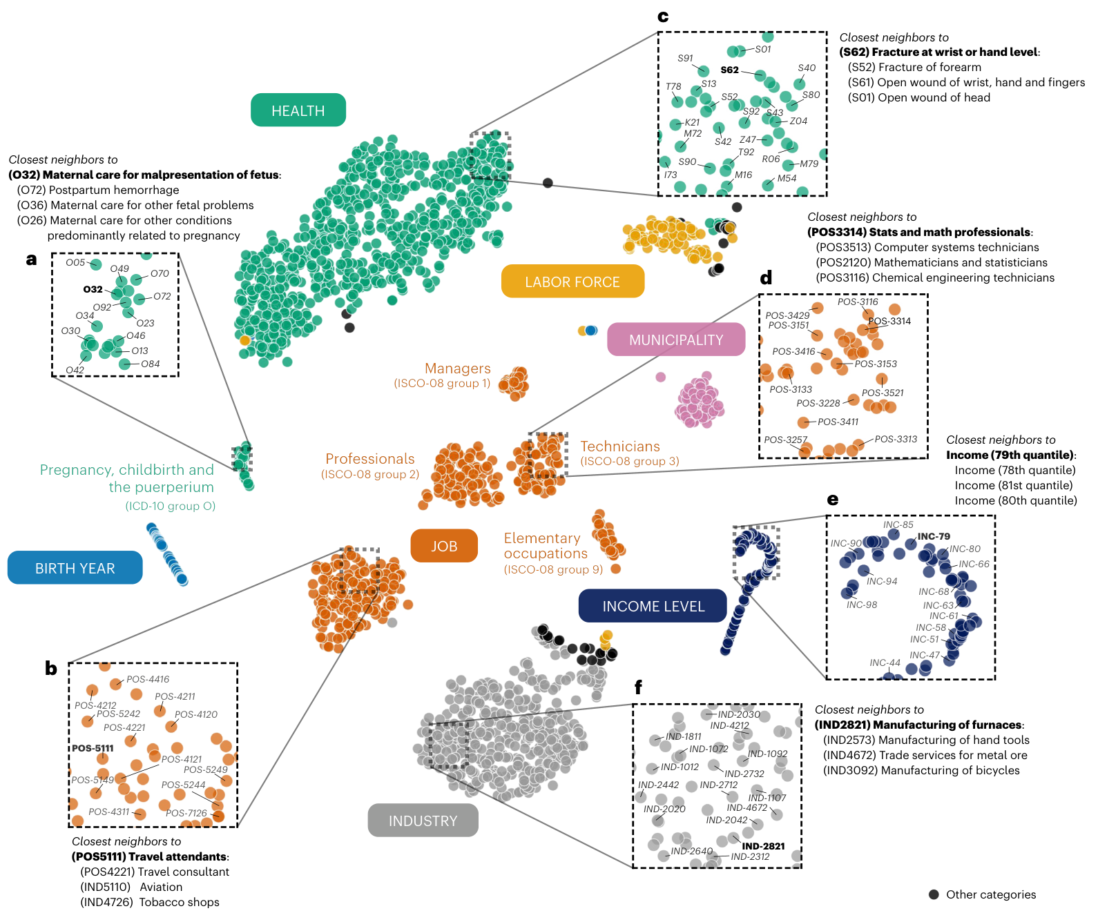
Method: a shared representation of life events
What the map shows
Related diagnoses and jobs cluster.
Income levels fall into order.
The model learns structure in events.
What is new here?
A shared language for nationwide
health and socioeconomic histories,
reusable across prediction tasks.
Earlier health transformers existed:
BEHRT (2020) and Med-BERT (2021).
Fig. 2. Prior work: BEHRT (2020), doi:10.1038/s41598-020-62922-y; Med-BERT (2021), doi:10.1038/s41746-021-00455-y
02
Notes:
Figure logic: the model gives event labels numerical vectors. This figure projects 2,043 concept tokens into two dimensions. Related diagnoses cluster (panels a and c), related work concepts appear near one another (b, d and f), and income levels recover an ordered structure (e). Similar contexts produce related vectors. The projection illustrates learned organization; it is not itself proof of biological mechanism. The paper supplements visualization with neighbor and robustness analyses.
Method novelty must be narrowly stated. Transformers and BERT-like pretraining were established. BEHRT used transformers for electronic health records in 2020, and Med-BERT pretrained on structured electronic health records in 2021. Therefore life2vec is not the first transformer applied to health sequences. The life2vec authors make a narrower claim about applying transformers to multimodal socioeconomic data outside industry. We report that as their positioning, not as independently proven universal priority.
The distinctive contribution is a common temporal vocabulary for nationwide linked socioeconomic and health events, whose representation can support multiple tasks and be studied in its own right.
Sources for prior work: https://www.nature.com/articles/s41598-020-62922-y and https://www.nature.com/articles/s41746-021-00455-y .
Discussion: Is the intellectual contribution the architecture, the representation of life histories, or their combination with the linked data?
Source: Savcisens et al., Using sequences of life-events to predict human lives. Nature Computational Science 4, 43–56 (2024). https://doi.org/10.1038/s43588-023-00573-5
Published PDF: https://dlab.epfl.ch/teaching/spring2024/cs727/papers/savcisens2023using.pdf
Figures are original article crops. All main figures (1–5) appear in this deck. Supplementary figures are not included. Publication-value judgments are our assessment of the paper, not private editorial reasoning.

Slide 3
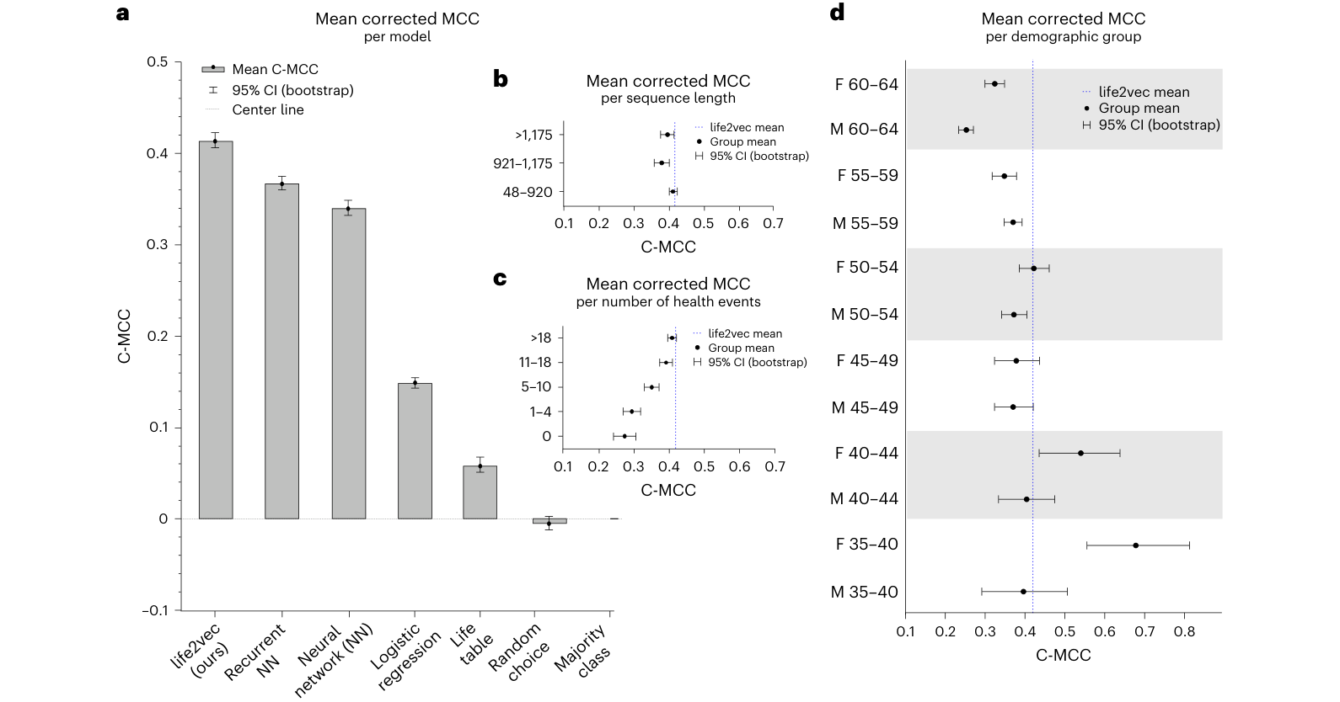
Evidence: better prediction, tested across groups
0.41
Corrected MCC
95% CI: 0.40–0.42
Panel a
11% relative gain over
the best baseline.
Panels b–d
Checks by age, sex,
record length and
health-event count.
Four-year death prediction, ages 35–65. Generalization beyond Denmark remains open.
Fig. 3. Corrected MCC accounts for unknown outcomes. Panels show means and 95% confidence intervals.
03
Notes:
Read panel a first: life2vec improves on recurrent neural networks, feed-forward networks, logistic regression and life tables in the reported comparison. Mean corrected Matthews correlation coefficient is 0.41, 95% CI 0.40–0.42. The paper reports an 11% relative gain over the best baseline; this is not 11 percentage points in accuracy. The target is death during the four years after 1 January 2016, among eligible people aged 35–65, using earlier histories. Panel a uses n=100,000.
Then read b–d: b compares different sequence lengths, c compares the number of health events, and d compares age and sex groups. Longer sequences do not automatically yield higher scores. Performance varies with health-event availability and demographic group. These panels show where the model works better or worse within the studied setting.
The paper also changes data sources while holding the cohort fixed (Supplementary Table 4), finding gains as more data domains are included. This reinforces the importance of the linked data. The figure alone does not isolate the independent causal contribution of event order or establish external validity.
Assessment: the predictive claim has meaningful comparative evidence, but the gain must be interpreted with its metric, population and observation period. Discussion: which comparison best separates data richness from model design?
Source: Savcisens et al., Using sequences of life-events to predict human lives. Nature Computational Science 4, 43–56 (2024). https://doi.org/10.1038/s43588-023-00573-5
Published PDF: https://dlab.epfl.ch/teaching/spring2024/cs727/papers/savcisens2023using.pdf
Figures are original article crops. All main figures (1–5) appear in this deck. Supplementary figures are not included. Publication-value judgments are our assessment of the paper, not private editorial reasoning.

Slide 4
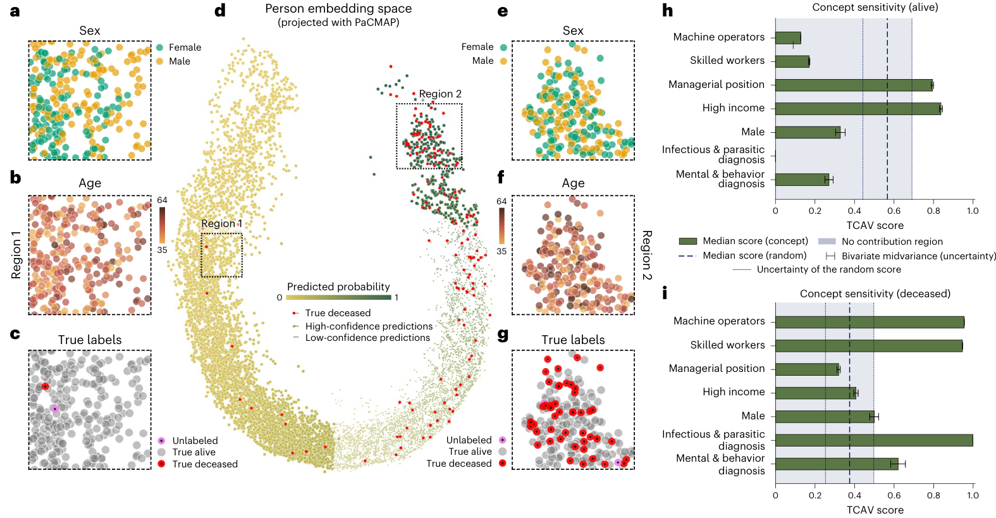
Scientific insight: the model organizes patterns of risk
a–g: map people
Life histories separate
into lower- and
higher-risk regions.
h–i: probe the model
Income, occupation
and diagnoses relate
to its predictions.
Scientific value: a way to study life trajectories. New biological mechanisms remain unproven.
Fig. 4. Person representations and concept sensitivity (TCAV). Interpretation concerns model behavior.
04
Notes:
Figure logic: panel d places people in a two-dimensional map of mortality-conditioned representations. Yellow-to-green encodes predicted mortality, and red marks observed deaths. Panels a–c examine a low-risk region, while e–g examine a high-risk region, using sex, age and true outcomes. Age contributes to the organization, but the regions contain a mixture of ages.
Panels h–i test concept sensitivity. Managerial position and high income support the model's survival predictions, while occupational and health concepts influence death predictions. Bars measure model sensitivity, not mortality probabilities or causal effects. These largely recognizable associations make the model's behavior interpretable.
What is scientifically added? Together with Fig. 2, the work shows how linked life histories can be organized into a shared representation, with event relationships and risk patterns that researchers can examine. The representation and ability to study predictability are the stronger advances. The paper does not establish a new biological mechanism. Income-health associations are not new discoveries by themselves, and changing a concept direction inside a model is not a real-world intervention.
Discussion: what new testable hypothesis could this representation generate, beyond recovering already known associations?
Source: Savcisens et al., Using sequences of life-events to predict human lives. Nature Computational Science 4, 43–56 (2024). https://doi.org/10.1038/s43588-023-00573-5
Published PDF: https://dlab.epfl.ch/teaching/spring2024/cs727/papers/savcisens2023using.pdf
Figures are original article crops. All main figures (1–5) appear in this deck. Supplementary figures are not included. Publication-value judgments are our assessment of the paper, not private editorial reasoning.

Slide 5
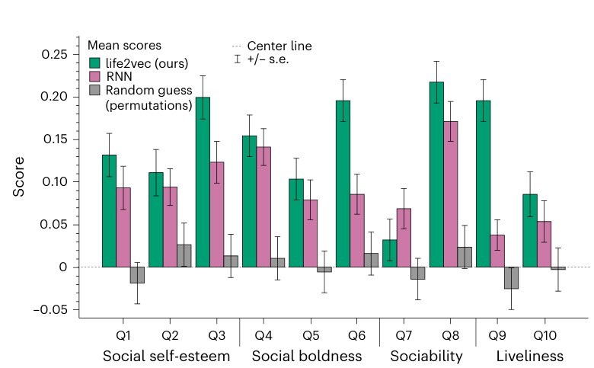
Reuse and publication value: three levels of assessment
Data scale: strong
National linkage and long histories.
Evidence comes from one country.
Method: useful adaptation
A reusable model of life histories,
built on established transformers.
Insight: predictive structure
Meaningful event and risk patterns.
Causal mechanisms remain open.
Fig. 5 tests reuse: significant gains over the RNN on 4 of 10 personality questions.
Fig. 5. Personality prediction uses Cohen’s quadratic kappa. Assessment reflects the published evidence.
05
Notes:
Figure logic: each group of bars is a personality questionnaire item within extraversion. Green is life2vec, pink is the RNN and grey is random prediction. The y-axis is Cohen's quadratic kappa; higher values mean greater agreement with reported answers, allowing for chance and ordinal differences. The sample has 9,794 linked respondents. life2vec beats the RNN significantly on items 3, 6, 8 and 9. For item 7 only the RNN significantly exceeds random. This is evidence of reuse with uneven gains, not a universal personality predictor.
Our three-level assessment:
DATA: Strong national coverage, eight-year histories and linked domains. One country limits the external generalization claim. Scale alone does not establish novelty, and task subsets are smaller than register coverage.
METHOD: An appealing representation and adaptation of existing transformers to linked life histories. Earlier health transformers preclude a broad first-in-health claim. The novelty is strongest in the domain integration and reusable representation.
SCIENTIFIC INSIGHT: The model exposes structured relationships among events and people and shows useful prediction across distinct outcomes. Many interpreted risk factors were already known. New causal or biological mechanisms, external transfer and clinical benefit remain unestablished.
Why Nature Computational Science? Our reading is that the paper combines an important scientific question, unusually rich linked data, a reusable computational approach and evidence across prediction and interpretation. The contribution spans machine learning, population health and computational social science, rather than resting on one larger score. This is a reasoned assessment, not a reconstruction of the editorial decision.
Final discussion: If we removed one ingredient—national linked data, the sequence model, or the scientific analyses—which removal would most weaken the paper?
Source: Savcisens et al., Using sequences of life-events to predict human lives. Nature Computational Science 4, 43–56 (2024). https://doi.org/10.1038/s43588-023-00573-5
Published PDF: https://dlab.epfl.ch/teaching/spring2024/cs727/papers/savcisens2023using.pdf
Figures are original article crops. All main figures (1–5) appear in this deck. Supplementary figures are not included. Publication-value judgments are our assessment of the paper, not private editorial reasoning.

Slide 6
Assessment against contemporary work
Dimension | Evidence in this paper | Assessment at publication (2023)
Data scale | ~6M source residents; 3.25M in the filtered dataset. Eight years of records from Denmark. | National linkage across health and work is the strength. Multi-country replication is absent.
Method innovation | BERT-like learning brings health and socioeconomic events into one reusable representation. | Strong integration of life histories. Health transformers already existed: BEHRT (2020), Med-BERT (2021).
Ahead of peers? | 11% relative gain in corrected MCC over the best tested baseline. Gains on 4 of 10 personality items. | Leads the tested baselines. Direct superiority to BEHRT or Med-BERT was not established.
Main scientific insight | One event space captures related diagnoses and jobs. Person representations organize patterns of risk. | A new way to study predictability. Many risk factors were known; new causal mechanisms remain unproven.
Publication appeal: linked national data, a reusable method, and evidence across outcomes.
Assessment based on Savcisens et al. (2024), Figs. 1–5 and Methods; BEHRT (2020); Med-BERT (2021). Sources in notes.
06
Notes:
This is an assessment of the evidence available at the paper's December 2023 publication, not a ranking of all contemporary systems or a claim about the editor's private reasoning.
DATA: The underlying Danish registers cover about six million residents, with 3,252,086 people in the filtered study dataset. Histories run from 2008 through 2015. The eligible mortality cohort has 2,301,993 people aged 35–65; the linked personality survey subset has 9,794 respondents. One country provides the main evidence. National linkage and domain breadth matter alongside sample count.
METHOD: BERT-like pretraining and transformers predate this study. BEHRT (2020) and Med-BERT (2021) demonstrate earlier health-record applications. life2vec's distinctive contribution integrates socioeconomic and health life histories into a reusable temporal representation. An unqualified first-in-health claim is unsupported.
CONTEMPORARY LEAD: The authors report mean corrected MCC 0.41 (95% CI 0.40–0.42), an 11% relative improvement over the best tested mortality baseline. The paper compares life tables, logistic regression, feed-forward networks and an RNN. Significant personality gains over the RNN occur on four of ten extraversion items. These results support superiority within the evaluated setting, not a head-to-head ranking against every contemporary health foundation model. Cross-paper scores are not directly comparable across datasets and tasks.
INSIGHT: Figure 2 shows meaningful concept neighborhoods and income ordering. Figure 4 organizes mortality-conditioned person representations and probes concept sensitivity. This creates an empirical way to examine life trajectories and predictability, while many highlighted risk associations were already known. It does not prove that changing income changes survival or establish a new biological mechanism.
DISCUSSION: Which contribution would survive if the dataset were smaller? Which experiment would establish a stronger claim of methodological leadership? What new scientific hypothesis would the representation enable?
Sources:
Savcisens et al., Using sequences of life-events to predict human lives, Nature Computational Science 4, 43–56 (2024), online 18 December 2023: https://doi.org/10.1038/s43588-023-00573-5
Li et al., BEHRT (2020): https://doi.org/10.1038/s41598-020-62922-y
Rasmy et al., Med-BERT (2021): https://doi.org/10.1038/s41746-021-00455-y

