Slide 1

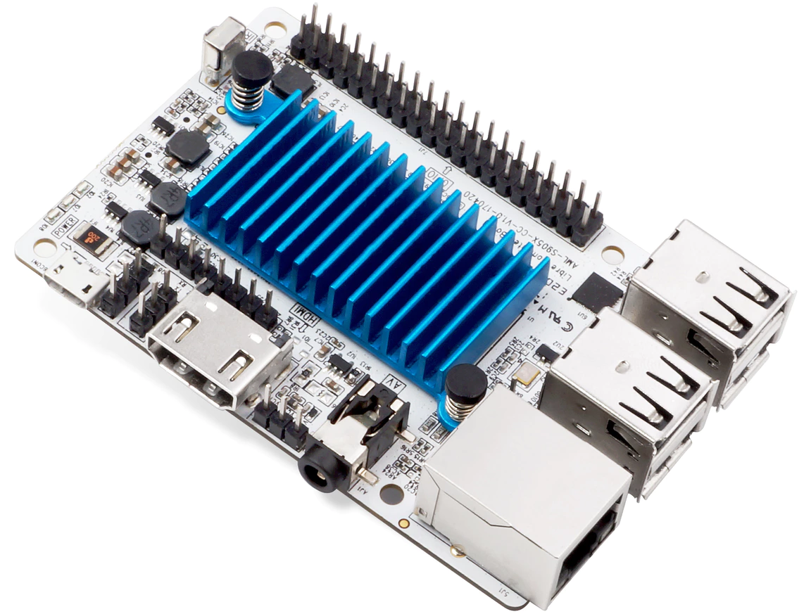

Edge node 1:
Edge node 2:
Potato
Arm64 Amlogic S905X 1.5GHZ
Lateralus
x68-64 Atom C2758 2.5GHZ
Edge client:
(my desktop)

Slide 2
Latency matters!
Even small latency increase have huge impact on req/s
Very early on latency becomes the bottleneck

Slide 3
Latency depends on client/server distance
https://www.cloudping.co/

Slide 4
Latency depends on client/server distance
https://www.cloudping.co/
Changes of <10ms make sense at the edge.

Slide 5
Scenario: latency sensitive (redis), edge client moving further from node 1 and closer to node 2:
  We make the assumption those are the only suitable nodes and they have different ISAs
  Over time, latency to node 1 increases while latency to node 2 decreases
EDGE
TIME & CLIENT LOCATION

Slide 6
Each edge node adjusts its latency using tc
EDGE
0ms
0ms
10ms
10ms
TIME & CLIENT LOCATION
Linear evolution of latency
Total time to move: 1000 seconds ~= 15 minutes

Slide 7

Without migration client is stuck with one node
→ Sample redis request throughput over time while the client moves as described

Slide 8
Scenario with migration
How to redirect traffic to the closest node?
  Use Haproxy with health check, automatically redirect to the node that is up
  Redis server is migrated and consume resources only on the closest node
Node2
Node1
HAproxy
Client
redis-benchmark

Slide 9
Scenario with migration
How to redirect traffic to the closest node?
  Use Haproxy with health check, automatically redirect to the node that is up
  Redis server is migrated and consume resources only on the closest node
migrate
Node2
Node1
HAproxy
Client
redis-benchmark

Slide 10
Scenario with migration
How to redirect traffic to the closest node?
  Use Haproxy with health check, automatically redirect to the node that is up
  Redis server is migrated and consume resources only on the closest node
Node2
Node1
HAproxy
Client
redis-benchmark

Slide 11
Scenario with migration
How to redirect traffic to the closest node?
  Use Haproxy with health check, automatically redirect to the node that is up
  Redis server is migrated and consume resources only on the closest node
Node2
Node1
HAproxy
Client
redis-benchmark

Slide 12
Scenario with migration
migration

Slide 13
Scenario with migration

