Slide 1
MVEDSUA
Higher Availability Dynamic Software Updates via Multi-Version Execution
Luís Pina∗ George Mason University | Anastasios Andronidis Imperial College London | Michael Hicks University of Maryland | Cristian Cadar Imperial College London
Notes:
MEDUSA

Slide 2
MVEDSUA
Multi-Version Execution (MVE)
A fork is updated
Original system continues
State of both versions in sync
Expected divergences expressed using MVE-specific DSL
Dynamic Software Updating
Update changes are introduced dynamically
No shutdown of system
Issues:
Can have bugs in the update
Or bugs in the way changes are introduced
May introduces a long delay in service
Notes:
MVE: update is applied to a forked copy

Slide 3
Motivation
Modern software systems require
Constant availability
Frequent updates
Security patches
Feature improvements
Applying updates by stopping, patching, and restarting the system causes loss of availability
Thus, need for new reboot less updating technique

Slide 4
Previous Works
Rolling Update
Supports updating stateless nodes in a distributed service
e.g., application servers in a web service
Once task queue is empty, gently redirect incoming connections away from a node and pause, patch, and resume it.
Issue: Don’t work with stateful nodes
Examples:
Long running sessions like SSH and remote access
In-memory databases, like Redis and Memcached
Checkpointing states will cause long pause in service
Notes:
In short: While rolling upgrades work well on stateless servers, they do not solve the problem of updating the stateful components of a service.

Slide 5
Previous Works (2)
Version N N -> N + 1 Version N + 1
Update
No service
Dynamic software updating (DSU)
Updates in stateful services without restarting
Replaces code and transforms the existing in-memory state to an equivalent representation compatible with new code
Replaces both states
control - thread call stacks and program counters
data - contents and format of heap objects
Issues:
Constant availability can be broken by errors in updates
Updated code itself may have errors or mechanics of applying it at runtime may be the issue
Pause the service for too long
Notes:
In short: While rolling upgrades work well on stateless servers, they do not solve the problem of updating the stateful components of a service.

Slide 6
DSU: Threats to Availability
Timing errors
Suppose a multithreaded program updates
T1 holds a lock and thread T2 waits for it
The programmer may have enabled an update at the incorrect time
T1 will stall until all threads are ready to update, while T2 waits for a lock that will never be released
State transformation errors
When the code to transform existing state is wrong
Post-update failures
Delay in service (less extreme)
the time to pause the program threads
transform an arbitrarily large program state (if SIZE is large)
Notes:
e.g., field t is left uninitialized instead being initialized to a default value. Will show you this in a example that will come after few slides

Slide 7
Previous Works (3)
Multi-version execution (MVE)
Runs multiple instances of a program parallelly
Ensures same inputs and equivalent outputs for all
One process is the leader, and all others are followers
Only leader interacts with OS using system calls
Ring Buffer
Leader stores system calls and its result
Followers check that they have the same syscall at current position and gets result directly from buffer
Divergence if follower's system calls don't match.
What if leader and followers have different versions (then divergence is expected) ?
To allow expected divergences, MVE system has rewriting rules to map the follower's system call into one that will match (Uses MVE-specific DSL).

Slide 8
Mvedsua: MVE-enhanced DSU
Uses Multi-version execution (MVE)
Runs multiple instances of a program at once
Ensures same inputs and equivalent outputs for all
Ensures availability
Fork current program (leader)
Update the child (follower)
Leader continues to provide service shortening update-induced pause
Ensure reliability
Monitors the behavior of both versions
If any disagreement, then terminates follower and rolls back update
No state changes made during or after the update are lost
After some time, promote the new version to leader, and eventually drop the old version (a demoted follower by now).

Slide 9
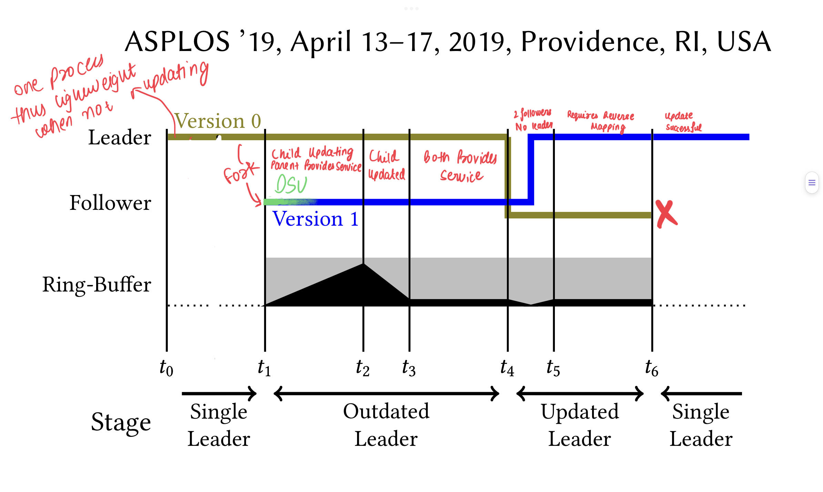

Mvedsua: MVE-enhanced DSU (2)

Slide 10
Mvedsua: MVE-enhanced DSU (3)
Reducing update latency
By performing the dynamic update in the follower in parallel
Handling in-update errors
If update fails prior to t2, rollback to single leader
Timing errors (or Nondeterministic failures): can simply be retried
State transformation errors can be retried once the update is fixed
Handling new-version errors
Bugs in the new version or incorrect state transformations
Terminates the follower and resumes old version until the bug is fixed
Handling old-version errors
May indicate an old version bug fixed in the new version
Promotes the new version to sole leader (jump to t6)
If bug between t5 and t6 (then divergence) and the new version will be terminated

Slide 11
Implementation
Implemented Mvedsua by extending Kitsune DSU framework with Varan, a state-of-the-art MVE system
Varan: 1202 lines of extra C code
Kitsune: 88 lines modified
Forking a multithreaded application in modern OS results in just one thread executing; the others must be restarted.
Kitsune already handles it
Mvedsua enhances Varan with efficient support for single leader mode

Slide 12
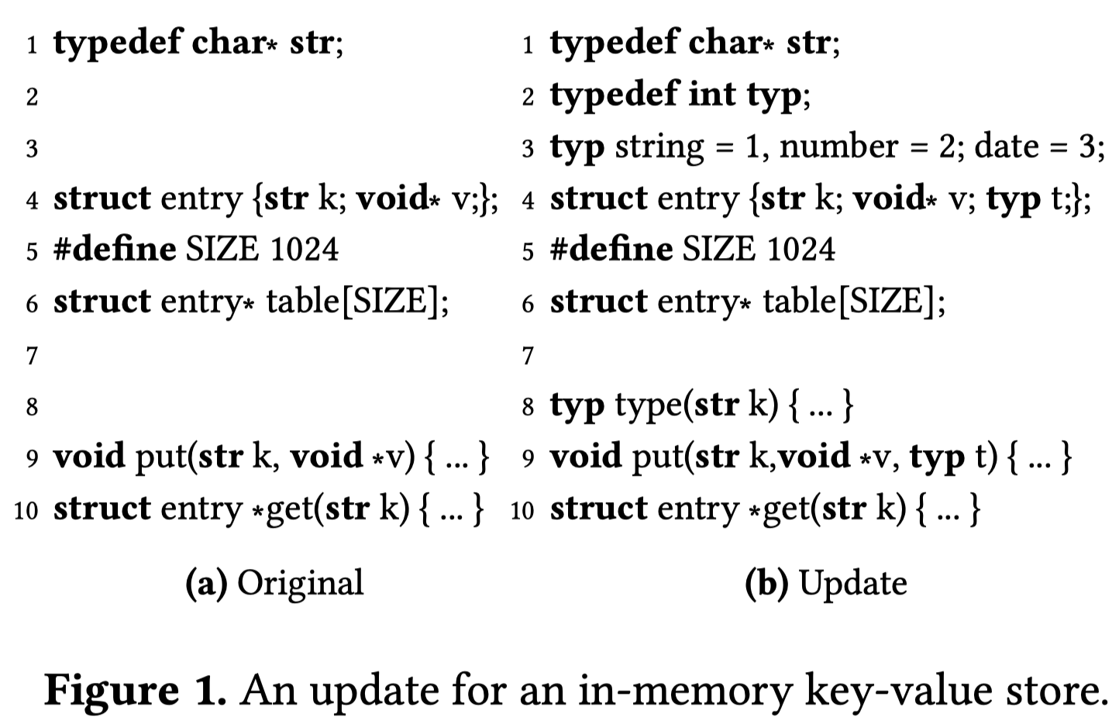
Update Example
Notes:
1a shows a key-value store's API. The global structure table has SIZE entries and contains the key-value store.
Figure 1b depicts a programme update that (1) adds a type field to input and (2) defines some standard types like string, integer, and date. Put now accepts typ as an additional argument.

Slide 13
Update Example: Challenges
Stop, Update and Restart ?
Will not work since table makes the program stateful
Rolling upgrades won’t work
Same problem as above, individual nodes are stateful
Checkpoint state before restart ?

Slide 14
Update Example: Challenges
Checkpoint state before restart ?
State format may change between versions
Needs backward-compatible checkpoint/restore protocol
Lengthen the latency of the full-service update
10GB Redis heap -> 28 seconds
1GB H2 heap -> 13 seconds
Issues if state replication
Restarted node will warm its state from nearby replicas
State representation changes need a version-compatible replication protocol update
Warming a replica after an update might take a long, affecting performance.
Notes:
When the way a state is represented changes, the replication protocol needs to be changed so that it works with all versions. Even if this change is made, it can take a long time to warm up a replica after an upgrade, which can hurt performance in the meantime.

Slide 15
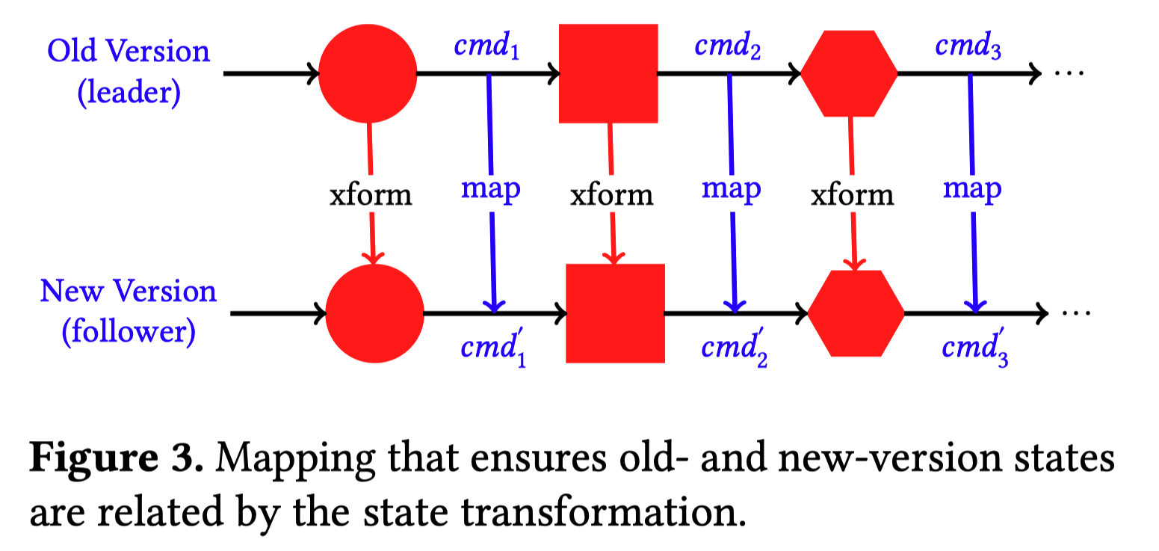
Mvedsua: Old-version Leader Mappings
Checks that no bugs in new version or update
Confirms that backward-compatible API portion act the same before and after update
Programmer should write a mapping that ensures that after processing each client command, both the old version and new version are in compatible states
If the dynamic update had happened before any of these commands, it would have produced an MVE system in the same state

Slide 16
Mvedsua: Old-version Leader Mappings
Examples:
PUT-number balance 1001
Rejected by the old version but accepted by the new version
PUT-type on leader should issue bad-cm on new version
If new version removed support for PUT
Map PUT to PUT-string in new version
Notes:
write rules to translate new commands that the leader does not understand to commands that the follower does not understand either

Slide 17
Mvedsua: New-version Leader Mappings
Required during the updated leader stage
If new version presents mostly backward compatible client API, then little work involved
Example:
PUT-type command
If type is string, then map the command to a normal PUT command (string is the default type)
For other values of type, there is no possible mapping
Old-version follower will diverge from the leader and be terminated
Inability to deal with new-version commands means that updated-leader stage is likely to be less useful at finding update-related errors compared to outdated-leader stage

Slide 18
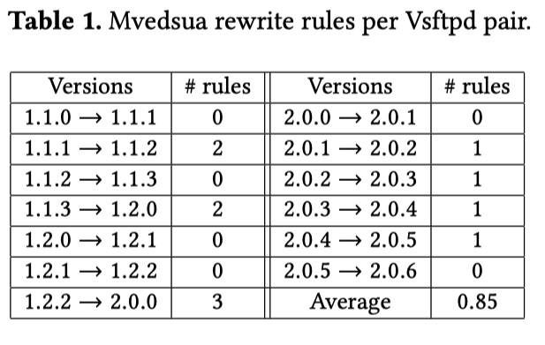
Case Studies
Vsftpd (open-source FTP server)
14 versions tested in 13 pairs
1 DSL rule per update on Average
Same number for forward and reverse
mapping
Latter were easily derived from the former
Version 1.2.0 introduced new command
STOU: stores a unique file in the current working directory
If old version is leader
Rule to trigger an invalid command on the new version
If new version is leader
Vsftpd has no state about the file system
Thus, leader executes the STOU command

Slide 19
Experimental Evaluation
Memcached required interesting code changes (about 100 lines) to work properly with Mvedsua
Reason: It has multiple threads and stateful libraries
3–9% overhead on throughput during normal operation
0–3% for Kitsune alone
25–52% overhead when monitoring an update
Essentially matches Varan’s overhead
Eliminates update pauses completely
Recovers from real and realistic update errors

Slide 20
Experimental Evaluation (2)
Performance
Redis 2.0.0 -> 2.0.1, benchmark used Memtier
Memcached 1.2.2 -> 1.2.3, benchmark used Memtier
Vsftpd 2.0.5 -> 2.0.6, Custom Benchmark script
Script logs in and repeatedly downloads a file for 60 sec before logging out
“small” version uses 5B file
Stresses user-space FTP command processing
“large” version uses 10MB file
Stresses kernel-space syscall processing, load on Varan
Performance results reflect a worst-case scenario
Client on the same machine as the server
Realistic scenario: Client and server on different machine
network latency would hide some of Mvedsua’s overhead

Slide 21
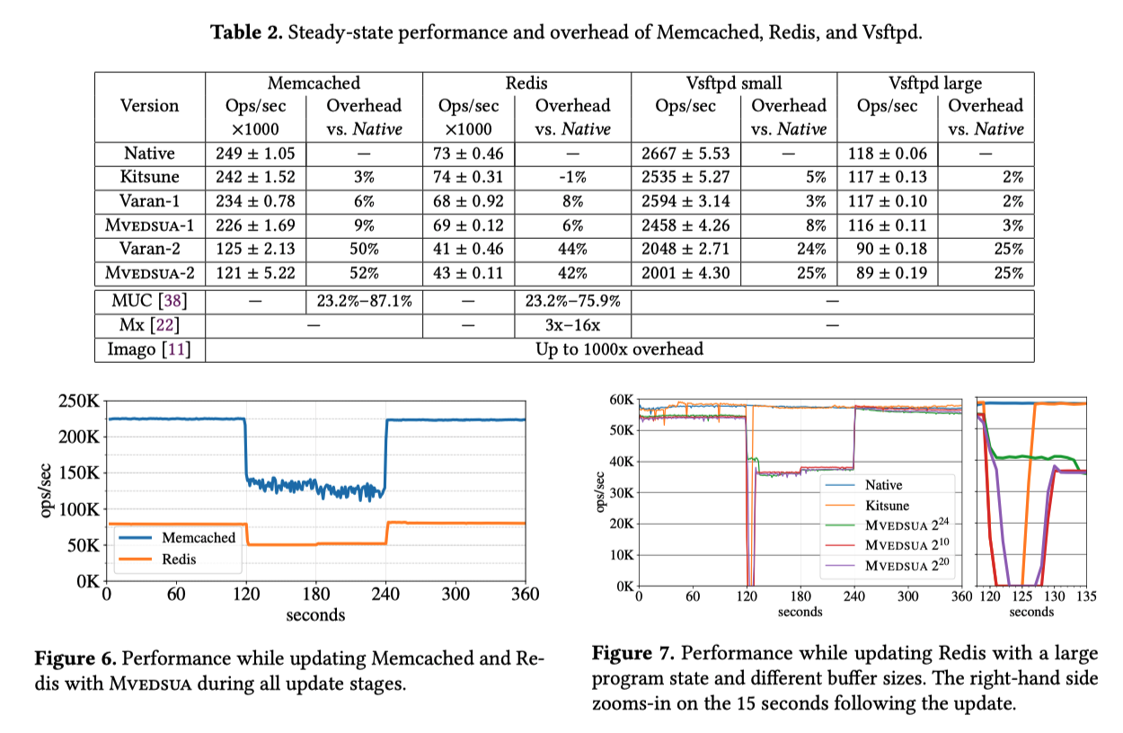
Experimental Evaluation (3)
Notes:
Mvedsua-1 represents a program’s normal mode of operation, and its overhead is small compared to a Native binary: 3–9%
Mvedsua-2 imposes around 50% overhead, but is only enabled for a relatively short period just during an update and afterward

Slide 22
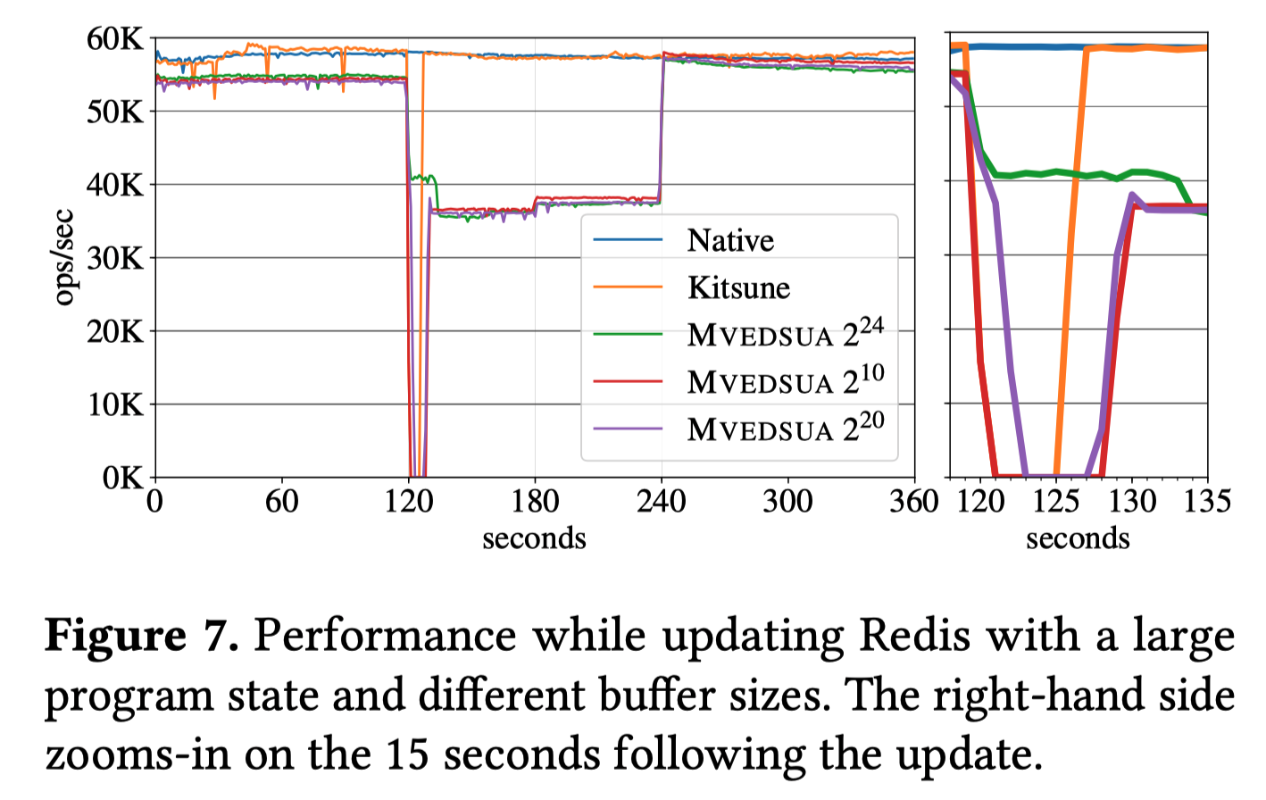
Experimental Evaluation (4)
Key takeaway: Service never stops during the updating process.
maximum latencies
Kitsune: 5040±101ms
Mvedsua-2^10: 7130 ± 45ms
Mvedsua-2^20: 5330 ± 100ms
Mvedsua-2^24: 117 ± 41ms
Native: 100 ± 46ms.
With large enough ring buffer, Mvedsua can mask the update pause introduced by DSU.

Slide 23
Experimental Evaluation (5)
Fault Tolerance
Error in the New Code
2.0.1 version: Redis crashes if HMGET called on the wrong type of data
Sending a bad HMGET command
Dynamic update with Kitsune: Program crashes
Mvedsua: Follower fails, and execution reverts to single-leader mode
Error in the State Transformation
A Kitsune-developed had bug that released memory still in use by LibEvent, causing a crash if the memory allocator reused it
This issue occurred when a significant number of clients were connected to Memcached
Kitsune crashed instantly
Mvedsua tolerates new-version crashes & executes old-version without clients knowing
Timing Error
There was a timing error in Memcached dynamic update
Configured Mvedsua to retry the update after waiting 500ms
Observation: update was always installed eventually
Notes:
Timing error was already fixed by adding code, but they still wanted to test how Mvedsua will tolerate this error

Slide 24
Advantages
Mvedsua significantly reduces the update-time delay
Imposes little overhead in steady state
Variety of update related errors

Slide 25
Thank You

