Slide 1
Progressive polynomial approximations for fast correctly-rounded math libraries
Systems Reading Group 2022
Mridul Aanjaneya, Jay P. Lim, Santosh Nagarakatte
Discussion Lead : Sorav Bansal

Slide 2
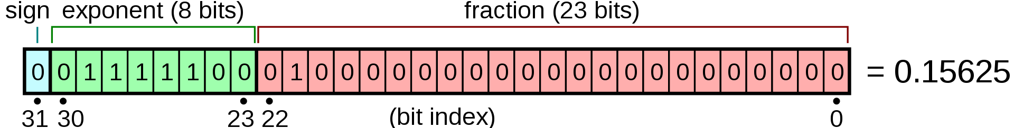


Floating Point

Slide 3
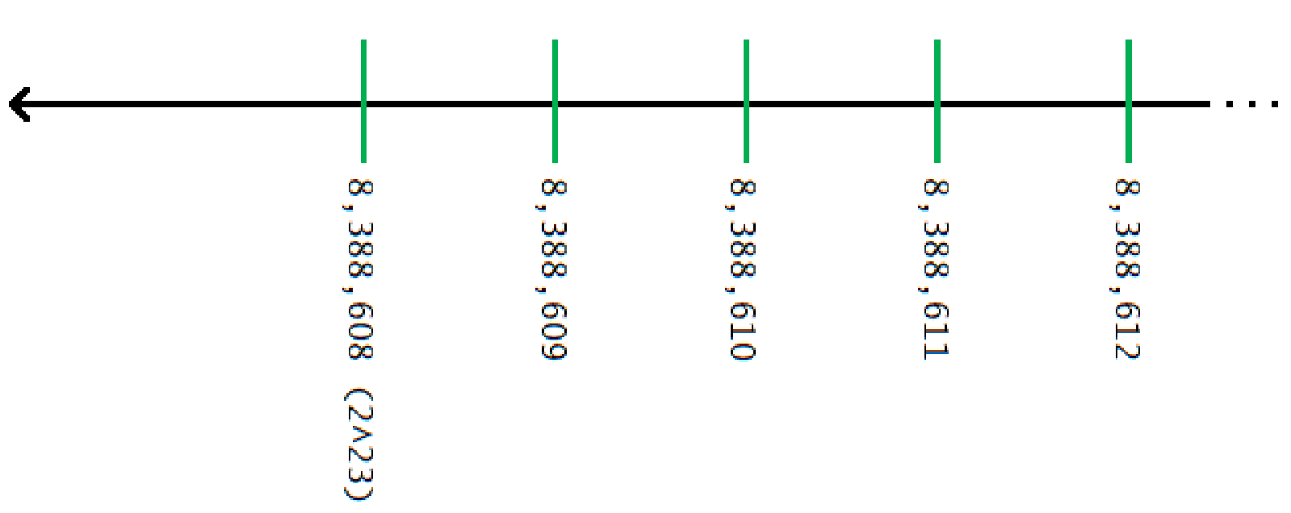
Number Line (Green lines mark representable values)

Slide 4
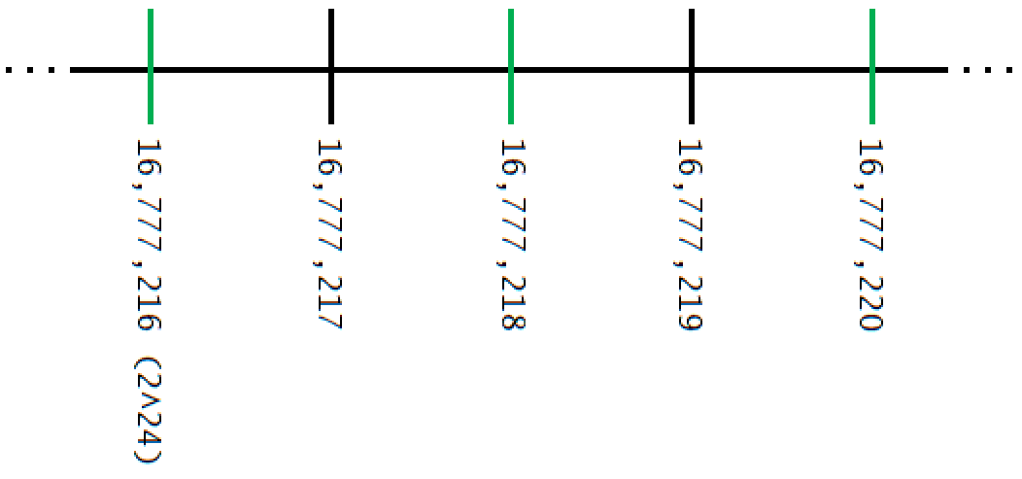
Number Line (Green lines mark representable values)

Slide 5
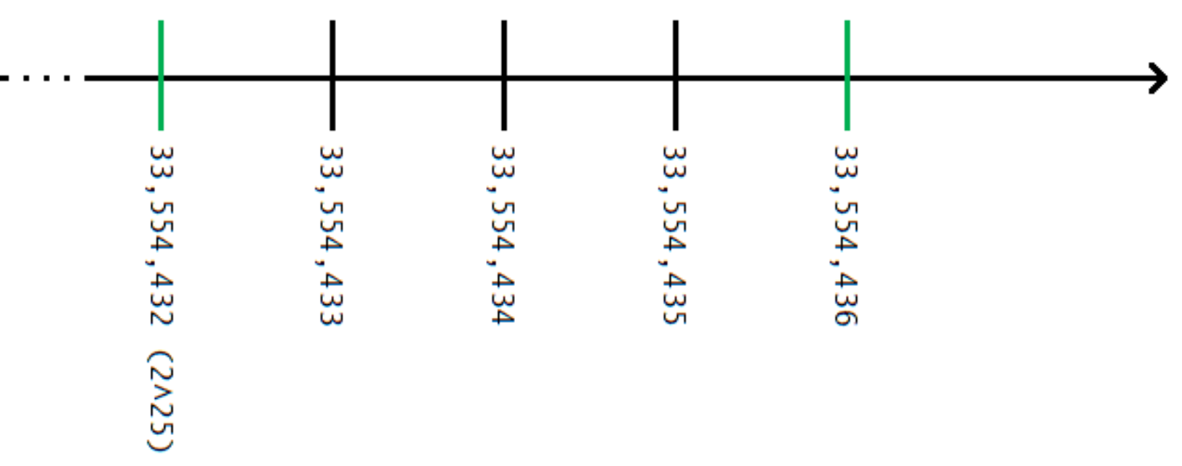
Number Line (Green lines mark representable values)

Slide 6
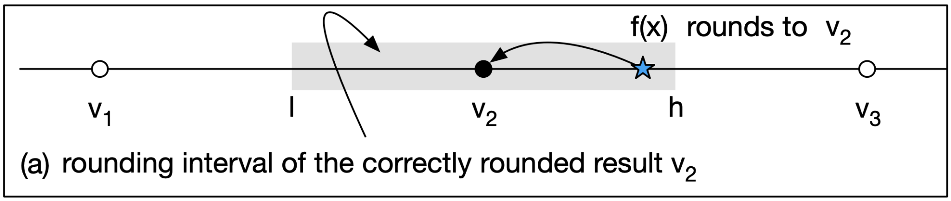
Elementary Functions (log x, e^x, sin x, cos x, …)
If the input (x) is a floating point number
The output is a real number that is usually not a representable value
Five rounding modes
Round to nearest; ties to even
Round to nearest; ties away from zero
Round up (towards +infinity)
Round down (towards -infinity)
Round toward zero
bfloat16
IEEE 754
tensorflow32

Slide 7
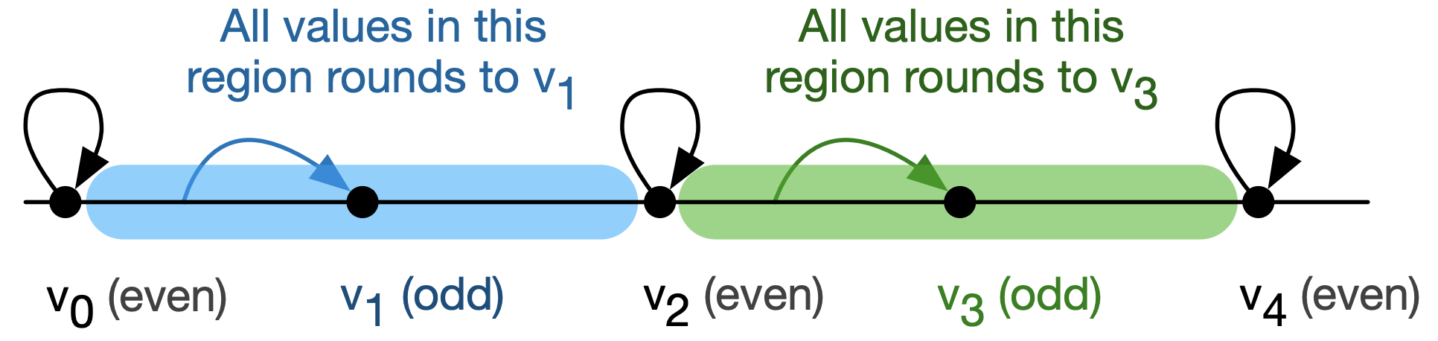
Example : Round to Odd

Slide 8
How are these functions implemented today (mechanism)
Hardware instructions
Software implementations

Slide 9
How are these functions implemented today (algorithms)
Polynomial Approximations
Find a polynomial, e.g., of degree 5, that produces a real-valued number close to the actual answer for a given range of inputs.
Possible to segment the input space at the cost of more memory consumption
Minimax strategy : Bound the maximum error of such a polynomial approximation
Important: This strategy works on (infinite precision) real numbers

Slide 10
Characteristics of the Minimax strategy
Pros
Efficient to identify in real-valued algebra?
Cons
Rounding errors
Not necessarily the most efficient implementation possible

Slide 11
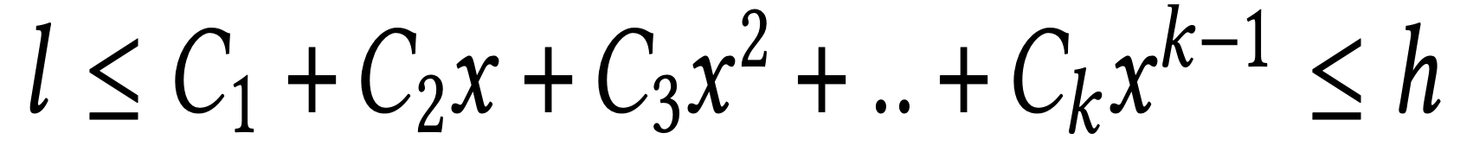
This paper
Six-term Fifth-degree Polynomial

Slide 12
Objective of the ALgorithm
Find C1, C2, …, Ck, such that these equations are satisfied for all possible input values of floating point numbers “x” and the corresponding (infinite precision) output values “l” and “h”

Slide 13
Naive Algorithm
Enumerate all possible inputs (e.g., 2^32 inputs for 32-bit values)
Create that many inequality constraints
Send these constraints to an Linear Programming (LP) Solver
Problem: Modern ILP Solvers cannot solve such large problem sizes (2^32 constraints)
Potential Solution: Use input segmentation (at the cost of more memory)

Slide 14
Tackling Rounding Modes
Naive Approach
Create a separate ILP for each rounding mode and solve separately
Prior work of the Authors (RLIBM-ALL)
If the precision of the floating point representation is “n” bits
If we generate a polynomial approximation that produces correctly rounded results for a FP representation of “n+2” bits using the round-to-odd mode
This output can be used to generate correctly rounded results for all other rounding modes with “n” bits of precision
Used segmentation of Input Space

Slide 15
Progressive Polynomials : A Harder Problem
Find a polynomial approximation
That generates the correctly rounded result for Float32 representation when all terms are used
That generates the correctly rounded result for a smaller representation (e.g., bfloat16) when a subset of the terms are used

Slide 16
Progressive Polynomials : A Harder Problem
Find a polynomial approximation
That generates the correctly rounded result for Float32 representation when all terms are used
That generates the correctly rounded result for a smaller representation (e.g., bfloat16) when a subset of the terms are used
Similar Solution (if we can get it to scale) Add more constraints to the LP Formulation for the lower-precision representation using the exact same coefficients

Slide 17
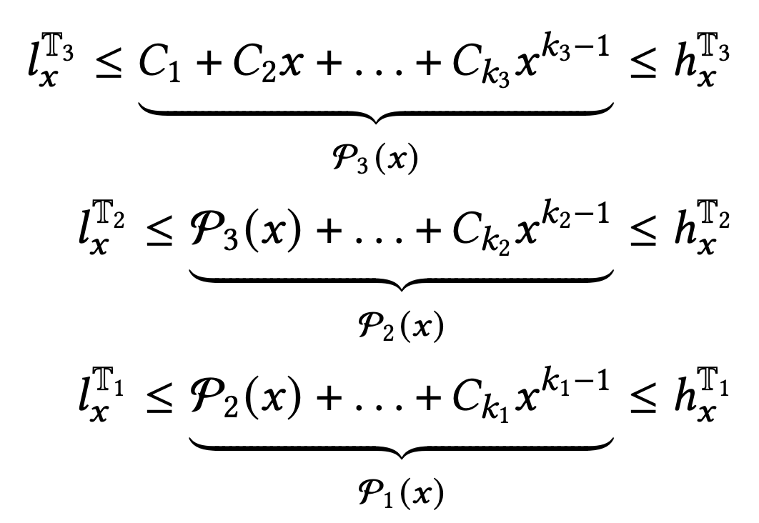
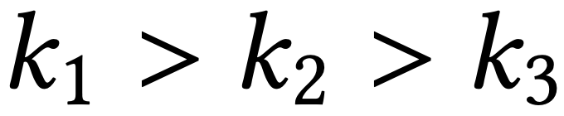
Formulation for Progressive Polynomials

Slide 18
Key Idea based on Prior Work (Authors were previously unaware of this prior work)
If there exists a solution to the LP, then that solution is a “low rank” solution, e.g., rank of 6 for a six-term polynomial.
However there are millions (or billions) of constraints on the same (small) set of coefficients.
If we can have an algorithm that identifies some subset of the constraints that are “full rank” constraints (linearly independent constraints), we are done
The solution of the full-rank constraints will be a solution to all constraints

Slide 19
But we do not know the rank a priori (although we know that it is likely small)
Iteratively increase the number of terms for the entire polynomial
And for the individual representations
Until we find a solution
It takes a long time to find the solution. But the solution is efficiently implemented in the library (Synthesis)

Slide 20
Clarkson’s Method
Fast randomized algorithm to identify k linearly independent constraints that identifies the polynomial of degree k
Let “M” be a multi-set of constraints (millions to billions)
Step 1: Sample 6k^2 constraints S from M uniformly at random
Step 2: Solve S using an LP solver, solution x*
Step 3: Check how many constraints of M are not satisfied by x*
If more than 1/3k of M constraints are not satisfied, discard this sample and goto Step 1
Else lucky, add all constraints not satisfied by x* another time to M (to increase their weights)

Slide 21
More details in the paper
How to represent a multi-set of billions of elements with uniform random sampling efficiently
Proof that this algorithm solves the system of equations (if a solution exists) in 6k log(n) iterations, where n is the number of elements in M
Input range reduction and output compensation

Slide 22
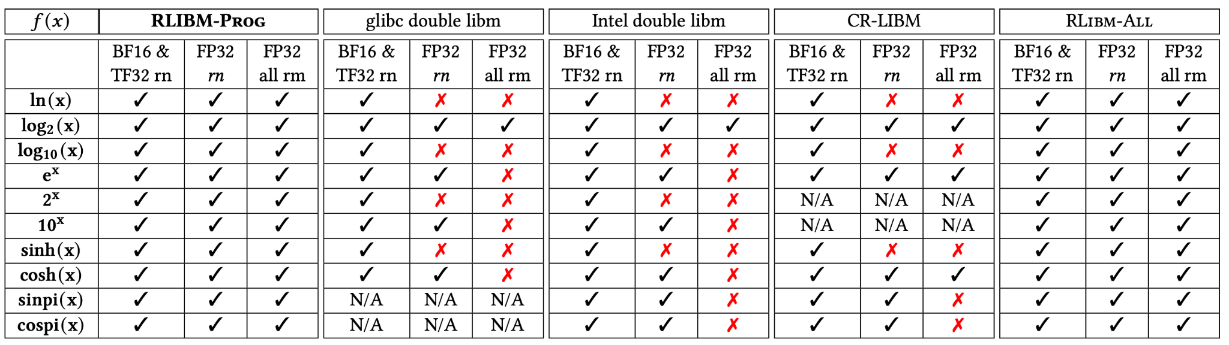
Experimental Evaluation

Slide 23
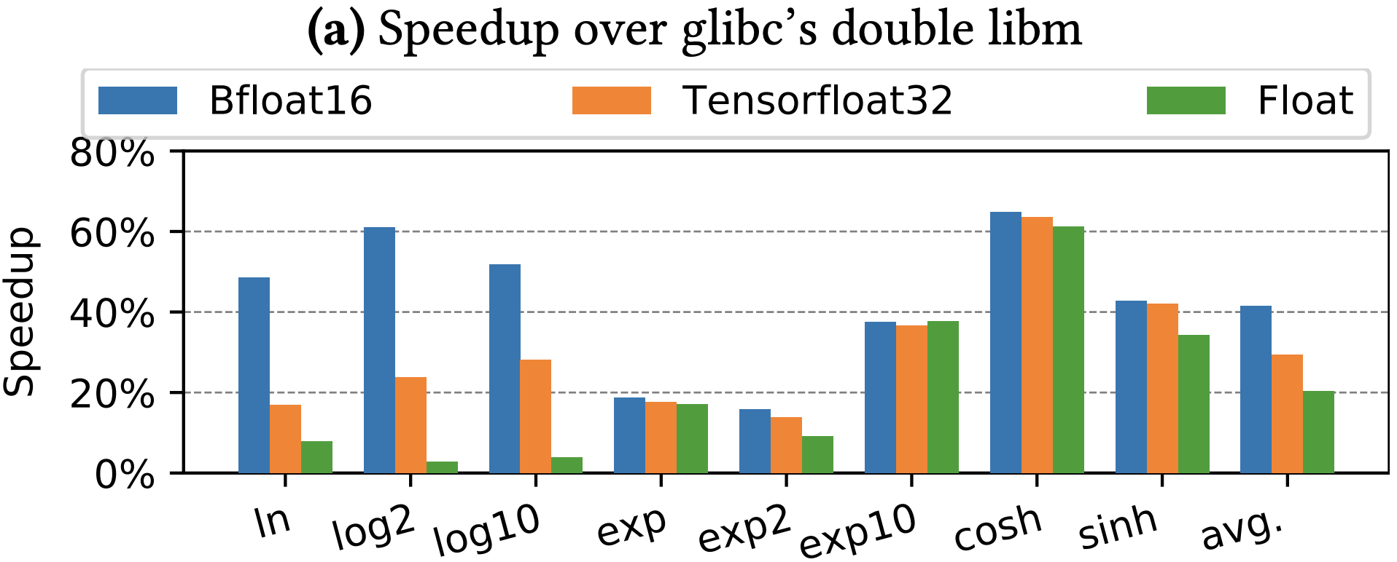
Performance of Generated Code

Slide 24
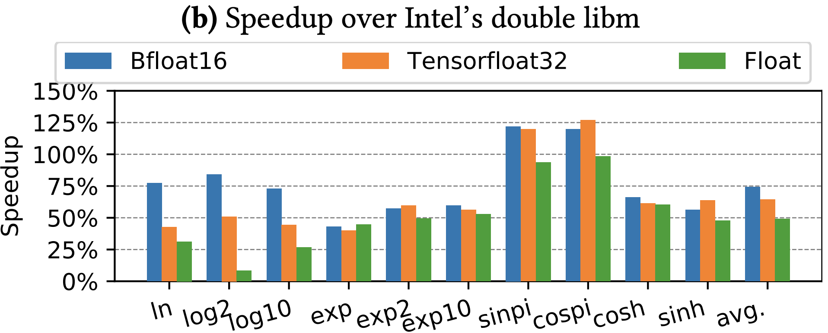
Performance of Generated Code

Slide 25
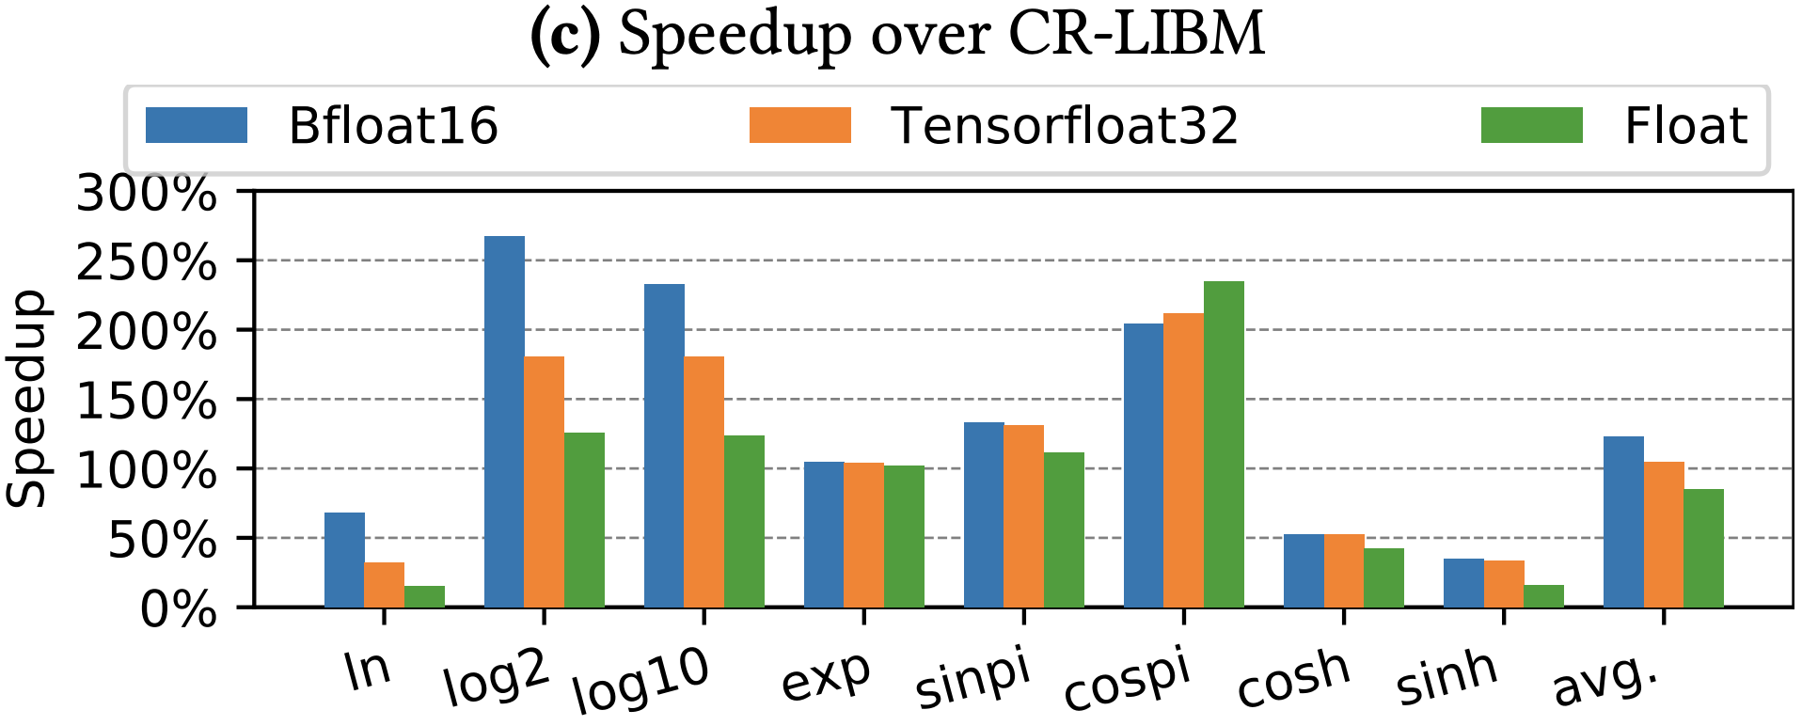
Performance of Generated Code

Slide 26
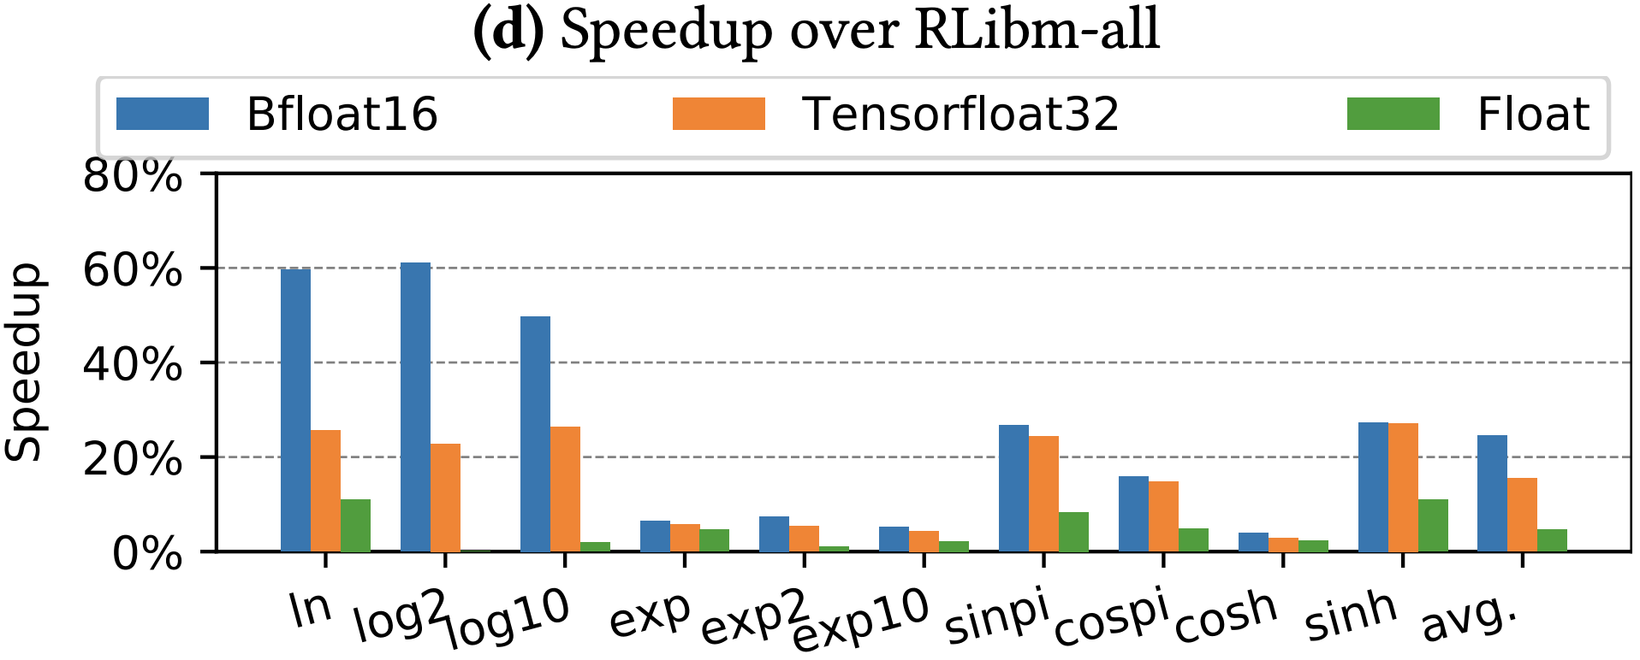
Performance of Generated Code

Slide 27
Other Results
4-158x memory reduction over RLIBM-ALL
Progressive performance
Bfloat16 and tensorflow32 are 25% and 16% faster than evaluating the entire polynomial
Three polynomial approximations (ln x, log2 x, log10 x) now incorporated into LLVM’s math library

Slide 28
Discussion
Can we go beyond polynomials?
Single term polynomials are sufficient? Really?
Which terms to use for lower precision, in the progressive polynomial?

