Slide 1

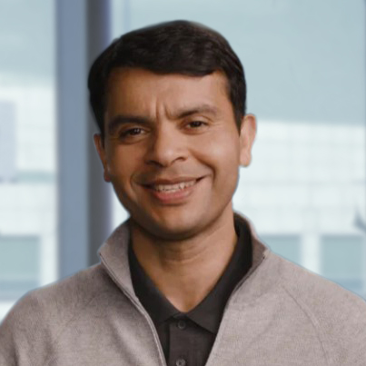

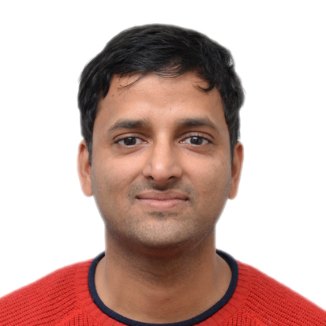
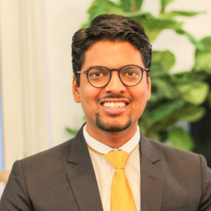
Winter Systems School
Supported by the Mohit Aron Endowment
Mohit Aron
Founder Cohesity. Co-founder Nutanix.
Inaugural talk: The Entrepreneurial Journey
Duration: Dec 5th-9th, 2022
Eligibility: UG/PG students interested in systems.
Financial support: In-campus lodging. Paid summer internships for selected students.
More on https://systems-rg.github.io/wss22
Sorav Bansal
Faculty, CSE IITD
Topic: Cybersecurity
https://sorav.compiler.ai/
Abhilash Jindal
Faculty, CSE IITD
Topic: Cloud computing
https://abhilash-jindal.com/

