Slide 1

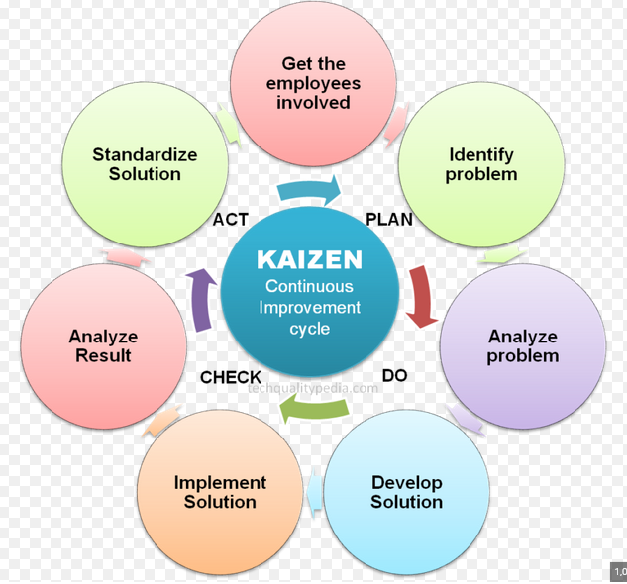

Slide 2




(2) Conscious Incompetence
(3) Conscious Competence
Wrong Analysis: You’re self aware you need to improve!
Right Analysis: You can now see yourself getting better
Lower ← Levels of Consciousness → Higher
Right Intuition: You’re so good, you do not have to think about the task to do it!
Wrong Intuition: You’re so bad, you don’t even know it!
(4) Unconscious Competence
(1) Unconscious Incompetence
Lower ← Levels of Competence → Higher

Slide 4
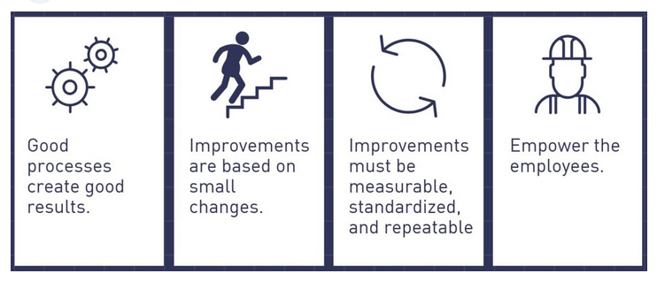
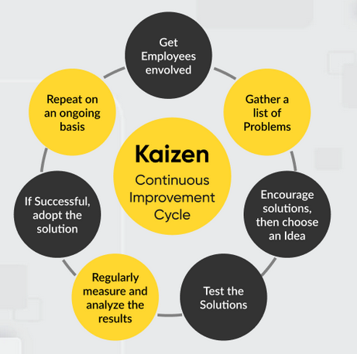

Slide 5


