Slide 1
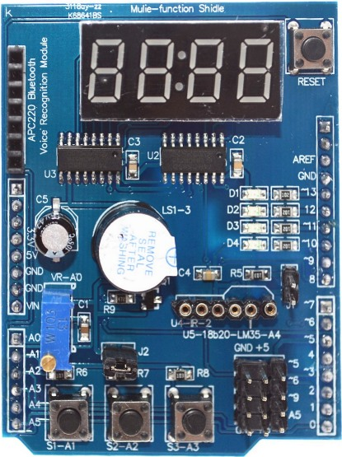
4 Digit, 7 Segment Display
LATCH = 4, CLK = 7, DATA = 8
LED
D1 = 13 Port
D2 = 12 Port
D3 = 11 Port
D4 = 10 Port
BUZZER 3 PORT
10K POT = A0
BUTONLAR
S1 = A1 Port
S2 = A2 Port
S3 = A3 PorT
http://arduinolearning.com/code/multi-function-shield-examples.php
https://www.cohesivecomputing.co.uk/hackatronics/arduino-multi-function-shield

