Slide 1
Isomorphic Javascript
陈柏信

Slide 2
What is isomorphic javascript?
Codes can run on browser and server. (Why?)
About the name:
https://news.ycombinator.com/item?id=6714349
https://medium.com/@ghengeveld/isomorphism-vs-universal-javascript-4b47fb481beb
Universal Javascript? Isomorphic Application?

Slide 3
What can it do for us?
Isomorphic web application
server rendering + client rendering
Why?
Reusability
User-friendly (SPA: perceived load time)
SEO
…

Slide 4
How to implement an isomorphic web app?
Framework & libraries - http://isomorphic.net/
Implementation points
To keep routers and application states the same
Codes can be reused on both client and server side
…

Slide 5
Take React.js as an example
https://github.com/bossonchan/isomorphic-javascript-demo

Slide 6
Introduce of React.js
Represent the View layer in MVC architecture
Virtual Dom
react.render() for client rendering
react.renderToString() for server rendering
…

Slide 7
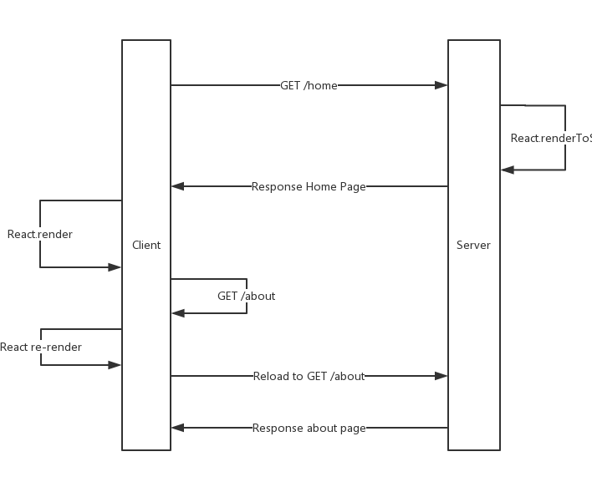
isomorphic react

Slide 8
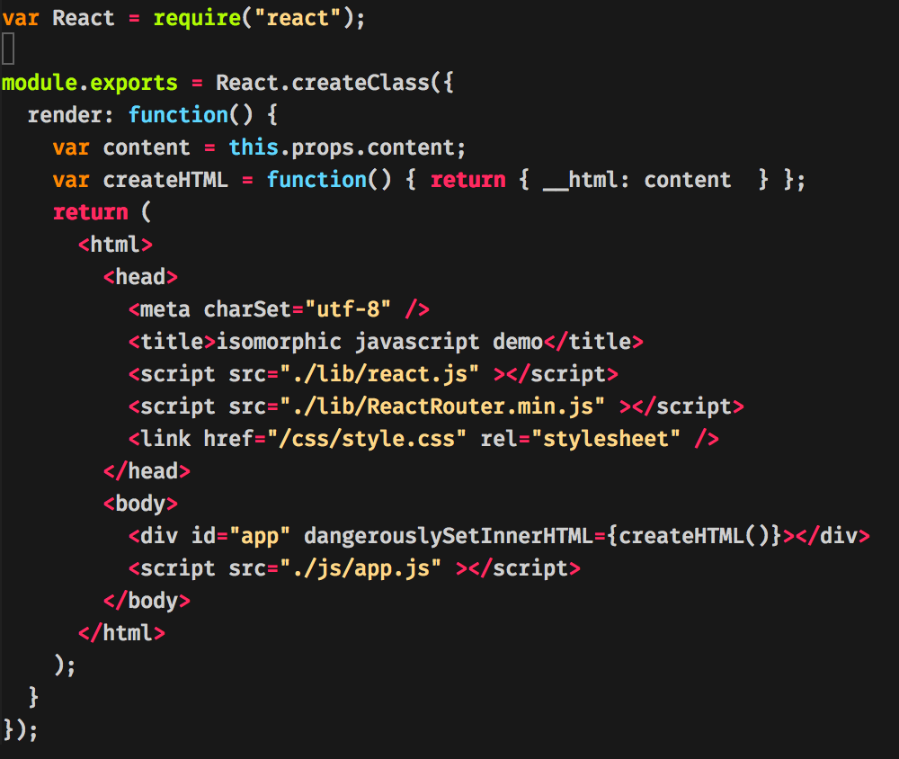

Slide 9
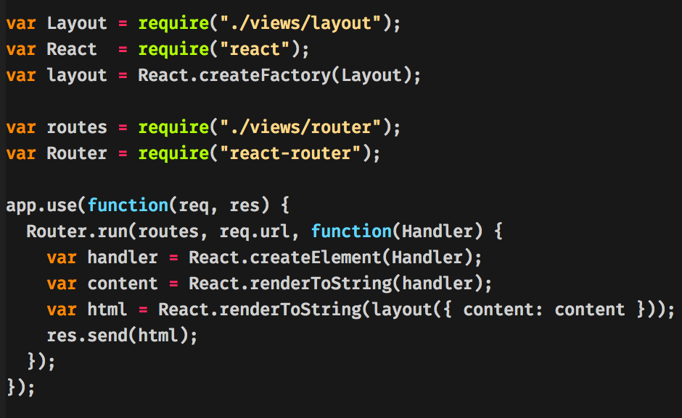
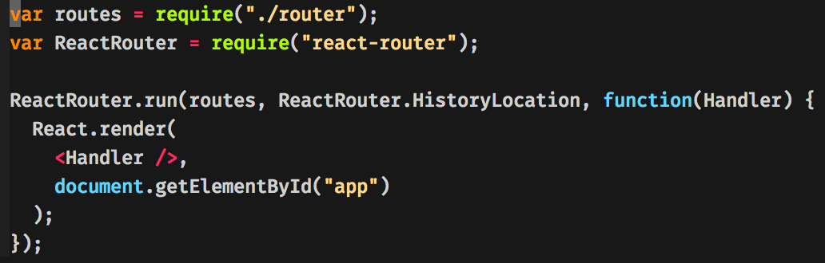

Slide 10
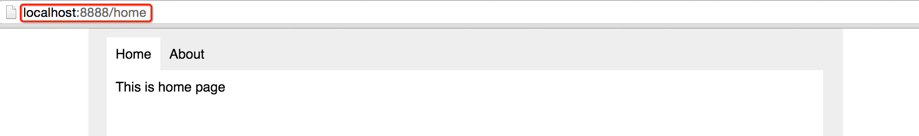
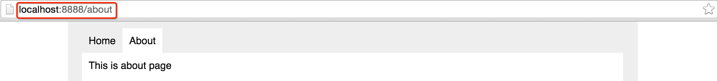
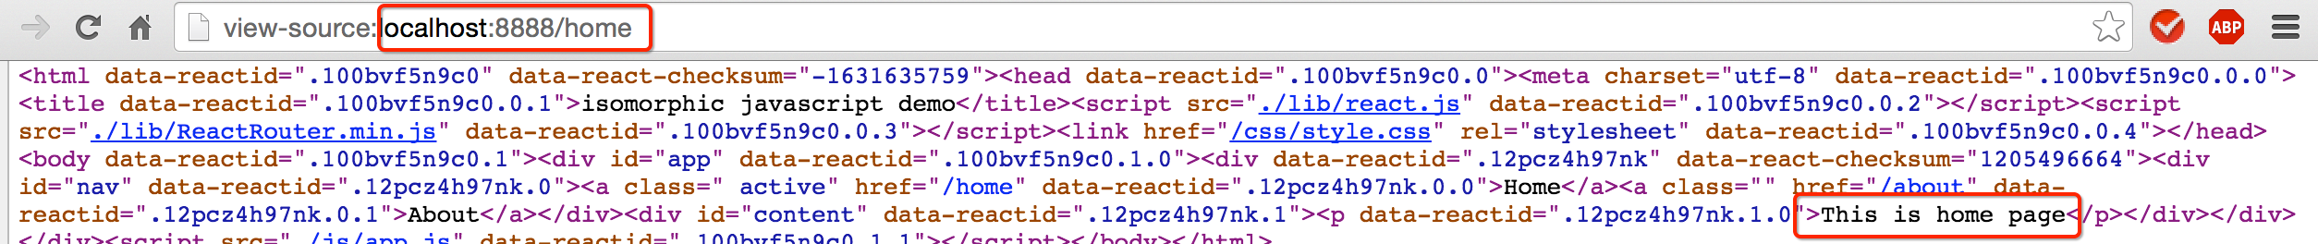
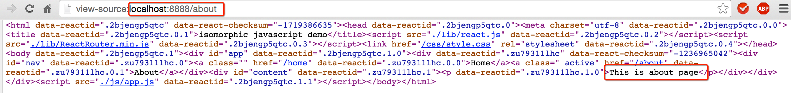

Slide 11
Websites using isomorphic javascript
https://www.state.com
https://www.medium.com
…

Slide 12
Reference
https://medium.com/@fteissier/going-isomorphic-with-reactjs-and-flux-73873a2f7f8
http://nerds.airbnb.com/isomorphic-javascript-future-web-apps/
https://thebhwgroup.com/blog/isomorphic-web-design-react-scala
https://medium.com/@ghengeveld/isomorphism-vs-universal-javascript-4b47fb481beb

Slide 13
Thanks!

