Slide 1
Javascript Bridge for Hybrid web application
陈柏信

Slide 2
Hybrid web app
What is it?
Drawbacks
Not only the performance and network..
the limit of capabilities comparing to native app

Slide 3
Javascript Bridge to the rescue!
Establish communication between javascript and native app
Support asynchronous processing
Support caching data

Slide 4
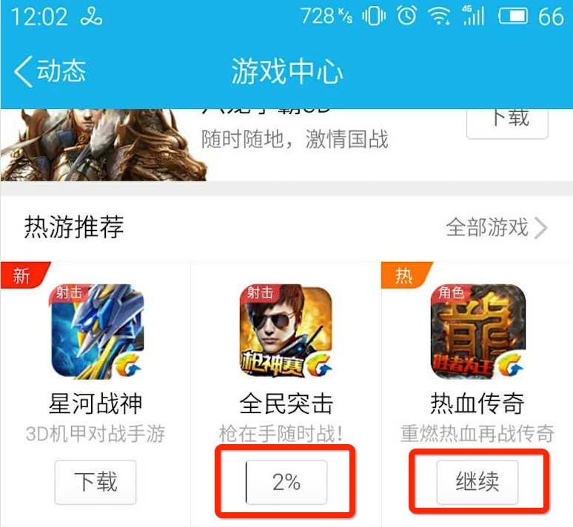

Scenarios

Slide 5
The ideas behind Game Centre
The main module: mqq.js/qqapi.js
What does it do?
Providing methods to call native app’s methods
Bridging web page and native app

Slide 6
Implementation Details
Protocols
Such as: jsbridge://xxx/xxx?data=xxx
Native App
Focus on the WebView component
Web Page
Sending fake request using iframe
Encapsulating the asynchronous process

Slide 7
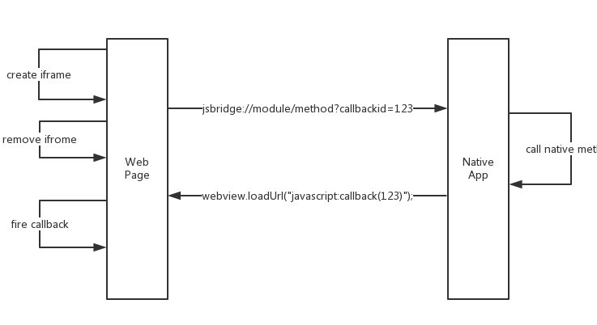
How does Javascript bridge work?

Slide 8
Demo

Slide 9
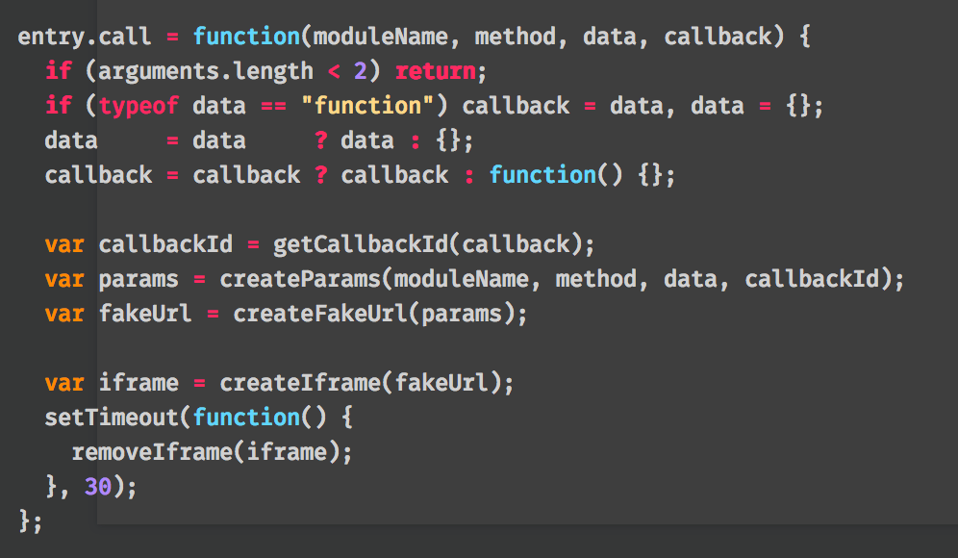
bridge.js

Slide 10
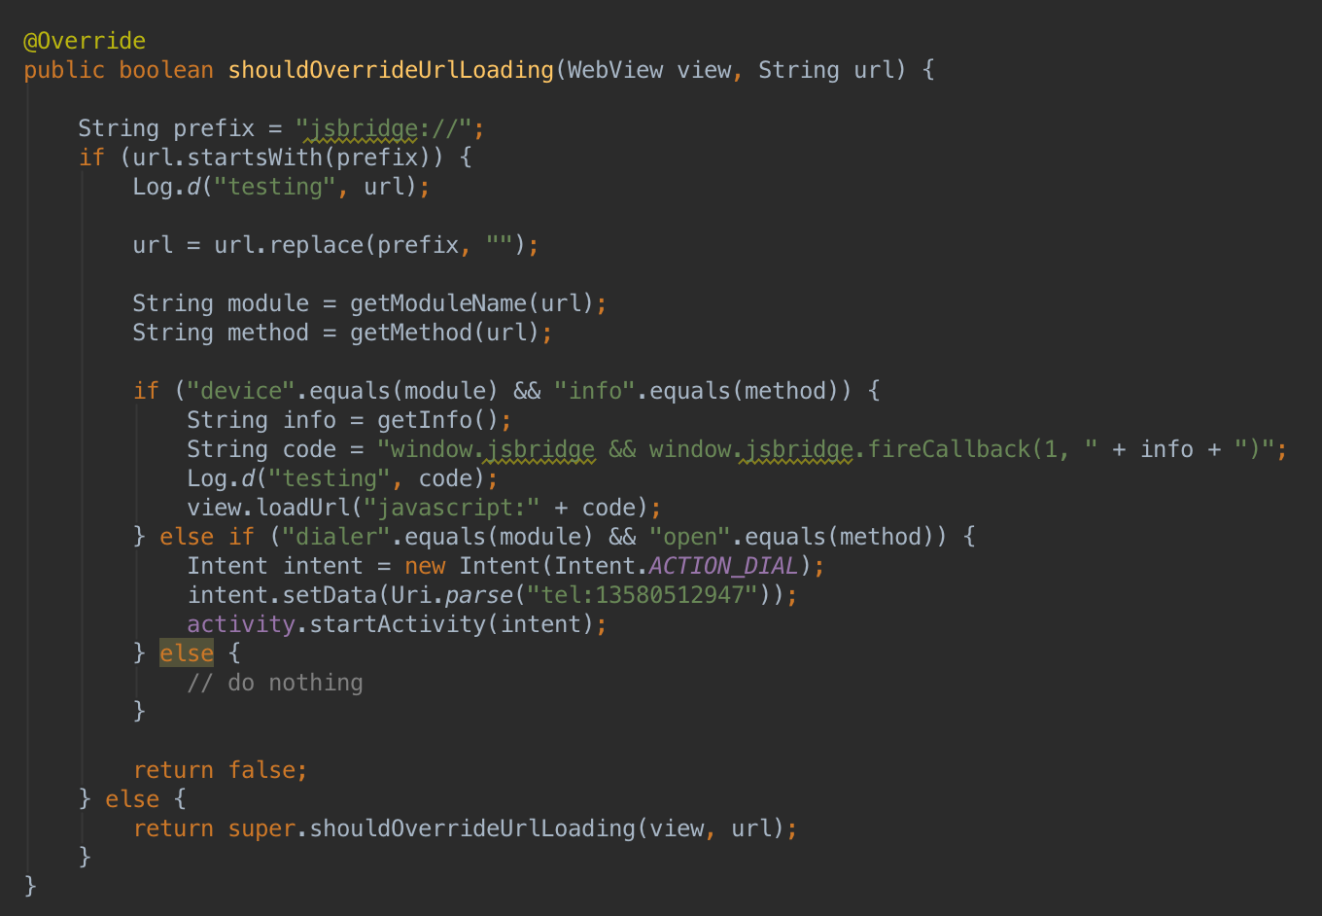
WebViewClient

Slide 11
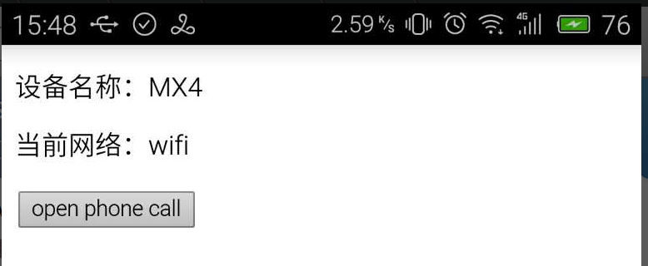
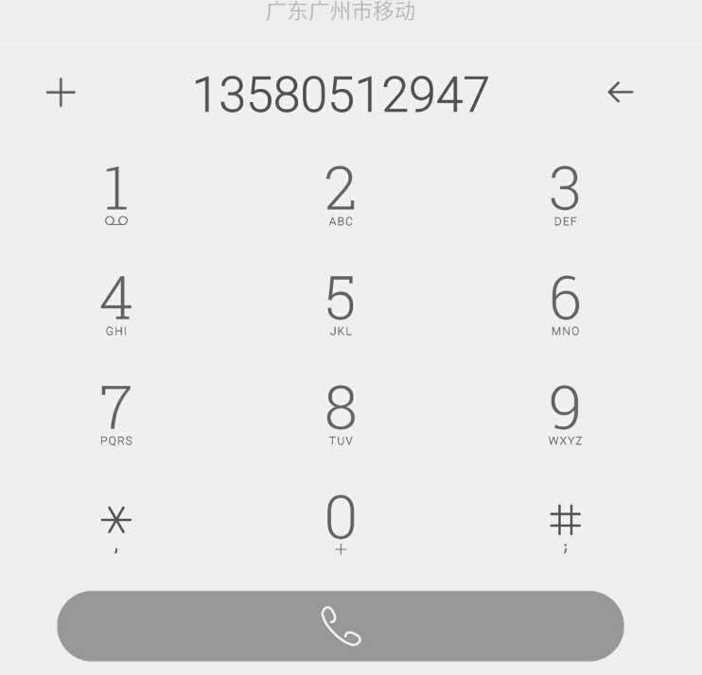

Slide 12
Reference
http://bridgeit.mobi/
http://stackoverflow.com/questions/19937424/hybrid-ios-web-and-native-app-events-communication
http://www.smashingmagazine.com/2014/10/providing-a-native-experience-with-web-technologies/

Slide 13
Thanks!

