Slide 1
Welcome to Machine Learning
14 计科二班 黄志豪
huangzhihaoyx@163.com

Slide 2
Mainly including:
When Can Machines(Computers) Learn?
--The Learning Problem
--Types of Learning
--Relations with AI, DM
How Can Machines(Computers) Learn?
--Linear Regression
--Logistic Regression
More Learning Techniques…
--Embedding Numerous Features: Support Vector Machine
--Distilling Hidden Features: Deep Learning
Some Warnings!
--Learning Curve
--Hazard of Overfitting

Slide 3
The Learning Problem
Plausible Definition of ML:
To improve some performance measure with experience computed from data.
Improved performance measure
data
ML
Example:
Stock data
More investment gain
ML

Slide 4
More applications to ML…
Little children ‘learn’ to recognize something…like trees, foods and peoples etc.
Spam filters
Recommender systems
Speech/visual recognition
Google’s self-driven cars
And so on… include medical, financial, biology, and any other area you can imagine :-)
ML can be found everywhere nowadays

Slide 5
Relations with DM, AI
Machine Learning:
Use data to compute hypothesis g that approximates target f
Data Mining:
Use (huge)data to find property that is interesting
--DM can help ML, and vice versa.
--Difficult to distinguish ML and DM in reality
Artificial Intelligence:
Compute something that shows intelligent behavior
--ML is one possible route to realize AI

Slide 6
Why use ML?
ML is an alternative route to solve complicated problems
More concretely…
Exists some ‘underlying pattern’ to be learned
--so ‘performance measure’ can be improved
But no programmable(easy) definition
--so alternative route needed
Somehow there is data about the pattern
--so ML has some ‘inputs’ to learn from
key essence: help decide whether to use ML

Slide 7
Practical Definition of Machine Learning
Hypothesis set
H
Unknown target function
f: X → Y
Training examples
D: (x₁, y₁), …, (x_{N}, y_{N})
Learning algorithm
A
Final hypothesis
g ≈ f
Use data to compute hypothesis g that approximates target f

Slide 8
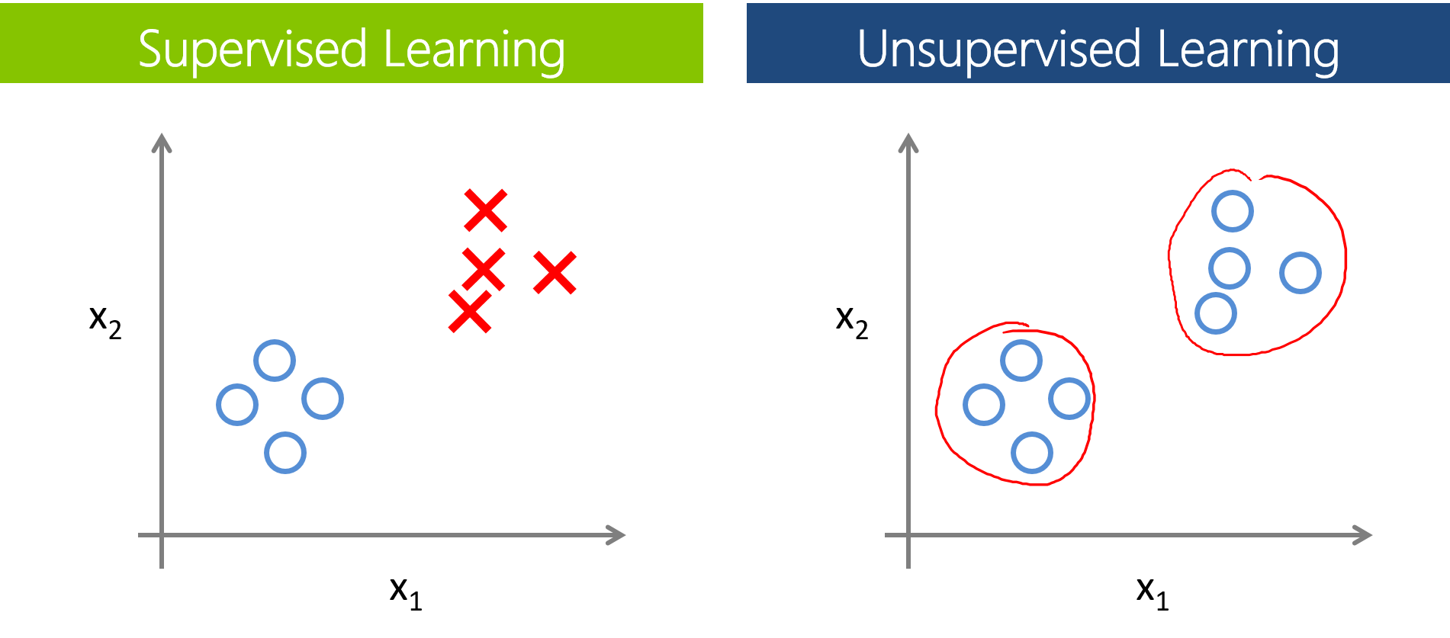
Types of Learning
Supervised Learning
--Learn from labeled training data, that means every x_{n} comes with corresponding y_{n}
Unsupervised Learning
--Learn from unlabeled training data.
--unsupervised multiclass classification <==> ‘clustering’
Semi-supervised Learning
--leverage unlabeled data to avoid ‘expensive’ labeling
--from Google images

Slide 9
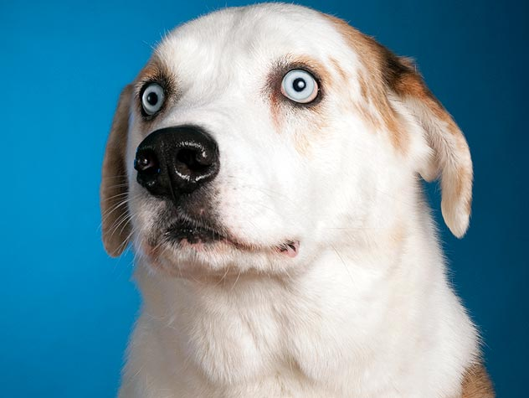
Reinforcement Learning
--a ‘very different’ but natural way of learning
Say ‘Sit down’ to your pet dog
The dog pees on the ground.
BAD DOG. THAT’S A VERY WRONG ACTION.
--Yes, we cannot easily show the dog that it should act ‘sit down’ when we say ‘sit down’ :-(
--But we can ‘punish’ the dog to let it know ‘pee on the ground’ is wrong :-)
Learn with ‘partial/implicit information’

Slide 10

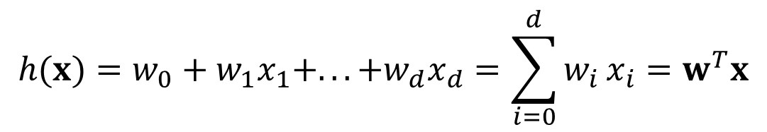
Linear Model
Before going on, we make a several of assumptions as follow:
Vector x^{(i)} = (x₁, x₂, x₃, …, x_{d}) which denotes the ith input feature, and y^{(i)} to denote the ith output variable.
A pair of (x^{(i)},y^{(i)}) is called a training example. So a list of m training examples {(x^{(i)},y^{(i)}) ; i = 1, …, m} --- is called a training set.
To simplify this, we usually write down this like:
$$h(x)=w_{0}+w_{1}x_{1}+...+w_{d}x_{d}=\sum_{i=0}^{d}{w_{i}}x_{i}=w^{T}x$$
$$\left(x_{0}=1\right)$$
Yup, we could also use polynomial models or any other much more complicated models. We would talk about this later. :-)

Slide 11
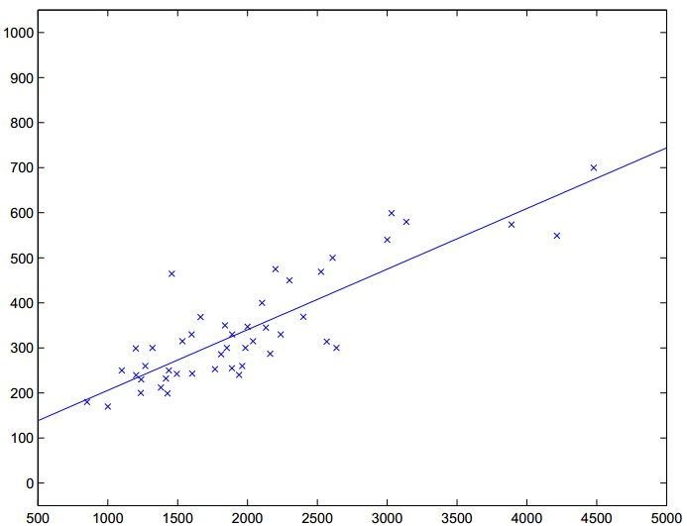
Linear Regression
So familiar? :-)
--from CS229, Stanford

Slide 12

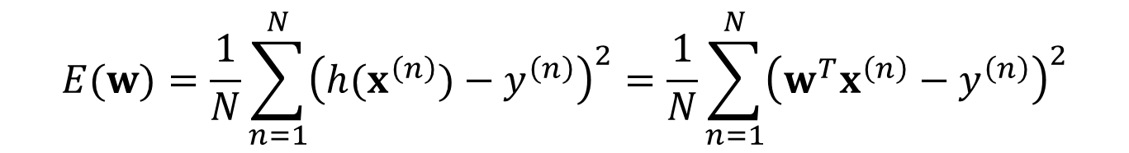

Note that N = #training examples
We now define the error function as below:
$$E(w)=\frac{1}{N}\sum_{n=1}^{N}{{\left(h(x^{\left(n\right)})−y^{\left(n\right)}\right)}^{2}}=\frac{1}{N}\sum_{n=1}^{N}{{\left(w^{T}x^{\left(n\right)}−y^{\left(n\right)}\right)}^{2}}$$
Do you remember:
$$\left.x^{\left(n\right)}=(x_{0}^{\left(n\right)},x_{1}^{\left(n\right)},...,x_{d}^{\left(n\right)}\right)$$
$$h(x^{\left(n\right)})=w^{T}x^{\left(n\right)}$$
Obviously, our goal is to minimize the error function!

Slide 13
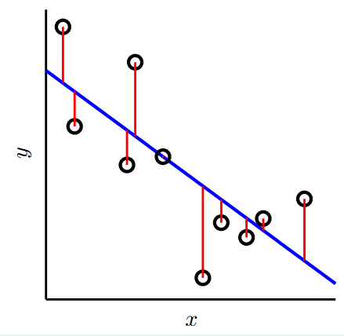
--from Machine Learning Foundations, Hsuan-Tien Lin

Slide 14
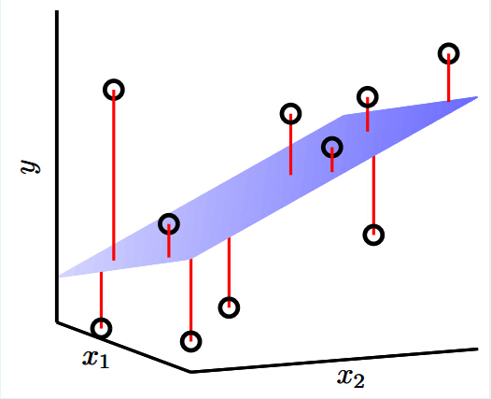
--from Machine Learning Foundations, Hsuan-Tien Lin

Slide 15
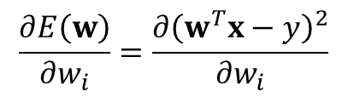
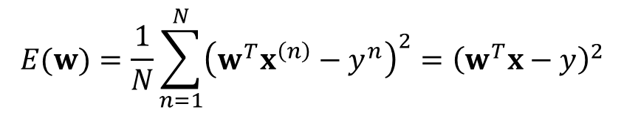
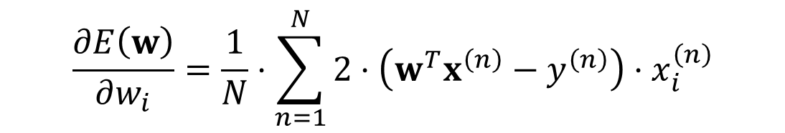

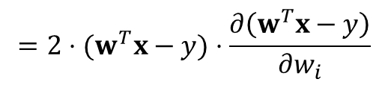
Gradient Descent
To simplify our derivation, we assume that we have only one training example. :-)
$$E(w)=\frac{1}{N}\sum_{n=1}^{N}{{\left(w^{T}x^{\left(n\right)}−y^{n}\right)}^{2}}={\left(w^{T}x−y\right)}^{2}$$
$$\frac{∂E\left(w\right)}{∂w_{i}}=\frac{∂{\left(w^{T}x−y\right)}^{2}}{∂w_{i}}$$
$$=2⋅(w^{T}x−y)⋅\frac{∂\left(w^{T}x−y\right)}{∂w_{i}}$$
$$=2⋅(w^{T}x−y)⋅x_{i}$$
More generally:
$$\frac{∂E\left(w\right)}{∂w_{i}}=\frac{1}{N}⋅\sum_{n=1}^{N}{2⋅\left(w^{T}x^{\left(n\right)}−y^{\left(n\right)}\right)⋅x_{i}^{\left(n\right)}}$$

Slide 16
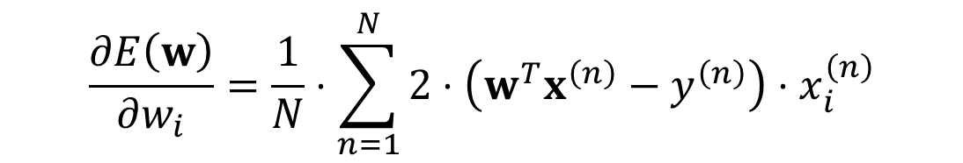
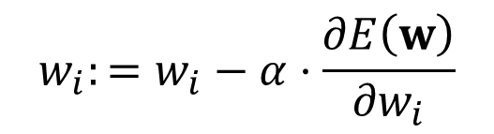
Batch Gradient Descent
So we derive the following algorithm:
Repeat until convergence {
$$w_{i}:=w_{i}−α⋅\frac{∂E\left(w\right)}{∂w_{i}}$$
(for every i)
}
We know that:
$$\frac{∂E\left(w\right)}{∂w_{i}}=\frac{1}{N}⋅\sum_{n=1}^{N}{2⋅\left(w^{T}x^{\left(n\right)}−y^{\left(n\right)}\right)⋅x_{i}^{\left(n\right)}}$$
Here, α is called the learning rate

Slide 17
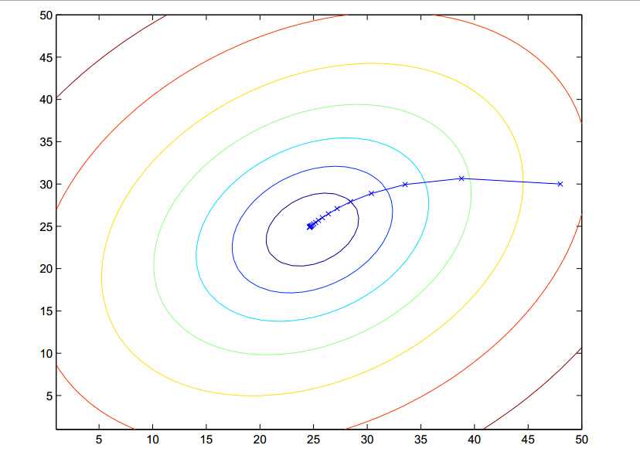
--from CS229, Stanford

Slide 18
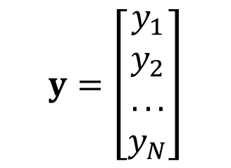
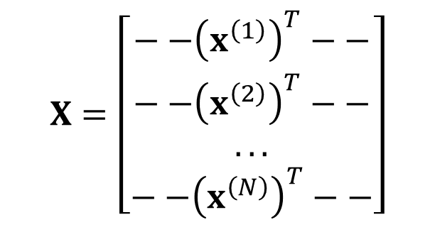


Analytic solution for LR
Construct input matrix X and output vector y by:
$$X=\left[\begin{matrix}−−{\left(x^{\left(1\right)}\right)}^{T}−− \\ −−{\left(x^{\left(2\right)}\right)}^{T}−− \\ ... \\ −−{\left(x^{\left(N\right)}\right)}^{T}−−\end{matrix}\right]$$
$$y=\left[\begin{matrix}y_{1} \\ y_{2} \\ ... \\ y_{N}\end{matrix}\right]$$
$$X^{†}$$
Calculate the pseudo-inverse
Finally, we get that:
$$w:=X^{†}y$$

Slide 19
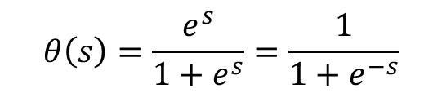
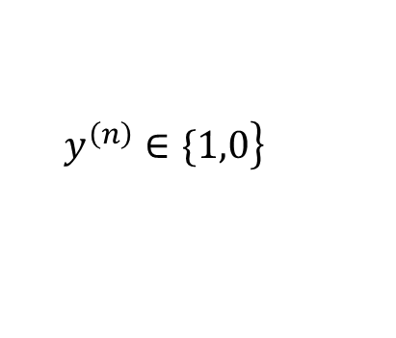
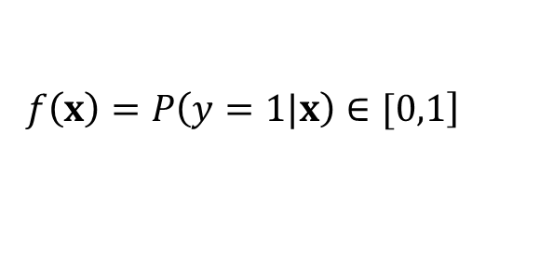
Logistic Regression
As for binary classification problem if:
$$\left.y^{\left(n\right)}∈\{1,0\right\}$$
Can we try to solve the classification problem?
--Of course! By using logistic regression, we can even solve ‘soft’ binary classification:
$$\left.f\left(x\right)=P\left(y=1|x\right)∈[0,1\right]$$
Sounds plausible than ‘hard’ binary classification, right?
First, we should have a glance at the logistic function:
$$θ\left(s\right)=\frac{e^{s}}{1+e^{s}}=\frac{1}{1+e^{−s}}$$

Slide 20
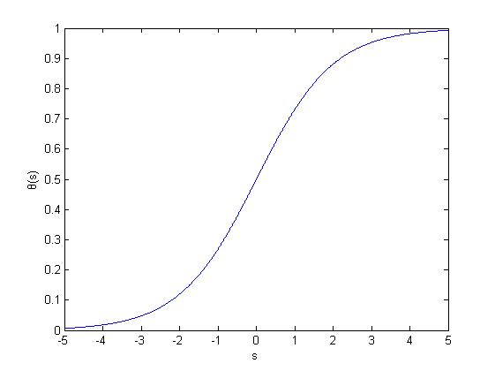

Continuous and differentiable! ‘Easy’ to optimize! :-)
And note that:
$$θ\left(s\right)∈\left(0,1\right)$$
Great, right?

Slide 21
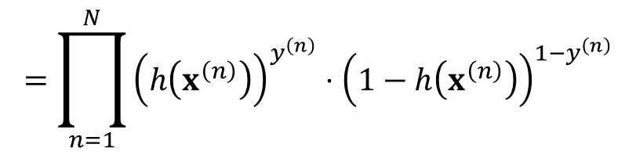


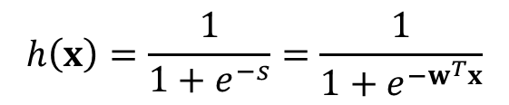





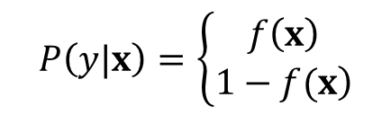
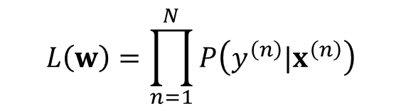

Use
$$h\left(x\right)=\frac{1}{1+e^{−s}}=\frac{1}{1+e^{−w^{T}x}}$$
To approximate target function:
$$⇔$$
$$P\left(y|x\right)=\left\{\begin{matrix}f\left(x\right) \\ \left.1−f(x\right)\end{matrix}\right.$$
$$y=1$$
$$f\left(x\right)=P\left(y=1|x\right)$$
$$y=0$$
To conclude:
$$P\left(y=1|x\right)=h\left(x\right)$$
$$⇔$$
$$P\left(y|x\right)={\left(h\left(x\right)\right)}^{y}⋅{\left(1−h\left(x\right)\right)}^{1−y}$$
$$P\left(y=0|x\right)=1−h\left(x\right)$$
We now define the likelihood of our model:
$$L\left(w\right)=\prod_{n=1}^{N}{P\left(y^{\left(n\right)}|x^{\left(n\right)}\right)}$$
$$=\prod_{n=1}^{N}{{\left(h\left(x^{\left(n\right)}\right)\right)}^{y^{\left(n\right)}}⋅{\left(1−h\left(x^{\left(n\right)}\right)\right)}^{1−y^{\left(n\right)}}}$$

Slide 22
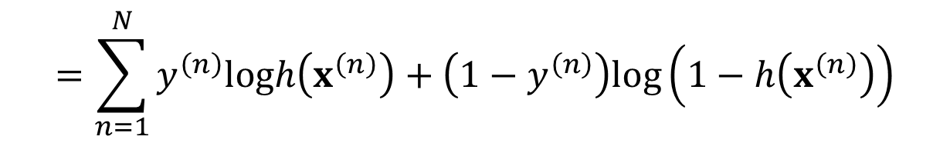

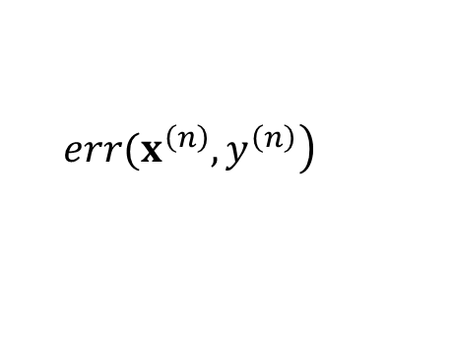
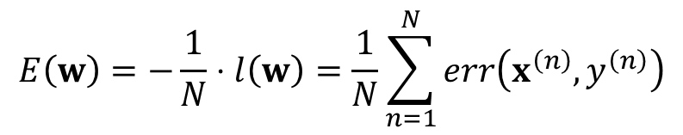
Cross-Entropy Error
Our goal is to maximize likelihood. But with little difficulty.
Note that it will be easier to maximize the following expression:
$$l\left(w\right)=logL\left(w\right)$$
$$=\sum_{n=1}^{N}{y^{\left(n\right)}logh\left(x^{\left(n\right)}\right)+\left(1−y^{\left(n\right)}\right)log\left(1−h\left(x^{\left(n\right)}\right)\right)}$$
$$E\left(w\right)=−\frac{1}{N}⋅l\left(w\right)=\frac{1}{N}\sum_{n=1}^{N}{err\left(x^{\left(n\right)},y^{\left(n\right)}\right)}$$
So as to minimize
$$\left.err(x^{\left(n\right)},y^{\left(n\right)}\right)$$
is called cross-entropy error
And we can use gradient descent to solve the rest problem :-)

Slide 23
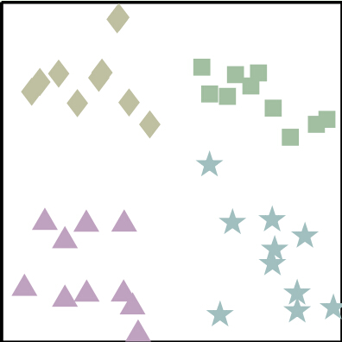
Multi-class Classification
--via logistic regression
There are four classes, right? :-)
--from Machine Learning Foundations, Hsuan-Tien Lin

Slide 24
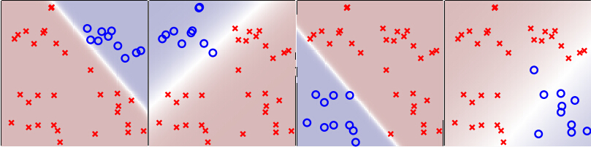
One-Versus-All Decomposition
One class at a time softly:
--from Machine Learning Foundations, Hsuan-Tien Lin
To choose the class with highest probability

Slide 25
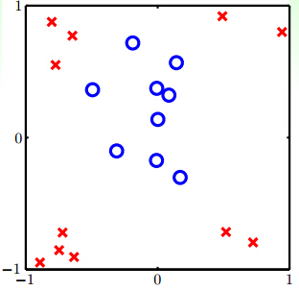
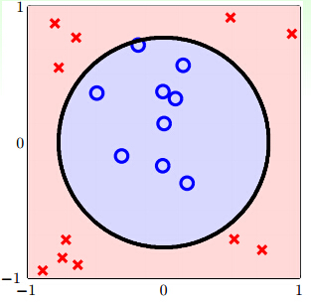


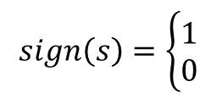

Non-linear Model
--from Machine Learning Foundations, Hsuan-Tien Lin
D is not linear separable
But circular separable:
$$h\left(x\right)=sign\left(−x_{1}^{2}−x_{2}^{2}+0.6\right)$$
$$sign\left(s\right)=\left\{\begin{matrix}1 \\ 0\end{matrix}\right.$$
$$s>0$$
$$s≤0$$

Slide 26






$$h\left(x\right)=sign\left(0.6⋅1+\left(−1\right)⋅x_{1}^{2}+\left(−1\right)⋅x_{2}^{2}\right)$$
$$=sign\left(w_{0}+w_{1}⋅z_{1}+w_{2}⋅z_{2}\right)$$
$$=sign\left(w^{T}z\right)$$
$$\left\{\left(x^{\left(n\right)},y^{\left(n\right)}\right)\right\}$$
circular separable
$$⇒$$
$$\left\{\left(z^{\left(n\right)},y^{\left(n\right)}\right)\right\}$$
linear separable
Actually:
$$x∈Χ\underset{→}{transform}z∈Ζ$$
That is:
$$\left(z_{0},z_{1},z_{2}\right)=z=Φ\left(x\right)=\left(1,x_{1}^{2},x_{2}^{2}\right)$$

Slide 27
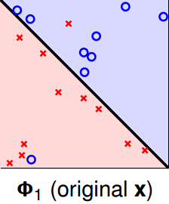
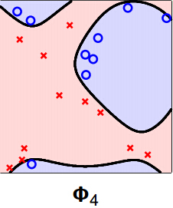



Polynomial transform
Q-th order polynomial transform:
$$Φ_{Q}\left(x\right)=\left(1,x_{1}^{Q},x_{1}^{Q−1}x_{2},…,x_{d}^{Q}\right)$$
Q large
$$⇒$$
Powerful model :-)
$$⇒$$
Difficult to compute/store :-(
--from Machine Learning Foundations, Hsuan-Tien Lin
Which one do you prefer?

Slide 28
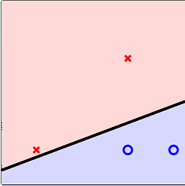
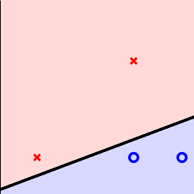
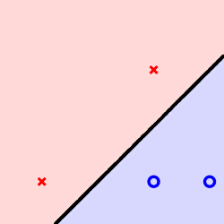
Support Vector Machine
--Sounds cool, right? I think so.
Motivation
--from Machine Learning Foundations, Hsuan-Tien Lin
Which line is the best classifier?

Slide 29
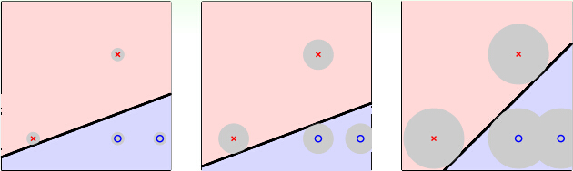
Why rightmost one?
--from Machine Learning Foundations, Hsuan-Tien Lin
--Tolerate more noise
--More robust because of larger distance to closest x_{n}

Slide 30
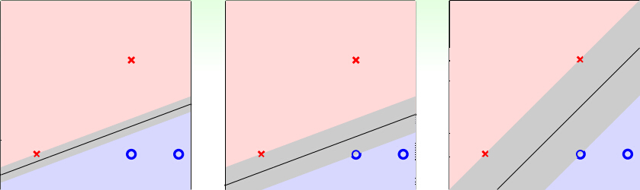
Goal: to find the ‘fattest’ separating ‘line’(hyperplane)
--from Machine Learning Foundations, Hsuan-Tien Lin

Slide 31
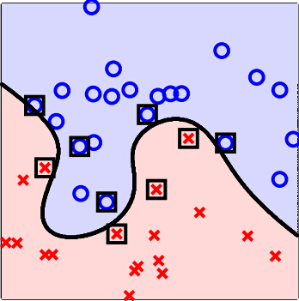
Powerful SVM(with kernel trick)
--from Machine Learning Foundations, Hsuan-Tien Lin
With kernel trick, we can transform the feature into higher dimensional space to make the data ‘separable’ but compute it efficiently!

Slide 32

Deep Learning

Slide 33
Perceptron
对于神经元我们作一个简单的抽象：每个神经元与其他神经元是联结在一起的，因而每个神经元会受到其他神经元状态的影响，并由此来决定自身是否被激发。
Mathematical model:
Threshold to activating

Slide 34
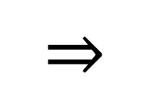

$$w^{T}x=w_{0}⋅x_{0}+w_{1}⋅x_{1}+...+w_{d}⋅x_{d}$$
$$=w_{0}+w_{1}⋅x_{1}+...+w_{d}⋅x_{d}$$
w₀: the threshold
$$⇒$$
$$w^{T}x>0$$
The neuron would be activated(vice versa)
More practical:

Slide 35
Neural Network
Each layer can be regarded as a logistic regression model.
Back-propagation:
几个人站成一排，第一个人看一幅画（输入数据），描述给第二个人（隐藏层），…依此类推，到最后一个人（输出）的时候，画出来的画肯定不能看了（误差较大）；反向传播就是，把画拿给最后一个人看（求取误差），然后最后一个人就会告诉前面的人下次描述时需要注意哪些地方（修正权值）。
--引自某知乎网友

Slide 36


Multi-layer neural network
Suppose that we have a system S which has n layers. Altogether, I is the input and O is the output:
$$I⇒S_{1}⇒S_{2}⇒...⇒S_{n}⇒O$$
Our goal is to make
$$I≈O$$
堆叠多层神经网络，对输入信息达到分级表达的目的
2006年，加拿大多伦多大学教授、机器学习领域的泰斗Geoffrey Hinton和他的学生在《科学》上发表了一篇文章，开启了深度学习在学术界和工业界的浪潮。这篇文章提出了两个主要观点：
1.多隐层的人工神经网络具有优异的特征学习能力；
2. 提出xxx方法来克服训练深度神经网络的难度。

Slide 37
深度学习在计算机视觉（Computer Vision）领域最具影响力的突破发生在2012年，Hinton的研究小组采用深度学习赢得了ImageNet图像分类比赛的冠军，排名第2到第4位的小组采用的都是传统方法，手工设计的特征，他们之间准确率的差别不超过百分之一，而Hinton的研究小组的准确率超出第二名百分之十以上。这个结果在计算机视觉领域产生了极大的震动，引发了深度学习的热潮。
同样在2012年，Google X实验室的一个研究项目---“谷歌大脑”，项目研究人员组建了一个庞大的神经网络学习系统，并通过从YouTube上随机抽取猫的照片交给“谷歌大脑”训练，训练结束后进行测试，测试结束后发现，“谷歌大脑”识别猫的照片的准确率基本达到四分之三。
在2012年，微软研究院和多伦多大学历时两年研发出一套实时语音机器翻译系统，它相比旧系统出错率至少降低百分之三十。

Slide 38



Warning
Notation
E_{in}: in-sample-error
E_{out}: out-of-sample-error
Our learning algorithm just to make(under ideal condition):
$$E_{in}≈0$$
But we actually want(under ideal condition):
$$E_{out}≈0$$
Need some mathematics(learning theory) to link each other(under ideal condition):
$$E_{in}≈E_{out}$$
(Theoretical guarantee)

Slide 39
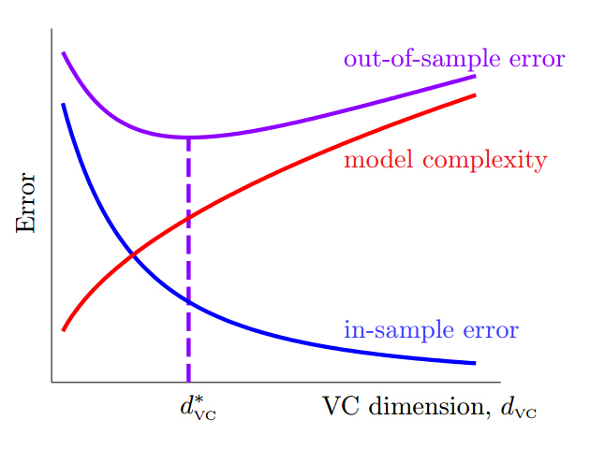
If over it, it will overfit :-(
--from Machine Learning Foundations, Hsuan-Tien Lin
Powerful model not always good :-(

Slide 40
References
CS229, Stanford University, Andrew Ng
Machine Learning Foundations, National Taiwan University, Hsuan-Tien Lin
Machine Learning Techniques, National Taiwan University, Hsuan-Tien Lin
To recommend:
Lecture notes:
http://cs229.stanford.edu/
Coursera:
Machine Learning Foundations: https://www.coursera.org/course/ntumlone
Machine Learning Techniques:
https://www.coursera.org/course/ntumltwo
Original Version:
https://www.csie.ntu.edu.tw/~htlin/course/ml15fall/
The homework upon here would teach you how to be a man :-)

Slide 41
Q＆A

