Slide 1

The Javascript Task Runner

Slide 2
Why grunt ?

Slide 3
Beside coding ...
minification
compilation
unit testing
linting
distribution
......

Slide 4
Using grunt
The Grunt ecosystem is huge and it's growing every day. With literally hundreds of plugins to choose from, you can use Grunt to automate just about anything with a minimum of effort.
If someone hasn't already built what you need, authoring and publishing your own Grunt plugin to npm is a breeze.

Slide 5

They use grunt ...

Slide 6
Getting started

Slide 7
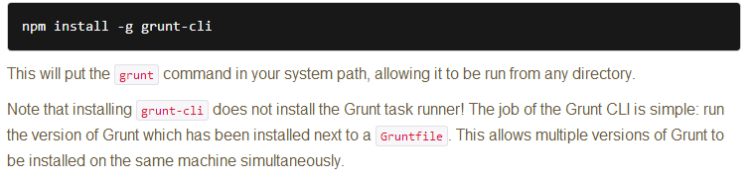
Install grunt-cli

Slide 8
Package.json
definition:
This file is used by npm to store metadata for projects published as npm modules. You will list grunt and the Grunt plugins your project needs as devDependencies in this file.
generation:
a. Most grunt-init templates will automatically create a project-specific package.json file.
b .The npm init command will create a basic package.json file

Slide 9
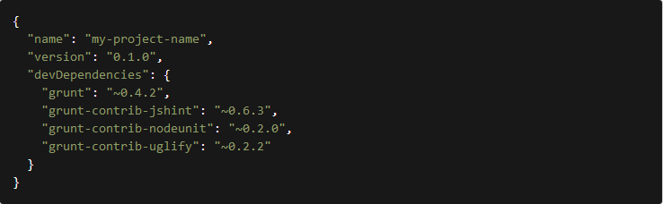
Example of package.json

Slide 10
Gruntfile
definition:
This file is named Gruntfile.js or Gruntfile.coffee and is used to configure or define tasks and load Grunt plugins.
structure:
a. The "wrapper" function
b. Project and task configuration
c. Loading Grunt plugins and tasks
d .Custom tasks

Slide 11
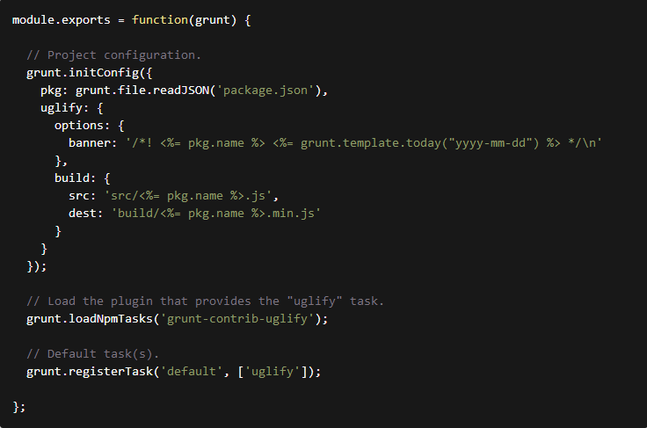
Example of Gruntfile

Slide 12
Popular plugins
JSHint
Uglify
Less
Sass
CoffeeScript
CSSLint
......

Slide 13
grunt-contrib-uglify
grunt-contrib-concat
grunt-contrib-qunit
grunt-contrib-watch
grunt-contrib-clean
connect-livereload
grunt-contrib-coffee
grunt-contrib-connect
......

Slide 14

所有东西都在官网， 去吧jerry

