Slide 1
Famo.us
Javascript Framework for any device
@allenfantasy
Notes:
famo.us 的基本结构
famo.us 解决的问题
解决的方案(rAF)
famo.us的主要部件
Render Tree
physics engine
examples:
vertical alignment
event & animation [TODO]
scrollview [TODO]
famo.us的其他部分:
layout
widgets [TODO]
开发实践
开发环境和依赖
适合场景 & 缺点
研究方向：
famo.us的physics engine的分析
famo.us在不同设备及浏览器上的性能测试：FPS等
结合MV* 框架，面向移动开发的javascript framework
基于famo.us设计完整的页面内用户行为监控和信息采集方案

Slide 2
famo.us
A front-end javascript framework
Includes:
A 3D layout engine that can render to DOM, Canvas and webGL
A 3D physics animation engine
Build-in event system
Widgets for mobile development

Slide 3
famo.us abstracts away DOM management by maintaining a representation called the Render Tree

Slide 4


CSS
HTML
jQuery
Prototype
[pure Javascript]
…
DOM
Traditional Model

Slide 5

Render Tree
DOM
CSS
Famo.us
HTML
Famo.us Model

Slide 6
Bottlenecks of web-app
Poor UX: slow, jank…(esp in mobile)
HTML is designed to render documents
couldn’t access native functionalities
Notes:
famo.us的这一套机制就是为了解决web技术在移动开发的各种瓶颈：
用户体验不如原生应用，特别在移动端
HTML最初设计的目的是显示文档，传统的基于DOM的开发不能满足开发app的需求
为了解决开发移动端应用的问题，已经产生了jQueryMobile, Sencha Touch, Ember.js, React等工具，绝大部分是基于DOM的js方案，React为开发者提供了对DOM进行抽象的方法
可以通过PhoneGap / Cordova将webapp打包为本地应用，并调用native的功能

Slide 7
Traditional approach
DOM manipulation
setInterval()
CSS3 transition
webGL / Canvas
Notes:
传统的实践方法
对DOM进行操作
传统的setInterval()的方法，在修改DOM时会使浏览器立即repaint
CSS3 通过transition属性支持元素的动态效果，但它非常难调试，且在Android上有很多问题
webGL / Canvas只是针对3d的效果处理，对大量的基于DOM的动画操作无能为力，如2D下的按钮，表单，文本选择及高亮

Slide 8
Famo.us approach
rAF(requestAnimationFrame)
Update contents in rAF’s callback function, trigger browser’s repaint
Use GPU via transform: matrix-3d
Notes:
现代浏览器通过rAF机制支持动画效果，rAF接受一个callback function作为参数，浏览器在下一次屏幕刷新前调用callback function
在callback function中对内容进行更新
使用polyfill shim解决不同浏览器的格式差异

Slide 9
3
Tick
4
5
2
1

Slide 10
user input
user input
fire event
update render spec
fire event
setInterval()
rAF
apply render spec
change content
change content
repaint
(could be anytime)
repaint
(only in rAF callbacks)

Slide 11
screen refresh
traditional repaint
Famo.us repaint

Slide 12
Render Tree
Context
Renderable
Modifier
Abstraction of DOM
RenderNode Basic Unit of tree
Context Root
Renderable Basic Unit of content
Modifier Add spec to it’s children node
Renderable

Slide 13
Context
Modifier
Context
Modifier
Renderable
Renderable
Renderable

Slide 14
Renderable
Surface <div>
InputSurface <input>
ImageSurface <image>
VideoSurface <video>
…

Slide 15
View
Context
Contains a set of ‘node’s.
Represent part of the page
‘Subtree’ in Render Tree
Modifier
Renderable
View

Slide 16

Example I
Vertical alignment

Slide 17
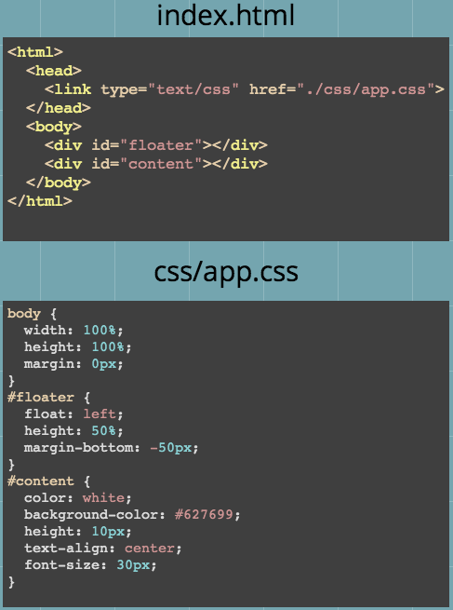
floater

Slide 18
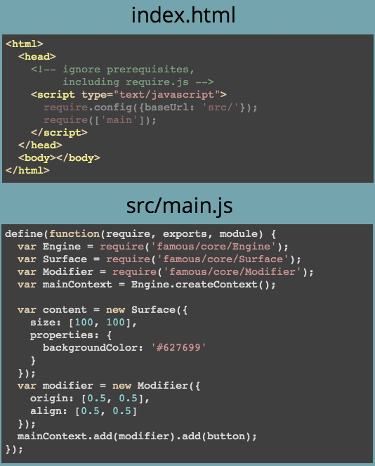

Slide 19
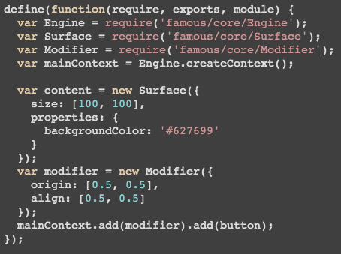
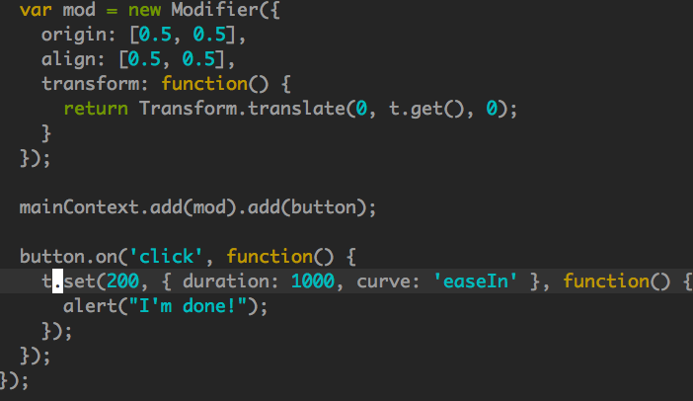
Context
Surface
(<div>)
Modifier

Slide 20
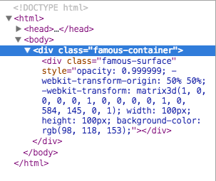

Slide 21
Example II
when clicked
Physics Animation
200px

Slide 22
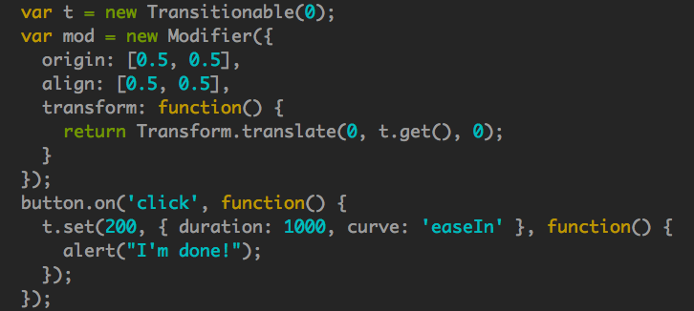
a
Notes:
Transitionable将数字或数组抽象成动态的数据，可以用set函数，通过一个插值函数，将其从起始状态变到给出的终止状态；同时set函数还可以在数据完成更改后调用一个回调函数。
在modifier中的transform属性接受一个函数，可以在每一tick中计算该函数的返回值作为该modifier的transform的值。在例子中，mod的transform函数利用了t这个Transitionable的值，则在t变化的过程中，mod的transform函数的返回值也在随之变化。

Slide 23

Layout
HeaderFooterLayout
GridLayout
Header
Content
Footer

Slide 24
Layout
Sequential Layout
FlexibleLayout
surface 1
1
surface 2
3
surface 3
1
surface 4

Slide 25
Widgets
NavigationBar
Slider
TabBar
ToggleButton
Deck
Scrollview
…

Slide 26
Famo.us in Production
Mobile WebApp + Wechat service for Business
7 man-month.
Express Famo.us Grunt Bower Mocha
95% Javascript, NO HTML
Learning curve: 2-3 weeks for js beginners

Slide 27
When to use ?
SPA
when you need fancy animation
Mobile Application (esp. for web devs)

Slide 28
Drawbacks
ONLY ‘View’
‘All or Nothing’ (e.g: touchmove)
Some specific device issues (e.g Android Keyboard)

Slide 29
Possibilities
Mobile-oriented javascript framework (famo.us + MV*)
Native app (famo.us + PhoneGap/Cordova)
Benchmark on different devices/browsers
Monitoring & collecting user behavior on famo.us application

Slide 30
Reference
使用famo.us 创建高性能移动UI http://www.ibm.com/developerworks/cn/web/wa-famous/
PhoneGap http://phonegap.com/
Apache Cordova http://cordova.apache.org/
requestAnimationFrame | MDN https://developer.mozilla.org/zh-CN/docs/Web/API/window.requestAnimationFrame
帧率 - 维基百科，自由的百科全书 http://zh.wikipedia.org/wiki/%E5%B8%A7%E7%8E%87
Refresh Rate http://en.wikipedia.org/wiki/Refresh_rate

Slide 31
Reference
Measuring HTML5 Browser FPS, or, You’re Not Measuring What You Think You’re Measuring http://blog.sethladd.com/2011/03/measuring-html5-browser-fps-or-youre.html
famo.us Render Tree http://famo.us/guides/render-tree
famo.us Animation http://famo.us/guides/animations
How browser works http://www.html5rocks.com/en/tutorials/internals/howbrowserswork/
浏览器的渲染原理简介 | 酷壳 http://coolshell.cn/articles/9666.html
HTML5 DevConf Oct 2012 Tech Talk by Steve Newcomb http://www.slideshare.net/befamous/html5-devconf-oct-2012-tech-talk

Slide 32
Thanks!

