Slide 1
Webpage:
loading & painting
@allenfantasy

Slide 2

About Me
@allenfantasy
Sun Yat Sen Univ.
Startup
Ruby / Javascript
Taekwondo (6 years)

Slide 3
Content
Browser structure
Flow: HTTP request => webpage
Some webpage optimization
Repaint & Reflow

Slide 4
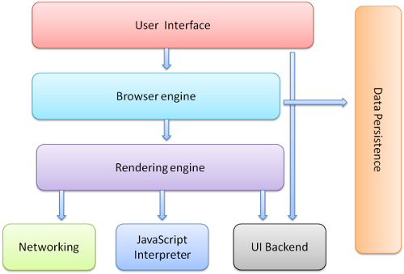
Browser structure
main difference

Slide 5
Layout engine
Trident : IE
Gecko : Firefox
Blink : Chrome, Opera
Webkit : Safari, earlier Chrome, Android
Presto[deprecated] : Opera

Slide 6
Javascript engine
V8: Google, Opera ( Node.js )
Chakra : IE ( JScript, Microsoft’s impl. of ECMAScript )
Spidermonkey : Firefox
Rhino : Mozilla Foundation
Caraken[deprecated] : Opera

Slide 7
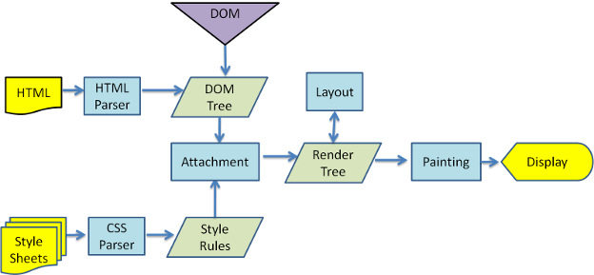
1: HTTP request
2: return HTML
3: parsing
4: build render tree
5: update layout
6: paint
webkit main flow
1
2
3
5
6
4

Slide 8
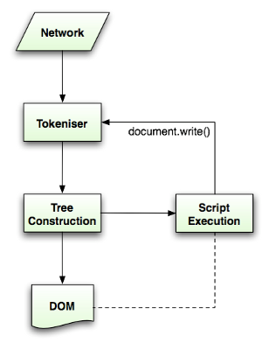
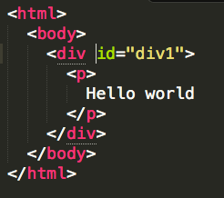
HTML Parsing
by char
HTML tokens
by token
DOM tree

Slide 9
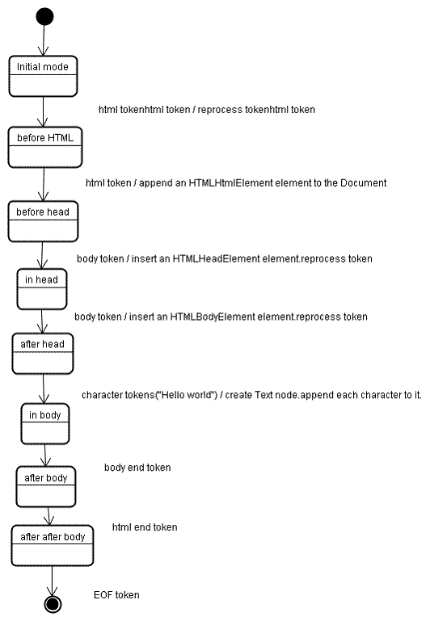

Slide 10
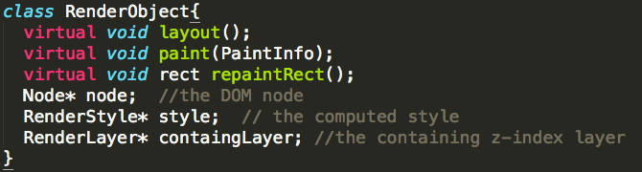
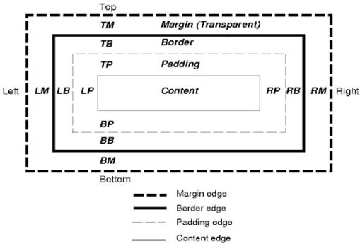
build render tree

Slide 11
Update Layout & paint
recursive
call UI Backend

Slide 12
1: HTTP request
2: return HTML
3: parsing
4: build render tree
5: update layout
6: paint
webkit main flow
1
2
3
5
6
4
DOM manipulation goes here

Slide 13
Some Optimization
loading javascript
Reduce HTTP requests
combine
compress
images: sprites
cache

Slide 14
Loading javascript
<head> OR <body> ?
block OR flicker ?
defer
document.ready [thus you can reach elems]

Slide 15
Reduce HTTP Requests
Combine all into one [js, css]
Compress your css & js
Uglify your js
Sprite => Combine all icons into one BIG image

Slide 16
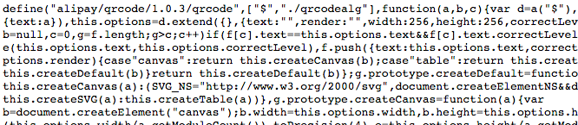
Uglify js

Slide 17


CSS Sprites

Slide 18
Cache
CDN ( Content Distribute Network )
Cache in browser: “Expires”
e.g: Expires: Thu, 15 Apr 2015 20:00:00 GMT

Slide 19
Q & A

Slide 20
Thanks !

