Slide 1
Marketing Project
Yang Song
06/2017

Slide 2
Project Goal and Steps
The goal of project is to increase the sales, reduce/ optimize the media cost and forecast sales and cost for 2010 based on data analysis and statistical model.
Step1: Data Merge and Cleaning
Step2: Reduce the Media Cost
Step3: Increase Sales
Step4: Optimization & Forecast Sales in 2010

Slide 3
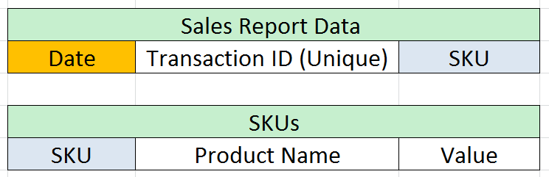
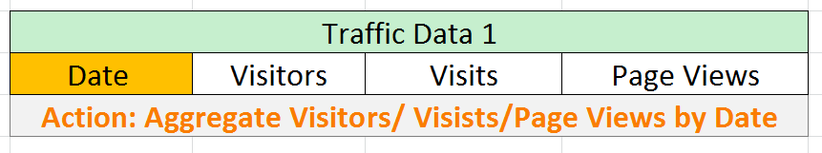
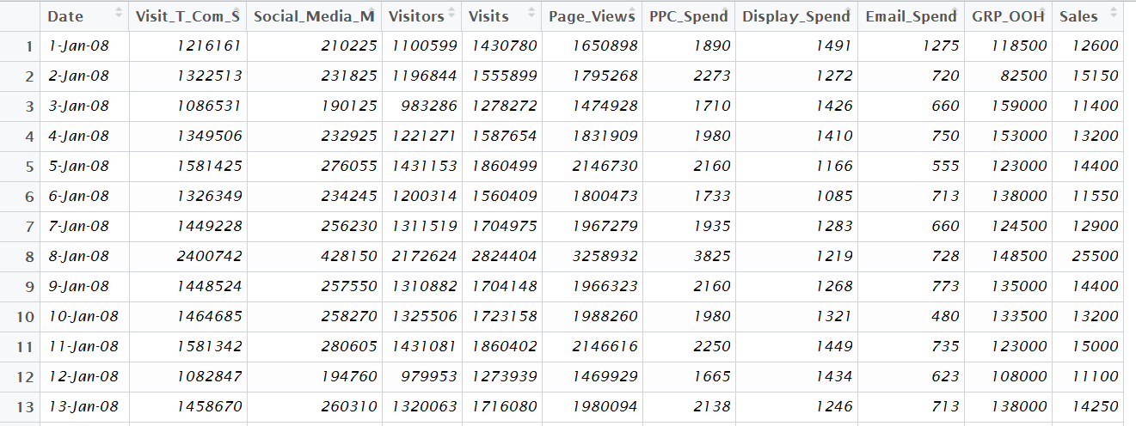
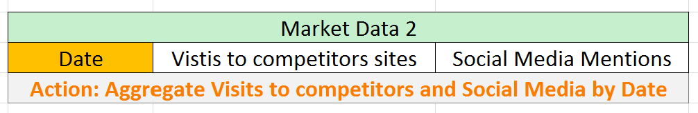
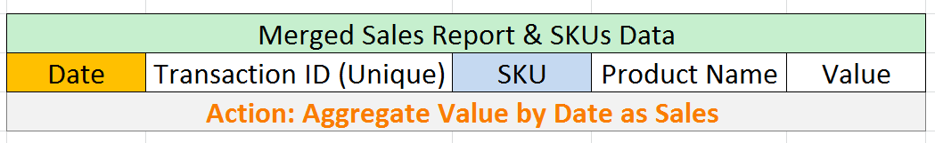
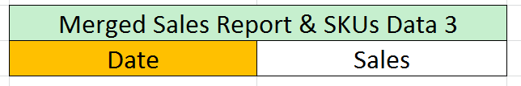
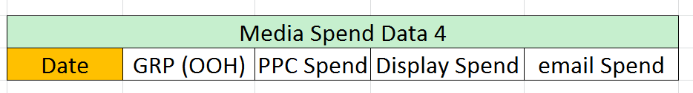
Step1: Data Merge and Cleaning
Merge data by SKU
Merge 4 data by Date
The Merged Raw Data contains 11 variables and 727 observations. The identifier to identify a unique observation is Date, which means that one unique date has one row of observation. The date ranges from Jan 2008 to Dec 2009. (Missing value is also checked and imputed. Please see Appendix 1 for details.)
Notes:
For Traffic Data, aggregate visitors/ visists/ page views by date
For Market Data, aggregate visits to competitors sites and social media mentions by date
Merge Sales Report Data & SKUs by SKU, aggregate value by date
Merge 4 data together into one data: Merged Raw Data, which contains 11 variables and 727 observations.

Slide 4
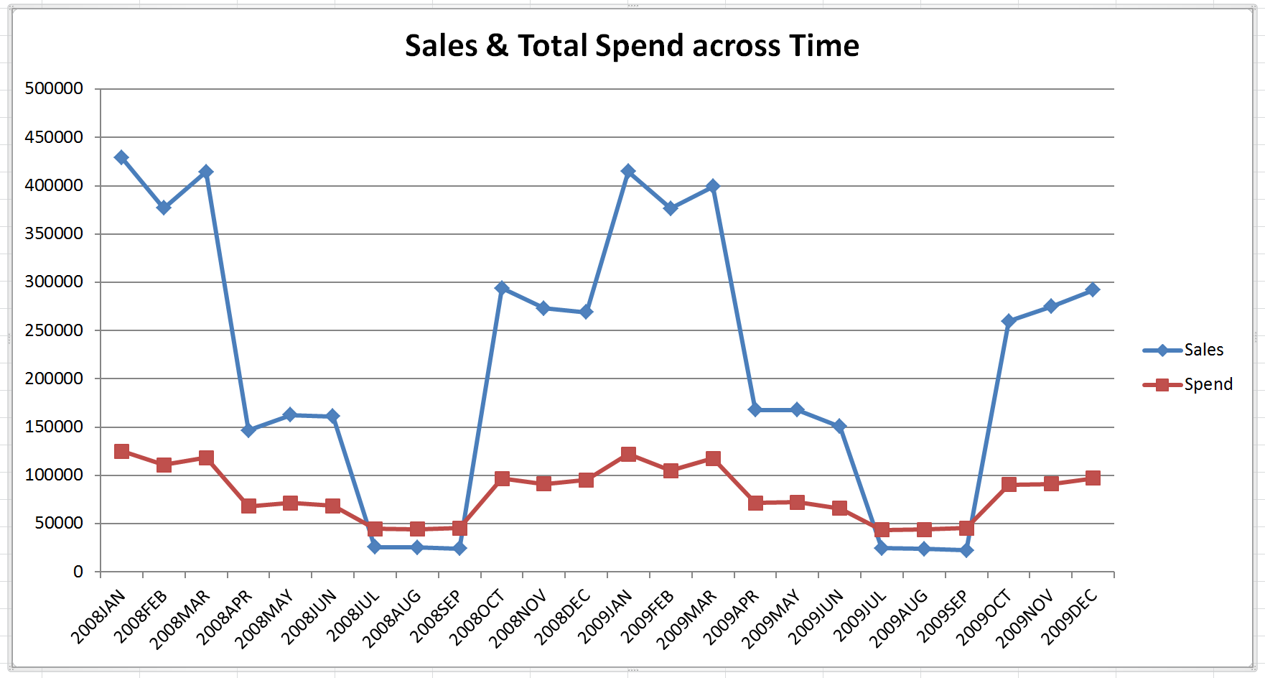
Step2: Reduce the Media Cost
Sales always have seasonal pattern. After aggregation sales and total spend (sum of Email, Display and PPC spend) for each month, two time series are visualized.
Problem:
For Q3, total marketing cost is higher than total sales.
Notes:
Seasonal pattern of sales, peak Q1, flat Q2, Q4 and bottom Q3.
Problem: For Q3, total marketing cost is higher than total sales.

Slide 5
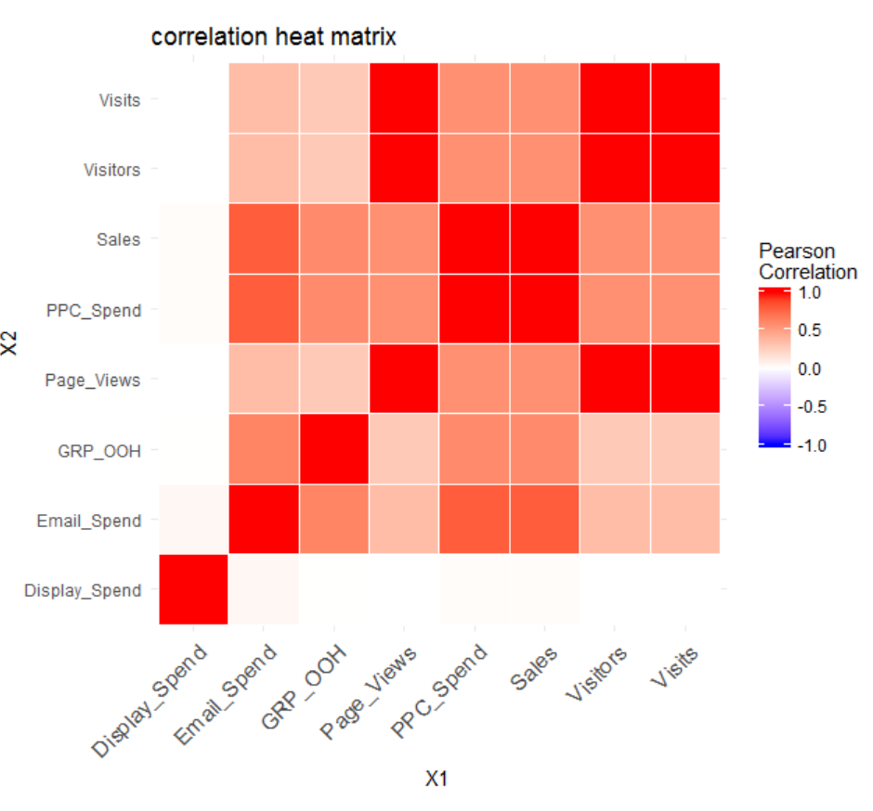
Step2: Reduce the Media Cost
Another way to do the analysis is to explore the relation between Sales and Email Spend, Display Spend, PPC Spend and other variables individually.
Problem:
Display Spend totally has no correlation to Sales.
Above all, explore cost reduction from two aspects, Seasonal Pattern and Media Channels.

Slide 6
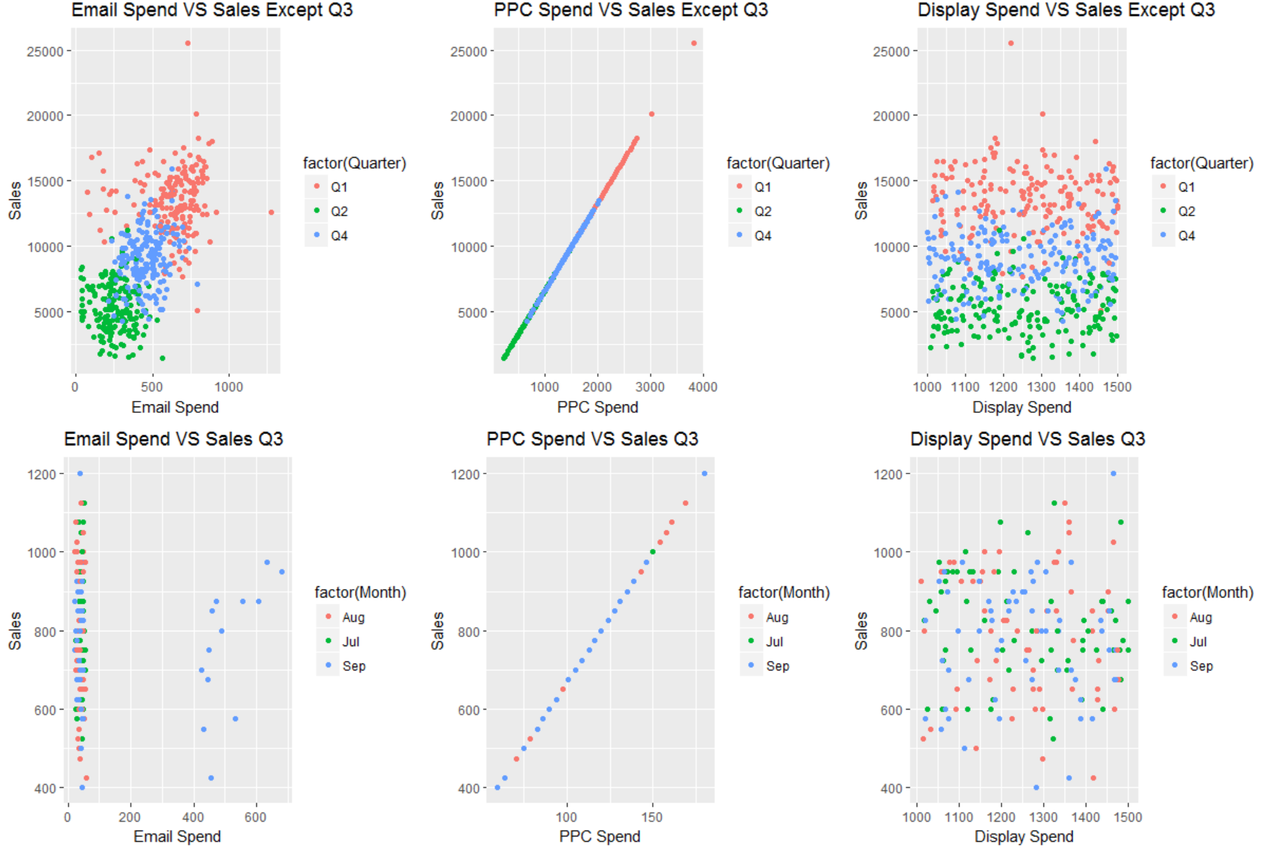
For Q1,2&4, Email Spend and Sales show positive linear relationship.
For Q1,2&4, PPC Spend and Sales show perfect linear relationship.
For Q1,2&4, Display Spend and Sales have no relation.
For Q3, Email Spend and Sales have no relation.
For Q3, PPC Spend and Sales show perfect linear relationship.
For Q3, Display Spend and Sales have no relation.

Slide 7
Step2: Reduce the Media Cost
Reduce Cost:
For Q1, Q2 and Q4, set ceiling for Display Spend. Cut the cost above ceiling.
For Q3, Email Spend, reduce the cost in the green cluster.
For Q3, set ceiling for Display Spend. Cut the cost above ceiling.
Notes:
Reduce Cost:
For Q1, Q2 and Q4, set ceiling for Display Spend. Cut the cost until ceiling.
For Q3, Email Spend, reduce the cost in the green cluster.
For Q3, set ceiling for Display Spend. Cut the cost until ceiling.

Slide 8
Step3: Increase Sales
Reinvest the cost saved to other channels!
Notes:
Increase Sales:
For Q1,Q2 and Q4, after saving the cost of display channel and reinvest the money to PPC channel or Email channel. Which channel to select will be determined by the model and it will be discussed later.
For Q3, after saving the cost of Email channel and Display channel and reinvest the money to PPC.

Slide 9
Step4: Optimization& Forecast Sales in 2010
In the 4th step, optimization for each channel on daily basis is applied and set as investment in 2010. Then prediction on sales in 2010 is made based on the optimized marketing cost.
Assumption before optimization:
Assumption 1: In the whole year, Sales and Display Spend are not correlated, so increase/ reduce Display Spend will not affect sales.
Assumption 2: In Q3, Sales and Email Spend are not correlated, so increase/ reduce Email Spend will not affect sales.
Assumption 3: No Advertising Adstock. The sales on a certain day is only affected by advertisement on that day.

Slide 10
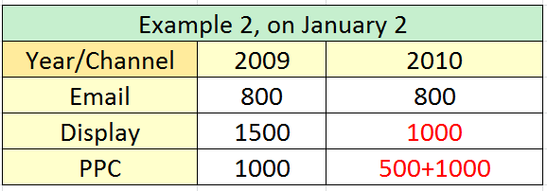
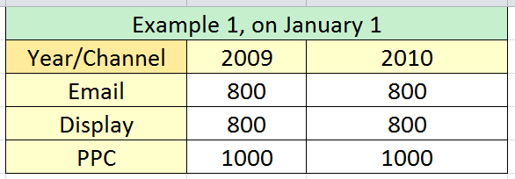
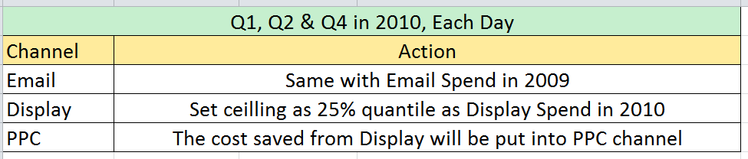
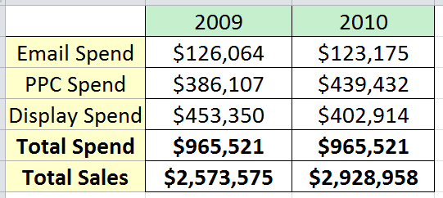
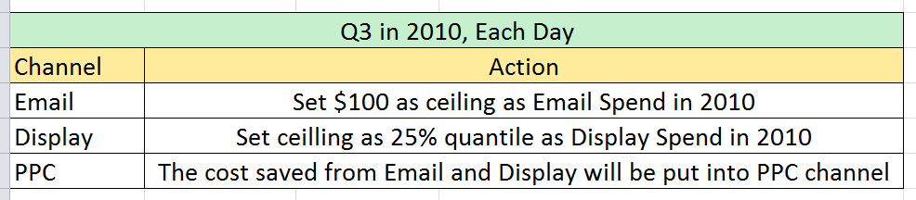
Step4: Optimization & Forecast Sales in 2010
Sum up cost
In Q1, Q2 & Q4
By Lasso Model: Sales~ Email Spend+ PPC
Predict Sales in Q1, Q2 & Q4 on daily basis
Predict Sales in Q3 on daily basis
By Simple Linear Model: Sales~ PPC
Sales Increase by 13.8%!
Sum up cost in Q3
Details of model can be seen in Appendix 2

Slide 11
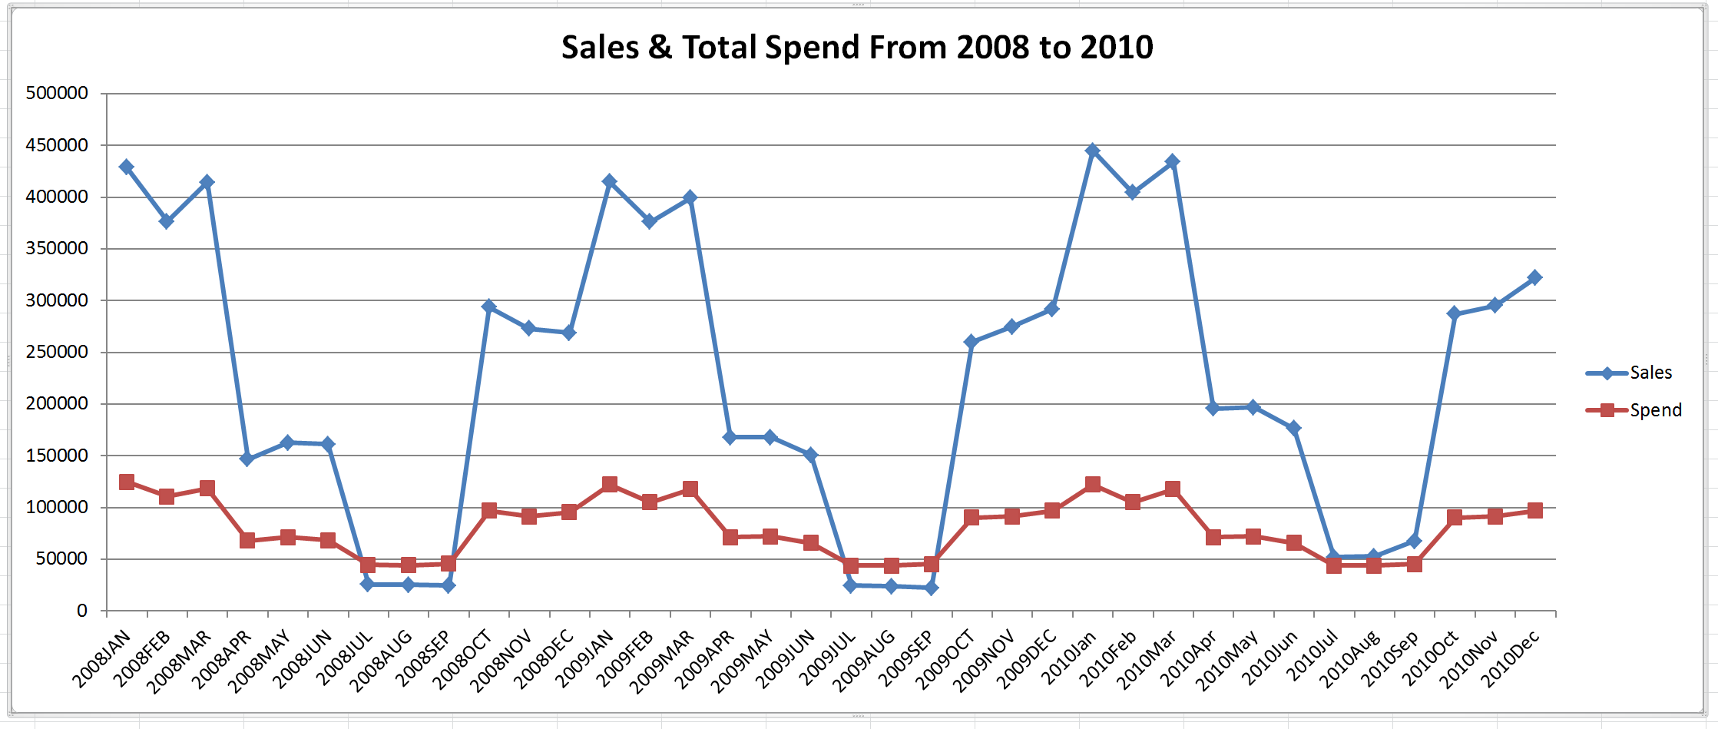
Step4: Optimization & Forecast Sales in 2010
In 2010 Q3, sales is higher than total marketing spend cost.
In 2010, total sales in each month is higher than those in 2009.

Slide 12
Q & A
Thank you very much~

Slide 13
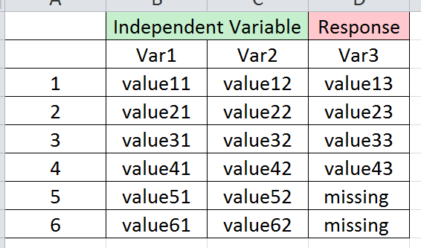
Appendix 1: Missing value Imputation
Missing values are also checked. Email Spend has 11 missing values and GRP OOH has 35 missing values.
Machine Learning methodology - Extreme Gradient Boosting (XGBoost) is used to impute the missing value. The reason to use XGBoost is its powerful prediction power.
Use observations without missing value as training data to construct the model.
Use observations with missing value as testing data to make prediction on the missing value.

Slide 14
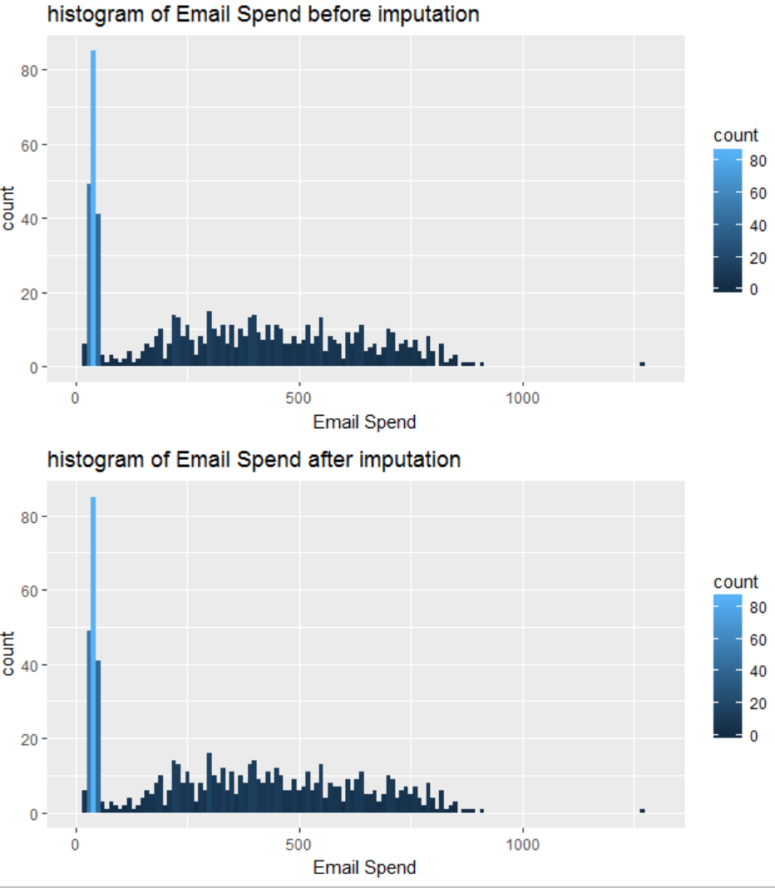
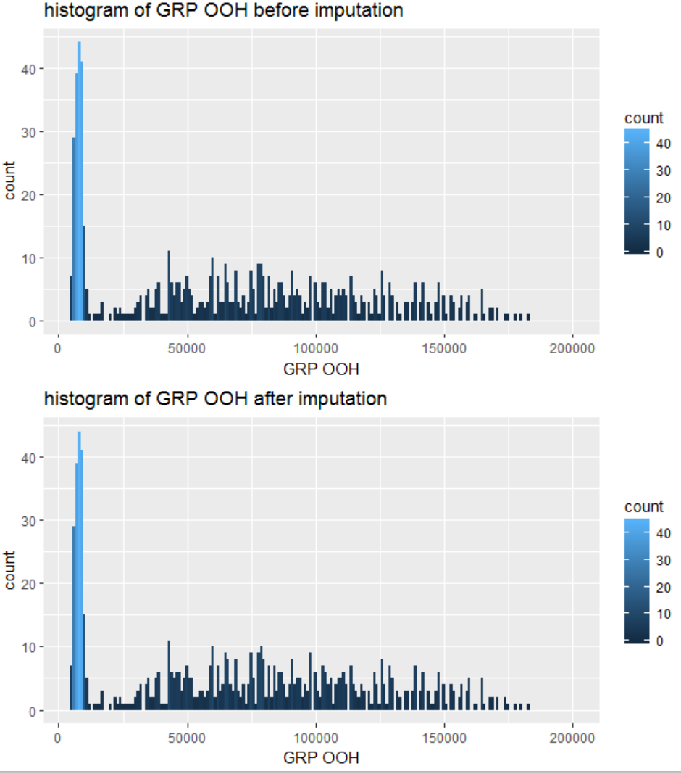
Appendix 1: Missing value Imputation
As quality control, I visualize the histogram of Email Spend and GRP OOH, before and after imputation of missing value. Overall, the distribution is similar, so the imputation is satisfactory.

Slide 15
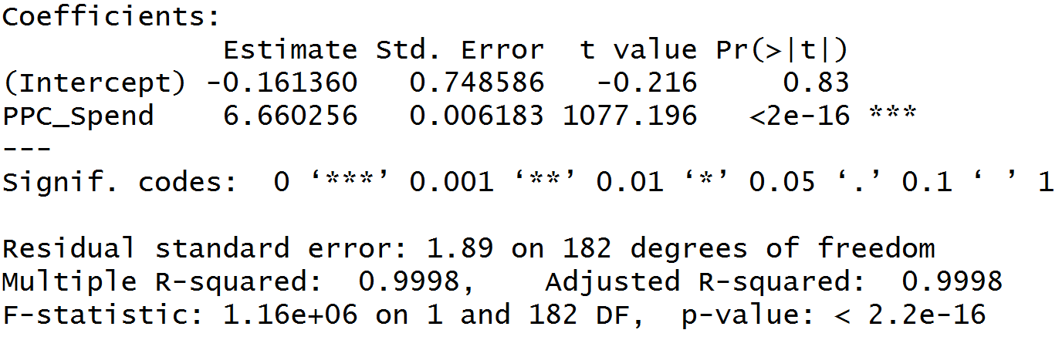
Appendix 2: Summary of model in part 4
For Q3, simple linear model is constructed.
Model formula: Sales=-0.161+6.660PPC_Spend
Model details:

Slide 16
Appendix 2: Summary of model in part 4
For Q1, Q2 and Q4, multiple linear regression model is constructed first. However, because of multicollinearity, the coefficient of model is not sensible. In order to solve this problem, Lasso (Least Absolute Shrinkage and Selection Operator) model is selected.
Optimal Shrinkage Parameter is calculated by cross validation. Optimal Shrinkage Parameter, Lambda=0.069.
Model Formula:
Sales=-0.847+0.0004Email_Spend+6.666PPC_Spend

Slide 17
Appendix 3: CI Method for Projection in 2010
Another way to make a projection of sale and cost in 2010 is to use confidence interval method.
Assumption:
Sales/ Email_Spend/ PPC_Spend/ Display_Spend in each month follow normal distribution.
Marketing Strategy in 2010 is similar to that in 2009.
Change in 2010 from 2009 for each month is same with that in 2009 from 2008. E.g. Sales in January, 2009 is 10% higher than that in 2008, so sales in January, 2010 is also expected to have a 10% growth.

Slide 18
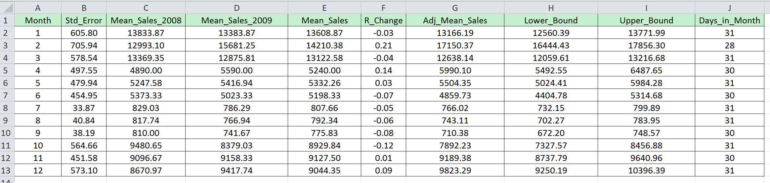
Appendix 3: CI Method for Projection in 2010
1. Calculate R_Change = (Mean_Sales_2009 - Mean_Sales_2008) / Mean_Sales_2008
2. Adjust Mean_Sales by R_Change
3. Confidence Interval is set at 95% level, so Z=1.96.
4. Std_Error=Z*std/sqrt(n)
5. Lower_Bound = Adj_Mean_Sales + Std_Error
6. Upper_Bound = Adj_Mean_Sales - Std_Error
7. Times Adj_Mean_Sales, Lower Bound and Upper Bound by Days in Month to get table in the next slide.

Slide 19
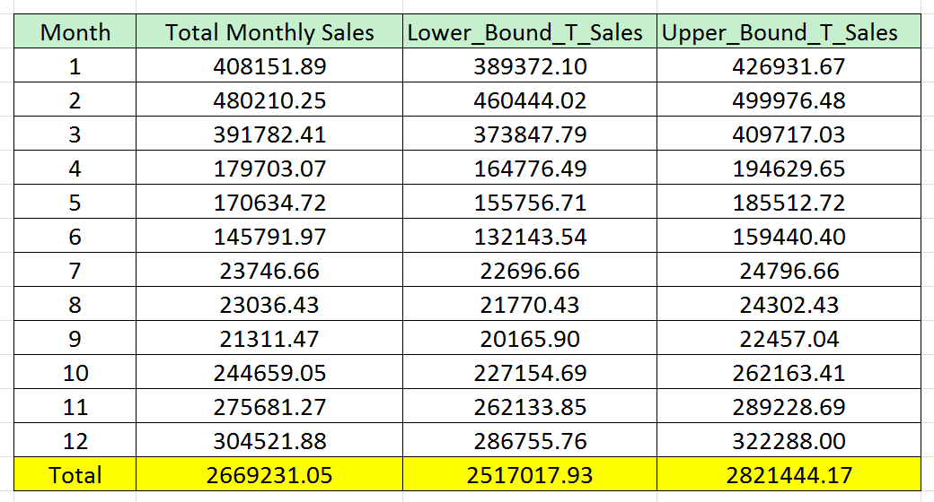
Appendix 3: CI Method for Projection in 2010
From table below, mean of Sales in 2010 is $2,669,231, with 95% probability fall in the interval of [$2,517,017, $2,821,444]
Same methodology is applied to cost.

Slide 20
Appendix 4: Documentations
Data: Analytics.csv
Code: Code.R
Software: R(version 3.2.5), Excel (version 2013)
Library used in R, <dplyr>: data profiling
<ggplot2>: visualization
<grid>: graphics support
<reshape>: contingency table
<xgboost>: Extreme Gradient Boosting model
<glmnet>: Lasso model

