Slide 1
Topic: "Transforming E-Commerce Growth: A Data-Driven Marketing Strategy for Enhanced Customer Acquisition and Retention"
Presented by:
Rohit
Aman Vashishtha
Sahil Mirshikari Date:
Avirat R. Deshmukh 12-02-2025

Slide 2
Introduction
Our project, focused on E-Commerce Customer Analysis and Segmentation, tackles this challenge head-on. We've delved into customer data to uncover valuable insights that can be leveraged to refine marketing strategies and, ultimately, drive sales growth. By analyzing customer behavior, demographics, and preferences, we aim to demonstrate how targeted marketing campaigns can be developed for maximum impact.

Slide 3
Technologies used:
Programming Language: Python
Libraries & Framework: Numpy, Pandas, Matplotlib, Seaborn, Scipy, Scikit-Learn, Pickle, Streamlit, Pyngrok.
Analysis: Tableau

Slide 4
Data Sources
To conduct our analysis, we utilized several datasets:
Discount Coupons: Information on discounts offered to customers.
Marketing Spend: Data on the marketing budget allocated for various campaigns.
Online Sales: Transaction data from our e-commerce platform.
Customer Data: Information about our customers, including demographics.
Tax Amounts: Data related to taxes applied to transactions.

Slide 5
Data Preparation
In the data preparation phase, we performed the following steps:
Data Import: We’ve used Pandas to read CSV and Excel files into our environment.
Data Merging: We’ve merged datasets on common keys such as CustomerID and Product_Category to create a comprehensive dataset.
Data Cleaning: We’ve handled missing values by using mean, median, or mode imputation, and checked for duplicates, removing any that were found.

Slide 6
Exploratory Data Analysis (EDA)
During the Exploratory Data Analysis, we focused on understanding the data better:
Basic Statistics: We’ve summarized numerical and categorical variables to get an overview of the dataset.
Visualizations: We’ve created bar plots to visualize the distribution and analyze monthly sales trends.
Insights: This analysis helped us identify key trends in customer behavior, such as peak purchasing months and popular product categories.

Slide 7
Customer Segmentation
The two main techniques for customer segmentation:
RFM Analysis: We’ve calculated Recency, Frequency, and Monetary value metrics to segment customers into groups such as Low, Medium, and High Value.
K-Means Clustering: We’ve applied K-Means clustering to further segment our customers. The optimal number of clusters was determined using the Elbow method, which indicated that 4 to 5 clusters would be ideal.

Slide 8
Predictive Modeling
In the predictive modeling phase, we focused on:
Customer Lifetime Value Prediction: We’ve built classification models, including RandomForest and SVC, to predict customer lifetime value. We evaluated model performance using accuracy and cross-validation techniques.
Next Purchase Prediction: We’ve analyzed the time between purchases to predict how soon each customer is likely to make their next purchase. ( Random Forest )

Slide 9
Market Basket Analysis
Market Basket Analysis is to understand product associations:
Association Rules: Using the Apriori algorithm, we identified product combinations that are frequently bought together.
Insights: This analysis revealed opportunities for cross-selling, such as promoting the Nest Cam Indoor Security Camera alongside the Nest Cam Outdoor Security Camera.

Slide 10
Business Objective:
1. Calculate Invoice amount or sale_amount or revenue for each transaction and item level.
Invoice Value =(( Quantity*Avg_price)*(1-Discount_pct)*(1+GST))+Delivery_Charges
2. Performing Customer Segmentation
Heuristic (Value based, RFM) – Divide the customers into Premium, Gold, Silver, Standard customers and define strategy on the same.
Scientific (Using K-Means) & Understand the profiles. Define strategy for each segment.

Slide 11
Business Objective:
3. Customer Lifetime Value (Low Value/Medium Value/High Value)
First define dependent variable with categories low value, medium value, high value using customer revenue.
Then perform Classification model.
4. Cross-Selling (Which products are selling together)
You can perform exploratory analysis & market basket analysis to understand which of items can be bundled together.

Slide 12
Business Objective:
5. Predicting Next Purchase Day(How soon each customer can visit the store (0-30 days, 30-60 days, 60-90 days, 90+ days):
For this, we need to create dependent variable at customer level (average days per one transaction for only repeat customers and divide into groups 0-30 days, 30-60 days,60-90 days and 90+ days) then build classification model to predict next purchase of given customer.
6. Perform cohort analysis by defining below cohorts:
Customers who started in each month and understand their behaviour
Which Month cohort has maximum retention?

Slide 13
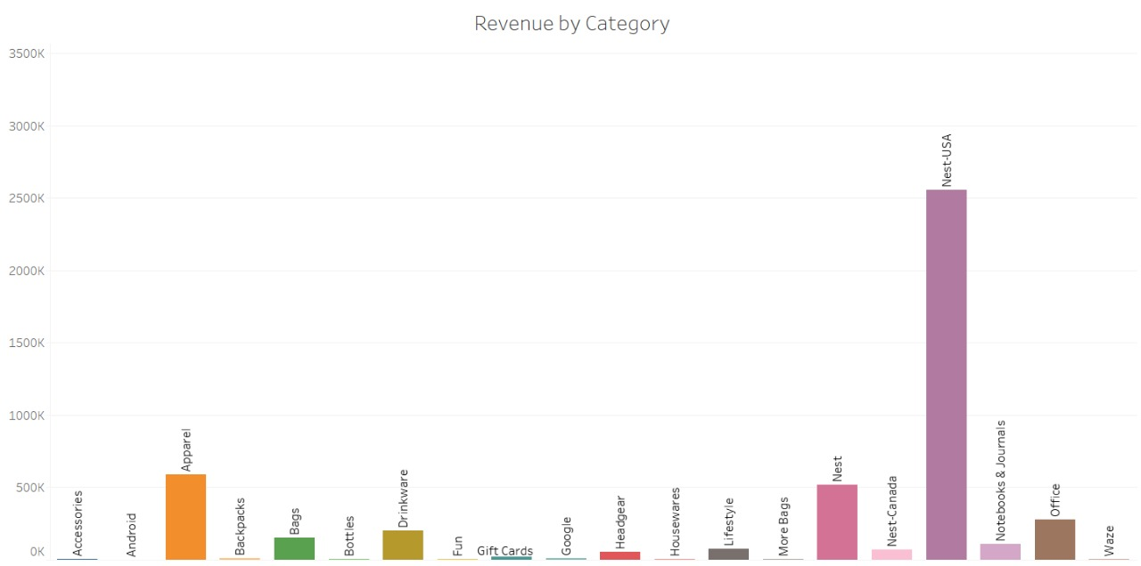
Visualization Analysis

Slide 14
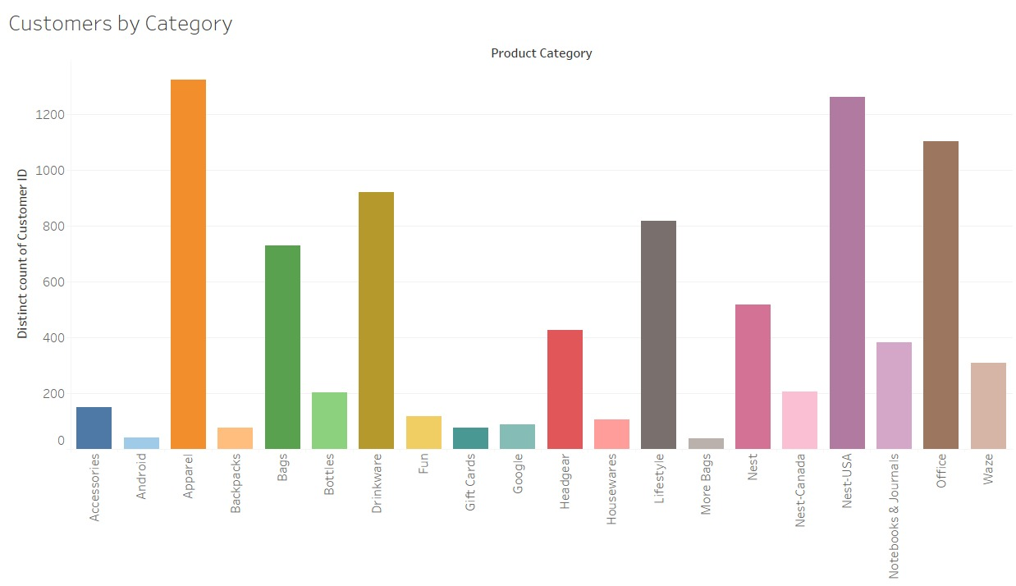
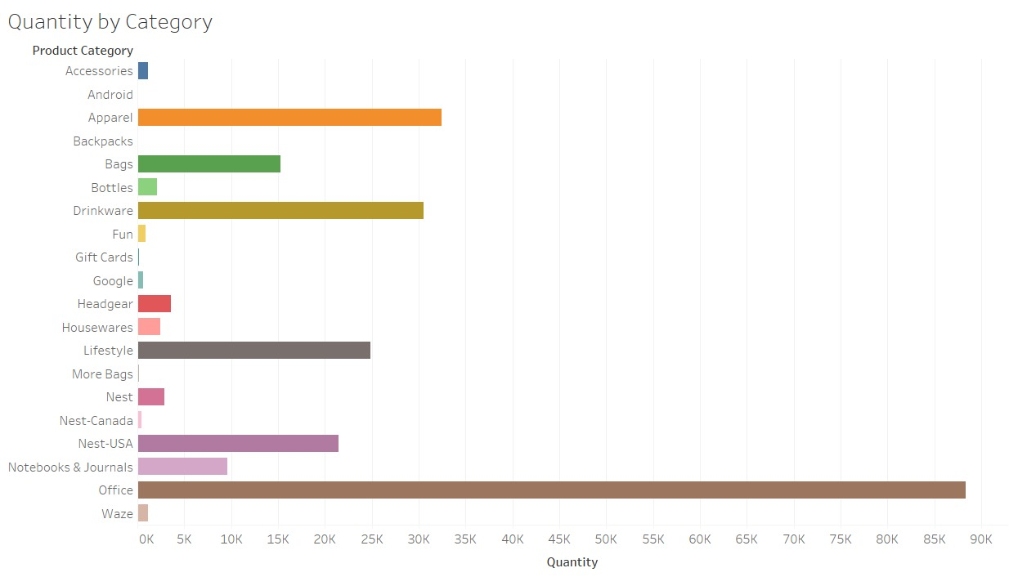
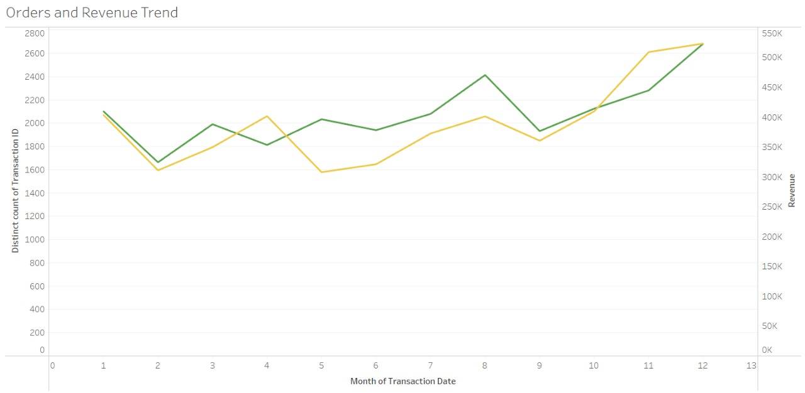

Slide 15
UI for CUSTOMER SEGEMNTATION & Next Product
An interactive Streamlit dashboard that predicts the likelihood of a customer's next purchase and recommends the next product based on transaction history and customer data.
Key Features:
User Input: Enter or select Customer ID via sidebar.
Data Display: Shows customer details and transaction history.
Predictions:Next Purchase Prediction – Forecasts if a customer will make another purchase.
Next Product Prediction – Suggests the product category likely to be purchased.

Slide 16
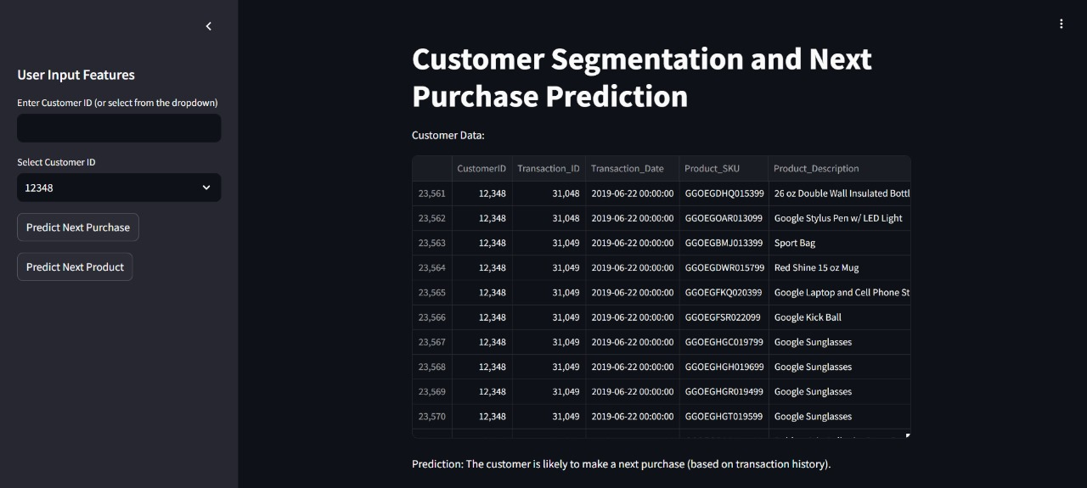

Slide 17
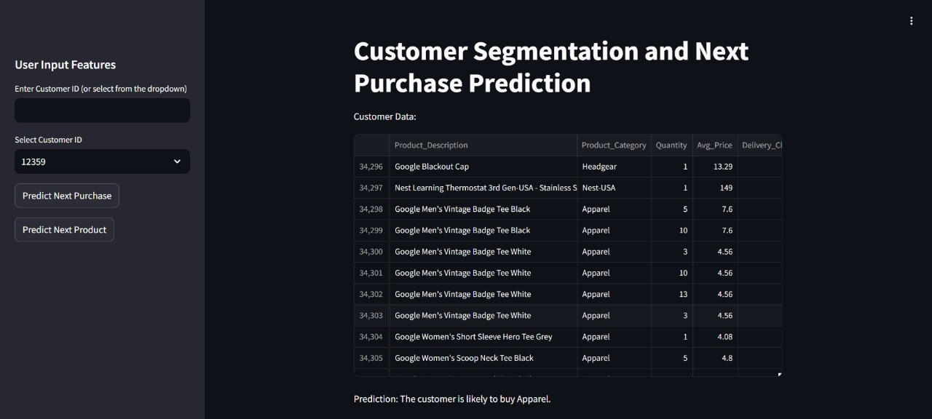

Slide 18
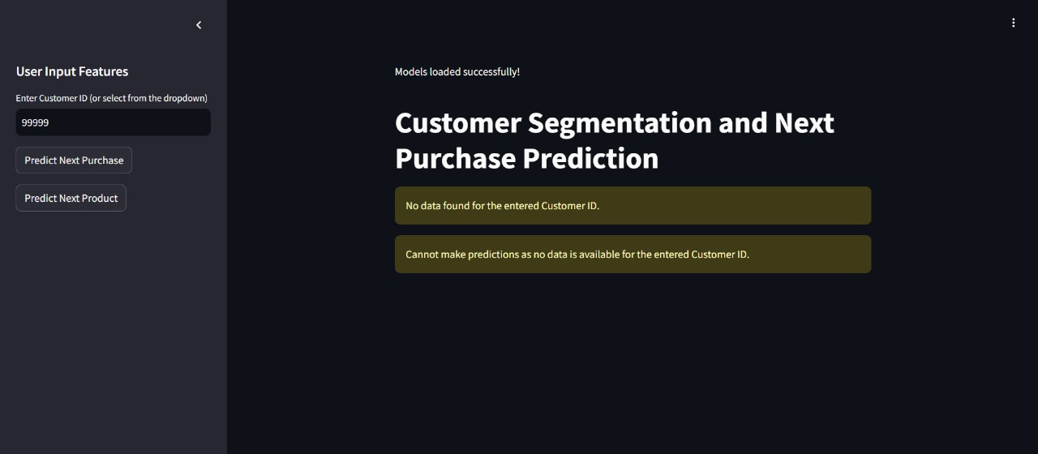

Slide 19
Key insights
From our analysis, we’ve derived several key findings:
Customer Insights: We’ve identified high-value customers and their purchasing patterns, which can inform targeted marketing efforts.
Marketing Strategies: Recommendations were made for targeted marketing based on customer segments to enhance engagement and sales.
Revenue Impact: We’ve analyzed how discounts and marketing spend affect overall revenue, providing insights into effective pricing strategies.

Slide 20
Conclusion
We can conclude that our project has provided valuable insights into customer behavior and segmentation.
The findings can significantly impact marketing strategies and revenue generation. For future work, we suggest further analysis on customer retention and exploring additional predictive modeling techniques.

Slide 21
THANK YOU.

