Slide 1
Relocation project

Slide 2
Business Problem
People relocate to another place because of different reasons: job offers, weather conditions, relationships and etc.
People still want to feel at home visiting the same places they used to.
That is why it is important to have a service that can help to find the same conditions for living when people change their residence.
Example task: : there is a very successful trader who lives in Downtown of Toronto and who got a job offer from one of the best firms of Wall Street, and now he has to decide which Manhattan neighborhood to choose to move to

Slide 3
Data
1) The dataset about New York City is extracted from the spatial data repository of New York University (https://geo.nyu.edu/catalog/nyu_2451_34572).
2) The data about boroughs and neighborhoods of Toronto with the corresponding postal codes is scraped from the Wikipedia page (https://en.wikipedia.org/wiki/List_of_postal_codes_of_Canada:_M).
3) There is a file that contains all the postal codes of Toronto with the corresponding geographical coordinates.
4) Information about centers of each city, borough and neighborhood is obtained using Nominatim, open-source geocoding tool.
5) Data about all venues for chosen neighborhoods in each city is retrieved using Foursquare API.

Slide 4
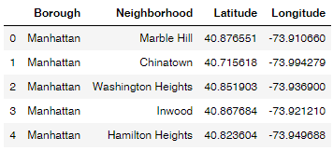
Manhattan and its neighborhoods with coordinates (the same one for toronto)

Slide 5
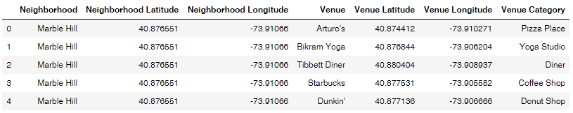
Venues of Manhattan neighborhoods (the same one for Toronto)

Slide 6
Methodology
1) Collect all the required data: name, location and category of every venue within 500 meters from centers of all considered neighborhoods using Foursquare API requests.
2) Analyze which venue categories we can leave and which ones we have to drop from our initial datasets.
3) Describe each neighborhood in terms of top 10 venues characterized them.
4) Focus on one of the Downtown Toronto neighborhoods and compare it to all the Manhattan neighborhoods by clustering them using k-means clustering technique.
5) Map the results (neighborhoods suited for relocation purposes) by means of Folium, map rendering library.

Slide 7
Analysis. common categories
There are 279 and 181 different venue categories in Manhattan and Downtown Toronto, correspondingly.
It was found that these boroughs have 142 venue categories in common.
The analysis is based on the assumption that this number of venue categories is enough to choose the best place to relocate.

Slide 8
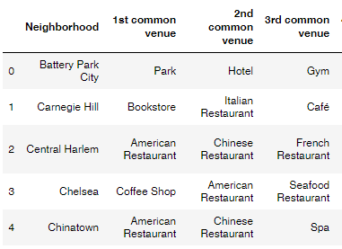
Analysis. Top 10 venues
For each neighborhood 10 top venues are defined.
Popular venues are very useful when it is time to make a final decision about which neighborhood to choose to move to because the final range of chosen neighborhoods will much more likely be consisted of more than one option.

Slide 9
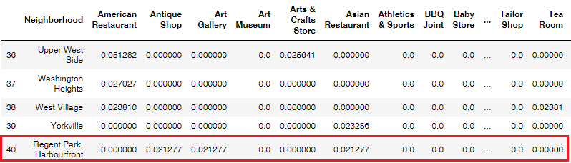
Analysis. Cluster neighborhoods (1)
In the example task we focus on one Downtown Toronto neighborhood: Regent Park, Harbourfront.
To start clustering it is necessary to create a new concatenated dataset that includes all the data about Manhattan neighborhoods and Regent Park, Harbourfront.

Slide 10
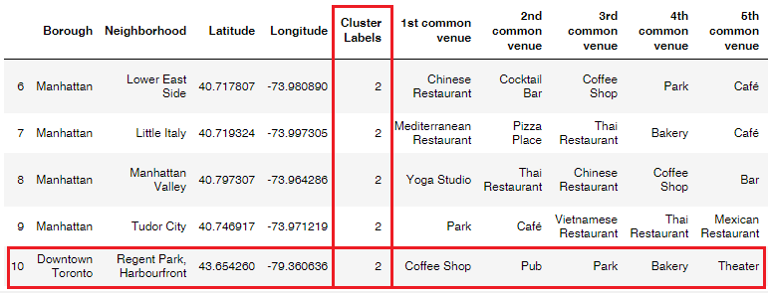
Analysis. Cluster neighborhoods (2)
After using k-means clustering each neighborhood in the concatenated dataset got its label.
We are interested only in those neighborhoods that have the same cluster label as Regent Park, Harbourfront neighborhood.

Slide 11
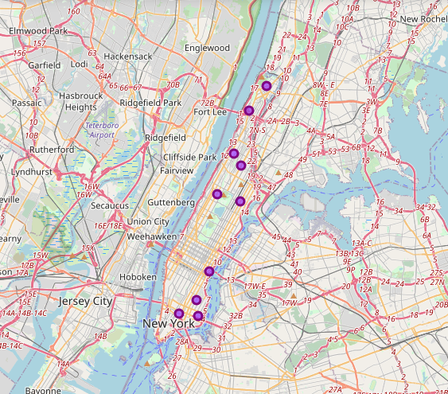
Analysis. Mapping
On the map presented on the left, there are 10 Manhattan neighborhoods that are recommended as similar ones to Regent Park, Harbourfront neighborhood from the perspectives of venues located next to and within these neighborhoods.

Slide 12
Results and discussion
We got 10 out of 40 Manhattan neighborhoods that can be recommended as potential places for relocation to Manhattan from Regent Park, Harbourfront Toronto neighborhood. These recommendations are based on the idea of similarity of venues that are typical for these neighborhoods.
HOW TO CONTRIBUTE TO THIS PROJECT:
1. We shouldn't be restricted by two possible cities. We need to expand it to a region, country continents and etc.
2. We should take into account not only the information about the venues of the neighborhoods but also the data about real estate prices, crime rate, level of noise and etc.
3. We should standardize venue categories and use their variety to make the results more accurate.

