Slide 1
AJAX

Slide 2
Contents
What is and Why AJAX
Brief view on AJAX
Review Client-Server communication
XMLHttpRequest
Steps
Header
Readystate
Response Handler

Slide 3
What is AJAX?
Shorthand for Asynchronous JavaScript and XML
Is a technique of designing web apps / single-page apps
Makes use of scripted http requests

Slide 4
Why AJAX
In essence:
Without replacing the current page
Make a new request to a server
Process the response
Update the display
Ajax is the core of all single-page apps today:
Gmail
Piazza
Tumblr
Many many others ...

Slide 5
Some Ajax patterns
Dynamically update content from remote source
Friendly interactive interface to remote services
Responsive first-person interaction
Collaborative interaction
Streaming within a web-page context
Submission throttling
E.g. Google docs (saves)
Partial completion
E.g. Google Suggest

Slide 6
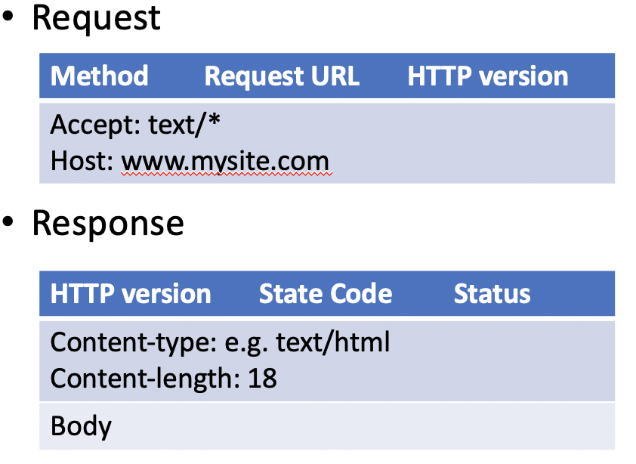
Browser-Server communication
HTTP
Transaction oriented:
client: request message
server: response message
Messages
Headers: Methods, URL, Status Code, Content-type, Hosts
Contents

Slide 7
Browser-Server communication
Key to the Ajax style communication is communication between a browser and a server within the context of a page
i.e. without a new page load
XMLHttpRequest is the primary means of facilitating this communication
All modern browsers have a built-in XMLHttpRequest object

Slide 8
XMLHttpRequest Overview
4-steps
Get a new XMLHttpRequest object
Open it
Send a request
When complete, handle the response

Slide 9
Step 1: Get a new XMLHttpRequest object
var xhr = new XMLHttpRequest();

Slide 10
Step 2: Open
xhr.open("GET", "data.txt", true);
1st : http request method (text string)
i.e. GET, POST (most often)
Also HEAD, PUT , DELETE, options
2nd: URL of HTTP request (text string)
i.e. Server/resources
3rd: Asynchronous switch (Trur/False)
is the request asynchronous
True means a send will not block (asynchronous)
AVOID: False means a send will block (synchronous)

Slide 11
Step 3: Send
GET, HEAD, PUT, DELETE, OPTIONS
Put parameters in the open URL query string
Then send(null)
E.g.:
open(“GET","http://localhost/foo/test?param1=x&m2=y", true);
send();
POST – Put parameters as arguments to send
E.g.:
open("POST", "http://localhost/foo/test", true);
send(“param1=x&m2=y");

Slide 12
Step 4: Handle Response
Define a callback function to process the response from the server
The browser calls an event handler for each change in the state of the XMLHttpRequest object
xhr.onreadystatechange = function() { ... }

Slide 13
Optional: add headers to the request
You can add headers to the request
E.g. xhr.setRequestHeader("Content-Type", "text/plain");
Cookies are handled automatically
Some headers are added automatically

Slide 14
XMLHttpRequest readyState
xhr.readyState values:
0: Object has been constructed
1: Open method successful
headers can now be set
send can now be done
2: Response headers have been received from the server
3: Response body is being received (in progress)
4: Response complete (or something went wrong)
The onreadystatechange event fires each time the value of readyState changes.

Slide 15
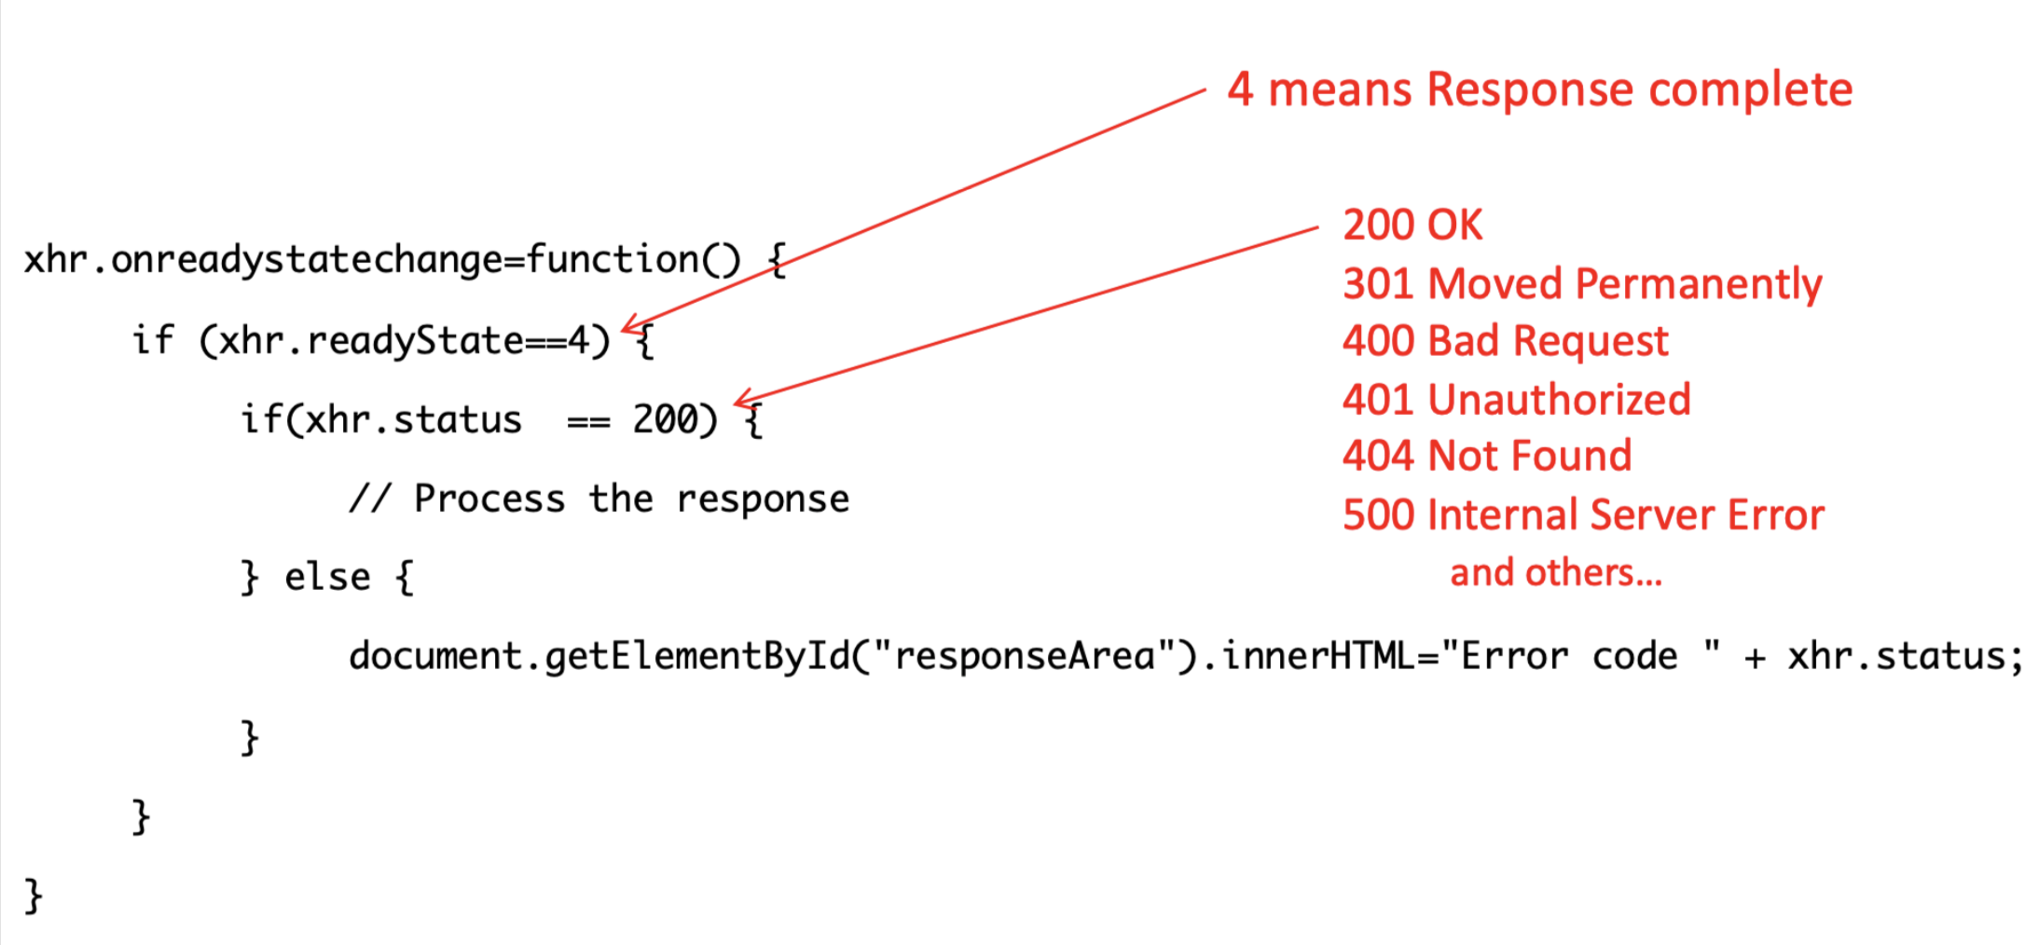
Response Handler Example

Slide 16
Use the results
XML
Iff the response is valid XML, it can be treated as such
responseXML will be a DOM document object
e.g. xhr.responseXML
JSON
Can be parsed into a JavaScript object using JSON.parse()
Text
The results can be treated as String
responseText
e.g. xhr.responseText
Can be manipulated as any String object

