Slide 1
Mid-term Review
Based on reviewing slides from Mr. Waits

Slide 2
Overview
75 mins
10 Sections
1 Bonus Section
Types
multiple-choice question
Short answer
Matching
Limited Code
Close book

Slide 3
HTML/CSS Topics
Understand difference between tags and attributes and how they represent elements
Tags: starting and ending of elements with angle brackets
Attributes: name/value pairs specified in a start tag, e.g. <img src="leader.jpg"/>

Slide 4
HTML/CSS Topics
Selectors
Common CSS selectors
Element
Class: Classes are attributes of HTML elements for which we want to define common properties
ID: IDs are attributes of HTML elements for which we want to identify uniquely
How to combine selectors
Child Combinator: E > F
Matches any F element that is a child of an element E
Next sibling combinator: E + F
The selector matches if E and F share the same parent and E immediately precedes F. Meaning it selects all F elements that are placed immediately after E elements.
Compounding multiple class or ID selectors:
.class1.class2(.classN) / #id.class1(.classN) / .class1(.classN)#id

Slide 5
General JavaScript
Equality
== vs ===:
==(loose equality): necessary type convert permitted
===(strict equality): both value and datatype should be identical
!= vs !==:
!=: not equal
!==: not equal value or not equal type

Slide 6
General JavaScript
Math operators with mixed types
var x = 5;
var y = 'y’;
var z = x + y;
z = ?

Slide 7
JavaScript Arrays and Objects
Arrays
Are Objects, The typeof operator in JavaScript returns "object" for array
Use numbers to access its "elements”
Array Elements Can Be Objects
Properties:
array.length: return number of array elements
Add elements: array.push(a)/array[array.length]
Adding elements with high indexes can create undefined "holes" in an array
Remove elements
delete array[ index ] (might result in empty slots)
array.splice( index, 1 )

Slide 8
JavaScript Arrays and Objects
Objects
Objects are variables too. But objects can contain many values
JavaScript objects are containers for named values called properties or methods
Object Definition
var person = {firstName:"John", lastName:"Doe", age:50, eyeColor:"blue"};
Accessing Object Properties/methods
objectName.propertyName/objectName["propertyName"]
objectName.methodName()/name = person.fullName()
Add/Delete:
Add: Simply assign a name with values
Delete: delete person.age

Slide 9
DOM
Document Object Model
Tree like (parents, children, siblings)
Get elements
document.getElementById("pp1").innerHTML
document.getElementsByName("2nd")
document.getElementsByTagName("span")
Changing
Changing HTML Content
document.getElementById(id).innerHTML = new HTML
Changing the Value of an Attribute
document.getElementById(id).attribute = new value

Slide 10
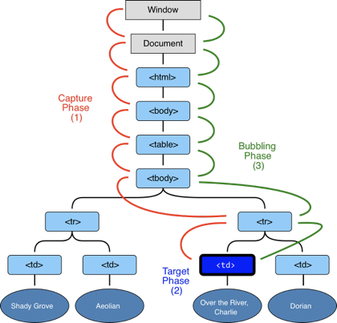
Events
the currentTarget refers to the elements whose eventlisteners are currently being processed. As the event capturing and bubbling occurs this value changes
the target refers to the DOM element on the lefthand side of the call that triggered this event

Slide 11
Web Storage
LocalStorage
stores data with no expiration dateSessionStorage
The sessionStorage
stores data for one session (data is lost when the browser tab is closed)
getItem, setItem, removeItem, clear, length

Slide 12
Regular Expressions
Check slides for recitation 3&4
Context based

Slide 13
HTTP
HTTP methods
safe if it doesn't alter the state of the server
HTTP status codes
See recitation “Network&HTTPs”

Slide 14
Python
Slicing
A = [1,2,3,4,5,6,7,8]
A[:-1]? A[2:5]?
Lists, Dictionaries, and Tuples
List comprehension
[ expression for item in list if conditional ]
Same as:
for item in list:
if conditional:
expression

Slide 15
Python
Classes
Inheritance from superclasses
class Person:
def __init__(self, first, last):
self.firstname = first
self.lastname = last
def Name(self):
return self.firstname + " " + self.lastname
class Employee(Person):
def __init__(self, first, last, staffnum):
Person.__init__(self,first, last)
self.staffnumber = staffnum
def GetEmployee(self):
return self.Name() + ", " + self.staffnumber
x = Person(“Marge”, “Simpson”)
y = Employee("Homer", "Simpson", "1007")
print(x.Name()) #Marge Simpson
print(y.GetEmployee()) #Homer Simpson, 1007
Can also use super() to represent superclasses

Slide 16
Python Decorators
# This is our decorator
def simple_decorator(f):
def wrapper():
print "Entering Function"
f()
print "Exited Function"
return wrapper
@simple_decorator
def hello():
print "Hello World"
hello()
Output:
Entering Function Hello World Exited Function

