Slide 1
XML, JSON and REST API

Slide 2
Contents Table
XML vs JSON
Examples of XML&JSON
Comparisons
REST API
What is REST
REST Principles
How to design a good RESTful API

Slide 3
XML vs JSON

Slide 4
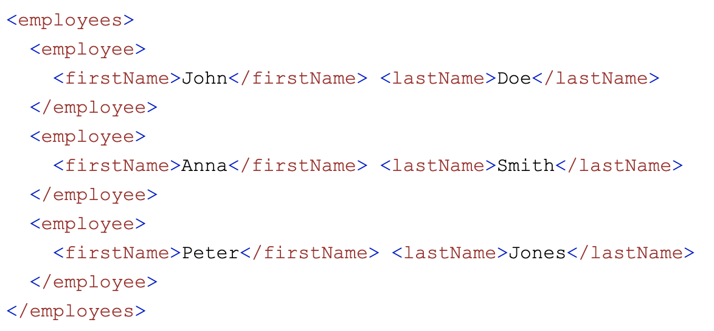
XML
Extensible Markup Language
Mark elements in HTML-like tagging
Example

Slide 5
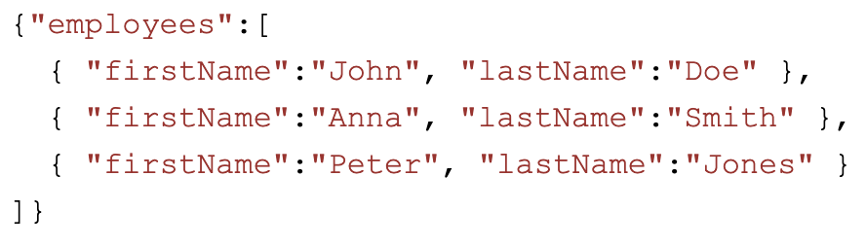
JSON
JavaScript Object Notation
Text
Written with JavaScript object notation
Example

Slide 6
XML vs JSON
Like for
Both JSON and XML are "self describing" (human readable)
Both JSON and XML are hierarchical (values within values)
Both JSON and XML can be parsed and used by lots of programming languages
Both JSON and XML can be fetched with an XMLHttpRequest
Unlike for
JSON doesn't use end tag
JSON is shorter
JSON is quicker to read and write
JSON can use arrays
XML has to be parsed with an XML parser. JSON can be parsed by a standard JavaScript function

Slide 7
Why JSON better than XML
Pros of JSON
XML is much more difficult to parse than JSON
JSON is parsed into a ready-to-use JavaScript object
Use
Using XML
Fetch an XML document
Use the XML DOM to loop through the document
Extract values and store in variables
Using JSON
Fetch a JSON string
JSON.Parse the JSON string

Slide 8
REST

Slide 9
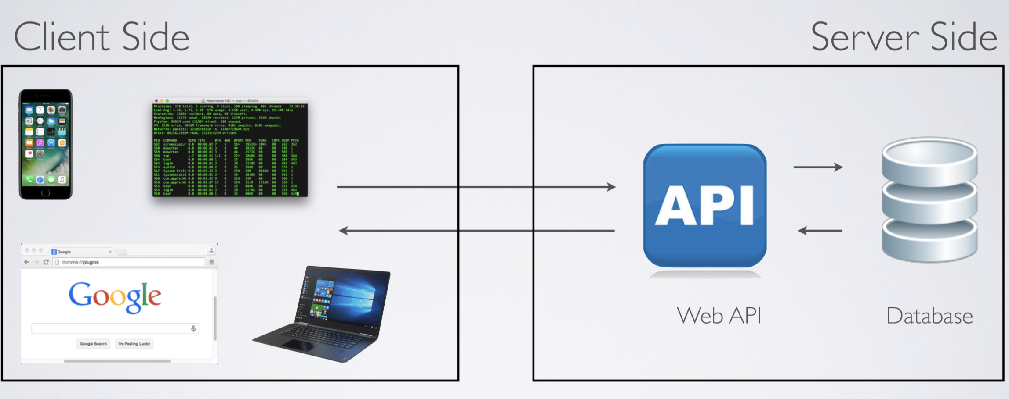
What is REST
REpresentational State Transfer
An API for server side storage to handling communications
Uniform across the frontend and backend devices with varies platform

Slide 10
Principles of REST
Client–server
Separating the user interface concerns from the data storage concerns
Stateless
Must contain all of the information necessary to understand the request
Cacheable
data within a response to a request be implicitly or explicitly labeled as cacheable or non-cacheable

Slide 11
Principles of REST
Uniform interface
Identification of resources (URI/URL)
Manipulation of resources through representations (HTTP methods)
Self-descriptive messages
Hypermedia as the engine
Layered system
Allow hierarchical designs
Code on demand (optional)
REST and HTTP are not same
REST is the way HTTP should be used
HTTP not required

Slide 12
RESTful API Design
1. Protocol
Typically HTTP/HTTPs
2. Domain
Good to have a subdomain
E.g. https://api.example.com
Can also locate in main domain if simple
E.g. https://example.org/api/
3. Version
In url: https://api.example.com/v1/

Slide 13
RESTful API Design
4. Endpoint
All the Elements should be saved under specific URL
Same Collection for same subsets.
Examples
https://api.example.com/v1/zoos
https://api.example.com/v1/animals
https://api.example.com/v1/employees
5. HTTP Methods
GET /zoos
POST /zoos
GET /zoos/ID
PUT /zoos/ID

Slide 14
RESTful API Design
6. Filtering
?limit=10 (length of return)
?offset=10 (start point of return)
?page=2&per_page=100 (which page(2) in size(100))
?sortby=name&order=asc (sorted return)
?animal_type_id=1 (filter condition)
7. HTTP Status Codes
8. Error handling
Using error as a key: { error: "Invalid API key" }

Slide 15
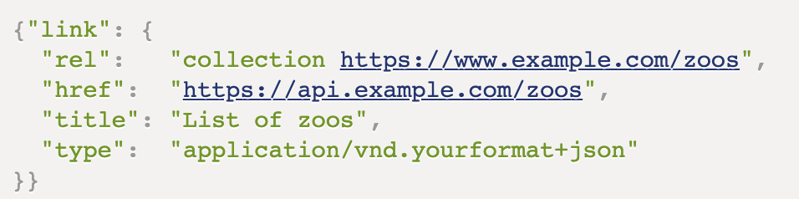
RESTful API Design
9. Return results
GET /collection (lists)
GET /collection/resource (object for specific resource)
POST /collection (object newly created)
PUT /collection/resource (entire object)
DELETE /collection/resource (empty document)
10. Hypermedia API
Link property to other APIs

