Slide 1


⚡ AI CODE ANALYZER
FULL-STACK INTELLIGENCE SYSTEM
PROJECT_ID: RED_OCTOBER

Slide 2
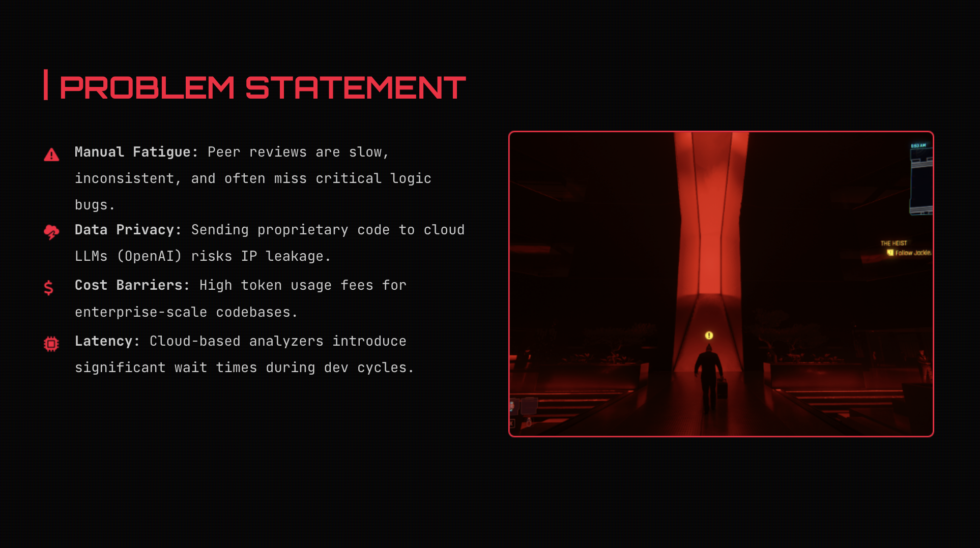
⚡ AI CODE ANALYZER
FULL-STACK INTELLIGENCE SYSTEM
PROJECT_ID: RED_OCTOBER

Slide 3

THE MISSION
Eliminate Technical Debt: Real-time semantic analysis to catch architectural flaws.
Security Hardening: Automatic detection of vulnerabilities in 15+ languages.
Vision-Powered: Extract and analyze code directly from IDE screenshots.
Decision Support: AI-driven "Should Push" metrics for Git workflows.

Slide 4







SYSTEM NUCLEUS
VITE FRONTEND
FASTAPI BACKEND
OLLAMA ENGINE
High-speed React interface with Black/Red Cyberpunk UI & Radar Charts.
Async Python engine handling Risk Scoring, SQLite logging, and AI orchestration.
Local LLM hosting: DeepSeek-Coder-6.7B & Qwen2.5-Coder-7B.
OS: macOS 13+ (Silicon Optimized) // DB: SQLite // VISION: LLaVA

Slide 5
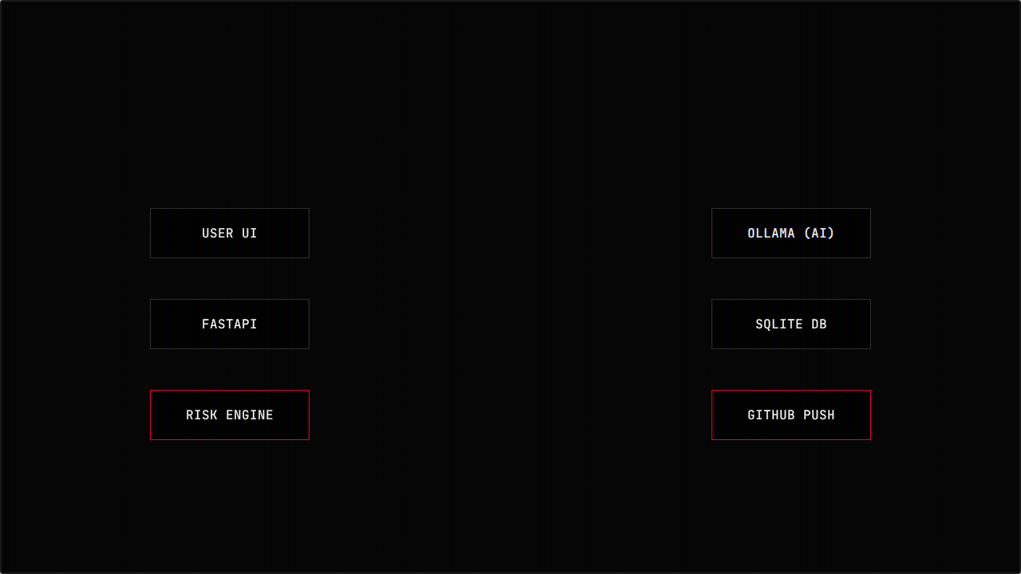







DATA TRAJECTORY

Slide 6
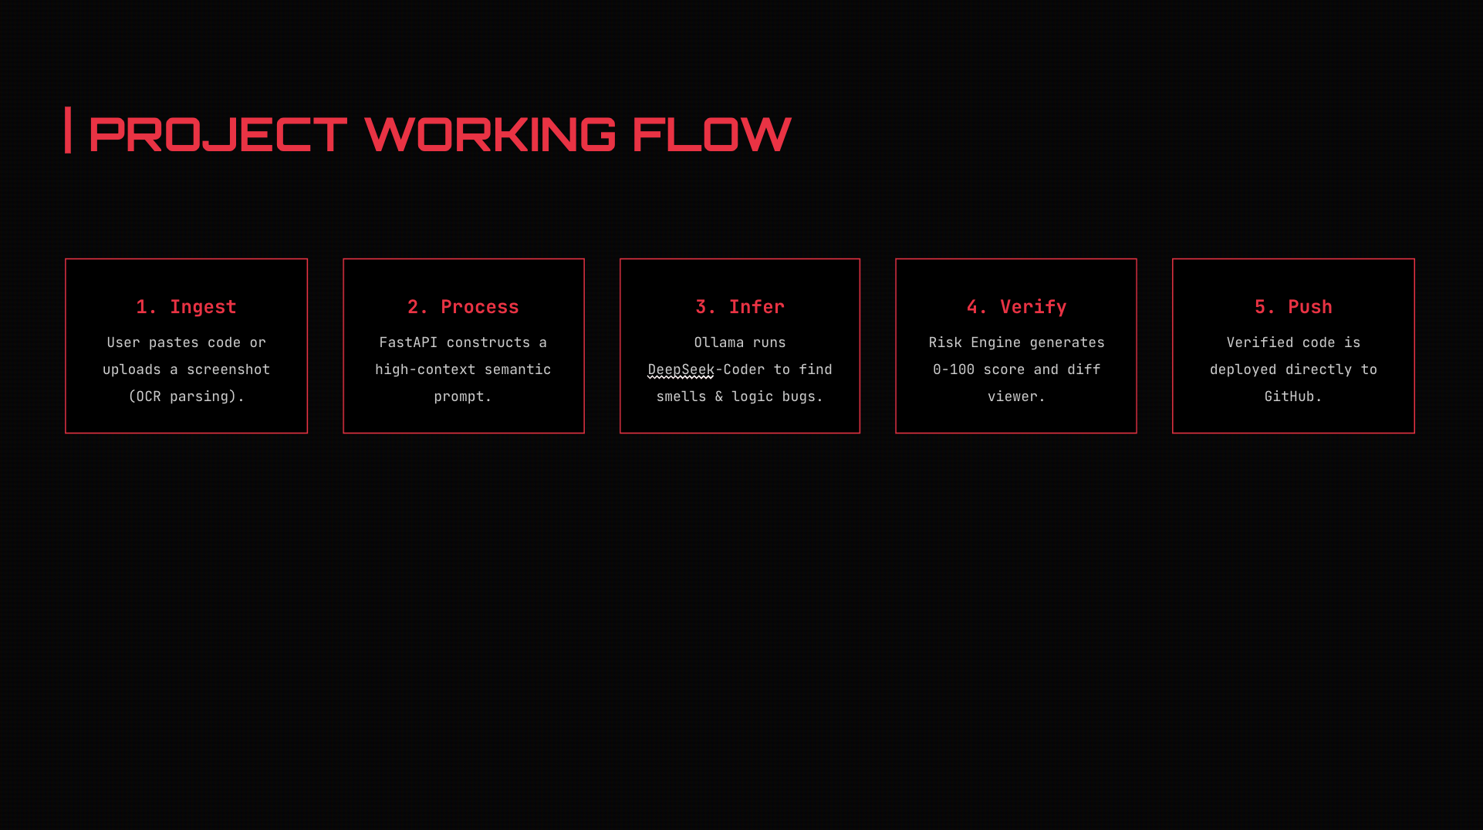
DATA TRAJECTORY

Slide 7
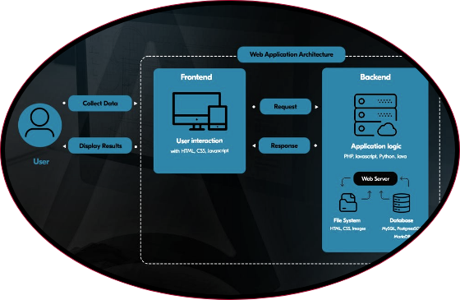
METRIC DASHBOARD
•
Risk Score (0-100): Classifies code from Safe to Critical.
•
Radar Charts: 5-point analysis (Security, Performance, etc.)
•
Semantic Diff: Visual Red/Green side-by-side refactoring.
•
History Replay: Track risk trends across all sessions.

Slide 8

OLLAMA INTEGRATION
MODEL HIERARCHY
> ollama pull deepseek-coder
Target: 6.7B Model - Optimized for macOS performance.
Offline Fallback: Static analysis triggers if Ollama server is unreachable.
> ollama pull qwen2.5-coder
Apple Silicon: Leverages Metal acceleration for instant code feedback.
Target: 7B Model - Multilingual semantic expert.
> ollama pull llava
Target: Vision Support - Screenshots extraction.

Slide 9




FUTURE UPGRADES
PHASE 1
PHASE 2
PHASE 3
Direct IDE Integration (VS Code / JetBrains Plugins)
Multi-modal Chat Interface for deeper refactor Q&A
Team Collaboration & Shared SQLite Cloud Sync

Slide 10

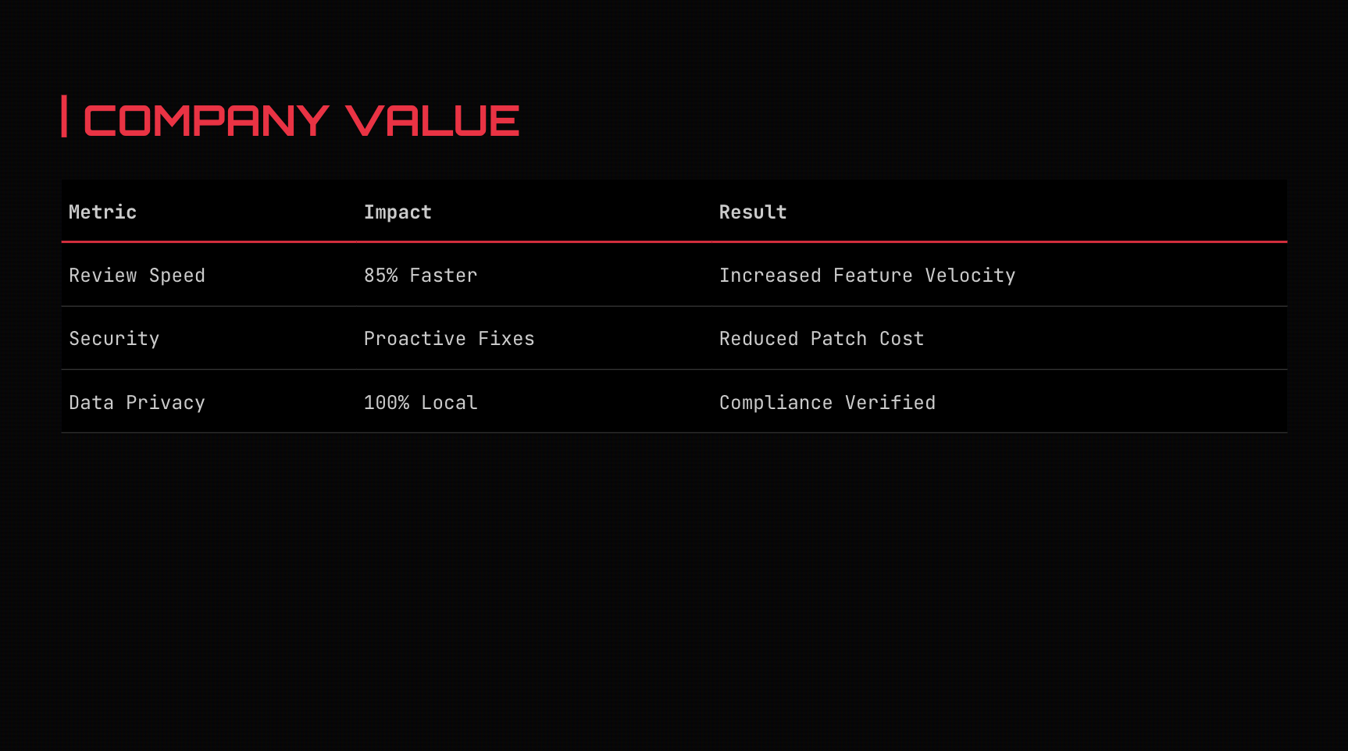

Slide 11
TERMINATED_01
THANK YOU

Slide 12


IMAGE SOURCES
https://www.softwareseni.com/wp-content/uploads/2025/08/header_image_CSW202508111258.png
Source: www.softwareseni.com
https://acropolium.com/img/articles/modern-web-app-architecture/img02.jpg
Source: acropolium.com

