Slide 1
Matematika Peminatan MA Husnul Khotimah Kelas 12 IPA
Tahun Pembelajaran 2020-2021

Slide 2
Cakupan Materi
Semester Ganjil
Bab 1 : Limit Fungsi Trigonometri
Bab 2 : Turunan Fungsi Trigonometri
Bab 3 : Integral Trigonometri
Semester Genap
Bab 4 : Distribusi dan Peluang Binomial
Bab 5 : Distribusi dan Peluang Normal

Slide 3
BAB 1 Limit Fungsi Trigonometri
Limit Fungsi Trigonometri
Limit di Ketakberhinggaan Fungsi Trigonometri

Slide 4
1.1 Limit di Keberhinggan Fungsi Trigonometri
Substitusi Langsung
Bentuk tak tentu 0/0 dengan pengubahan bentuk trigonometri
Bentuk tak tentu 0/0 dengan rumus dasar limit trigonometri
Bentuk tak tentu 0/0 dengan menggunakan rumus-rumus trigonometri

Slide 5
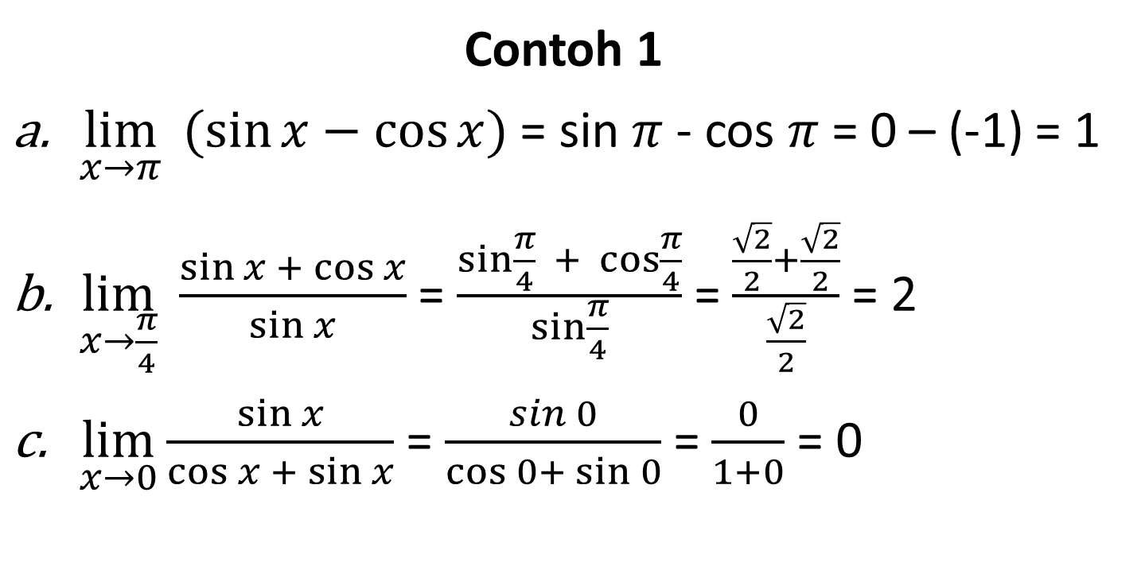
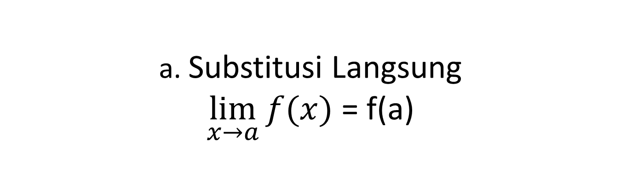
a. Substitusi Langsung $\lim_{x→a}{f(x)}$ = f(a)
Contoh 1
$\lim_{x→π}{ (\sin{x−\cos{x)}}}$ = sin $π$ - cos $π$ = 0 – (-1) = 1
$\lim_{x→\frac{π}{4}}{ \frac{\sin{x + \cos{x}}}{\sin{x}}}$ = $\frac{sin\frac{π}{4}{ + \cos{\frac{π}{4}}}}{\sin{\frac{π}{4}}}$ = $\frac{\frac{\sqrt{2}}{2}+\frac{\sqrt{2}}{2}}{\frac{\sqrt{2}}{2}}$ = 2
$\lim_{x→0}{\frac{\sin{x}}{\cos{x +\sin{x}}}}$ = $\frac{\sin{0}}{\cos{0+}\sin{0}}$ = $\frac{0}{1+0}$ = 0

Slide 6
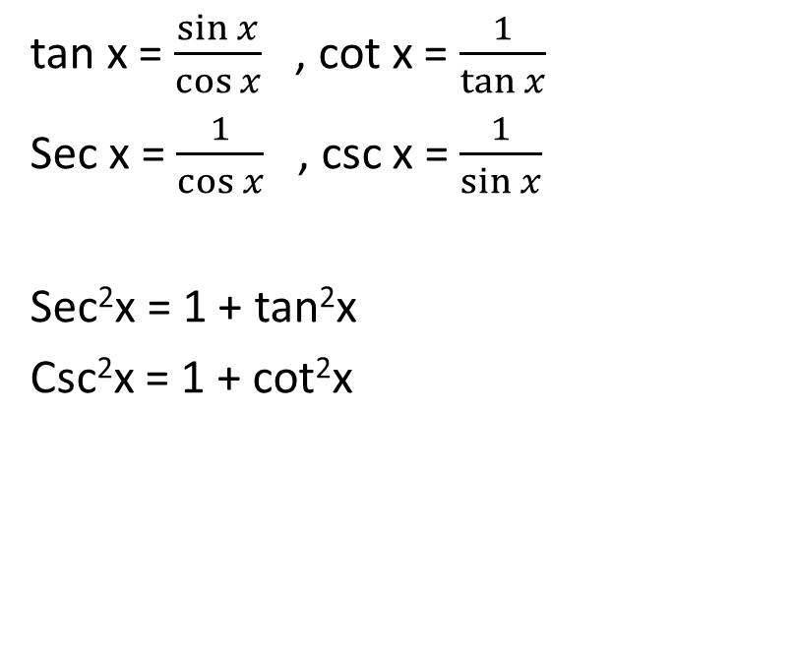
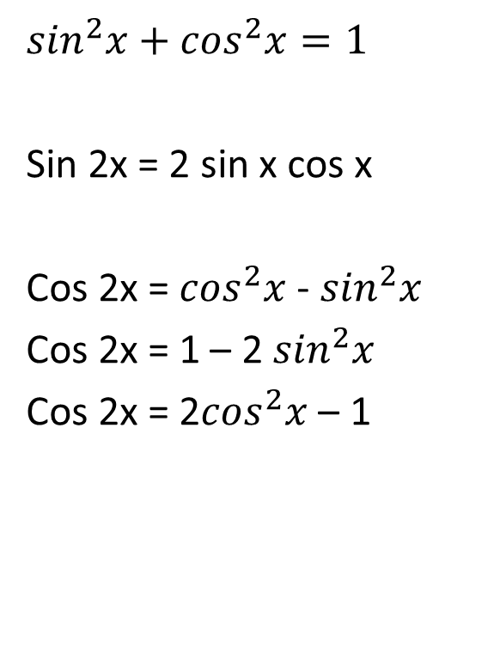
b. Bentuk tak tentu 0/0 dengan pengubahan bentuk trigonometri
$$\sin^{2}x+\cos^{2}x=1$$
Sin 2x = 2 sin x cos x
Cos 2x = $\cos^{2}x$ - $\sin^{2}x$
Cos 2x = 1 – 2 $\sin^{2}x$
Cos 2x = 2$\cos^{2}x$ – 1
tan x = $\frac{\sin{x}}{\cos{x}}$ , cot x = $\frac{1}{\tan{x}}$
Sec x = $\frac{1}{\cos{x}}$ , csc x = $\frac{1}{\sin{x}}$
Sec²x = 1 + tan²x
Csc²x = 1 + cot²x

Slide 7
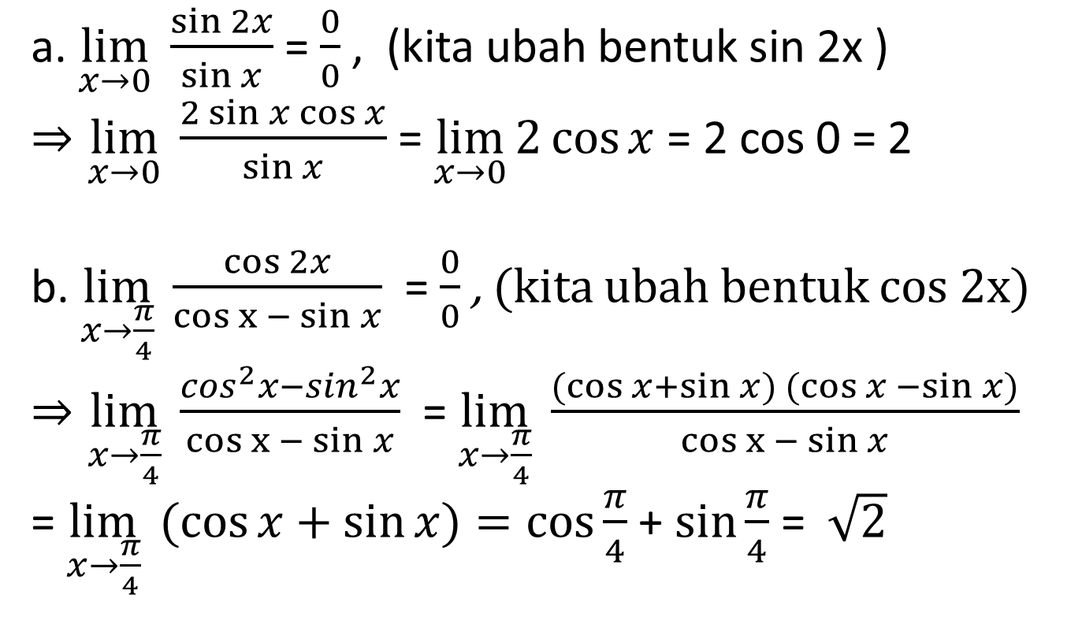
Contoh 2
a. $\lim_{x→0}{ \frac{\sin{2x}}{\sin{x}}}$ = $\frac{0}{0}$ , (kita ubah bentuk sin 2x )
$⇒\lim_{x→0}{ \frac{2\sin{x\cos{x}}}{\sin{x}}}$ = $\lim_{x→0}{2\cos{x}}$ = 2 cos 0 = 2
b. $\lim_{x→\frac{π}{4}}{ \frac{\cos{2x}}{cos x − sin{x}}}$ = $\frac{0}{0}$ , (kita ubah bentuk cos 2x)
$⇒\lim_{x→\frac{π}{4}}{ \frac{\cos^{2}x−\sin^{2}x}{cos x − sin{x}}}$= $\lim_{x→\frac{π}{4}}{ \frac{(cos{x+\sin{x) (\cos{x −\sin{x)}}}}}{cos x − sin{x}}}$
= $\lim_{x→\frac{π}{4}}{ (\cos{x+\sin{x)=\cos{\frac{π}{4}} }}}$+ $\sin{\frac{π}{4}}$ = $\sqrt{2}$

Slide 8
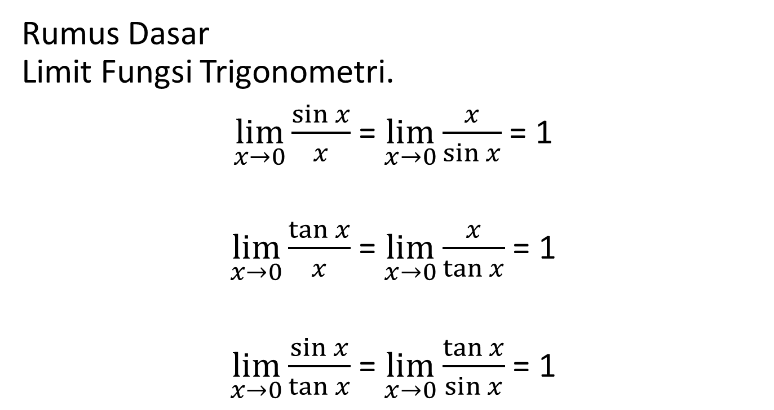
c. Bentuk tak tentu 0/0 dengan menggunakan rumus dasar
Rumus Dasar Limit Fungsi Trigonometri.
$\lim_{x→0}{\frac{\sin{x}}{x}}$ = $\lim_{x→0}{\frac{x}{\sin{x}}}$ = 1
$\lim_{x→0}{\frac{\tan{x}}{x}}$ = $\lim_{x→0}{\frac{x}{\tan{x}}}$ = 1
$\lim_{x→0}{\frac{\sin{x}}{\tan{x}}}$ = $\lim_{x→0}{\frac{\tan{x}}{\sin{x}}}$ = 1

Slide 9
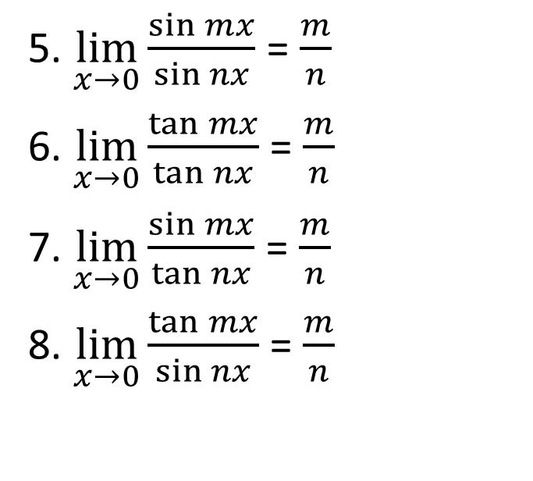
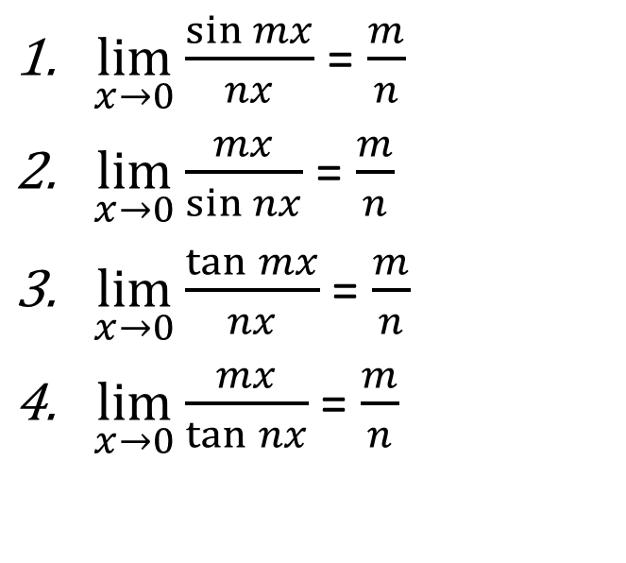
Rumus Perluasan 1 Limit Fungsi Trigonometri
$\lim_{x→0}{\frac{\sin{mx}}{nx}}$ = $\frac{m}{n}$
$\lim_{x→0}{\frac{mx}{\sin{nx}}}$ = $\frac{m}{n}$
$\lim_{x→0}{\frac{\tan{mx}}{nx}}$ = $\frac{m}{n}$
$\lim_{x→0}{\frac{mx}{\tan{nx}}}$ = $\frac{m}{n}$
5. $\lim_{x→0}{\frac{\sin{m}x}{\sin{nx}}}$ = $\frac{m}{n}$
6. $\lim_{x→0}{\frac{\tan{mx}}{\tan{nx}}}$ = $\frac{m}{n}$
7. $\lim_{x→0}{\frac{\sin{mx}}{\tan{nx}}}$ = $\frac{m}{n}$
8. $\lim_{x→0}{\frac{\tan{mx}}{\sin{nx}}}$ = $\frac{m}{n}$

Slide 10
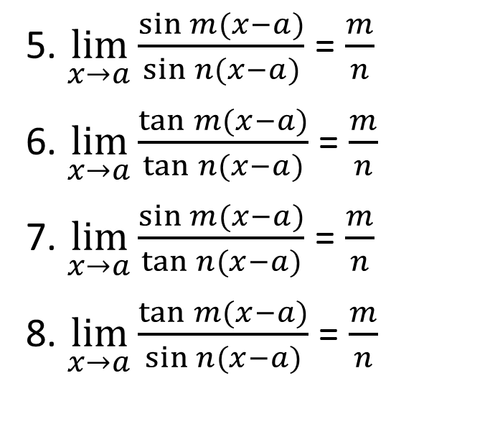
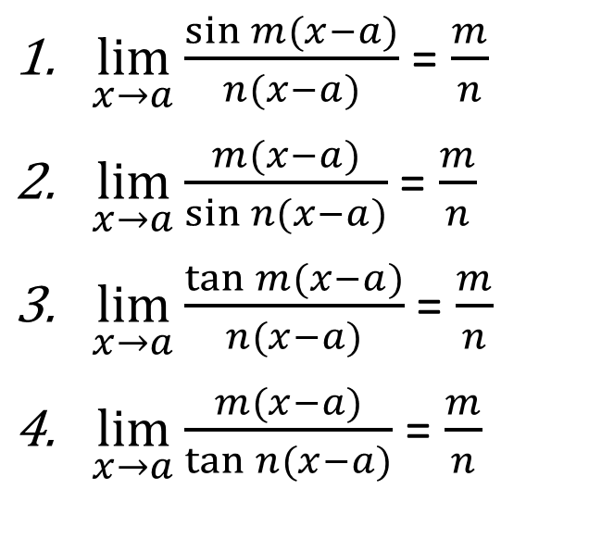
Rumus Perluasan 2 Limit Fungsi Trigonometri
$\lim_{x→a}{\frac{\sin{m(x−a)}}{n(x−a)}}$ = $\frac{m}{n}$
$\lim_{x→a}{\frac{m(x−a)}{\sin{n(x−a)}}}$ = $\frac{m}{n}$
$\lim_{x→a}{\frac{\tan{m(x−a)}}{n(x−a)}}$ = $\frac{m}{n}$
$\lim_{x→a}{\frac{m(x−a)}{\tan{n(x−a)}}}$ = $\frac{m}{n}$
5. $\lim_{x→a}{\frac{\sin{m}(x−a)}{\sin{n(x−a)}}}$ = $\frac{m}{n}$
6. $\lim_{x→a}{\frac{\tan{m(x−a)}}{\tan{n(x−a)}}}$ = $\frac{m}{n}$
7. $\lim_{x→a}{\frac{\sin{m(x−a)}}{\tan{n(x−a)}}}$ = $\frac{m}{n}$
8. $\lim_{x→a}{\frac{\tan{m(x−a)}}{\sin{n(x−a)}}}$ = $\frac{m}{n}$

Slide 11
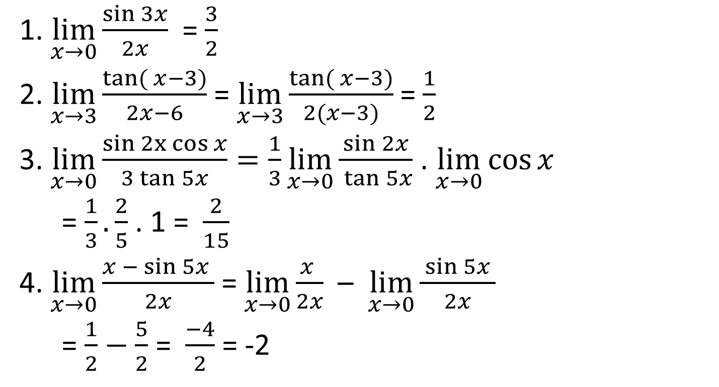
contoh 3
1. $\lim_{x→0}{\frac{\sin{3x}}{2x}}$ = $\frac{3}{2}$
2. $\lim_{x→3}{\frac{tan({x−3)}}{2x−6}}$ = $\lim_{x→3}{\frac{tan({x−3)}}{2(x−3)}}$ = $\frac{1}{2}$
3. $\lim_{x→0}{\frac{sin 2x cos{x}}{3\tan{5x}}}=\frac{1}{3}\lim_{x→0}{\frac{\sin{2x}}{ \tan{5x}}}$ . $\lim_{x→0}{\cos{x}}$
= $\frac{1}{3}.\frac{2}{5}$ . 1 = $\frac{2}{15}$
4. $\lim_{x→0}{\frac{x −\sin{5x} }{2x}}$ = $\lim_{x→0}{\frac{x }{2x}}$ – $\lim_{x→0}{\frac{\sin{5x} }{2x}}$
= $\frac{1}{2}−\frac{5}{2}$ = $\frac{−4}{2}$ = -2

Slide 12
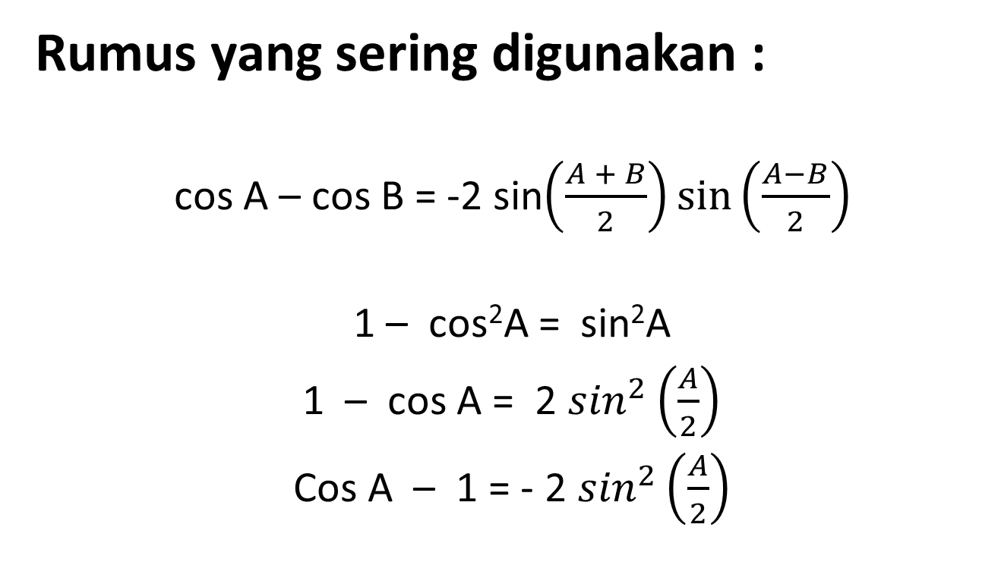
d. Bentuk tak tentu 0/0 dengan menggunakan Rumus-Rumus Trigonometri
Rumus yang sering digunakan :
cos A – cos B = -2 sin$\left(\frac{A + B}{2}\right)sin\left(\frac{A−B}{2}\right)$
1 – cos²A = sin²A
1 – cos A = 2 $\sin^{2}\left(\frac{A}{2}\right)$
Cos A – 1 = - 2 $\sin^{2}\left(\frac{A}{2}\right)$

Slide 13
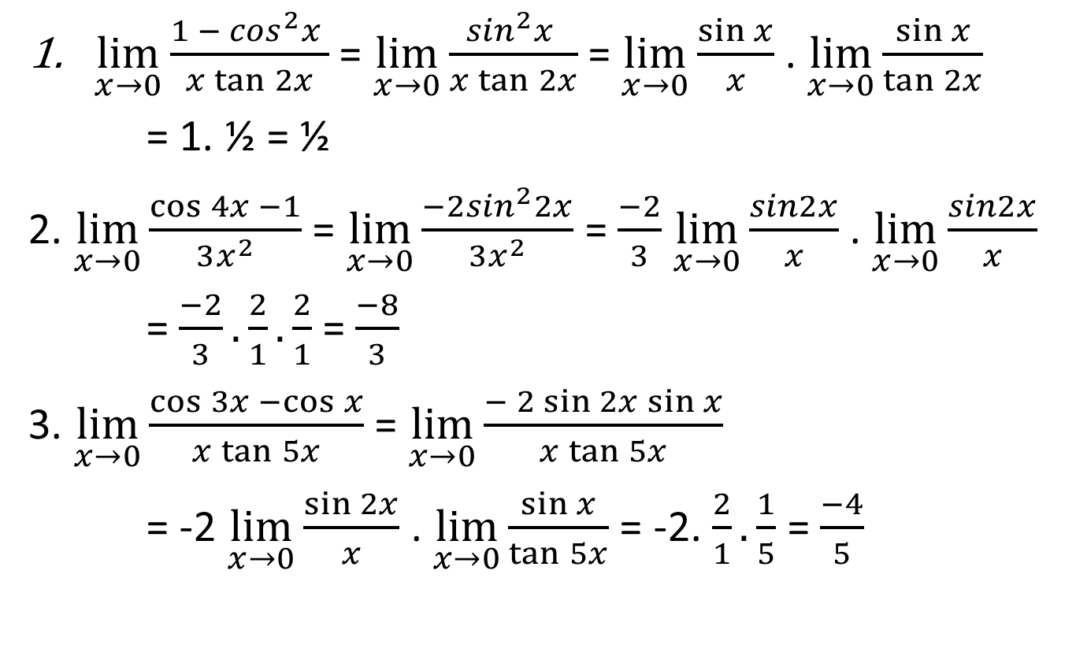
Contoh. 4
$\lim_{x→0}{\frac{1 − \cos^{2}x }{x\tan{2x}}}$ = $\lim_{x→0}{\frac{\sin^{2}x }{x\tan{2x}}}$ = $\lim_{x→0}{\frac{\sin{x}}{x}}$ . $\lim_{x→0}{\frac{\sin{x}}{\tan{2x}}}$
= 1. ½ = ½
2. $\lim_{x→0}{\frac{\cos{4x −1}}{3x^{2}}}$ = $\lim_{x→0}{\frac{−2\sin^{2}2x}{3x^{2}}}$ = $\frac{−2}{3}$ $\lim_{x→0}{\frac{sin2x}{x}}$ . $\lim_{x→0}{\frac{sin2x}{x}}$
= $\frac{−2}{3}.\frac{2}{1}.\frac{2}{1}$ = $\frac{−8}{3}$
3. $\lim_{x→0}{\frac{\cos{3x −\cos{x}}}{x\tan{5x}}}$ = $\lim_{x→0}{\frac{− 2\sin{2x\sin{x}}}{x\tan{5x}}}$
= -2 $\lim_{x→0}{\frac{\sin{2x}}{x}}$ . $\lim_{x→0}{\frac{\sin{x}}{\tan{5x}}}$ = -2. $\frac{2}{1}.\frac{1}{5}$ = $\frac{−4}{5}$

Slide 14
Latihan Soal
Latihan 1
Latihan 2
Latihan 3
Latihan 4

Slide 15
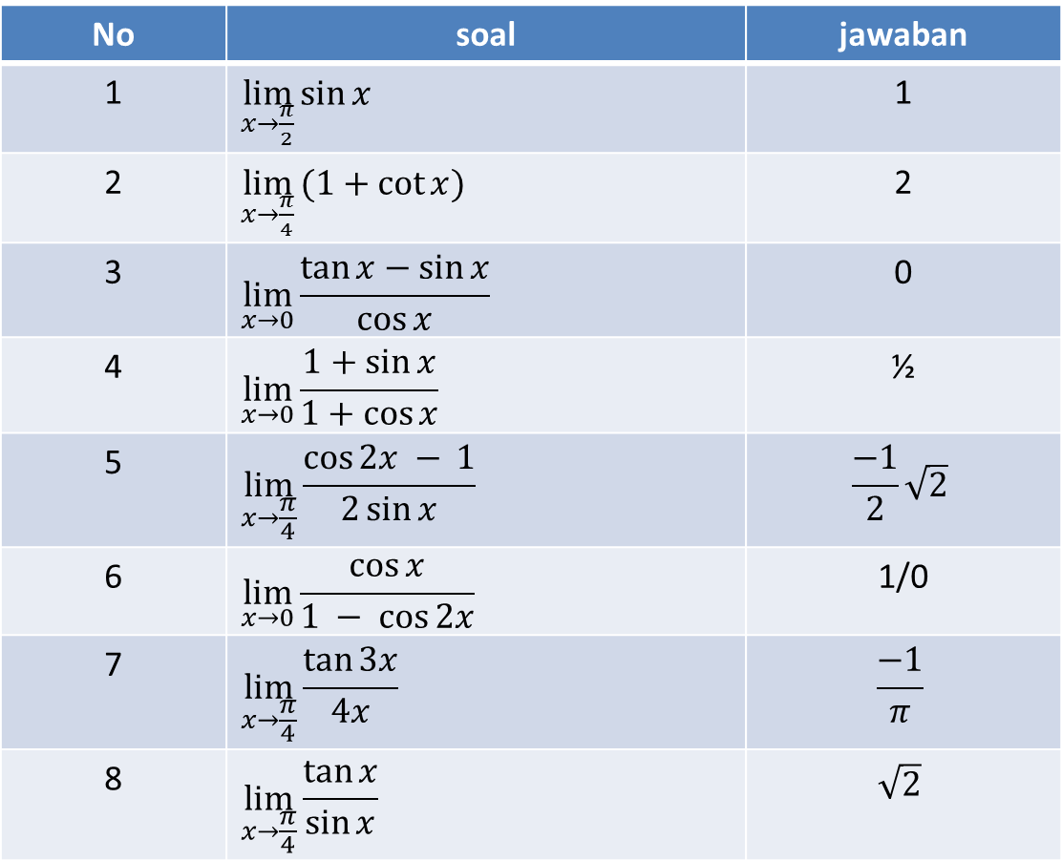
Latihan 1
No | soal | jawaban
1 | $\lim_{x→\frac{π}{2}}{\sin{x}}$ | 1
2 | $\lim_{x→\frac{π}{4}}{(1+cot{x})}$ | 2
3 | $$\lim_{x→0}{\frac{\tan{x}−\sin{x}}{\cos{x}}}$$ | 0
4 | $$\lim_{x→0}{\frac{1+\sin{x}}{1+cos{x}}}$$ | ½
5 | $$\lim_{x→\frac{π}{4}}{\frac{\cos{2x − }1}{2\sin{x}}}$$ | $$\frac{−1}{2}\sqrt{2}$$
6 | $$\lim_{x→0}{\frac{\cos{x}}{1 − cos{2x}}}$$ | 1/0
7 | $$\lim_{x→\frac{π}{4}}{\frac{\tan{3x}}{4x}}$$ | $$\frac{−1}{π}$$
8 | $$\lim_{x→\frac{π}{4}}{\frac{\tan{x}}{\sin{x}}}$$ | $$\sqrt{2}$$

Slide 16
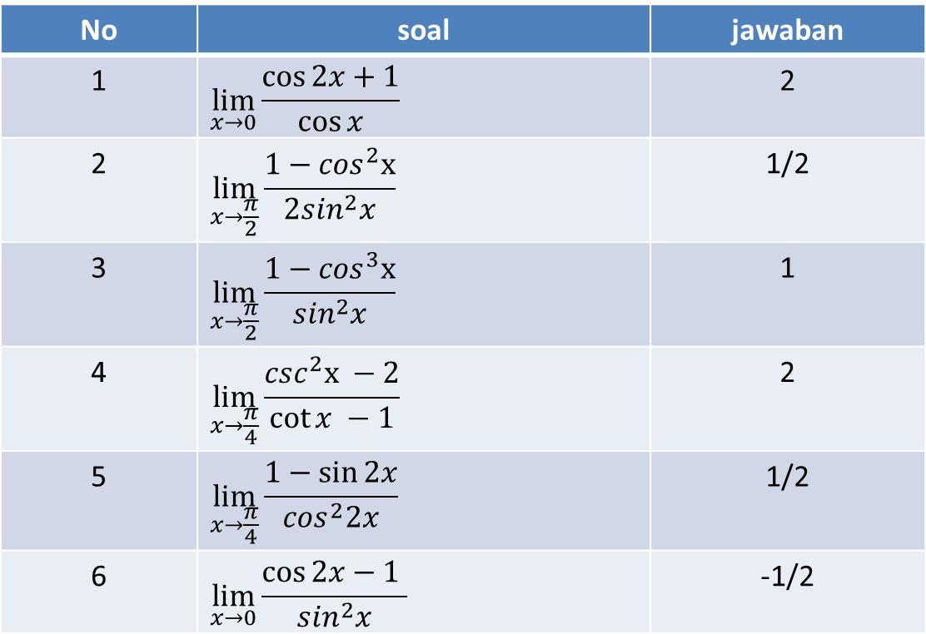
Latihan 2
No | soal | jawaban
1 | $$\lim_{x→0}{\frac{\cos{2x}+1}{\cos{x}}}$$ | 2
2 | $$\lim_{x→\frac{π}{2}}{\frac{1−\cos^{2}x}{2\sin^{2}x}}$$ | 1/2
3 | $$\lim_{x→\frac{π}{2}}{\frac{1−\cos^{3}x}{\sin^{2}x}}$$ | 1
4 | $$\lim_{x→\frac{π}{4}}{\frac{\csc^{2}x −2}{\cot{x −1}}}$$ | 2
5 | $$\lim_{x→\frac{π}{4}}{\frac{1−\sin{2x}}{\cos^{2}2x}}$$ | 1/2
6 | $$\lim_{x→0}{\frac{\cos{2x}−1 }{\sin^{2}x}}$$ | -1/2

Slide 17
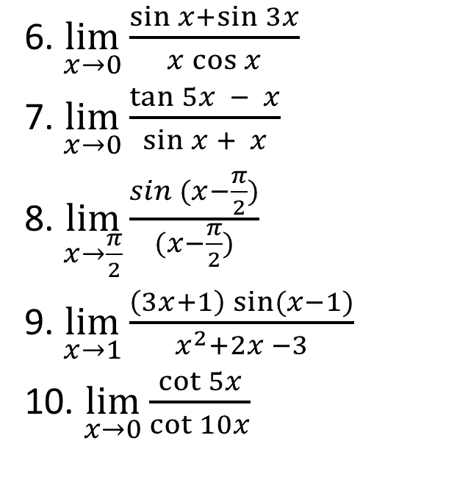
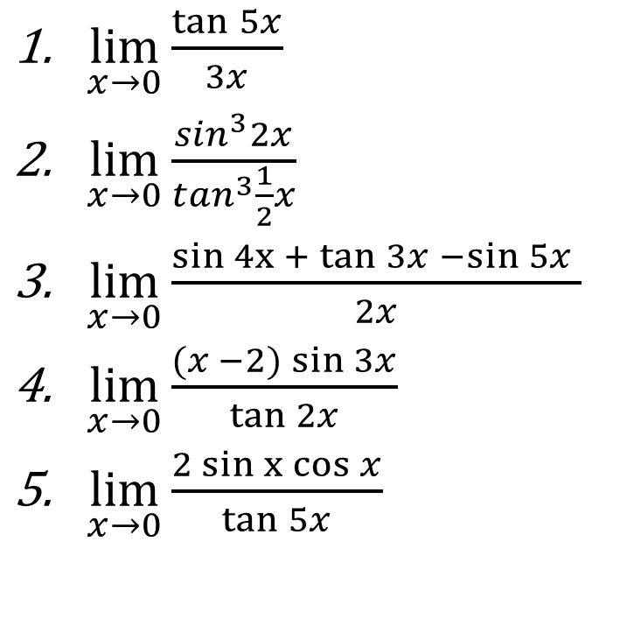
Latihan 3
$\lim_{x→0}{\frac{\tan{5x}}{3x}}$
$\lim_{x→0}{\frac{\sin^{3}2x}{\tan^{3}\frac{1}{2}x}}$
$\lim_{x→0}{\frac{sin 4x + tan{3x} −\sin{5x} }{2x}}$
$\lim_{x→0}{\frac{(x −2)\sin{3x}}{\tan{2x}}}$
$\lim_{x→0}{\frac{2 sin x cos{x}}{\tan{5x}}}$
6. $\lim_{x→0}{\frac{\sin{x+\sin{3x}}}{x\cos{x}}}$
7. $\lim_{x→0}{\frac{\tan{5x − x}}{\sin{x + x}}}$
8. $\lim_{x→\frac{π}{2}}{\frac{sin (x−\frac{π}{2})}{(x−\frac{π}{2})}}$
9. $\lim_{x→1}{\frac{\left(3x+1\right)\sin{(x−1)}}{x^{2}+2x −3}}$
10. $\lim_{x→0}{\frac{\cot{5x}}{\cot{10x}}}$

Slide 18
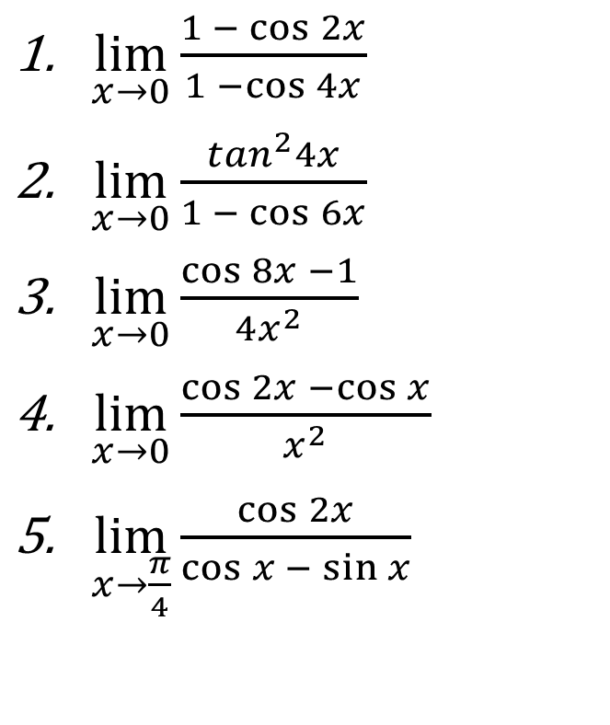
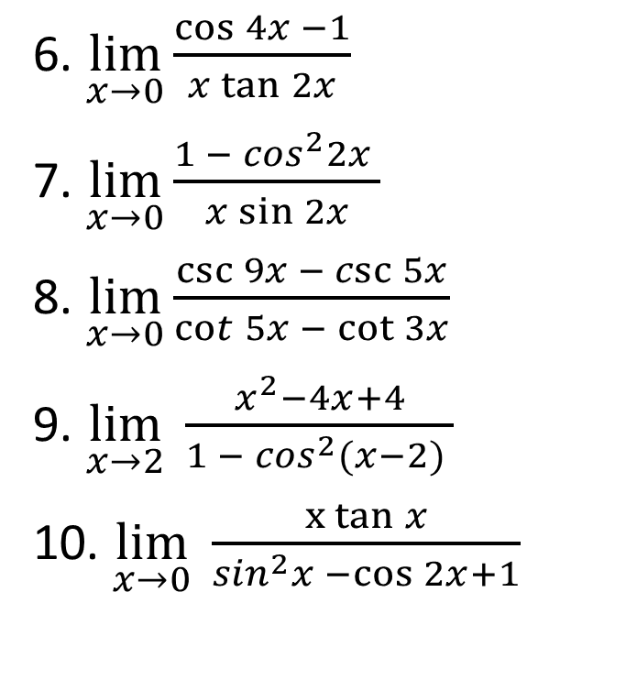
Latihan. 4
$\lim_{x→0}{\frac{1 − \cos{2x}}{1 −\cos{4x}}}$
$\lim_{x→0}{\frac{\tan^{2}4x}{1 − \cos{6x}}}$
$\lim_{x→0}{\frac{\cos{8x −1}}{4x^{2}}}$
$\lim_{x→0}{\frac{\cos{2x −\cos{x}}}{x^{2}}}$
$\lim_{x→\frac{π}{4}}{\frac{\cos{2x}}{\cos{x −\sin{x}}}}$
6. $\lim_{x→0}{\frac{\cos{4x −1}}{x\tan{2x}}}$
7. $\lim_{x→0}{\frac{1 − \cos^{2}2x }{x\sin{2x}}}$
8. $\lim_{x→0}{\frac{\csc{9x −\csc{5x}}}{\cot{5x − \cot{3x}}}}$
9. $\lim_{x→2}{\frac{x^{2}−4x+4}{1 − \cos^{2}(x−2) }}$
10. $\lim_{x→0}{\frac{x tan{x}}{\sin^{2}x −\cos{2x+1}}}$

Slide 19
Penutup
Alhamdulillah
Selesai sudah pertemuan pertama
Terus dibaca dan dipahmi
Terus berlatih dan berlatih
Bersiap dengan pertemuan selanjutnya
)|(

