Slide 1
Data Partition for Wavefront Parallelization of H.264 Video Encoder
Zhuo Zhao, Ping Liang
IEEE ISCAS 2006

Slide 2
Outline
Introduction
Data Dependencies in H.264
Data Partition and Task Priority
Experimental Results
Conclusions

Slide 3
Introduction
Background Knowledge (1/7)
Video compression technologies
  Spatial Redundancy
  Temporal Redundancy
H.264/AVC new features
  Quarter-pel ME, variable block sizes, multiple reference frames, intra-prediction, CAVLC, CABAC, in-loop deblocking filter, etc.

Slide 4
Introduction
Background Knowledge (2/7)
In [1], compared with MPEG-4 Simple profile
  Up to 50% bitrate reduction is achieved at the cost of more than four times of computation.
  Bitrate Computation Complexity
  Hardware and Software acceleration for real-time applications

Slide 5
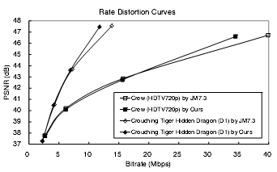
Introduction
Background Knowledge (3/7)
In [2], a single chip encoder for H.264 using a four-stage macroblock pipeline architecture.
  Satisfactory R-D tradeoff is reported.
  Find the coding mode of current MB by approximations of neighboring coding information.

Slide 6
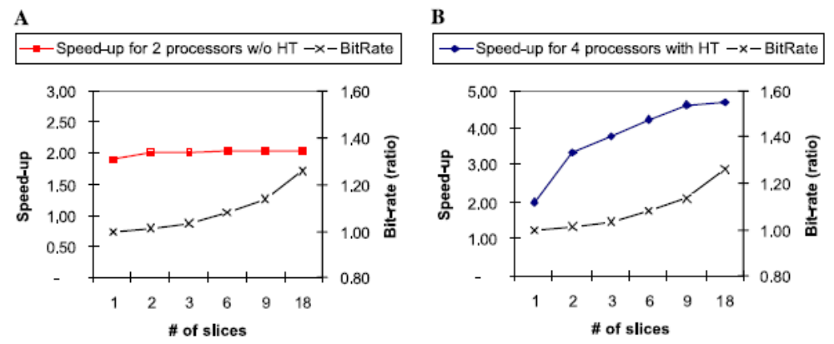
Introduction
Background Knowledge (4/7)
In [3], an H.264 encoder using the hyper-threading architecture is reported.
  Split a frame into several slices and processed by multiple threads.
  Heavy overheads : The impairments to data dependencies among MBs.

Slide 7
Introduction
Background Knowledge (5/7)
Image buffer
Input File
Thread 0
Output File
Thread 1
Slice Queue 0 (I/P)
Thread 2
Slice Queue 1 (B)
Thread 3
Thread 4

Slide 8
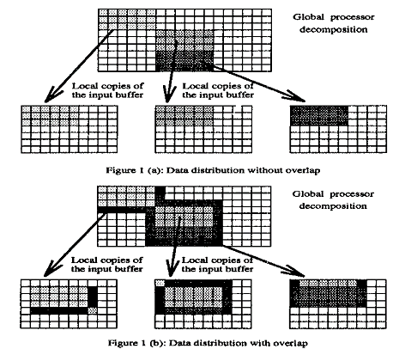
Introduction
Background Knowledge (6/7)
In [4], a frame is divided into many small partitions with overlapping areas and processed concurrently.
  Not feasible for H.264.
  Redundant data
  ➔ form the complete
  search data

Slide 9
Introduction
Background Knowledge (7/7)
In [5][6], using temporal parallelism in GOP level
  A large number of frames being ready before the encoding actually starts.
  Temporal parallelism is limited to coding standards with GOP structure.

Slide 10
Introduction
Main Purpose (1/2)
This paper presents a new method for parallel processing of H.264 video encoder
  Data partition
  Task scheduling
The new method outperforms prior approaches in both encoding speed and compression efficiency.

Slide 11
Introduction
Main Purpose (2/2)
This paper gives the relations between
  # of parallel processing element and theoretical encoding time.
  # of processors and # of concurrently processed frames.
The result shows that this method achieves the same compression efficiency as a sequential processing encoder.

Slide 12
Data Dependencies in H.264
Overview (1/2)
Reference software : JM 9.0
  Sequential processing of MBs
  Data dependencies
  Produce optimal bitstream in terms of coding efficiency
  ➔ highest compression ratio

Slide 13
Data Dependencies in H.264
Overview (2/2)
Objective
  Explore elements of encoder that can be processed in parallel.
  Maximally exploit the temporal and spatial data dependencies for optimal coding efficiency.

Slide 14
Data Dependencies in H.264
Predicted Motion Vector
  In inter-prediction, PMV defines the search center of motion estimation.
  Useful in maintaining continuity of the motion field.
  It is determined by the MVs of its neighboring subblocks and the corresponding reference indexes.

Slide 15
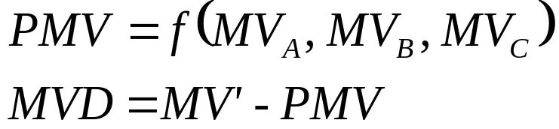
Data Dependencies in H.264
Intra-frame data dependencies
Only the difference (MVD) between the final optimal MV (MV’) and PMV will be encoded.
MB D
MB B
MB C
MB A
Current
MB

Slide 16
Data Dependencies in H.264
Inter-prediction and mode decision
  H.264 needs the reconstructed images from encoded frames as reference to exploit temporal redundancy.
  At least the co-located MB and its eight neighboring MBs must be available before current MB can be encoded.
Reference frame
Current frame

Slide 17
Data Dependencies in H.264
Quarter-pel interpolation
  Before the reconstructed result of current MB can be used as reference, it must be interpolated to get the values in ½ and ¼ pel position.
  Boundary area of current MB need 3 rows/cols of pixels value from it’s neighboring MBs.

Slide 18
Data Dependencies in H.264
Quarter-pel interpolation
A
aa
B
C
bb
D
E
F
G
a
b
c
H
I
J
d
e
f
g
cc
dd
h
i
j
k
m
ee
ff
n
p
q
r
K
L
M
s
N
O
P
R
gg
S
T
hh
U

Slide 19
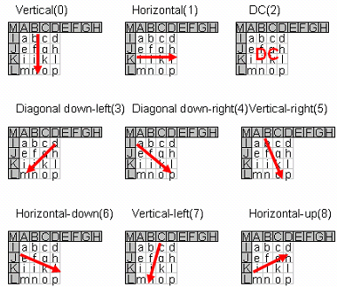
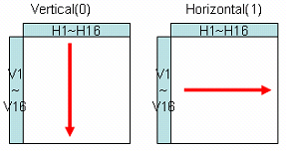
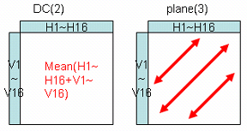
Data Dependencies in H.264
4×4 and 16×16 intra-prediction & mode decision

Slide 20
Data Dependencies in H.264
Intra-prediction data dependencies
MB(i-1, j)
MB(i, j-1)
MB(i, j)

Slide 21
Data Dependencies in H.264
Number of skipped MBs before current MB
In H.264/AVC standard : mb_skip_run
  Indicates how many MBs before current MB in raster- scan order are skipped.
  Needs to know the encoding status of previous MBs.

Slide 22
Data Partition & Task Priority
Data Partition (1/5)
MBs in different frames can be processed concurrently, only if its necessary reconstructed MBs from reference frame are all available.
MBs from different MB rows in the same frame can be processed concurrently, only if its neighboring MBs in its top MB row all have been encoded and reconstructed.

Slide 23
Data Partition & Task Priority
Data Partition (2/5)
Concurrently processed MBs
MBs which have already been encoded
Frame number
MBs which are being encoded now
MBs which have not been encoded yet
Wavefront Parallelization

Slide 24
Data Partition & Task Priority
Data Partition (3/5)
Wavefront Parallelization can achieve a constant frame rate for any video format. (e.g..QCIF, CIF, HDTV720).
  Sufficient number of processors.
  Video sequence is long enough.

Slide 25

Data Partition & Task Priority
Data Partition (4/5)
Example
  With the increase of the frame number, the average encoding time for a frame approach 4TMB.
  The number of processor units to needed to achieve this is :
Frame number

Slide 26
Data Partition & Task Priority
Data Partition (5/5)
Each frame is partitioned into MB rows first
  A MB can’t be processed until its left neighbor in the same row is encoded
  Reduce data exchanges between processors
Current Frame
………
………

Slide 27
Data Partition & Task Priority
Task assigning and priorities (1/5)
Task assignment timing diagram
Frame i, MB row j
Frame i, MB row j + 1
Frame i, MB row j + 2
Frame i + 1, MB row j
t
t+2T t+4T
Task assigning schedule

Slide 28
Data Partition & Task Priority
Task assigning and priorities (2/5)
Example
4 TMB
Frame 1, MB row 1
Task assigning schedule
Frame 1, MB row 2
Frame 1, MB row 3
Frame 2, MB row 1
Frame 1, MB row 4
Frame 2, MB row 2
Frame 1, MB row 5
Frame 2, MB row 3
Frame 3, MB row 1
Frame 2, MB row 4
Frame 3, MB row 2
Frame 2, MB row 5
Frame 3, MB row 3
Frame 4, MB row 1
…

Slide 29
Data Partition & Task Priority
Task assigning and priorities (3/5)
To achieve optimal encoding speed
  QCIF ➔ requires 25 processors
  CIF ➔ requires 99 processors
  HDTV720 ➔ requires 900 processors

Slide 30
Data Partition & Task Priority
Task assigning and priorities (4/5)
In practice, we can’t have a large number of processor unit.
➔ Priority based task scheduling
Define the priorities in two levels
  Inter-frame level
  Intra-frame level

Slide 31
Data Partition & Task Priority
Task assigning and priorities (5/5)
Inter-frame level
  If several MBs belonging to different frames are ready to be encoded concurrently, the MBs in the frame with smaller frame number should be encoded first.
Intra-frame level
  If several MBs belonging to different MB rows in the same frame are ready to be encoded concurrently, the MBs in the row with smaller row index should be encoded first.

Slide 32
Experimental Results
Overview (1/1)
The wavefront simulator is developed in C language and implemented in a PC with a P4 2.8 GHz processor and a 512MB memory.
The simulation results are compared with JM 9.0
H.264 baseline profile
  Search range = ±10
  One reference frame, Hadamard transform, full R-D optimization, CAVLC entropy coding

Slide 33
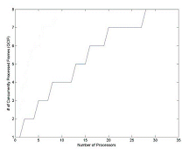
Experimental Results
The relationship between the number of processors and the number of concurrently processed frames

Slide 34
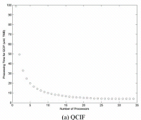
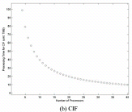
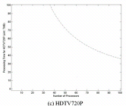
Experimental Results
Theoretical processing time per frame

Slide 35
Experimental Results
Simulation results
Grandma.YUV (QCIF)
 | Avg Encoding time per frame | SnrY | SnrU | SnrV | # of bytes | Speed up
Wavefront simulator | 273 ms | 37.157 | 39.869 | 40.450 | 61464 | 3.17
JM9.0 | 865 ms | 37.157 | 39.869 | 40.450 | 61464 | 1
Paris.YUV (CIF)
 | Avg Encoding time per frame | SnrY | SnrU | SnrV | # of bytes | Speed up
Wavefront simulator | 1272 ms | 35.729 | 39.181 | 39.279 | 128419 | 3.08
JM9.0 | 3914 ms | 35.729 | 39.181 | 39.279 | 128419 | 1

Slide 36
Conclusions
This paper presents the new Wavefront Parallelization method for H.264 encoder.
Analysis and simulation results show that it can achieve the optimal compression at a frame rate that increases approximately linearly as the number of parallel processing elements.

Slide 37
References
[1] T.-C. Chen, Y.-W. Huang, and L.-G. Chen, "Analysis and design of macroblock pipelining for h.264/avc vlsi architecture," in Proceedings of the 200>4 International Symtposium on Circuits and Systems, vol. 2, May 2004, pp. II-273-6
[2] Y.-W. Huang, T.-C. Chen, C.-H. Tsai, C.-Y. Chen, T.-W. Chen, C.-S.Chen, C.-F. Shen, S.-Y. Ma, T.-C. Wang, B.-Y. Hsieh, H.-C. Fang, and L.-G. Chen, "A 1.3tops h.264/avc single-chip encoder for hdtv applications,” in IEEE Int. Conf.Solid-State Circuits, Feb 2005, pp. 128-130
[3] Y.-K. Chen, T. X, S. Ge, and G. M, "Towards efficient multi-level threading of h.264 encoder on intel hyper-threading architectures," in 18th Int.Parallel and Distributed Processing Symposium, Apr 2004, p.63
[4] S. M.Akramulah, I. Ahmad, and M. L.Liou, "Parallelization of mpeg-2 video encoder for parallel and distributed computing systems," in Proceedings of the 38th Midwest Symposium on Circuits and Systems, vol. 2, Aug 1995, pp. 834-837.
[5] P. Tiwari and E. Viscito, "A parallel mpeg-2 video encoder with look-ahead rate control," in Int.Conf: Acoustics, Speech, and Signal Processing, vol. 4, May 1996, pp. 1994-1997.
[6] K.Shen, L.A.Rowe, and E.J.Delp, "Parallel implementation of an mpeg-1 encoder: faster than real time," in SPIE, vol. 2419, Feb 1995, pp.407-418

