Slide 1
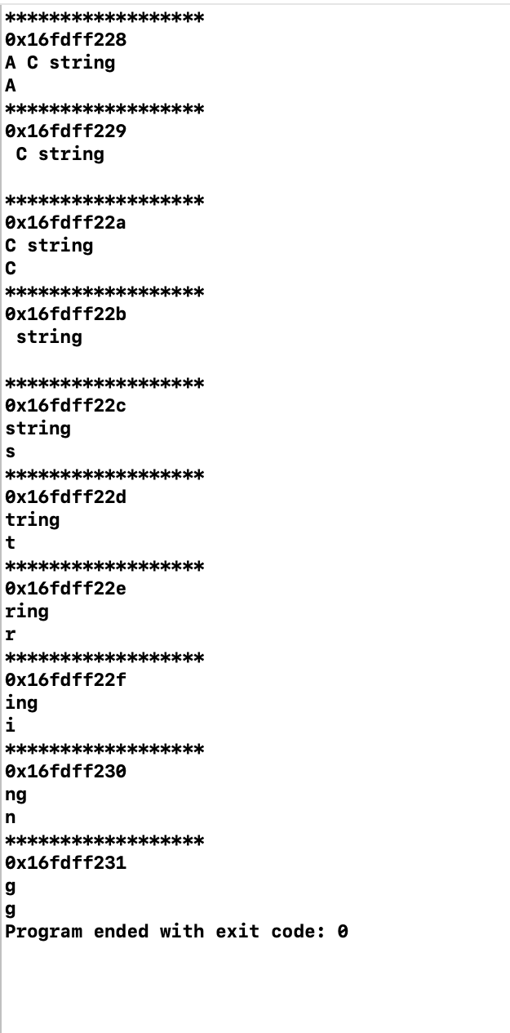
#include <iostream>
int main() {
char s[] = "A C string";
std::cout << std::hex;
for (int i = 0; s[i]; i++)
{
std::cout << "******************" << std::endl;
std::cout << (int*)& s[i] << std::endl;
std::cout << &s[i] << std::endl;
std::cout << s[i] << std::endl;
}
\
Code-1

Slide 2
#include <iostream>
int main() {
char s[] = "A C string";
std::cout << std::hex;
for (int i = 0; s[i]; i++)
{
std::cout << "******************" << std::endl;
std::cout << (int*)& s[i] << std::endl;
std::cout << &s[i] << std::endl;
std::cout << s[i] << std::endl;
}
\
Code-2

Slide 3
#include <iostream>
int main() {
char s[] = "A C string";
std::cout << std::hex;
for (int i = 0; s[i]; i++)
{
std::cout << "******************" << std::endl;
std::cout << (int*)& s[i] << std::endl;
std::cout << &s[i] << std::endl;
std::cout << s[i] << std::endl;
}
\
Code-3

Slide 4
#include <iostream>
int main() {
char s[] = "A C string";
std::cout << std::hex;
for (int i = 0; s[i]; i++)
{
std::cout << "******************" << std::endl;
std::cout << (int*)& s[i] << std::endl;
std::cout << &s[i] << std::endl;
std::cout << s[i] << std::endl;
}
\
Code-4

Slide 5
#include <iostream>
int main() {
char s[] = "A C string";
std::cout << std::hex;
for (int i = 0; s[i]; i++)
{
std::cout << "******************" << std::endl;
std::cout << (int*)& s[i] << std::endl;
std::cout << &s[i] << std::endl;
std::cout << s[i] << std::endl;
}
\
Code-5

Slide 6
#include <iostream>
int main() {
char s[] = "A C string";
std::cout << std::hex;
for (int i = 0; s[i]; i++)
{
std::cout << "******************" << std::endl;
std::cout << (int*)& s[i] << std::endl;
std::cout << &s[i] << std::endl;
std::cout << s[i] << std::endl;
}
\
Code-6

Slide 7
#include <iostream>
int main() {
char s[] = "A C string";
std::cout << std::hex;
for (int i = 0; s[i]; i++)
{
std::cout << "******************" << std::endl;
std::cout << (int*)& s[i] << std::endl;
std::cout << &s[i] << std::endl;
std::cout << s[i] << std::endl;
}
\
Code-7

Slide 8
#include <iostream>
int main() {
char s[] = "A C string";
std::cout << std::hex;
for (int i = 0; s[i]; i++)
{
std::cout << "******************" << std::endl;
std::cout << (int*)& s[i] << std::endl;
std::cout << &s[i] << std::endl;
std::cout << s[i] << std::endl;
}
\
Code-8

Slide 9
#include <iostream>
int main() {
char s[] = "A C string";
std::cout << std::hex;
for (int i = 0; s[i]; i++)
{
std::cout << "******************" << std::endl;
std::cout << (int*)& s[i] << std::endl;
std::cout << &s[i] << std::endl;
std::cout << s[i] << std::endl;
}
\
Code-9

Slide 10
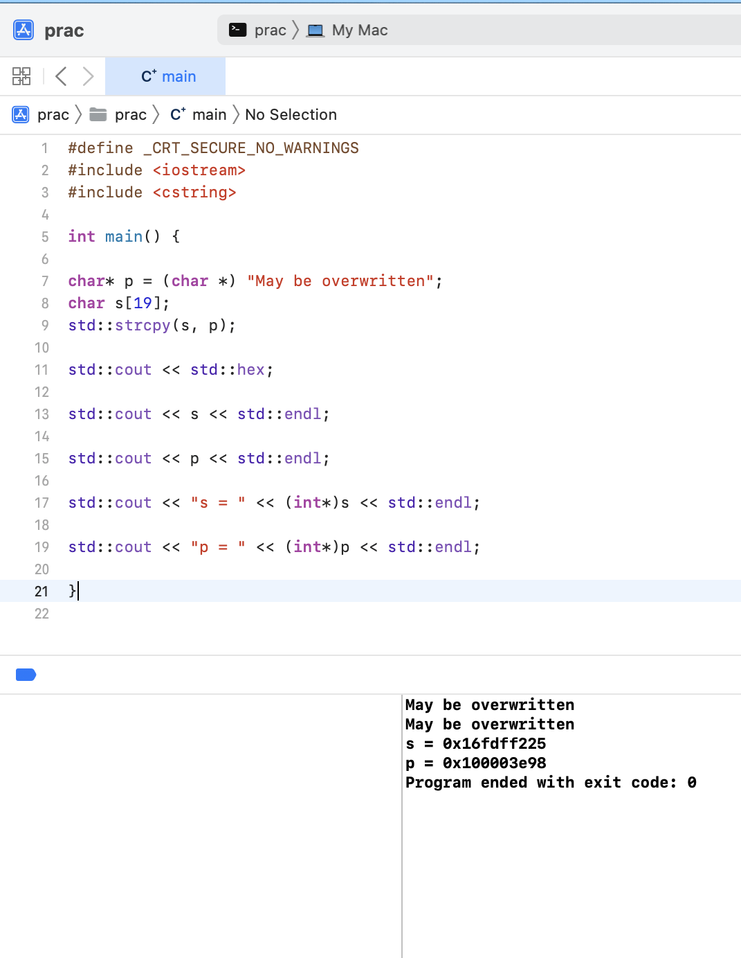
#define _CRT_SECURE_NO_WARNINGS
#include <iostream>
#include <cstring>
int main() {
char* p = (char *) "May be overwritten";
char s[19];
std::strcpy(s, p);
std::cout << std::hex;
std::cout << s << std::endl;
std::cout << p << std::endl;
std::cout << "s = " << (int*)s << std::endl;
std::cout << "p = " << (int*)p << std::endl;
}
\
Code-10

Slide 11
#define _CRT_SECURE_NO_WARNINGS
#include <iostream>
#include <cstring>
int main() {
char* p = (char *) "May be overwritten";
char s[19];
std::strcpy(s, p);
std::cout << std::hex;
std::cout << s << std::endl;
std::cout << p << std::endl;
std::cout << "s = " << (int*)s << std::endl;
std::cout << "p = " << (int*)p << std::endl;
}
\
Code-11

Slide 12
#define _CRT_SECURE_NO_WARNINGS
#include <iostream>
#include <cstring>
int main() {
char* p = (char *) "May be overwritten";
char s[19];
std::strcpy(s, p);
std::cout << std::hex;
std::cout << s << std::endl;
std::cout << p << std::endl;
std::cout << "s = " << (int*)s << std::endl;
std::cout << "p = " << (int*)p << std::endl;
}
\
Code-12

Slide 13
#define _CRT_SECURE_NO_WARNINGS
#include <iostream>
#include <cstring>
int main() {
char* p = (char *) "May be overwritten";
char s[19];
std::strcpy(s, p);
std::cout << std::hex;
std::cout << s << std::endl;
std::cout << p << std::endl;
std::cout << "s = " << (int*)s << std::endl;
std::cout << "p = " << (int*)p << std::endl;
}
\
Code-13

Slide 14
#define _CRT_SECURE_NO_WARNINGS
#include <iostream>
#include <cstring>
int main() {
char* p = (char *) "May be overwritten";
char s[19];
std::strcpy(s, p);
std::cout << std::hex;
std::cout << s << std::endl;
std::cout << p << std::endl;
std::cout << "s = " << (int*)s << std::endl;
std::cout << "p = " << (int*)p << std::endl;
}
\
Code-14

Slide 15
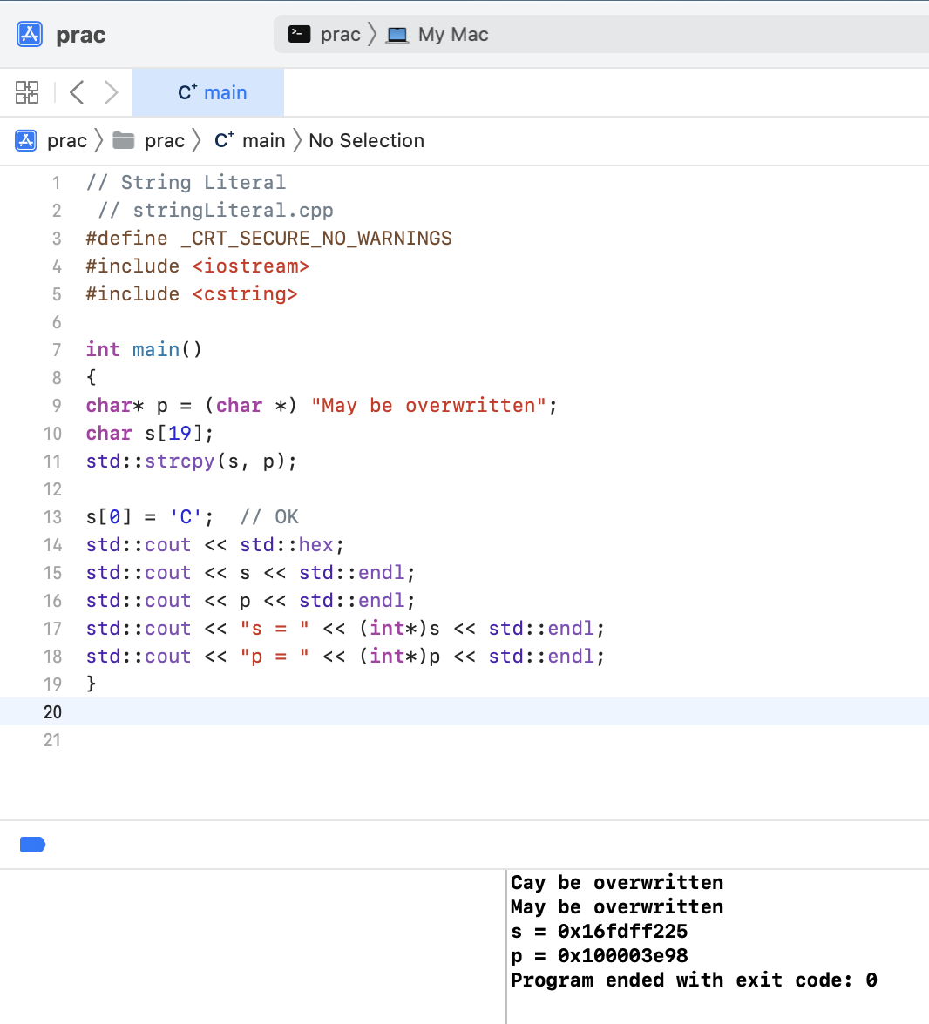
// String Literal
// stringLiteral.cpp
#define _CRT_SECURE_NO_WARNINGS
#include <iostream>
#include <cstring>
int main()
{
char* p = (char *) "May be overwritten";
char s[19];
std::strcpy(s, p);
s[0] = 'C'; // OK
std::cout << std::hex;
std::cout << s << std::endl;
std::cout << p << std::endl;
std::cout << "s = " << (int*)s << std::endl;
std::cout << "p = " << (int*)p << std::endl;
}
\
Code-15

Slide 16
// String Literal
// stringLiteral.cpp
#define _CRT_SECURE_NO_WARNINGS
#include <iostream>
#include <cstring>
int main()
{
char* p = (char *) "May be overwritten";
char s[19];
std::strcpy(s, p);
s[0] = 'C'; // OK
std::cout << std::hex;
std::cout << s << std::endl;
std::cout << p << std::endl;
std::cout << "s = " << (int*)s << std::endl;
std::cout << "p = " << (int*)p << std::endl;
}
\
Code-16

Slide 17
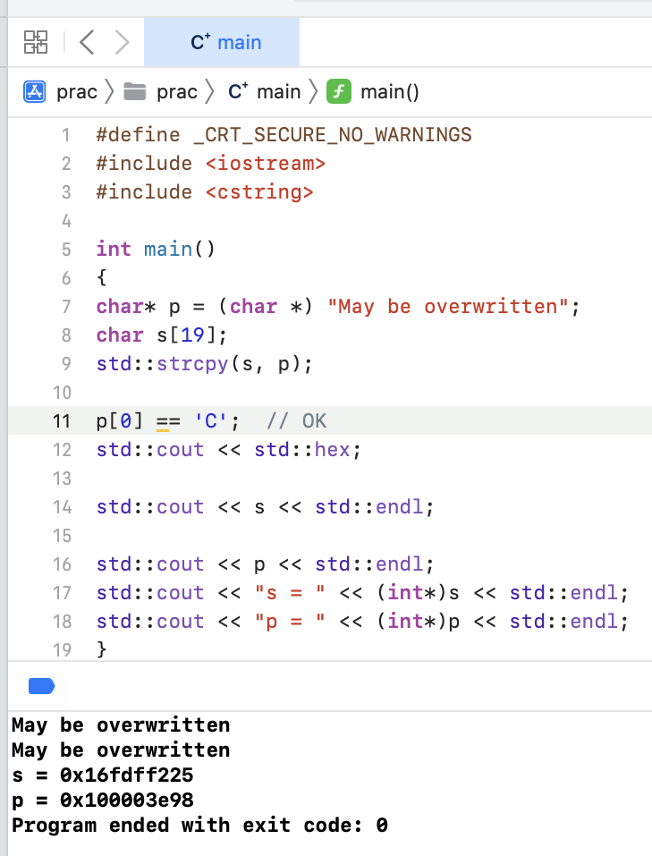
#define _CRT_SECURE_NO_WARNINGS
#include <iostream>
#include <cstring>
int main()
{
char* p = (char *) "May be overwritten";
char s[19];
std::strcpy(s, p);
p[0] = 'C'; // OK
std::cout << std::hex;
std::cout << s << std::endl;
std::cout << p << std::endl;
std::cout << "s = " << (int*)s << std::endl;
std::cout << "p = " << (int*)p << std::endl;
}
\
Code-17

Slide 18
#define _CRT_SECURE_NO_WARNINGS
#include <iostream>
#include <cstring>
int main()
{
const char* p = (char *) "May be overwritten";
char s[19];
std::strcpy(s, p);
p[0] = 'C'; // OK
std::cout << std::hex;
std::cout << s << std::endl;
std::cout << p << std::endl;
std::cout << "s = " << (int*)s << std::endl;
std::cout << "p = " << (int*)p << std::endl;
}
\
Code-18

Slide 19
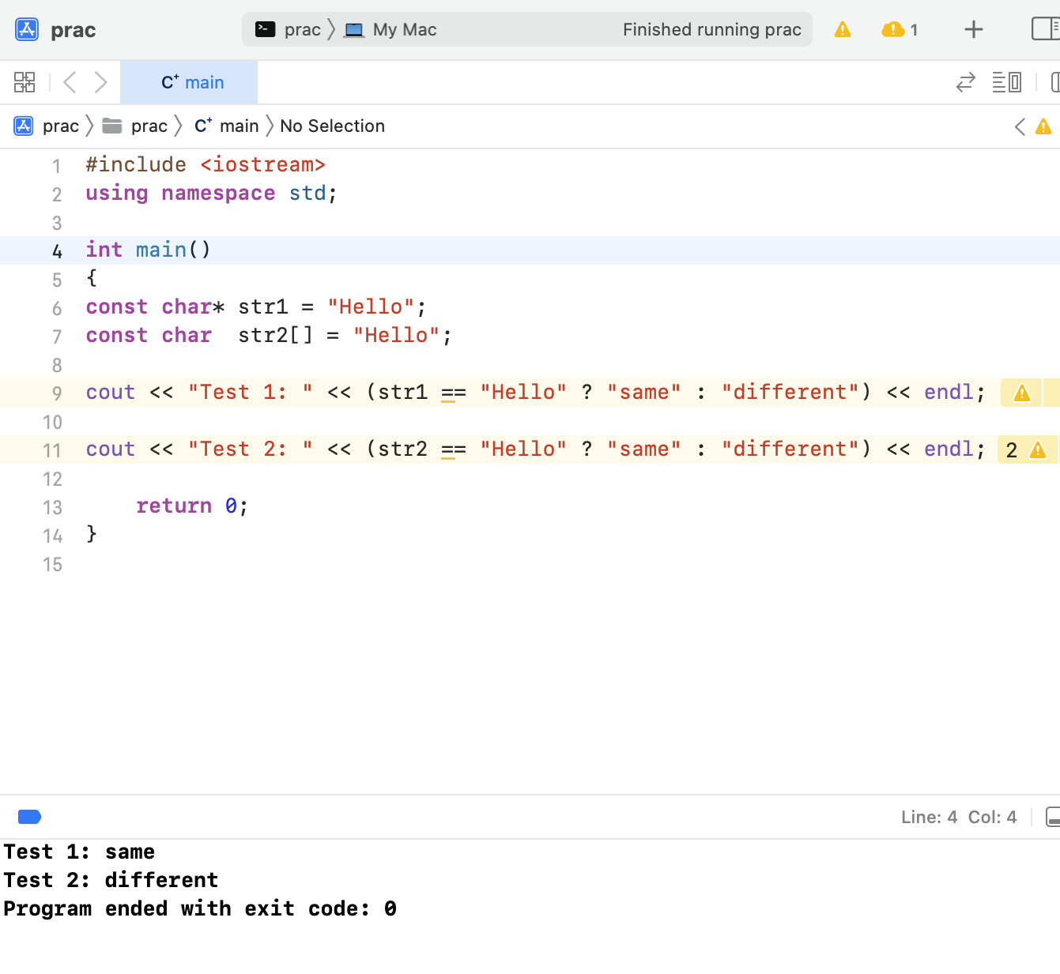
#include <iostream>
using namespace std;
void main()
{
const char* str1 = "Hello";
const char str2[] = "Hello";
cout << "Test 1: “ << (str1 == "Hello" ? "same" : "different") << endl;
cout << "Test 2: “ << (str2 == "Hello" ? "same" : "different") << endl;
}
\
Code-19

Slide 20
#include <iostream>
using namespace std;
void main()
{
const char* str1 = "Hello";
const char str2[] = "Hello";
cout << "Test 1: “ << (str1 == "Hello" ? "same" : "different") << endl;
cout << "Test 2: “ << (str2 == "Hello" ? "same" : "different") << endl;
}
Code-20
\

Slide 21
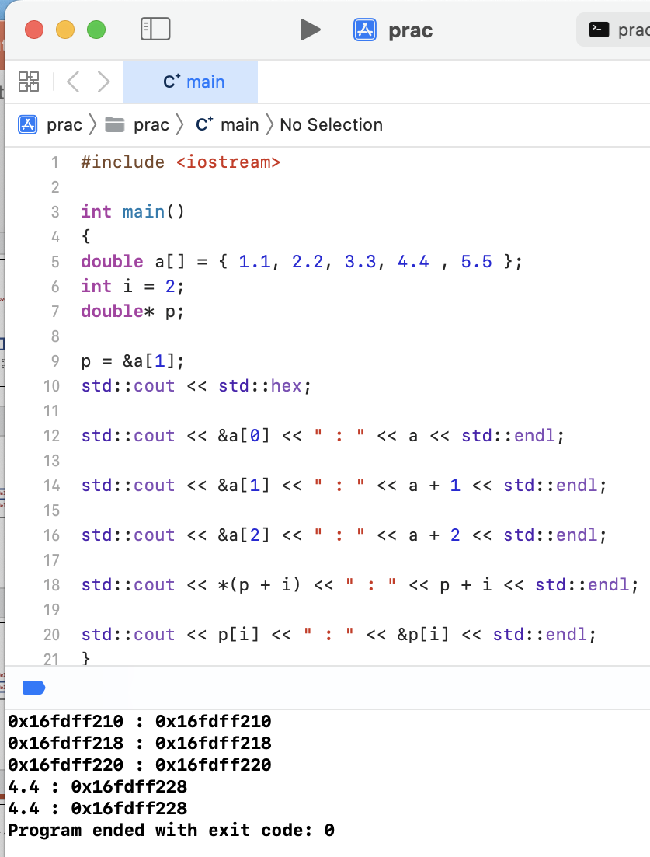
Code-21
#include <iostream>
int main()
{
double a[] = { 1.1, 2.2, 3.3, 4.4 , 5.5 };
int i = 2;
double* p;
p = &a[1];
std::cout << std::hex;
std::cout << &a[0] << " : " << a << std::endl;
std::cout << &a[1] << " : " << a + 1 << std::endl;
std::cout << &a[2] << " : " << a + 2 << std::endl;
std::cout << *(p + i) << " : " << p + i << std::endl;
std::cout << p[i] << " : " << &p[i] << std::endl;
}
\

Slide 22
#include <iostream>
int main()
{
double a[] = { 1.1, 2.2, 3.3, 4.4 , 5.5 };
int i = 2;
double* p;
p = &a[1];
std::cout << std::hex;
std::cout << &a[0] << " : " << a << std::endl;
std::cout << &a[1] << " : " << a + 1 << std::endl;
std::cout << &a[2] << " : " << a + 2 << std::endl;
std::cout << *(p + i) << " : " << p + i << std::endl;
std::cout << p[i] << " : " << &p[i] << std::endl;
}
Code-22
\

Slide 23
#include <iostream>
int main()
{
double a[] = { 1.1, 2.2, 3.3, 4.4 , 5.5 };
int i = 2;
double* p;
p = &a[1];
std::cout << std::hex;
std::cout << &a[0] << " : " << a << std::endl;
std::cout << &a[1] << " : " << a + 1 << std::endl;
std::cout << &a[2] << " : " << a + 2 << std::endl;
std::cout << *(p + i) << " : " << p + i << std::endl;
std::cout << p[i] << " : " << &p[i] << std::endl;
}
Code-23
\

