Slide 1
Acknowledgements
Slides are combination of
  354 instructors’ notes and slides
  The main text: Database Management Systems, Raghu Ramakrishnan/Johannes Gehrke
  Reference: Database systems: the complete book, H. G. Molina, J.D. Ullman, and J. Widom.

Slide 2

Introduction to Database Systems
Chapter 1

Slide 3
Questions
What is a DBMS (Database Management System)
Why should we consider a DBMS to manage data?
How is application data represented in a DBMS?
How is data in a DBMS retrieved and manipulated?
How does a DBMS support concurrent access and protect data during system failure?
Who is involved with databases in real life?

Slide 4
Database Applications
Any application that has to store large amounts of data probably needs a database
  Financial industry
  Government agencies
  Airlines
  Universities
  Utilities
  High street retailers
  Online retailers
  Manufacturing
  Human resources
  Social media sites
  Online games
  …

Slide 5
Data Storage Without DBMS
File systems: data would be collected in many different files and used by many application programs
File 1
Application Program 1
File 2
Application Program 2
…
…
File m
Application Program n

Slide 6
What Happens If …
Information that is in more than one file is changed by a program that only interacts with one file?
We need to repeatedly access a single record out of millions of records?
We need to retrieve data stored in multiple files?
Several programs need to access and modify the same record at the same time?
The system crashes while one of the application programs is running?

Slide 7
Data Storage with a DBMS
File 1
Application Program 1
File 2
Application Program 2
DBMS
…
…
File m
Application Program n

Slide 8
DBMS Functions
All access to data is centralized and managed by the DBMS
Design and implementation advantages
  Logical data independence
  Physical data independence
  These reduce application development time
Use advantages
  Efficient access
  Data integrity and security
  Concurrent access and concurrency control
  Crash recovery

Slide 9

What Is a DBMS?
A database is a very large, integrated collection of data.
Models real-world enterprise.
  Entities (e.g., staff, students, courses)
  Relationships (e.g., wangk is lecturing CMPT354)
A Database Management System (DBMS) is a software package for providing EFFICIENT, CONVENIENT, and SAFE MULTI-USER storage of and access to MASSIVE amount of SHARED PERSISTENT data

Slide 10
Example: A Banking System
Data = entities and relationships.
MASSIVE: many gigabytes
  More if history of transactions are kept,
  Even more if images of checks are maintained.
  Too large to fit in memory.
SHARED: reduce redundancy and ensure data consistency and control of access
PERSISTENT: data outlives programs that operate on them

Slide 11
Example (Contd)
SAFE: from system failures, from malicious users
MULTI-USER: many people/programs accessing same data, simultaneously
  appears similar to concurrent programming. BUT data are not main-memory variables
  appears similar to file system concurrent access. BUT want to control at smaller granularity

Slide 12
Example (Contd)
CONVENIENT
  High level commands for writing ad-hoc queries
  data independence facilitates rapid application development
EFFICIENT: Massive data implies that the DBMS must be carefully tuned for performance - don’t search all files or all records in order to get a few records, e.g., find the accounts with >= 10M in balances, etc.

Slide 13
Structure of a DBMS
These layers
must consider
concurrency
control and
recovery
A typical DBMS has a layered architecture.
This is one of several possible architectures; each system has its own variations.
Query Optimization
and Execution Plans
Relational Operators
Files and Access Methods
Buffer Management
Disk Space Management
DB

Slide 14

DBMS Components
DBMS
Connection Manager
Security Manager
DDL Compiler
Database Utilities
Query Processor
DML Compiler
Query Parser
Query Rewriter
Query Optimizer
Applications
Query Executor
Storage Manager
Transaction Manager
Buffer Manager
Lock Manager
Recovery Manager
data indices catalog

Slide 15
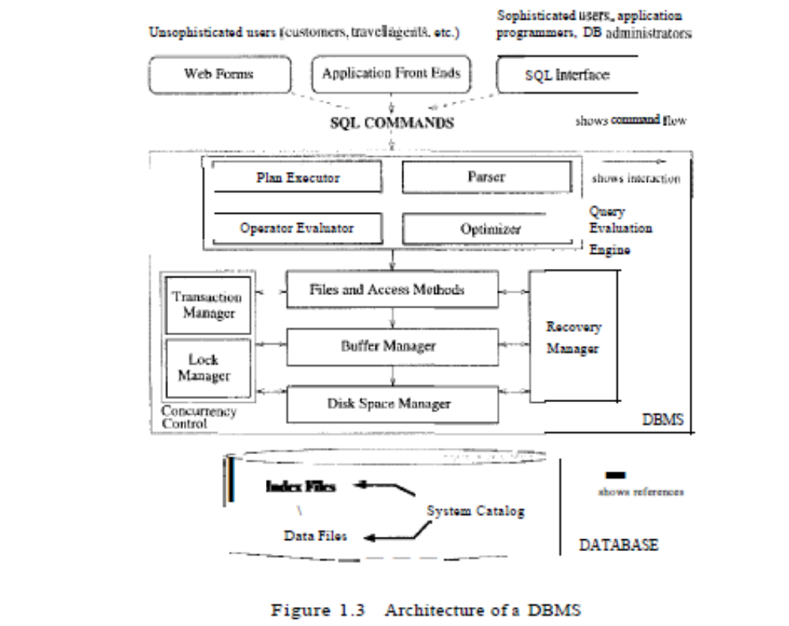

Slide 16
DATA MODELS AND ABSTRACTION

Slide 17
Data Models
A data model is a collection of concepts for describing data.
A schema is a description of a particular collection of data, using the given data model.
Notes:
5

Slide 18
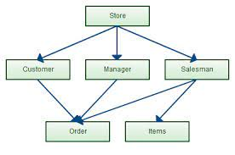
Data Models
Network Model
  data are represented by collections of records.
  relationships among records are represented by pointers in an arbitrary graph.

Slide 19
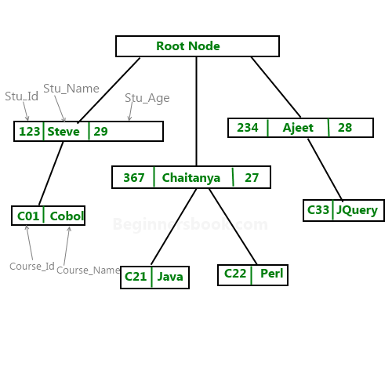
Data Models
Hierarchical Model
  Organization of the records is as a collection of trees, rather than arbitrary graphs.

Slide 20
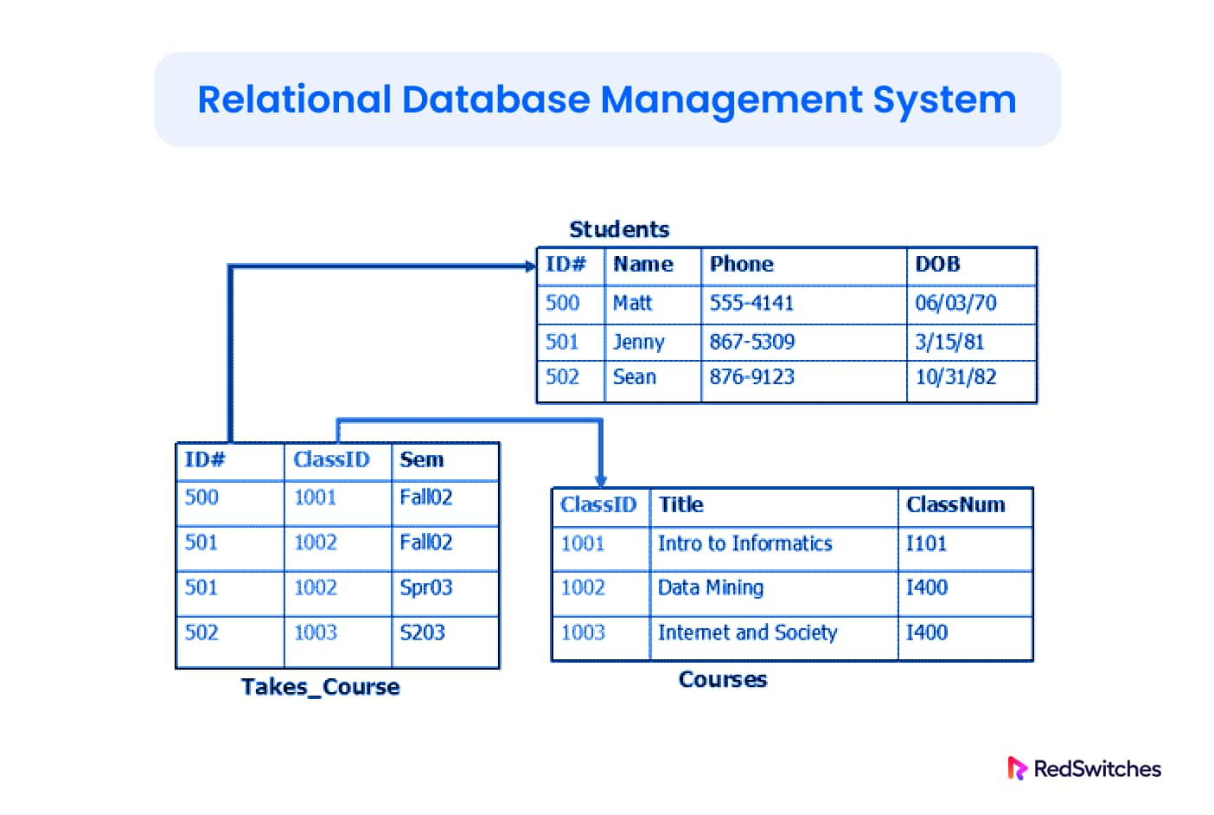
Data Models
The relational model is the most widely used model today.
  Main concept: relation, basically a table with rows and columns.
  Every relation has a schema, which describes the columns, or fields (also called attributes) and their types.
We consider relational model.
Notes:
5

Slide 21
Instances and Schemas
Data change over time, so a relation consists of instance and schema.
An instance refers to the data at a particular time, modified/retrieved using DML.
The schema refers to the data semantics at all time, defined using DDL.
Schemas exist at different levels of abstraction:
  Physical level
  Logical level
  View level

Slide 22
Three Levels of Abstraction
Many views (or externals), single logical schema and physical schema.
  Views describe how users see the data.
  Logical schema defines logical structure
  Physical schema describes the files and indexes used.
View 1
View 2
View 3
Logical Schema
Physical Schema
Schemas are defined using DDL; instances are modified/queried using DML.
Notes:
6

Slide 23
Example: University Database
Logical level:
  Students(sid: string, name: string, login: string,
  age: integer,gap: real, major: string)
  Courses(cid: string, cname:string, credits:integer)
  Enrolled(sid:string, cid:string, grade:char)
Physical level:
  File organization and index structures used to store relations (e.g., unordered files, indexed on first column of Students, etc.)
View level:
  allow data access to be customized at individual user levels.
  View 1: Course_info(cid:string,enrollment:integer)
  View 2: CS_Major(sid: string, …)
  not stored but is generated at runtime using stored relations at logical level.

Slide 24
Data Independence
Applications insulated from how data is structured and stored
  The ability to modify the schemas without affecting application programs
Logical data independence: Protection from changes in logical structure of data.
Physical data independence: Protection from changes in physical structure of data.

Slide 25
Logical data independence
Suppose the Students(sid,name,login,age,major) table is replaced with
  Name (sid,name)
  Detail (sid, login, age, gap, major)
  Your program can continue referring to Students by creating Students as a view that is the join of the Name and Detail (on common sid) - users need not know that the remodeling has occurred.
Users are shielded from changes in the logical structure of the data, or changes in the choice of relations to be stored.

Slide 26
Physical data independence
Modifications at physical level are usually done to improve performance
  Switching between different file organizations, storage structures, or indexing strategies.
The logical schema, which defines user views, hides such details.

Slide 27
Database Queries
Query language: the language in which questions involving data in DBMS can be posed.
  What is the average salary of professors who teach the course with cid CS564?
Relation calculus: based on math logic.
Relational algebra: based on a collection of relational (table) operators.
SQL: A real query language

Slide 28
Database Languages
SQL has two main components
  Data Definition Language (DDL)
    Used to create and modify DB schemas
  Data Manipulation Language (DML)
    Used to modify and query DB instances

Slide 29
Query Optimization
User focuses on what he wants when specifying a query, based on his/her views.
DBMS figures out efficient plan to evaluate the query – query optimization
  Using information on physical schema: how data is stored, what indexes and access methods are available, the size of data, etc.
  Minimize I/O cost of disk pages, the bottleneck of performance.

Slide 30
Database Managers
A database manager is a program module, which provides the interface between physical level data stored in the database and application programs/queries submitted to the system.
  Interaction with the file manager
  Integrity enforcement
  Security enforcement
  Concurrency control and recovery
A collection of specialized managers (buffer managers, disk managers, query optimizers, etc.)

Slide 31
Database Administrator (DBA)
A person having central control over data and programs accessing data through DDL.
Duties include:
  Logical and physical schema definitions.
  Granting authorization for data access.
  Data availability and recovery from failures.
  Tuning logical and physical schemas to ensure high performance as requirement changes.

Slide 32
Database (DBMS) developers
Who develops the DBMS software (various database companies like Oracle, Sybase, MS, …)

Slide 33
Database (DBMS) Users
Application programmers interact with the system through DML calls (e.g., SQL) embedded in a program written in a host language (e.g. C, PL/1, Java).
  E.g., smart webmasters
Sophisticated users write queries in a database query language, e.g., SQL.
End users using permanent application programs written by application programmers (e.g. automated teller machines)

Slide 34
Review Questions
What are the benefits of DBMS over file systems.
What are the benefits of three levels of abstractions?
Examples to illustrate data independence and benefits.
Examples of database instances and schemas.
Examples of data integrity constraints.
Milestones of DBMS
  Data model, 3 level abstractions and data independence, query languages, query optimization, concurrency control, crash recovery.
People involved.

Slide 35
Exercises (the main text)
1.1, 1.3, 1.5, 1.8.

