Slide 1
The Relational Model
Chapter 3

Slide 2
Why the Relational Model?
Most widely used model.
  Vendors: IBM, Informix, Microsoft, Oracle, Sybase, etc.
“Legacy systems” in older models
  e.g., IBM’s IMS
Recent competitor: Object-Oriented model, object-relational model.

Slide 3
Why Relations?
Very simple model; often a good match for the way we think about our data.
Abstract model that underlies SQL, the most important language in DBMS today.
Abstract vs concrete relations
  Abstract relations are sets of tuples; SQL relations are bags of tuples (i.e., duplicates allowed).
  Abstract relations vital for foundation.

Slide 4
Definitions
Relational database: a set of relations (to represent both entities and relationships).
Relation: made up of 2 parts:
  Instance : a table, with rows and columns. #rows = cardinality, #fields = degree / arity
  Schema : specifies name of relation, plus name and type of each column.
    E.g. Students(sid: string, name: string, login: string, age: integer, gpa: real)
Can think of a relation as a set of rows or tuples. (Note that all rows are distinct)

Slide 5
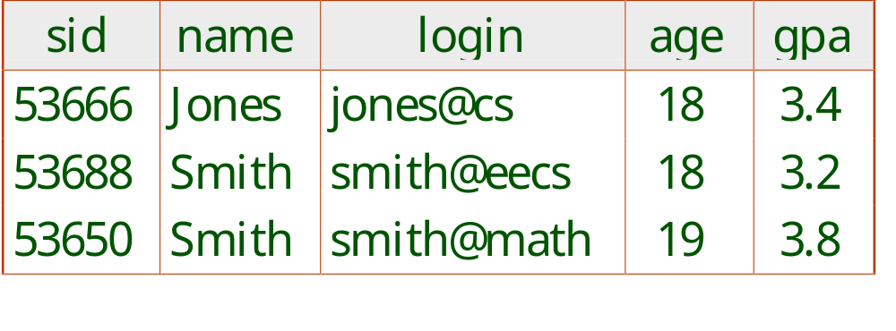
Example Instance of Students Relation
Cardinality = 3, degree = 5 , all rows distinct
Do all columns in a relation instance have to
be distinct?

Slide 6
SQL DDL
SQL stands for Structured Query Language
SQL is divided into two parts
  Data Manipulation Language (DML) which allows users to create, modify and query the instance
  Data Definition Language (DDL) which is used to define the schema at view and logical levels
The DDL supports the creation, deletion and modification of tables
  Including the specification of domain constraints and other constraints

Slide 7
Creating Relations in SQL
Creates Students relation. The type (domain) of each field is enforced by DBMS whenever tuples are added or modified.
Enrolled table holds information about courses that students take.
CREATE TABLE Students
(sid: CHAR(20),
name: CHAR(20),
login: CHAR(10),
age: INTEGER,
gpa: REAL)
CREATE TABLE Enrolled
(sid: CHAR(20),
cid: CHAR(20),
grade: CHAR(2))

Slide 8
Adding and Deleting Tuples
Can insert a single tuple using:
INSERT INTO Students (sid, name, login, age, gpa)
VALUES (53688, ‘Smith’, ‘smith@ee’, 18, 3.2)
Can delete all tuples satisfying some condition (e.g., name = Smith):
DELETE
FROM Students S
WHERE S.name = ‘Smith’
Powerful variants of these commands are available; more later!

Slide 9
Modifying Records
Use the UPDATE statement to modify a record, or records, in a table
  The WHERE statement is evaluated before the SET statement
Like DELETE the WHERE clause specifies which records are to be deleted
UPDATE Customer
SET income = 37491
WHERE sin = '111'

Slide 10
Deleting Tables
Use the DROP TABLE statement
  This not only deletes all the records but also deletes the table schema
DROP TABLE Customer

Slide 11
Modifying Tables
Columns can be added or removed to tables using the ALTER TABLE statement
  ADD to add a column and
  DROP to remove a column
ALTER TABLE Customer
ADD height INTEGER
ALTER TABLE Customer
DROP height

Slide 12
Drop Tables
DROP TABLE Students RESTRICT: destroy the Students table unless some view or IC refers to Students; if so, the command fails
If RESTICTS is replaced by CASCADE, Students is dropped and any referencing views or ICs are dropped (recursively).
Similarly, DROP VIEW
ALTER TABLE Students ADD COLUMN maiden-name CHAR(20)
  All existing rows are padded with null values in this column

Slide 13
Integrity Constraints (ICs)

Slide 14
Integrity Constraints (ICs)
IC: condition that must be true for any instance of the database; e.g., domain constraints, key constraints, e.g.
  ICs are specified when schema is defined.
  ICs are checked when relations are modified.
A legal instance of a relation satisfies all specified ICs.
  DBMS should not allow illegal instances - stored data is more faithful to real-world meaning.
  Avoids data entry errors, too!

Slide 15
Types of Integrity Constraints
Domain Constraints
  Specified when tables are created by selecting the type of the data
    e.g. dob DATETIME
Key Constraints
  Identifies primary keys and other candidate keys
Foreign Key Constraints
  References primary keys of other tables
General constraints

Slide 16
Primary Key Constraints
A set of fields is a (candidate) key for a relation if : Uniqueness: no two distinct tuples can have same values in all key fields , and minimality: not true for any subset of the key.
  If (name,age) uniquely identify a student, and each alone does not, (name,age) is a key, and (name,age, address) and (name) are not keys. But (name,age,address) is a superkey
A key is specified using UNIQUE.
One key is chosen (by DBA) to be primary key, by underlining its attributes
  E.g. Students(sid: string, name: string, login: string, age: integer, gpa: real)

Slide 17
Primary and Candidate Keys
Possibly many candidate keys (specified using UNIQUE), one is chosen as the primary key.
“For a given student and course, there is a single grade.” vs. “Students can take only one course and receive a single grade for that course; further, no two students in a course receive the same grade.”
Used carelessly, an IC can prevent the storage of instances that arise in practice!
CREATE TABLE Enrolled
(sid CHAR(20)
cid CHAR(20),
grade CHAR(2),
PRIMARY KEY (sid,cid) )
CREATE TABLE Enrolled
(sid CHAR(20)
cid CHAR(20),
grade CHAR(2),
PRIMARY KEY (sid),
UNIQUE (cid, grade) )

Slide 18
Foreign Keys, Referential Integrity
Foreign key (i.e., referential integrity) : Set of fields in relation R1 (for a relationship set) used to `refer’ to a tuple in relation R2 (for an entity set).
  Must correspond to primary key of R2, like a `logical pointer’, and all its values in R1 must exist in R2, i.e., no dangling references.
E.g. sid is a foreign key referring to Students:
  Enrolled(sid: string, cid: string, grade: string)

Slide 19
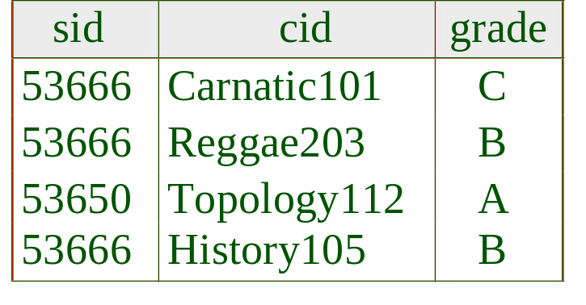
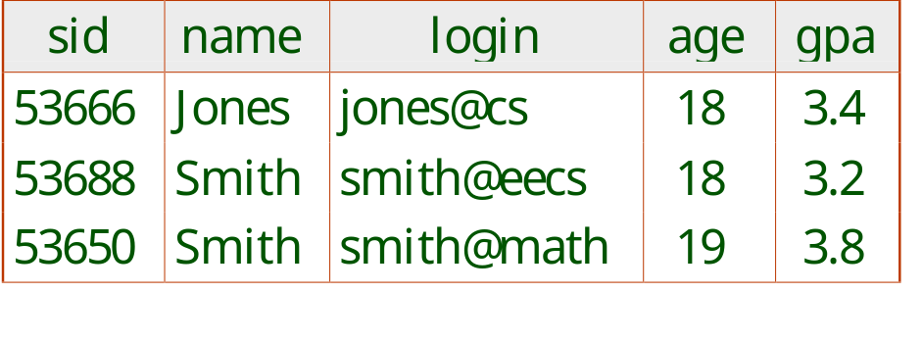
Foreign Keys in SQL
Only students listed in Students should be allowed to enrol for courses.
CREATE TABLE Enrolled
(sid CHAR(20), cid CHAR(20), grade CHAR(2),
PRIMARY KEY (sid,cid),
FOREIGN KEY (sid) REFERENCES Students )
Does it allow some students not enrolled?
Enrolled
Students

Slide 20
Enforcing Referential Integrity
What if we insert into Enrolled a tuple with sid not found in Students? (Reject it!)
What if the tuple with sid=53666 is deleted from Students table?
  Also delete all its Enrolled tuples (ON DELETE CASCADE)
  Disallow the deletion (ON DELETE NO ACTION).
  Change 53666 in Enrolled to a default sid (ON DELETE SET DEFAULT)
  Change 53666 to null, denoting `unknown’ or `inapplicable’
Similar if primary key of Students tuple is updated.

Slide 21
Where do ICs Come From?
ICs are derived from the semantics of the enterprise that must hold all times for all instances.
  We can check if an instance violates an IC, but can NEVER infer an IC by looking at a particular instance.
Key and foreign key ICs are the most common; more general ICs supported too.

Slide 22
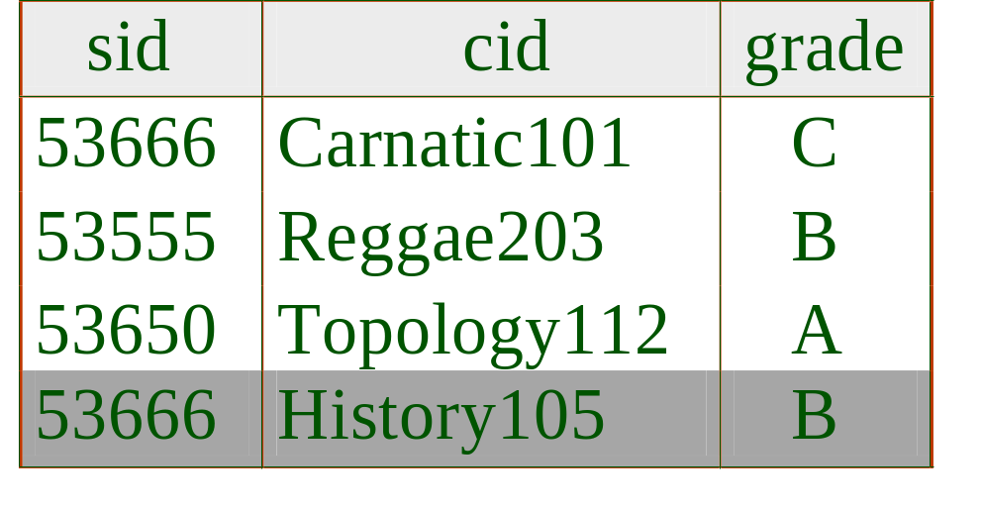
What can be inferred from this instance (e.g., sid is a key, cid is a key, etc)?

Slide 23
Query Languages

Slide 24
Relational Query Languages
A major strength of relational model: supports simple, powerful querying of data.
Queries can be written intuitively, and the DBMS is responsible for efficient evaluation.
  Precise semantics for relational queries (unlike google queries).
  Allows the optimiser to extensively re-order operations, and still ensure that the answer does not change.

Slide 25
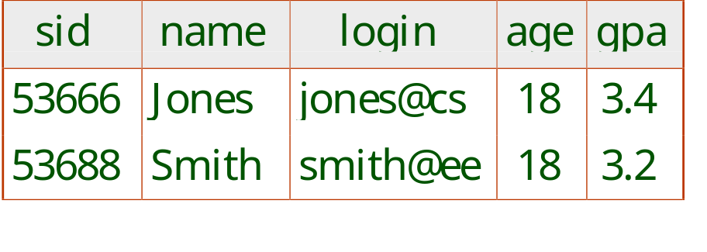
SQL Query Language
The most widely used relational query language.
Find all 18 year old students:
SELECT *
FROM Students S
WHERE S.age=18
Find just names and logins, replace the first line:
SELECT S.name, S.login

Slide 26
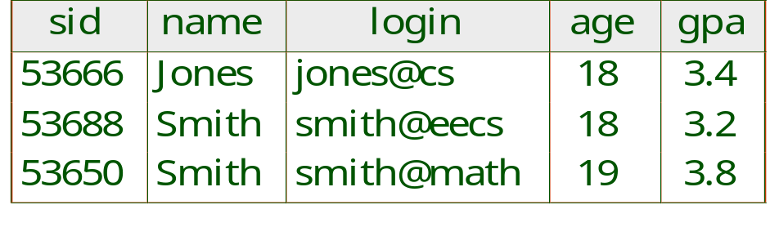
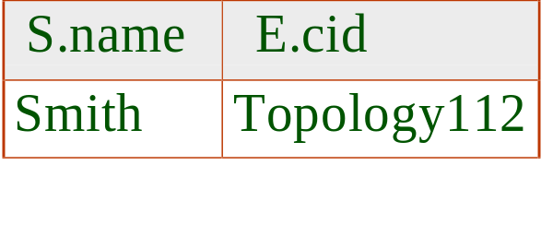
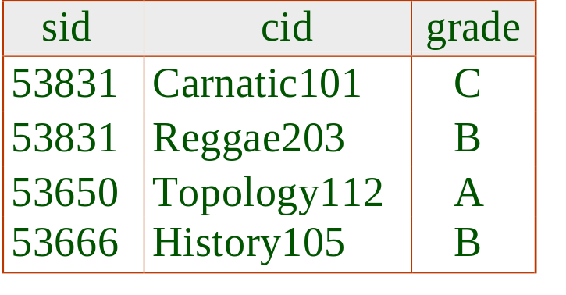
Querying Multiple Relations
What does the following query compute?
Students
SELECT S.name, E.cid
FROM Students S, Enrolled E
WHERE S.sid=E.sid AND E.grade=“A”
Enrolled
we get:
Is the above instance possible if referential integrity is enforced?

Slide 27
Semantics of a SQL Query
A conceptual evaluation method:
  1. do FROM clause: compute cross-product of Students and Enrolled
  2. do WHERE clause: Check conditions, discard tuples that fail
  3. do SELECT clause: Delete unwanted fields
Remember, this is conceptual. Actual evaluation will be much more efficient, but produce the same answer.

Slide 28

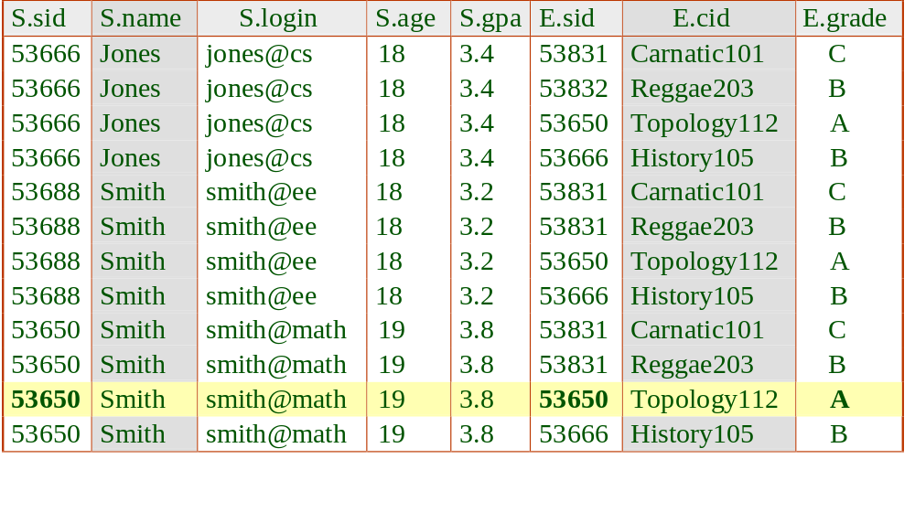
Cross-product of Students and Enrolled
Students
Enrolled

Slide 29
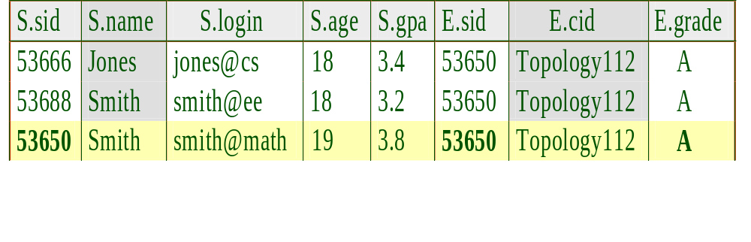
Actual evaluation: Select on E.grade=A, then cross-product - much smaller cross-product!

Slide 30
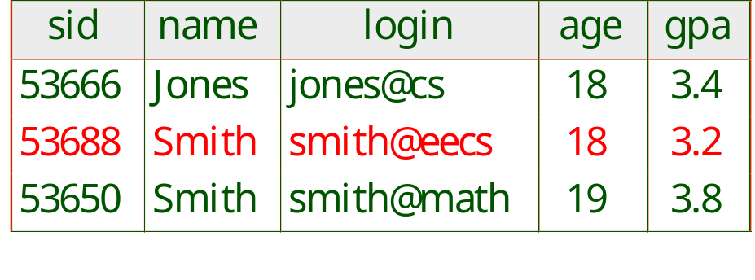
Join on ‘name’ messes up records of different students
SELECT S.age, E.cid
FROM Students S, Enrolled E
WHERE S.name=E.name AND E.grade=“A”
Enrolled
Sid | cid | grade | name
53666 | Carnatic101 | C | Jones
53666 | Reggae203 | B | Jones
53650 | Topology112 | A | Smith
53688 | History105 | B | Smith
We get:
age | cid
18 | Topology112
19 | Topology112
Students
Extra record because this person did not take Topology112

Slide 31
Views

Slide 32
Three Levels Revisited
Physical level: actual structures for storing relations.
Logical level: all (stored) base tables created by CREATE TABLE.
View level: tailoring how users see the data and for providing security, defined by some base tables and views created by CREATE VIEW).

Slide 33
Views
A view: records are not stored but are computed ‘on the fly’ as needed from “view definition”.
Whenever B-Students is used in a query, the view definition is first evaluated to produce B-Students, then the query treats B-Students as a base table.
  Users should not worry about the view vs base table distinction.
CREATE VIEW B-Students (name, sid, course)
AS SELECT S.name, S.sid, E.cid
FROM Students S, Enrolled E
WHERE S.sid=E.did AND E.grade=‘B’.

Slide 34
View Updates
Updatable views: views defined on a single base table.
  Simply update the underlying base table.
  E.g., to modify gpa of a GoodStudents row, we can modify the corresponding row in Students.
  What if S.name instead of S.sid is used in the view definition?
CREATE VIEW GoodStudents (sid,gpa)
AS SELECT S.sid,S.gpa
FROM Students S
WHERE S.gpa>3.0

Slide 35
View Updates
Students
Sid | gpa | name | year
50000 | 3.3 | Dave | 1991
53666 | 3.4 | Jones | 1992
53688 | 3.2 | Smith | 1993
53650 | 3.8 | Smith | 1994
Club
cname | mname
Sailing | Dave
Hiking | Smith
Rowing | Smith
CREATE VIEW Active Students (name, club, year)
AS SELECT S.name, C.cname ,S.year
FROM Students S, Club C
WHERE S.name=C.mname AND S.gpa>3.
ActiveStudents
name | club | year
Dave | Sailing | 1991
Smith | Hiking | 1993
Smith | Rowing | 1993
Smith | Hiking | 1994
Smith | Rowing | 1994
It is not possible to delete only the record (Smith,Hiking,1993) from the view: neither deleting (Hiking, Smith) from Club nor deleting (53688, 3.2, Smith, 1993) from Students will work, why?

Slide 36
Relational Model: Summary
A tabular representation of data.
Simple and intuitive, currently the most widely used.
Integrity constraints can be specified by the DBA, based on application semantics. DBMS checks for violations.
  Two important ICs: primary and foreign keys
  In addition, we always have domain constraints.
Powerful and natural query languages exist.

Slide 37
Review Questions
What does the DBMS do when ICs are violated?
Where do ICs come from? How can we determine if an IC should hold? How can we determine if an IC holds on an instance?
Exercises:
  3.5, 3.11, 3.19, and Case Study 3.8 (pp 92)

