Slide 1
Relational Algebra
Chapter 4

Slide 2
Relational Query Languages
Query languages: Allow manipulation and retrieval of data from a database.
Relational model supports simple, powerful QLs:
  Formal foundation based on logic.
  Allows for much optimization.
Query Languages != programming languages!
  QLs not expected to be “Turing complete”.
  QLs not intended to be used for complex calculations.
  QLs support easy, efficient access to large data sets.

Slide 3
Formal Relational Query Languages
The basis for “real” languages (e.g. SQL), and for query processing:
Relational Algebra: operational, useful for representing execution plans for computing a query.
Relational Calculus: declarative, useful for describing what is wanted.
We do RA

Slide 4
Preliminaries
A query is applied to relation instances, and the result of a query is also a relation instance.
  Schemas of input relations for a query are fixed (i.e., query will run regardless of instance!)
  Schemas of the result of a given query is determined by the schemas of input and query constructs.
Positional vs. named field notation:
  Positional notation easier for formal definitions, named-field notation more readable.
  Both used in SQL

Slide 5
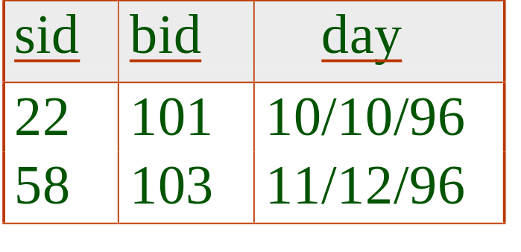
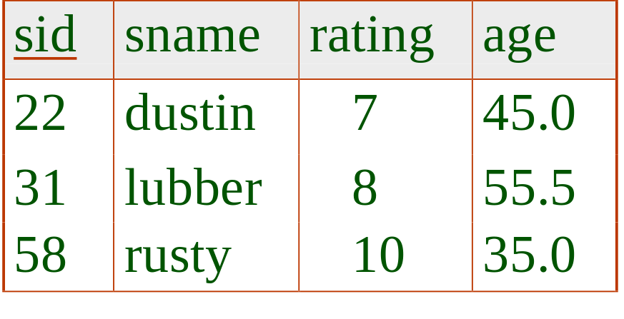
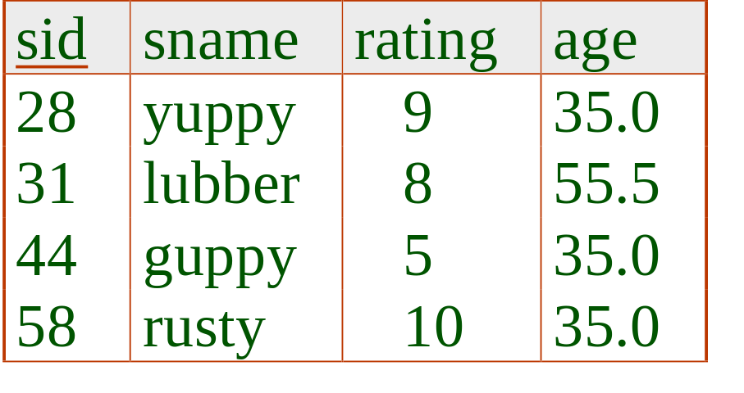
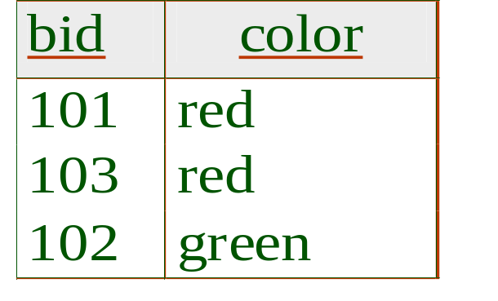
Example Instances
R1
“Sailors”, “Reserves”, “Boat” relations for our examples.
Names of fields in query results are `inherited’ from names of fields in input relations.
S1
S2
B

Slide 6

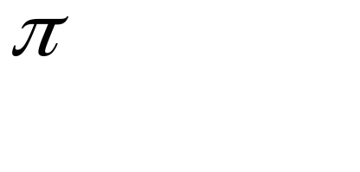



Relational Algebra
Basic operations:
  Selection ( ) Selects a subset of rows from relation.
  Projection ( ) Deletes unwanted columns from relation.
  Cross-product ( ) Allows us to combine two relations.
  Set-difference ( ) Tuples in reln. 1, but not in reln. 2.
  Union ( ) Tuples in reln. 1 and in reln. 2.
Additional operations:
  Intersection, join, division, renaming: Not essential, but (very!) useful.
Since each op returns a relation, ops can be composed! (Algebra is “closed”.)

Slide 7
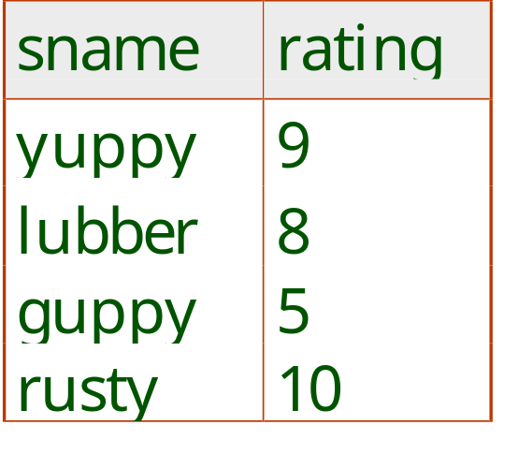
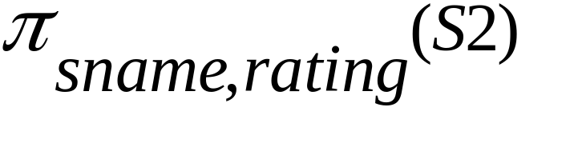
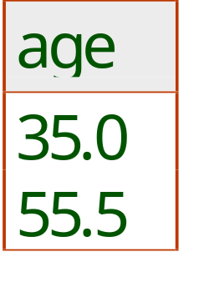
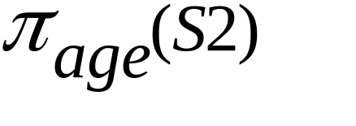
Projection
Deletes attributes that are not in projection list.
Schema of result contains exactly the fields in the projection list, with the same names that they had in the (only) input relation.
Projection operator has to eliminate duplicates! (Why??)
  Real systems (i.e., SQL) typically don’t do duplicate elimination unless the user explicitly asks for it. (Why not?)

Slide 8
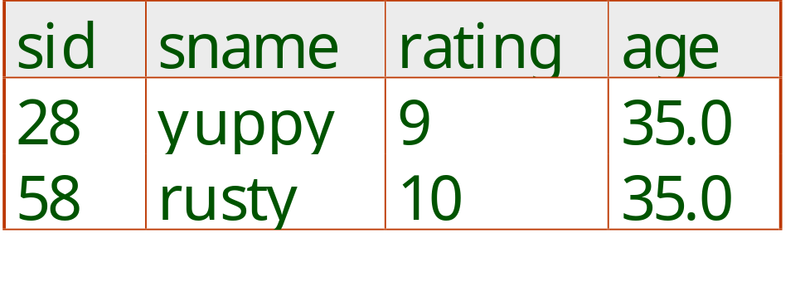
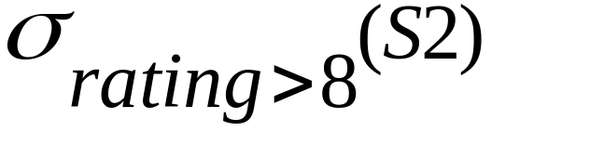
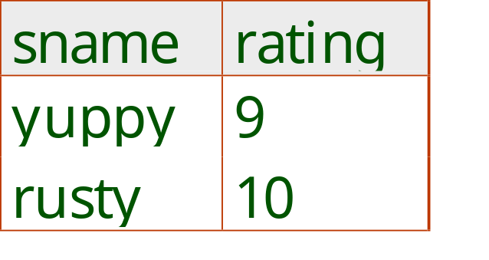
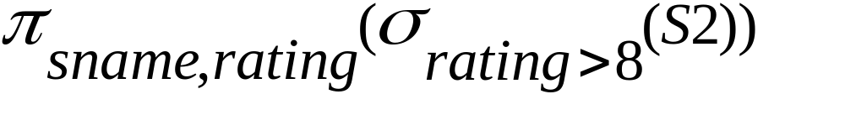
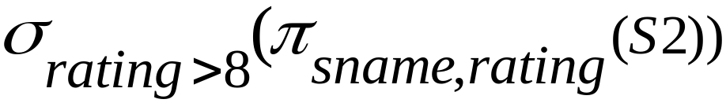
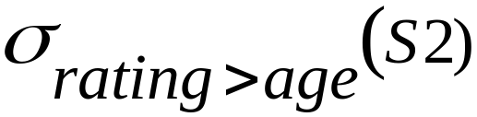
Selection
Selects rows that satisfy selection condition.
No duplicates in result! (Why?)
Result schema is identical to schema of (only) input relation.
Result relation can be the input for another relational algebra operation! (Operator composition.)
What about:

Slide 9
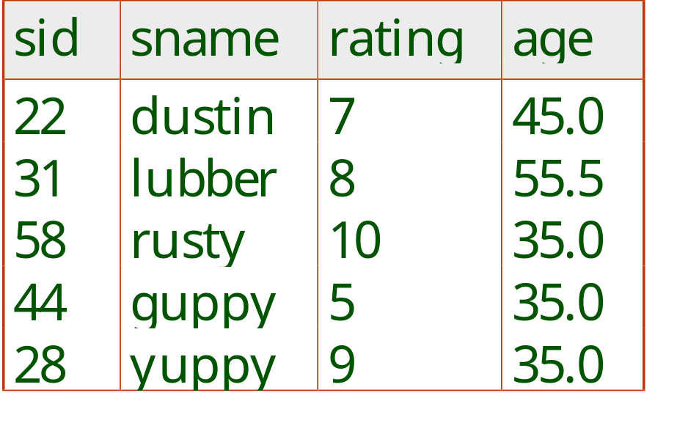

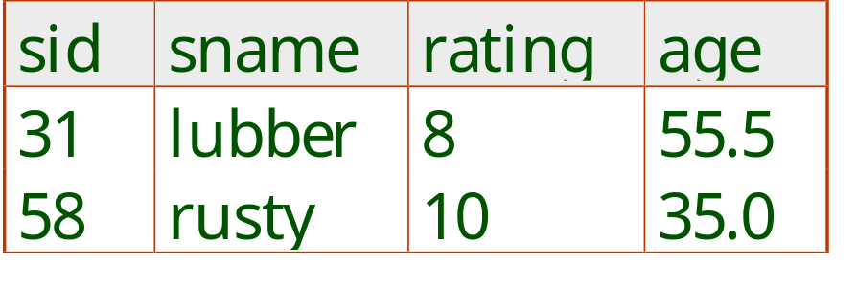
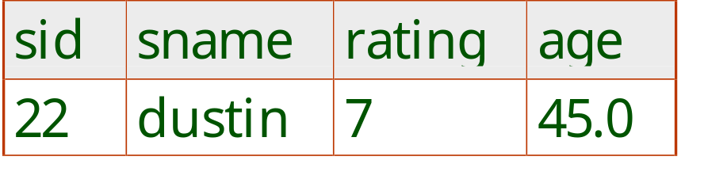


Union, Intersection, Set-Difference
All of these operations take two input relations, which must be union-compatible:
  Same number of fields.
  `Corresponding’ fields have the same type.
The schema of result is identical to the schema of S1.

Slide 10
Operator Composition
What does (S1-S2)∪(S2-S1) compute? What is the result schema?
How about (S1∪S2)-(S1∩S2)? Does the following hold?
σ_{rating>8}(S1∪S2)=σ_{rating>8}(S1)∪σ_{rating>8}(S2)
σ_{rating>8}(S1∩S2)=σ_{rating>8}(S1)∩σ_{rating>8}(S2)
Π_{sname}(S1∩S2)=Π_{sname} (S1)∩Π_{sname} (S2)

Slide 11
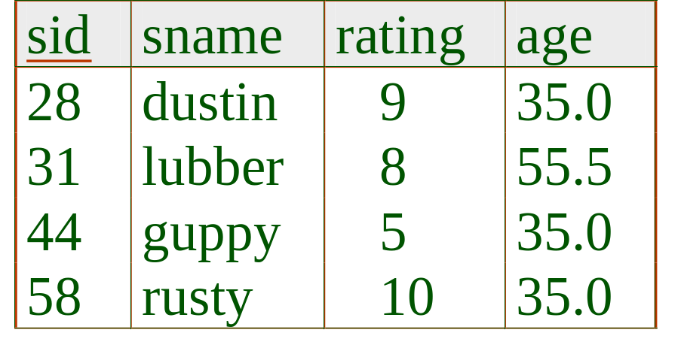
Example Instances
Π_{sname}(S1∩S2) ≠ Π_{sname} (S1)∩Π_{sname} (S2)
S1
S2

Slide 12
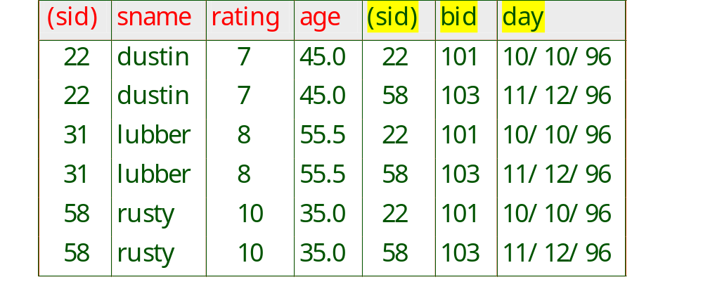
Cross-Product (S1×R1)
Each row of S1 is paired with each row of R1.
Result schema has one field per field of S1 and R1, field names `inherited’ if possible.
  Conflict: Both S1 and R1 have a field called sid.
Renaming operator:

Slide 13
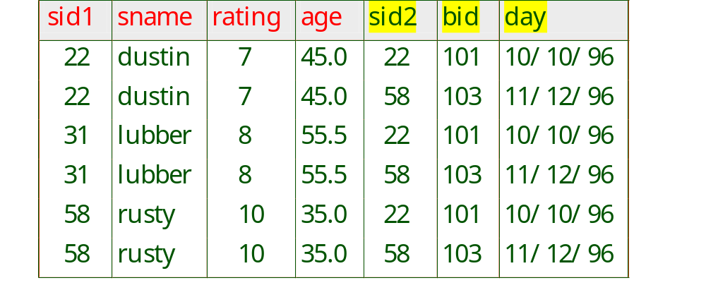
Renaming
ρ(R(list),E): take an expression E and creates a copy of E under the new name R with fields renamed according to list.
creates a relation C:

Slide 14

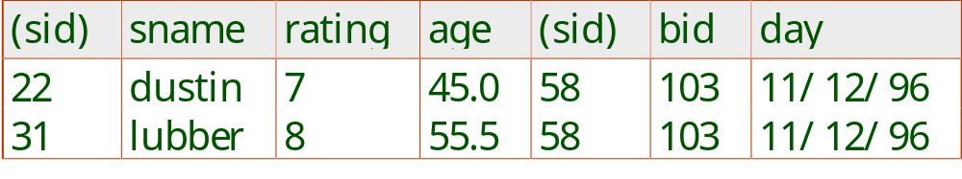
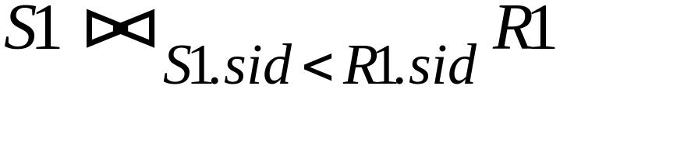
Joins
Condition Join:
Result schema same as that of cross-product.
Fewer tuples than cross-product, might be able to compute more efficiently

Slide 15
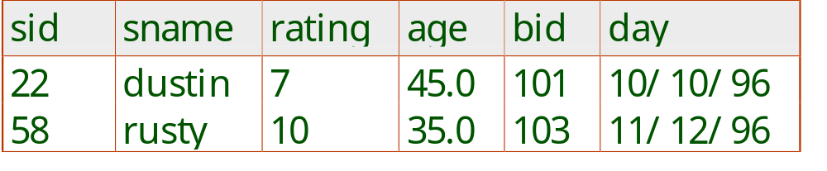
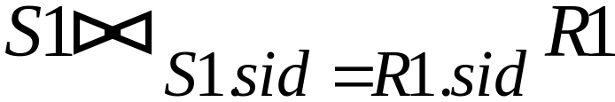
Joins
Equi-Join: A special case of condition join where the condition c contains only equalities.
Result schema similar to cross-product, but only one copy of fields for which equality is specified (i.e., sid).

Slide 16


Natural Join
Equi-join on all common field names.
A | B | C
1 | 0 | 2
3 | 0 | 2
1 | 1 | 1
B | C | D
0 | 2 | 4
1 | 1 | 5
0 | 1 | 3
A | B | C | D
1 | 0 | 2 | 4
3 | 0 | 2 | 4
1 | 1 | 1 | 3
=
B and C are common field names

Slide 17
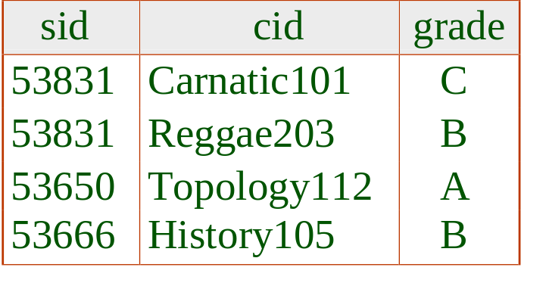
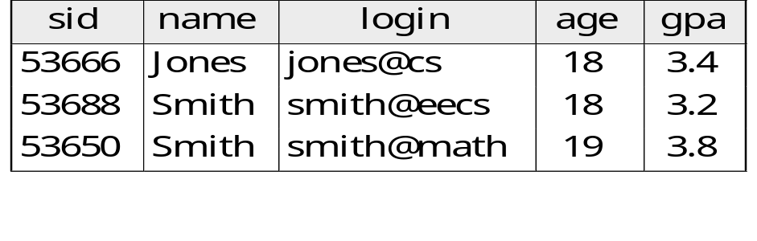
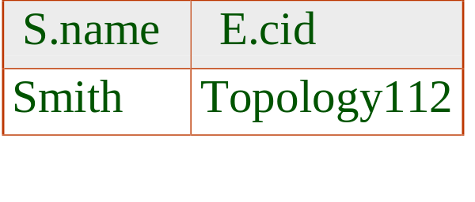
∏ _{name,cid} σ_{grade=“A”} (Student Enrolled)
Students
Enrolled
we get:

Slide 18
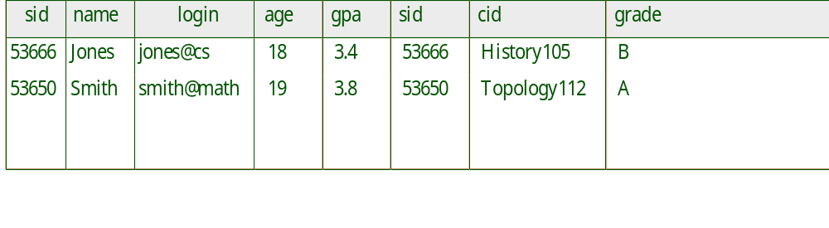

Student Enrolled
we get:

Slide 19
Natural Join
What if there is no common field, or all fields are common?
A | B | C
1 | 0 | 2
3 | 0 | 2
1 | 1 | 1
D | E | F
0 | 2 | 4
1 | 1 | 5
0 | 1 | 3
=
B | C
0 | 2
1 | 1
B | C
0 | 2
1 | 1
0 | 1
=
B
0
1
B | C
0 | 2
1 | 1
0 | 1
=

Slide 20

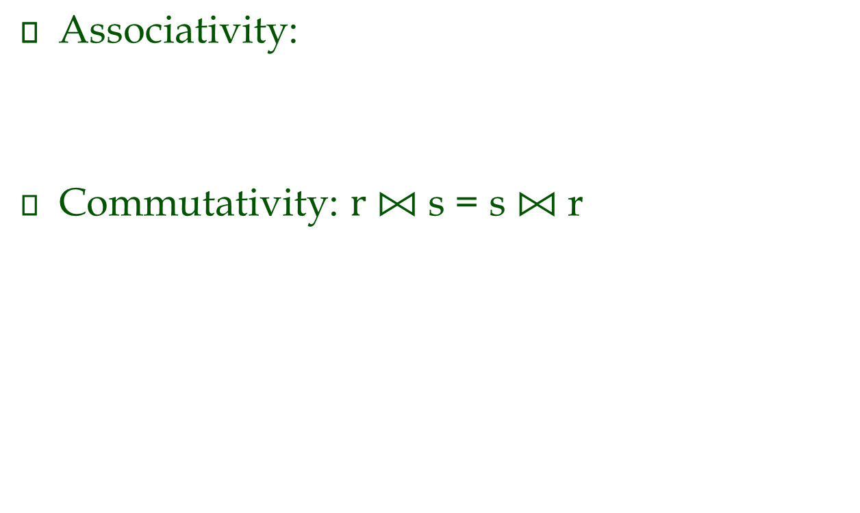
Natural Join

Slide 21
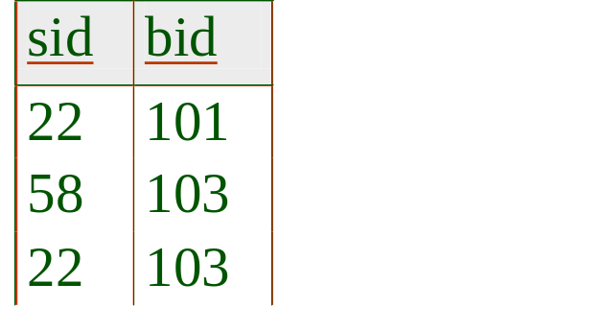


Division A/B
R(sid,bid) and B(bid):
  Find sailors who reserved all boats in B.
R
B
R/B

Slide 22
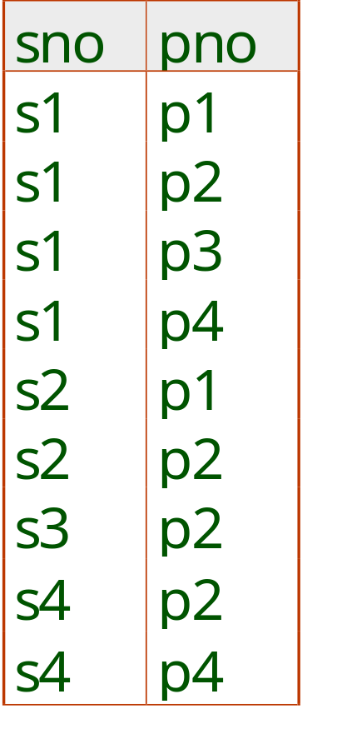
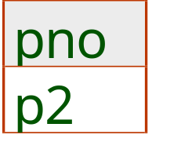
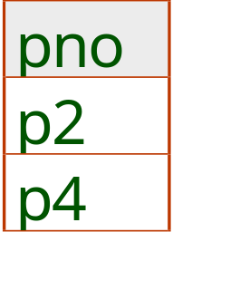
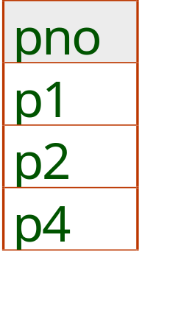
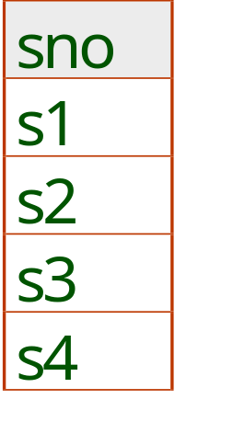
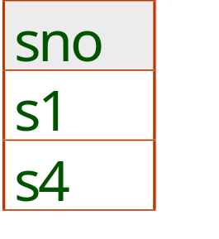
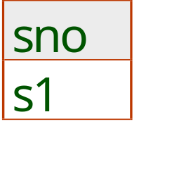
Examples of Division A/B
B1
B2
B3
A
A/B1
A/B2
A/B3

Slide 23
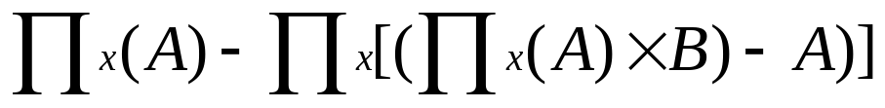
Expressing A/B Using Basic Operators
Let A(x,y) and B(y) where x and y are attribute lists.
Idea: compute all x values (first term), minus `disqualified’ (second term):
Disqualified: x values where (x,y) is not found in A for some y in B
disqualified

Slide 24
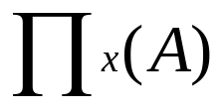
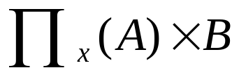

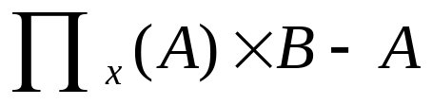
A
B
x | y
s1 | b1
s1 | b2
s2 | b1
y
b1
b2
x | y
s1 | b1
s1 | b2
s2 | b1
s2 | b2
x
s1
s2
x
s2
x | y
s2 | b2

Slide 25
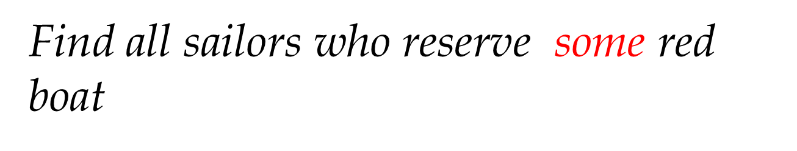


Find all sailors who reserve all red boats
S(sid,sname,…)
R(sid,bid,…)
B(bid,color,…)

Slide 26
Find all sailor who reserve only red boats
Sailors reserving some non-red boat.
Compared to
S(sname,sid,…), R(sid,bid,…), (bid,color,…)
(Joe, s1) (s1,b1) (b1,green)
(Joe, s2) (s2,b2) (b2,red)
(s1,b2)

Slide 27
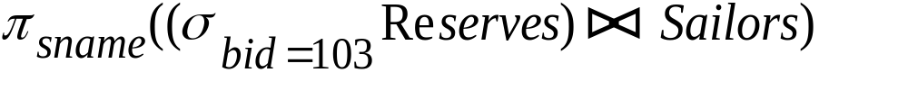
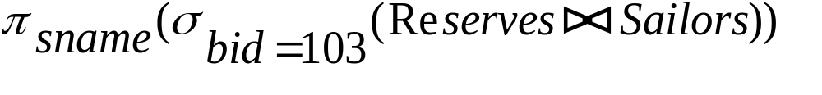
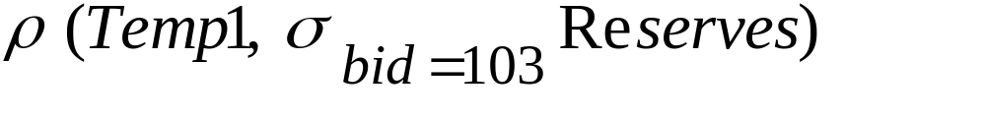
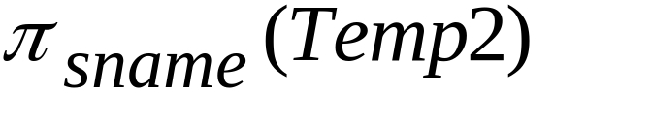
Find names of sailors who’ve reserved boat #103
Solution 1:
Solution 2:
Solution 3:

Slide 28
Find names of sailors who’ve reserved some red boat
boat colour only available in Boats; so need an extra join:
A more efficient solution:
A query optimiser can find this given the first solution!

Slide 29
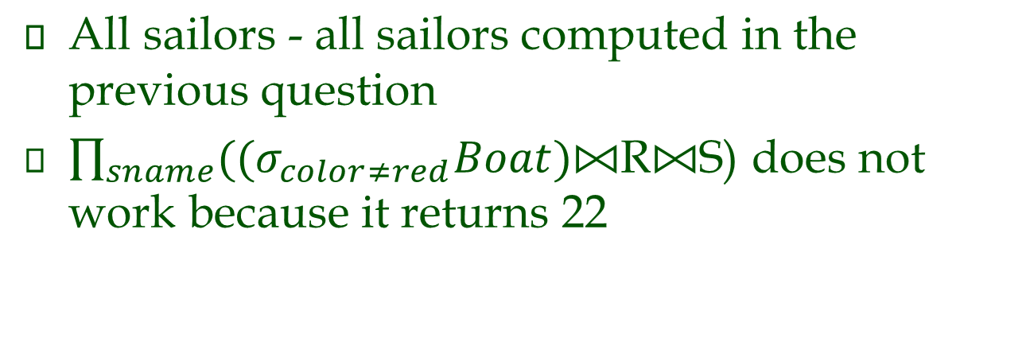
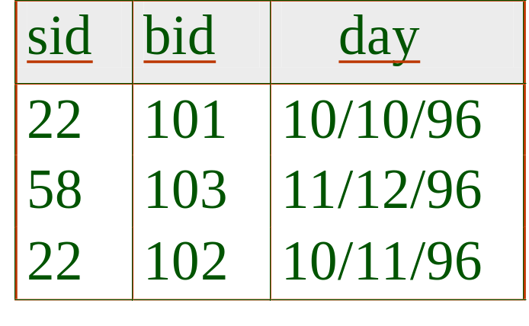
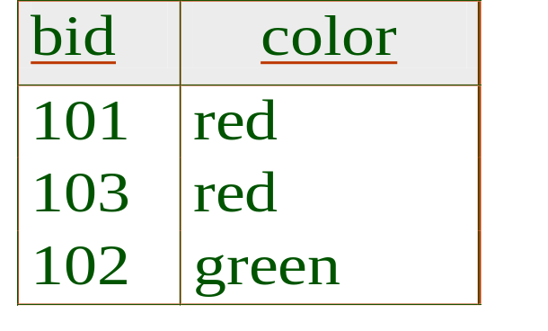
Find names of sailors who’ ve not reserved a red boat

Slide 30
Find sailors who’ve reserved a red or a green boat
Identify red or green boats, then find sailors who’ve reserved some of these boats:

Slide 31
Find sailors who’ve reserved both a red boat and a green boat
Identify sailors who’ve reserved red boats, sailors who’ve reserved green boats, then find the intersection:
note that sid is a key for Sailors. What if sid is replaced with sname?

Slide 32


Find the names of sailors who’ve reserved all boats
Uses division; schemas of the input relations must be carefully chosen:
Find sailors who’ve reserved all ‘Interlake’ boats:
.....

Slide 33
Summary
The relational model has rigorously defined query languages that are simple and powerful.
Know the schema of input and output relations.
Know the join and selection conditions.
Know how to do “all”, “only”, “some”, and “not”.
Relational algebra is operational; useful as internal representation for query evaluation plans.
Several ways of expressing a given query; a query optimizer should choose the most efficient version.

Slide 34
Exercises
Refer to sample-db.doc under Assignment in the course wiki site.
Do following queries in RA: 35, 36, 39, 40, 42, 45, 47.

