Slide 1
SQL: The Query Language
Chapter 5
Notes:
The slides for this text are organized into several modules. Each lecture contains about enough material for a 1.25 hour class period. (The time estimate is very approximate--it will vary with the instructor, and lectures also differ in length; so use this as a rough guideline.) This covers Lectures 3 and 4 (of 6) in Module (3).
Module (1): Introduction (DBMS, Relational Model)
Module (2): Storage and File Organizations (Disks, Buffering, Indexes)
Module (3): Database Concepts (Relational Queries, DDL/ICs, Views and Security)
Module (4): Relational Implementation (Query Evaluation, Optimization)
Module (5): Database Design (ER Model, Normalization, Physical Design, Tuning)
Module (6): Transaction Processing (Concurrency Control, Recovery)
Module (7): Advanced Topics

Slide 2
SQL
Simple queries
Set operations
Aggregate operators
Null values
Joins
Query Optimization

Slide 3
Components of SQL
Data Manipulation Language (DML) to
  Write queries
  Insert, delete and modify records
Data Definition Language (DDL) to
  Create, modify and delete table definitions
  Define integrity constraints
  Define views

Slide 4
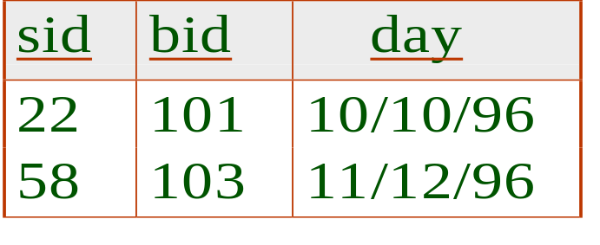
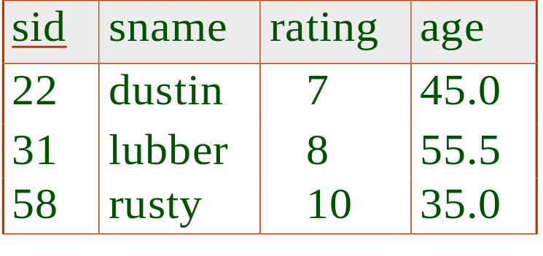
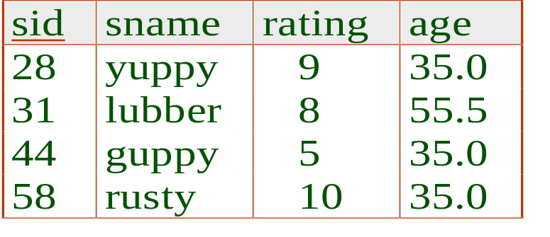
Example Instances
R1
We will use these instances of the Sailors, Reserves, Boats.
If the key for the Reserves relation contained only the attributes sid and bid, how would the semantics differ?
S1
S2
bid | color
B1

Slide 5

Basic SQL Query
SELECT [DISTINCT] target-list
FROM relation-list
WHERE qualification
relation-list A list of relation names (possibly with a tuple-variable after each name).
target-list A list of attributes of relations in relation-list. * is a shorthand for all attributes.
qualification Comparisons (Attr op const or Attr1 op Attr2, where op is one of ) combined using AND, OR and NOT.
DISTINCT is optional, indicating that the answer should not contain duplicates. Default is that duplicates are not eliminated!

Slide 6

Basic SQL Syntax
The basic form of an SQL query is
Which is equivalent to
π_{target-list}(σ_{qualification}(relation-list₁ × … × relation-list_{n}))

Slide 7
Conceptual Evaluation
Semantics of an SQL query:
  Compute the cross-product of relation-list.
  Discard resulting tuples if they fail qualifications.
  Delete attributes that are not in target-list.
  If DISTINCT is specified, eliminate duplicate rows.
This strategy is the least efficient way to compute a query! An optimiser will find more efficient strategies to compute the same answers.

Slide 8
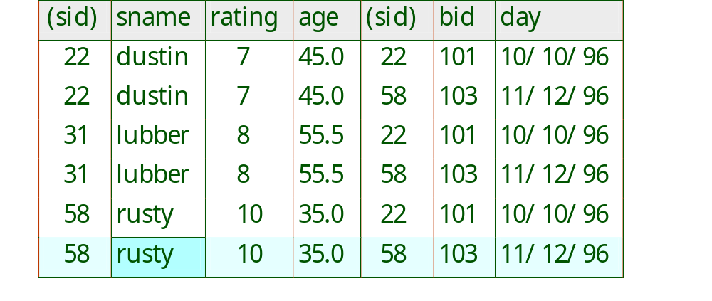
Example of Conceptual Evaluation
SELECT S.sname
FROM Sailors S, Reserves R
WHERE S.sid=R.sid AND R.bid=‘103’
Sailors
Reserves

Slide 9
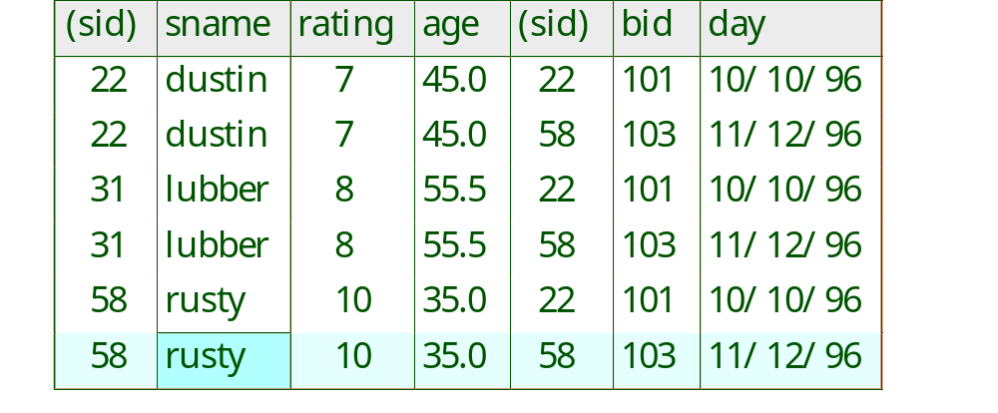
Find sailors who’ve reserved at least one boat
SELECT S.sname
FROM Sailors S, Reserves R
WHERE S.sid=R.sid AND bid=103
When does the result contain duplicate sname?

Slide 10
Example
Tuple variables
SELECT S.sname
FROM Sailors S, Reserves R
WHERE S.sid=R.sid AND R.bid=‘103’
Also possible:
SELECT Sailors.sname
FROM Sailors, Reserves
WHERE Sailors.sid=Reserves.sid AND Reserves.bid=‘103’

Slide 11
A Note on Tuple Variables
Really needed only if the same relation appears twice in the FROM clause. The previous query can also be written as:
SELECT S.sname
FROM Sailors S, Reserves R
WHERE S.sid=R.sid AND bid=‘103’
It is good style,
however, to use
tuple variables
always!
OR
SELECT sname
FROM Sailors, Reserves
WHERE Sailors.sid=Reserves.sid
AND bid=‘103’

Slide 12
Why Use Tuple Variables?
Distinguish between columns with same name but from different tables
Readability
Laziness
  C.birthDate is less to type than Customer.birthDate
To refer to same table more than once in the FROM clause

Slide 13
Required Tuple Variables
Find the names and customerIDs of customers who have an income greater than Rupert Giles
  Using two references to the customer table
SELECT C.customerID, C.firstName, C.lastName
FROM Customer C, Customer RG
WHERE RG.firstName = 'Rupert' AND RG.lastName = 'Giles' AND C.income > RG.income
What would the query return if there are two customers called Rupert Giles?

Slide 14
Expressions and Strings
SELECT S.age, age1=S.age-5, 2*S.age AS age2
FROM Sailors S
WHERE S.sname LIKE ‘B_%B’
Find triples (ages of sailors and two fields defined by expressions) for sailors whose names begin and end with B and contain at least three characters.
LIKE is used for string matching. `_’ stands for any one character and `%’ stands for 0 or more arbitrary characters.
AS and = are two ways to name fields in result.

Slide 15
Null Values
A database may contain NULL values where
  Data is unknown, or
  Data does not exist for an attribute for a particular row
There are special operators to test for null values
  IS NULL tests for the presence of nulls and
  IS NOT NULL tests for the absence of nulls
Other comparisons with nulls evaluate to UNKNOWN
Arithmetic operations on nulls return NULL

Slide 16
Evaluating Nulls and Unknown
Comparing NULLs
  NULL >= 47
    UNKNOWN
  NULL = NULL
    UNKNOWN
  NULL IS NULL
    TRUE
  23 + NULL - 3
    NULL
  NULL * 0
    NULL
Truth values for unknown results
  true OR unknown = true,
  false OR unknown = unknown,
  unknown OR unknown = unknown ,
  true AND unknown = unknown,
  false AND unknown = false,
  unknown AND unknown = unknown
  NOT unknown = unknown
A WHERE clause is treated as false if it evaluates to unknown

Slide 17
More Fun with Nulls
Let's say there are 2,753 records in Customer
SELECT customerID, firstName, lastName
FROM Customer
WHERE income <= 50000 OR income > 50000
This should return 2,753 customers, but what happens when we don't know a customer's income (i.e. it is null)?
null <= 50000 = unknown and null > 50000 = unknown and unknown or unknown = unknown which is treated as false!

Slide 18
Find sid’s of sailors who’ve reserved a red or a green boat
UNION: Can be used to compute the union of any two union-compatible sets of tuples (which are themselves the result of SQL queries).
How to modify these queries for “have reserved both a red and a green boat”?
SELECT R.sid
FROM Boats B, Reserves R
WHERE R.bid=B.bid
AND (B.color=‘red’ OR B.color=‘green’)
SELECT R.sid
FROM Boats B, Reserves R
WHERE R.bid=B.bid AND B.color=‘red’
UNION
SELECT R.sid
FROM Boats B, Reserves R
WHERE R.bid=B.bid AND B.color=‘green’

Slide 19
Find names of sailors who’ve reserved a red or a green boat
SELECT S.sname
FROM Sailors S, Boats B, Reserves R
WHERE S.sid=R.sid AND R.bid=B.bid
AND (B.color=‘red’ OR B.color=‘green’)
SELECT S.sname
FROM Sailors S, Boats B, Reserves R
WHERE S.sid=R.sid AND R.bid=B.bid AND B.color=‘red’
UNION
SELECT S.sname
FROM Sailors S, Boats B, Reserves R
WHERE S.sid=R.sid AND R.bid=B.bid AND B.color=‘green’

Slide 20
Find sid’s of sailors who’ve reserved a red and a green boat
Reserves
sid | bid
x | y
x | z
SELECT R1.sid
FROM Boats B1, Reserves R1,
Boats B2, Reserves R2
WHERE R1.sid=R2.sid
AND R1.bid=B1.bid
AND R2.bid=B2.bid
AND (B1.color=‘red’ AND B2.color=‘green’)
R1
R2
Boats
bid | color
y | red
z | green
B1
Key field!
B2
Contrast symmetry of the UNION and INTERSECT queries with how much the other versions differ.
SELECT R.sid
FROM Boats B, Reserves R
WHERE R.bid=B.bid AND B.color=‘red’
INTERSECT
SELECT R.sid
FROM Boats B, Reserves R
WHERE R.bid=B.bid AND B.color=‘green’

Slide 21
Find names of sailors who’ve reserved a red and a green boat
SELECT S.sname
FROM Sailors S, Boats B1, Reserves R1,
Boats B2, Reserves R2
WHERE S.sid=R1.sid AND R1.bid=B1.bid
AND S.sid=R2.sid AND R2.bid=B2.bid
AND (B1.color=‘red’ AND B2.color=‘green’)
Non Key field, not working
Joe | s
Sailors
SELECT S.sname
FROM Sailors S, Boats B, Reserves R
WHERE S.sid=R.sid AND R.bid=B.bid AND B.color=‘red’
INTERSECT
SELECT S.sname
FROM Sailors S, Boats B, Reserves R
WHERE S.sid=R.sid AND R.bid=B.bid AND B.color=‘green’
s | x
s | y
Reserves
x | red
y | green
Boats

Slide 22
Nested Queries
Find names of sailors who’ve reserved boat #103:
SELECT S.sname
FROM Sailors S
WHERE S.sid IN (SELECT R.sid
FROM Reserves R
WHERE R.bid=103)
Non-nesting version:
SELECT S.sname
FROM Sailors S, Reserves R
WHERE S.sid=R.sid AND R.bid=103
A powerful feature of SQL: WHERE clause can itself contain an SQL query!
A nested loops evaluation: For each Sailors (outer) tuple, check the qualification by computing the subquery.
NOT IN: sailors who’ve not reserved #103

Slide 23
Nested Queries with Correlation
Find names of sailors who’ve reserved boat #103:
SELECT S.sname
FROM Sailors S
WHERE EXISTS (SELECT *
FROM Reserves R
WHERE R.bid=103 AND S.sid=R.sid)
EXISTS() returns true if subquery returns non-empty.
Correlation: S for Sailor tuple occurs in the subquery, so subquery must be re-computed for each Sailors tuple.
s1 | Joe
s2 | Peter
Sailors
s1 | 103
s1 | 101
s2 | 101
Reserves

Slide 24

Nested Queries with Correlation
Find sailors with reservation for boat #103
SELECT S.sname
FROM Sailors S
WHERE UNIQUE (SELECT R.bid
FROM Reserves R
WHERE R.bid=103 AND S.sid=R.sid)
UNIQUE() returns true if subquery returns no duplicate.
s1 | Joe
s2 | Peter
s1 | 103
s1 | 103
s2 | 101
Sailors
Reserves

Slide 25

More on Set-Comparison Operators
We’ve already seen IN, EXISTS and UNIQUE. Can also use NOT IN, NOT EXISTS and NOT UNIQUE.
op ANY, op ALL, op is any of
IN and NOT IN equivalent to =ANY and ≠ALL
5 >ANY {2,5,6} returns true
5 >ANY {5,6,7} returns false
5 >ALL {1,2,3} returns true
5 >ALL {1,2,5} returns false

Slide 26
More on Set-Comparison Operators
Find sailors whose rating is greater than that of all sailors called Horatio:
SELECT *
FROM Sailors S
WHERE S.rating > ALL (SELECT S2.rating
FROM Sailors S2
WHERE S2.sname=‘Horatio’)
Find sailors whose rating is greater than that of some sailor called Horatio: replace ALL with ANY

Slide 27
Rewriting INTERSECT Queries Using IN
Find sname of sailors who’ve reserved both a red and a green boat:
SELECT S.sname
FROM Sailors S, Boats B, Reserves R
WHERE S.sid=R.sid AND R.bid=B.bid AND B.color=‘red’
AND R.sid IN (SELECT R2.sid
FROM Boats B2, Reserves R2
WHERE R2.bid=B2.bid
AND B2.color=‘green’)
Similarly, EXCEPT queries re-written using NOT IN.

Slide 28
Division in SQL
s1 | Joe
s2 | Peter
Find sailors who’ve reserved all boats.
Sailors
SELECT S.sname
FROM Sailors S
WHERE NOT EXISTS
((SELECT B.bid
FROM Boats B)
EXCEPT
(SELECT R.bid
FROM Reserves R
WHERE R.sid=S.sid))
s1 | 101
s1 | 103
s2 | 103
Subquery computes the boats
that S.sid does not reserve.
Reserves
101
103
Boats

Slide 29
Division in SQL
Let’s do it the hard way, without EXCEPT:
Find sailors who’ve reserved all boats.
Boats that S.sid does
not reserve
SELECT S.sname
FROM Sailors S
WHERE NOT EXISTS (SELECT B.bid
FROM Boats B
WHERE NOT EXISTS (SELECT R.bid
FROM Reserves R
WHERE R.bid=B.bid
AND R.sid=S.sid))
Sailors
Reserves
s1 | Joe
s2 | Peter
s1 | 101
s1 | 103
s2 | 103
101
103
Boats

Slide 30
Aggregate Operators
COUNT (*)
COUNT ( [DISTINCT] A)
SUM ( [DISTINCT] A)
AVG ( [DISTINCT] A)
MAX (A)
MIN (A)
Significant extension of RA.
SELECT COUNT (*)
FROM Sailors S
single column
SELECT S.rating
FROM Sailors S
WHERE S.rating= (SELECT MAX(S2.rating)
FROM Sailors S2)
SELECT AVG (S.age)
FROM Sailors S
WHERE S.rating=10
sid | sname | rating | age
s1 | Joe | 9 | 19
s2 | Bob | 9 | 21
s3 | Bob | 10 | 20
s4 | Peter | 10 | 30
s5 | Alice | 10 | 30

Slide 31
Aggregate Operators
SELECT COUNT (DISTINCT S.rating)
FROM Sailors S
WHERE S.sname=‘Bob’
SELECT AVG ( DISTINCT S.age)
FROM Sailors S
WHERE S.rating=10
sid | sname | rating | age
s1 | Joe | 9 | 19
s2 | Bob | 9 | 21
s3 | Bob | 10 | 20
s4 | Peter | 10 | 30
s5 | Alice | 10 | 30

Slide 32
Find name and age of the oldest sailor(s)
Important: if aggregate operator occurs in SELECT, the output is a single row.
SELECT S.sname, S.age
FROM Sailors S
WHERE S.age =
(SELECT MAX (S2.age)
FROM Sailors S2)
Illegal: because there may be more than one name but only one max value:
SELECT S.sname, MAX (S.age)
FROM Sailors S
Illegal: because MAX() occurs in WHERE condition for a single record.
SELECT MAX(S.rating)
FROM Sailors S
WHERE S.rating=MAX(S.rating)

Slide 33
GROUP BY and HAVING
Sometimes, we want to apply aggregate operators to several groups of tuples.
Consider: Find the age of the youngest sailor for each rating level.
sid | sname | rating | age
s1 | Joe | 9 | 19
s2 | Bob | 9 | 21
s3 | Bob | 10 | 20
s4 | Peter | 10 | 30
s5 | Alice | 10 | 30

Slide 34
GROUP BY and HAVING
Find the age of the youngest sailor for each rating level.
  Suppose we know that rating values go from 1 to 10; we can write 10 queries that look like this (!), i=1,2,…,10.
  In general, we don’t know what rating levels exist.
SELECT MIN (S.age)
FROM Sailors S
WHERE S.rating = i

Slide 35
Queries With GROUP BY and HAVING
SELECT [DISTINCT] target-list (step 5)
FROM relation-list (step 1)
WHERE qualification (step 2)
GROUP BY grouping-list (step 3)
HAVING group-qualification (step 4)
grouping-list specifies groups; each group is a set of tuples that have the same value for all attributes in grouping-list.
group-qualification must have a single value per group!.
target-list contains (i) attribute names (ii) terms with aggregate operations (e.g., MIN (S.age)).
If (ii) is present, (i) must be a subset of grouping-list, to ensure single value per group.

Slide 36
Conceptual Evaluation
Step 1: compute the cross-product of relation-list
Step 2: discard tuples that fail qualification
Step 3: partition remaining tuples into groups by the attributes in grouping-list.
Step 4: eliminate some groups by group-qualification.
SELECT [DISTINCT] target-list (step 5)
FROM relation-list (step 1)
WHERE qualification (step 2)
GROUP BY grouping-list (step 3)
HAVING group-qualification (step 4)

Slide 37
Find the age of the youngest sailor for each rating level.
SELECT S.rating, MIN (S.age)
FROM Sailors S
GROUP BY S.rating
sid | sname | rating | age
s1 | Joe | 9 | 19
s2 | Bob | 9 | 21
s3 | Bob | 10 | 20
s4 | Peter | 10 | 30
s5 | Alice | 10 | 30
Important: if aggregate operator occurs in SELECT, the output has one row per group
Illegal: Not single value per group:
SELECT S.sname, MIN (S.age)
FROM Sailors S
GROUP BY S.rating

Slide 38
Group-qualification must have a single value per group
Not single value per group
Single value per group
SELECT S.sname, MAX (S.age)
FROM Sailors S
GROUP BY S.rating
HAVING S.age >=20
sid | sname | rating | age
s1 | Joe | 9 | 19
s2 | Bob | 9 | 21
s3 | Bob | 10 | 20
s4 | Peter | 10 | 30
s5 | Alice | 10 | 30
SELECT S.rating, MAX (S.age)
FROM Sailors S
GROUP BY S.rating
HAVING MIN(S.age)>=20

Slide 39

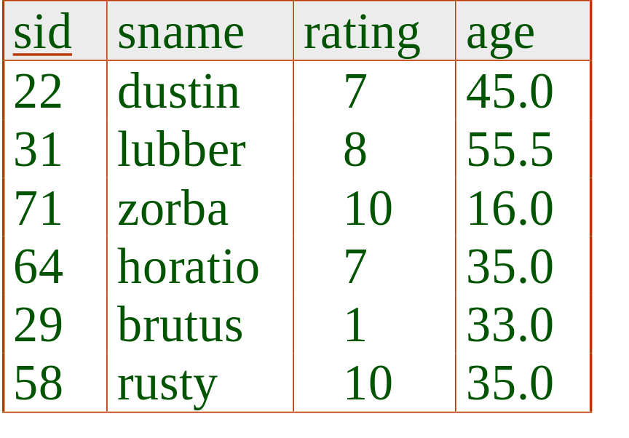
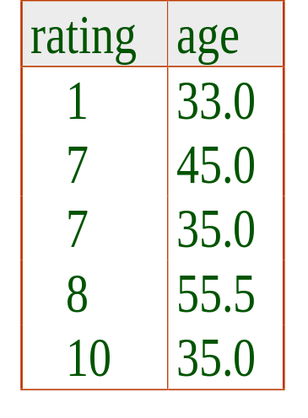
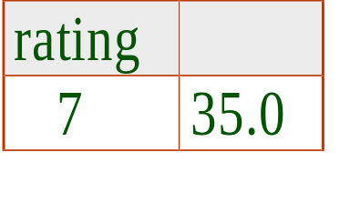
Find the age of the youngest sailor with age 18, for each rating with at least 2 such sailors
SELECT S.rating, MIN (S.age)
FROM Sailors S
WHERE S.age >= 18
GROUP BY S.rating
HAVING COUNT (*) > 1
2nd column of result is unnamed. (Use AS to name it.)
Answer relation

Slide 40
For each rating with at least 2 sailors (of any age), find the age of the youngest sailor with age >18.
SELECT S.rating, MIN (S.age)
FROM Sailors S
WHERE S.age > 18
GROUP BY S.rating
HAVING 1 < (SELECT COUNT (*)
FROM Sailors S2
WHERE S.rating=S2.rating)
Compare this with the query where we considered only ratings with 2 sailors over 18!
What if HAVING clause is replaced by
  HAVING COUNT(*) >1
HAVING clause can contain a subquery.

Slide 41
For each red boat, find the number of reservations for this boat
How about this:
SELECT COUNT(*)
FROM Reserves R
WHERE R.bid IN
(SELECT B.bid
FROM Boat B
WHERE B.color=‘red’)
SELECT B.bid, COUNT (*) AS scount
FROM Boats B, Reserves R
WHERE R.bid=B.bid AND B.color=‘red’
GROUP BY B.bid
How about this:
SELECT B.bid, COUNT (*) AS scount
FROM Boats B, Reserves R
WHERE R.bid=B.bid
GROUP BY B.bid
HAVING B.color=‘red’
Disallowed because only attributes in GROUP BY can appear in HAVING clause, to be single value per group.

Slide 42
Find those ratings that have smallest average age
sid | sname | rating | age
s1 | Joe | 9 | 19
s2 | Bob | 9 | 21
s3 | Bob | 10 | 20
s4 | Peter | 10 | 30
s5 | Alice | 10 | 30
SELECT S.rating
FROM Sailors S
GROUP BY S.rating
HAVING AVG(S.age) <= ALL (SELECT AVG(S2.age)
FROM Sailors S2
GROUP BY S2.rating)

Slide 43
Find those ratings that have smallest average age
sid | sname | rating | age
s1 | Joe | 9 | 19
s2 | Bob | 9 | 21
s3 | Bob | 10 | 20
s4 | Peter | 10 | 30
s5 | Alice | 10 | 30
Aggregate cannot be nested:
SELECT S.rating
FROM Sailors S
WHERE S.age = (SELECT MIN (AVG (S2.age)) FROM Sailors S2)
Wrong:
SELECT S.rating
FROM Sailors S
GROUP BY S.rating
HAVING AVG(S.age)= (SELECT MIN(S2.age)
FROM Sailors S2)

Slide 44
Summary
An important factor in the early acceptance of the relational model.
Significantly more expressive power than relational algebra.
Many alternatives to write a query; optimiser should look for most efficient evaluation plan.
Understand the text query is the first step.
Conceptual evaluation is important for understanding the semantic of SQL.
Exercise 5.1 and 5.5.

Slide 45
SQL: ICs, Views and Security
Chapter 21

Slide 46
Creating Relations
Creates the Boats relation that we know and love.
CREATE TABLE Boats
(bid: INTEGER, bname: CHAR(10), color: CHAR(10))
CREATE TABLE Reserves
(sname: CHAR(10), bid: INTEGER, day: DATE)
A small change: Reserves uses sname instead of sid.

Slide 47
General Constraints
CREATE TABLE Sailors
( sid INTEGER,
sname CHAR(10),
rating INTEGER,
age REAL,
PRIMARY KEY (sid),
CHECK ( rating >= 1
AND rating <= 10 )
Useful when more general ICs than keys are involved.
Can use queries to express constraint.
Constraints can be named.
CREATE TABLE Reserves
( sname CHAR(10),
bid INTEGER,
day DATE,
PRIMARY KEY (bid,day),
CONSTRAINT noInterlakeRes
CHECK (`Interlake’ <>
( SELECT B.bname
FROM Boats B
WHERE B.bid=bid)))

Slide 48
Views
A view is just a relation, but we store a definition, rather than a set of tuples.
CREATE VIEW ActiveSailors (name, age, day)
AS SELECT S.sname, S.age, R.day
FROM Sailors S, Reserves R
WHERE S.name=R.sname AND S.rating>6
Views can be dropped using the DROP VIEW command.
  How to handle DROP TABLE if there’s a view on the table?
    DROP TABLE command has options to let the user specify this.

Slide 49
Queries on Views
Evaluated using a technique known as query modification.
  Reference to view is replaced by its definition.
Note how sname has been renamed to name to match the view definition.
SELECT A.name, MAX ( A.day )
FROM Active Sailors A
GROUP BY A.name
SELECT A.name, MAX ( A.Day )
FROM
( SELECT S.sname AS name, S.age, R.day
FROM Sailors S, Reserves R
WHERE S.sname=R.sname
AND S.rating>6 ) AS A
GROUP BY A.name

Slide 50
Queries on Views
CREATE VIEW ActiveSailors (name, age, day)
AS SELECT S.sname, S.age, R.day
FROM Sailors S, Reserves R
WHERE S.name=R.sname AND S.rating>6
SELECT A.name, MAX ( A.Day )
FROM
( SELECT S.sname AS name, S.age, R.day
FROM Sailors S, Reserves R
WHERE S.sname=R.sname
AND S.rating>6 ) AS A
GROUP BY A.name
SELECT A.name, MAX ( A.day )
FROM Active Sailors A
GROUP BY A.name

Slide 51
Security in SQL
(i) Create a view called OVERPAID for consultants who earn more than $100,000 and who work on projects with a budget of less than $50,000.
CONSULTANT(staffid, name, date-of-birth,
annual-salary)
ASSIGNED-TO(staffid, projid, date-assigned,
hours-worked)
PROJECT(projid, description, budget,
proj-manager)
CREAT VIEW OVERPAID AS
SELECT *
FROM CONSULTANT
WHERE annual-salary > 100000
AND staffid IN
(SELECT staffid
FROM ASSIGNED-TO
WHERE projid IN
(SELECT projid
FROM PROJECT
WHERE budget < 50000))

Slide 52
Security in SQL
Alternative solution!
(i) Create a view called OVERPAID for consultants who earn more than $100,000 and who work on projects with a budget of less than $50,000.
CONSULTANT(staffid, name, date-of-birth,
annual-salary)
ASSIGNED-TO(staffid, projid, date-assigned,
hours-worked)
PROJECT(projid, description, budget,
proj-manager)
CREAT VIEW OVERPAID AS
SELECT C.staffid, C.name, C.date-of-birth, C.annual-salary
FROM CONSULTANT AS C,
ASSIGNED-TO AS A,
PROJECT AS P
WHERE (annual-salary > 100000) AND (C.staffid=A.staffid)
AND (A.projid=P.projid) AND (budget < 50000)

Slide 53
Security in SQL
(ii) Describe what the DBMS does to process the following query:
SELECT name
FROM OVERPAID
WHERE date-of-birth < '01-01-1970'
SELECT name
FROM CONSULTANT
WHERE annual-salary > 100000
AND staffid IN
(SELECT staffid
FROM ASSIGNED-TO
WHERE projid IN
(SELECT projid
FROM PROJECT
WHERE budget < 50000))
AND date-of-birth < '01-01-1970'
Query modification by the DBMS

Slide 54
Views and Security
Views can be used to present necessary information (or a summary), while hiding details in underlying relation(s).
  Given ActiveSailors, but not Sailors or Reserves, we can find sailors who have a reservation, but not the bid’s of boats that have been reserved.
The GRANT/REVOKE commands can be used to control access to relations and views.
Together with the ability to define views, this provides a very powerful access control mechanism.

Slide 55
GRANT and REVOKE of Privileges
GRANT INSERT, SELECT ON Sailors TO Horatio
  Horatio can query Sailors or insert tuples into it.
GRANT DELETE ON Sailors TO Yuppy WITH GRANT OPTION
  Yuppy can delete tuples, and also authorize others to do so.
GRANT UPDATE (rating) ON Sailors TO Dustin
  Dustin can update (only) the rating field of Sailors tuples.
GRANT SELECT ON ActiveSailors TO Yuppy
  This does NOT allow Yuppy to query Sailors directly!

Slide 56
Rules
A user creating a table (owner) has all privileges on it, including GRANT privilege.
A user creating a view has those privileges and grant options on the view that he has on every view or table used to define the view. This must include SELECT privilege.
Only the owner of a schema can execute CREATE, ALTER and DROP on that schema.
REVOKE: When a privilege is revoked from X, it is also revoked from all users who got it solely from X.

Slide 57
Examples
Joe creates tables Boats, Reserves, and Sailors.
Joe can execute
  GRANT INSERT, DELETE ON Reserves TO Yuppy WITH GRANT OPTION:
    Yuppy can insert or delete Reserves rows and authorize someone else to do the same.

Slide 58
Examples
Joe creates tables Boats, Reserves, and Sailors.
Joe can execute
  GRANT SELECT ON Reserves TO Michael
  GRANT SELECT ON Sailors TO Michael WITH GRANT OPTION
    Michael can execute SELECT on Reserves and Sailors, and can pass this privilege to others for Sailors but not for Reserves, Michael can create a view that accesses Sailors and Reserves, like ActiveSailors, but cannot grant SELECT on ActiveSailors to others (why?)

Slide 59
Examples
On the other hand, suppose Michael creates
  CREATE VIEW YoungSailors (sid,age,rating) AS SELECT S.sid, S.age, S.rating
  FROM Sailors WHERE S.age<18
    Michael has SELECT with the grant option on YoungSailors, and can pass it to Eric and Yuppy:
      GRANT SELECT ON YoungSailors TO Eric, Yuppy

Slide 60
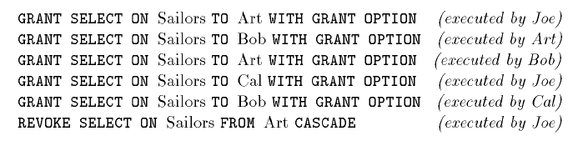
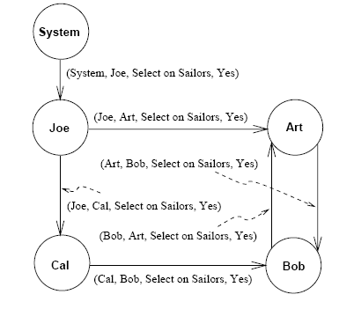
On executing REVOKE, the arc (Joe,Art) is removed
If node N has an outgoing arc labeled with privilege p, there is a path from System to N in which every arc is labeled p
That is, any remaining granting action is justified directly or indirectly from System.

Slide 61
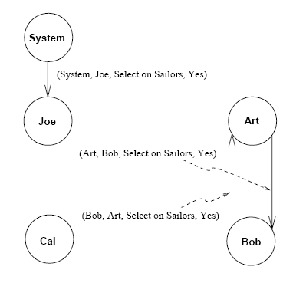
Suppose Joe further revokes Cal

Slide 62
DBA defined the views EmployeeNames (with Ename as the only attribute) as well as DeptInfo with fields Dept and AvgSalary. The latter lists the average salary for each department.
Security in SQL
(i) Define the two views:
EmployeeNames(Ename)
DeptInfo(Dept, AvgSalary)
EMP(Ename, Dept, Salary)
CREATE VIEW EmployeeNames(Ename) AS
SELECT Ename
FROM EMP;
CREATE VIEW DeptInfo (Dept, AvgSalary) AS
SELECT Dept, AVG(Salary) AS AvgSalary
FROM EMP
GROUP BY Dept;

Slide 63
Security in SQL
(ii) What privileges should be granted to a user who needs to know only the average department salaries for the “Toy” and “CS” departments?
To allow a user to access only the “Toy” and “CS” departments, it is better to create another view!
CREATE VIEW U-VIEW (Dept, AvgSalary) AS
SELECT D.Dept, D.AvgSalary
FROM DeptInfo AS D
WHERE D.Dept = “Toy” OR D.Dept = “CS”;
GRANT SELECT ON U-VIEW TO “user”;

Slide 64
Security in SQL
(iii)The secretary has to be authorised to fire people, to check on who is an employee, and to check on average department salaries. What
privileges should be granted to the secretary?
GRANT DELETE ON EMP TO “secretary”;
GRANT SELECT ON EmployeeNames TO “secretary”;
GRANT SELECT ON DeptInfo TO “secretary”;
(iv)You do not want your secretary to be able to look at the salaries of individuals. Does your answer to the question (iii) ensure this?
If there is just one employee in the department and if the secretary knows this, then he/she can find out the salary of the employee. Otherwise, the relations themselves do not allow the secretary to deduce the salary of individuals.

Slide 65
Security in SQL
(v) Show the command that enables the secretary to pass read access on the EmployeeNames view to other people.
GRANT SELECT ON EmployeeNames TO “secretary”
WITH GRANT OPTION;
(vi)Your secretary defines two new views using EmployeeNames view.
AtoRNames: Select names that begin with a letter in the range A to R
HowManyNames: Count the number of names
Grant your secretary the right to insert tuples into the EmployeeNames view and describe what privileges your secretary has afterwards.
⇒ Secretary can insert tuples in AtoRNames, but cannot insert
tuples into view HowManyNames.

Slide 66

Security in SQL
(vii) Your secretary allows Todd to read the EmployeeNames relation and later quits. You then revoke the secretary’s privileges. What happens to Todd’s privileges?
Todd’s privileges are revoked.
Your secretary after she quit!

Slide 67
9.2 Security in SQL (Overview)
DELETE
(INSERT)
Secretary
EMP(Ename, Dept, Salary)
SELECT+
GRANT OPTION
SELECT
EmployeeNames(Ename)
DeptInfo(Dept, AvgSalary)
AtoRNames(Ename)
HowManyNames
U-View(Dept, AvgSalary)

Slide 68
Summary of SQL’s DDL
DDL supports creation of relations, ICs, views and indexes. Tables can also be altered (by adding or dropping fields, indexes, and ICs).
Views can be queried just like ordinary relations, using query modification, but only limited forms of updates are allowed.
The GRANT / REVOKE commands for controlling privileges (ability to read or modify a relation), in conjunction with views, provide a powerful security and access control mechanism.

Slide 69
Summary (Contd.)
Many kinds of integrity constraints are supported in SQL/92.
  Domain constraints, primary and candidate key specification, foreign keys, and general constraints over one or more relations.
  Foreign key constraints, in particular, interact closely with insert / delete / modify commands, and users have several choices wrt this interaction.
Exercises: read 21.1, 21.2, and 21.3

