Slide 1
Application Development
Embedded SQL
Call-Level Interface
(Source: 9.1, 9.3 and 9.5 of Reference 1)

Slide 2
Acknowledgements
Modified/adapted from:
  Database systems: the complete book, H. G. Molina, J.D. Ullman, and J. Widom, 2009, Chapter 9.

Slide 3
SQL Injection
So far, a SQL interpreter accepts and executes SQL queries.
In reality, SQL queries are executed in some host languages with some steps being SQL statements.
SQL queries are often constructed by programs.
Careless code can allow rather unexpected queries to be constructed and executed.

Slide 4
Example: SQL Injection
Relation Accounts(name, passwd, acct).
Web interface: get name and password from user, store in strings n and p, issue query, display account number.
SELECT acct FROM Accounts
WHERE name = :n AND passwd = :p

Slide 5
User Types
Comment
in Oracle
Name:
gates’ --
Password:
who cares?
Your account number is 1234-567

Slide 6
Three-Tier Architecture
A common environment for using a database has three tiers of processors:
  Web servers --- talk to the user.
  Application servers --- execute the business logic.
  Database servers --- get what the app servers need from the database.

Slide 7
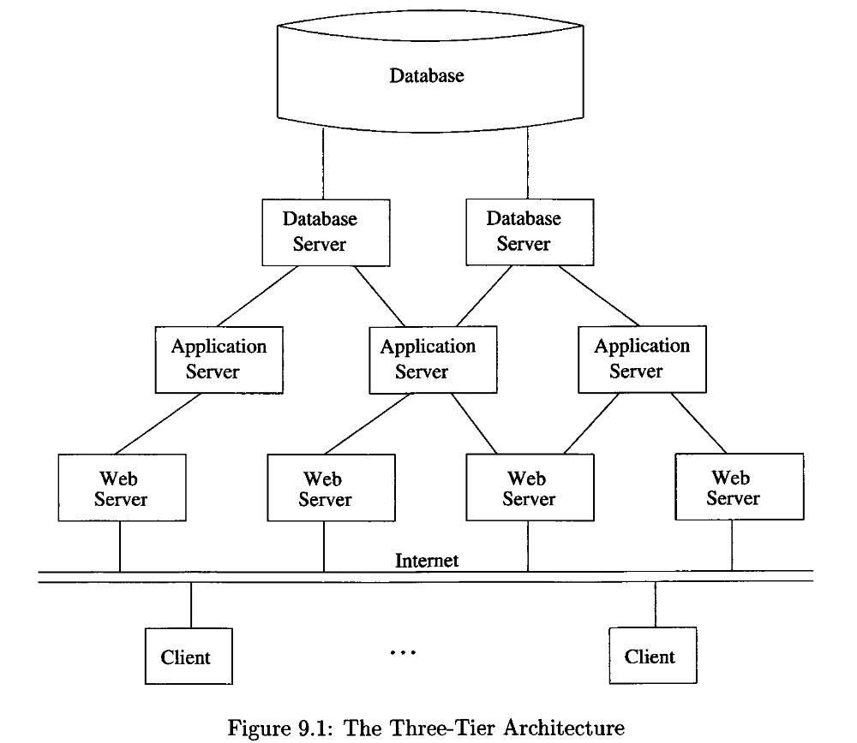

Slide 8
Example: Amazon
Database holds the information about products, customers, etc.
Business logic includes things like “what do I do after someone clicks ‘checkout’?”
  Answer: Show the “how will you pay for this?” screen.

Slide 9
Environments, Connections, Queries
The database installation is an environment.
Database servers maintain some number of connections, so app servers can ask queries or perform modifications.
The app server issues statements: queries and modifications.

Slide 10
Two Ways to Embed SQL in Host Languages
Directly embedding
  Host language program+ embedded SQL statements → preprocessor → library calls.
Call-level interface
  Library calls with SQL statements being string arguments in these calls.
We will do direct embedding

Slide 11
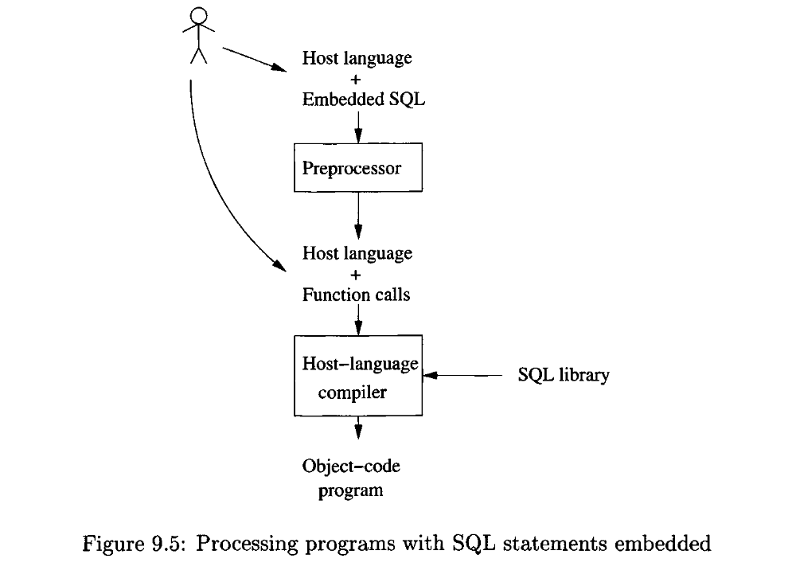
Directly embedding
Call-level interface

Slide 12
Direct Embedding (Embedded SQL)
EXEC SQL: Start a SQL statement.
Shared variables: allowed to appear in both host-language statements and SQL statements.
  Prefixed by a colon within SQL statements.
  Declared by DECLARE section

Slide 13
Impedance Mismatch
SQL Deals with relations, with no a priori bound on the number of records.
No such data structure in C.
Use cursor to bridge this gap.

Slide 14
Cursors
Declared on a relation or query statement (which generates a relation).
Open a cursor causes the statement executed, and pointing to the first record.
Fetch the tuple under cursor, and cursor advance to the next record.
Can also modify/delete tuple pointed to by a cursor.

Slide 15
Embedding SQL in C
Shared variables
char SQLSTATE[6];
EXEC SQL BEGIN DECLARE SECTION
char c_sname[20]; short c_minrating; float c_age;
EXEC SQL END DECLARE SECTION
c_minrating = random();
EXEC SQL DECLARE sinfo CURSOR FOR
SELECT S.sname, S.age FROM Sailors S
WHERE S.rating > :c_minrating
ORDER BY S.sname;
EXEC SQL OPEN sinfo;
do {
EXEC SQL FETCH sinfo INTO :c_sname, :c_age;
printf(“%s is %d years old\n”, c_sname, c_age);
} while (SQLSTATE != ‘02000’);
EXEC SQL CLOSE sinfo;

Slide 16
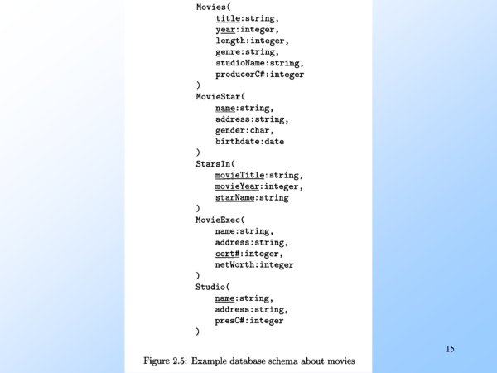
Example from Section 2.2.8 of “Database systems: the complete book”

Slide 17
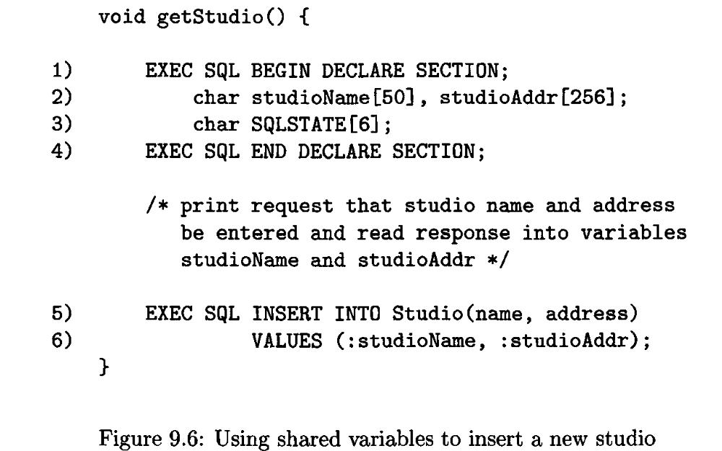

Slide 18
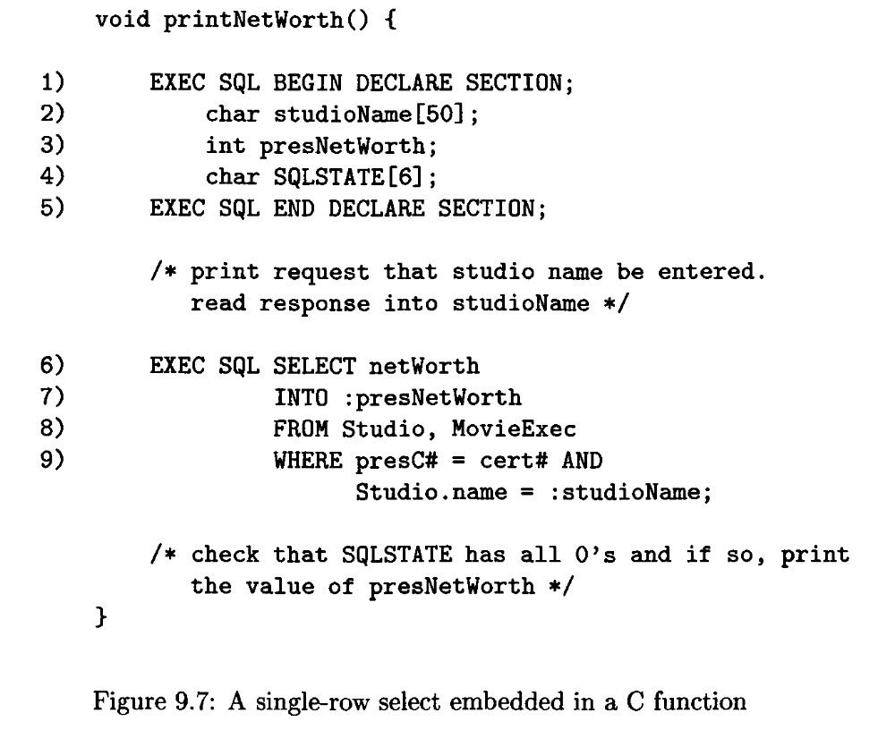

Slide 19
Suppose we wish to determine the number of movie executives whose net worth fall into a sequence of bands, each band corresponding to a number of digits in the net worth.
For five executives with net worth:
  1,000,000,
  1,000,000,
  10,000,000,
  100,000,000,
  100,000,000
  Then count[7]=2, count[8]=1, and count[9]=2

Slide 20
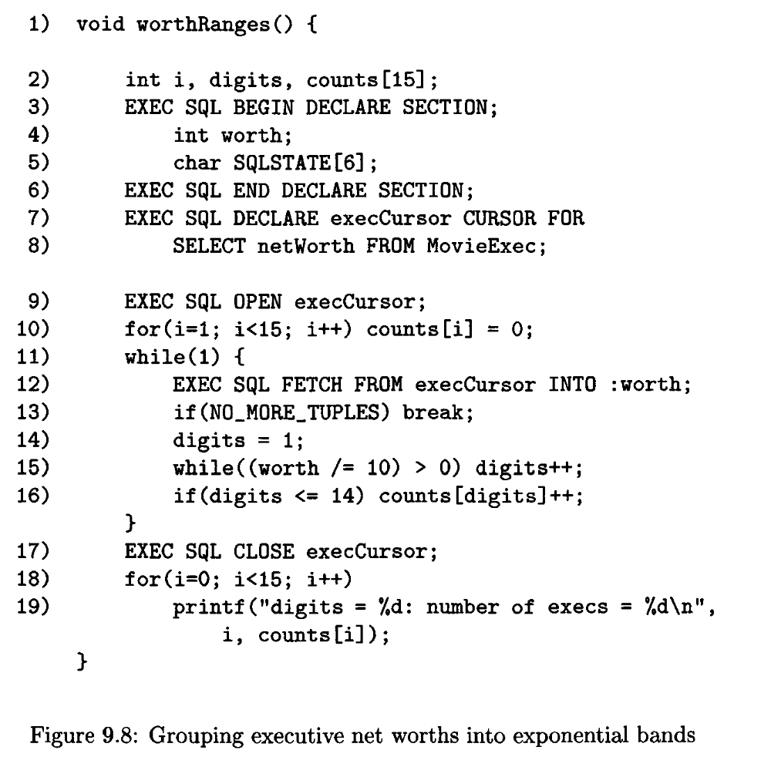
worth /= 10 is same as worth = worth /10
# define N0_M0RE_TUPLES ! (strcmp(SqLSTATE,"02000"))

