Slide 1
Real PCMASS automated tutorial

Slide 2
Install pCMASS32
Its on brookhaven national lab’s ftp server. Windows only.
ftp://ftp.stem.bnl.gov/pub/PCMass32
You also need a computer with > 720p screen resolution.
Open PCMASS32, file-> open STEM images -> select the images downloaded from brookhaven ftp server. Typically they came with 64 images with a naming scheme nkxxxx01-nkxxxx64, open up the first one will load all 64.
Open files will initiate a background scan (blue dots and what not), can be slow.

Slide 3
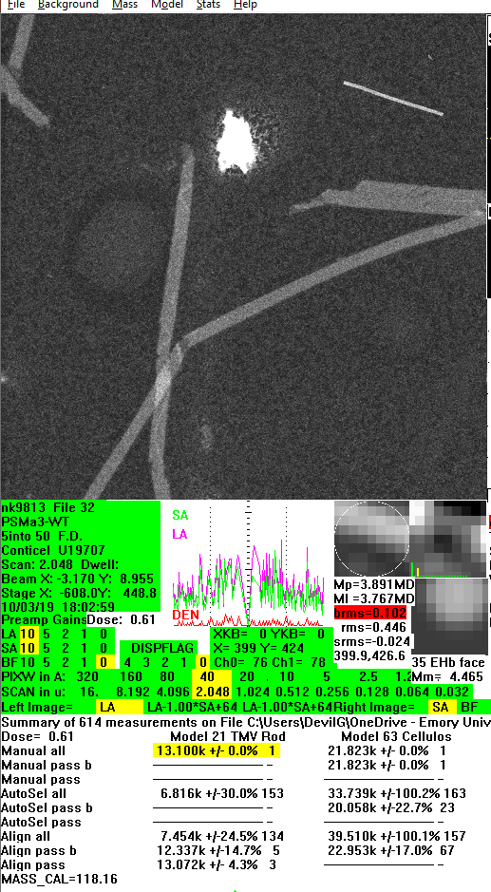
1. TMV calib
Everything needs calibration and STEM uses TMV (13.1kda/ans). It’s the bright rod thingy.
The way to do it is you use TMV model, click on it, then press O, go to the TMV column, press [, and it should read 13.1kda/ans.
It probabaly has to be done for each image.

Slide 4
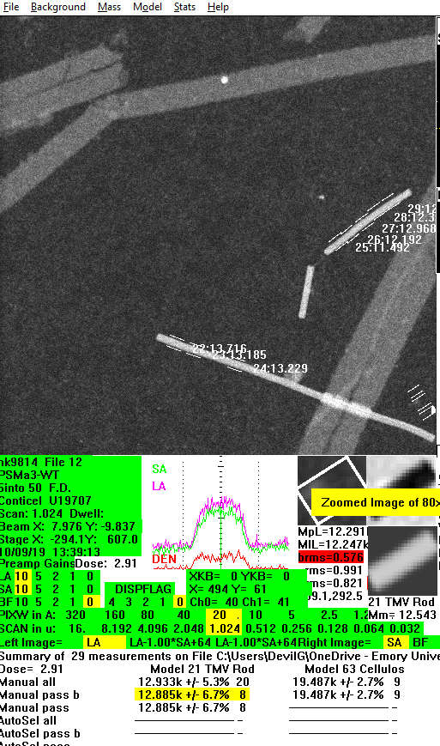
TMV…
PCMASS-model-model21 TMVrod. Click on TMV a couple of times. Press O. press down arrow to a TMV column (all or passb or pass, I typically use all since its MY HARD WORK), press “[”. Press down and up again, you should see 13.1k
Press “[”!

Slide 5
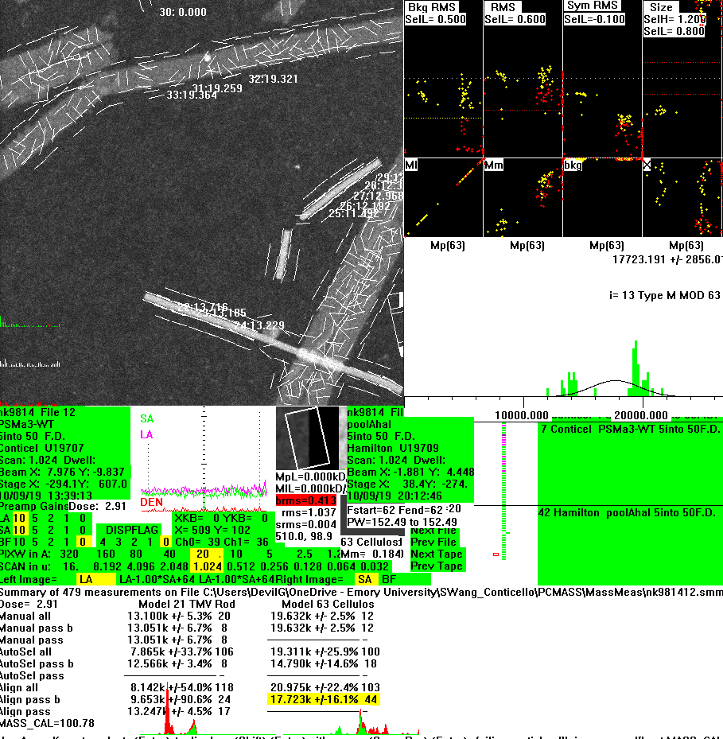
automation
Once TMV calib is done, select an appropriate model and make 1 or several boxing. Remember the M/L value for your refference. Press F11, press F12. press O, and check the values.
WOW!
SUCH AUTOMATION!

Slide 6
But wait
Sheng, why is your number so bad? Because I used a box that’s larger than tmv so it boxed TMV as well.

Slide 7
Save and process
File-write .smm to save all the measured points
Rinse and repeat for all images to be processed
Save files can be found in PCMASS-massmeas->nkxxxxxx.smm

Slide 8
QA Break!
Is automated picker accurate?
Yes.
Why shouldn’t I do it by hand?
Yes.

Slide 9
Manual smm processing
You care about this portion:
Type # M S R L KE M/L l M/L p M/L m x y t xt yt size ht str bkp bkRMS RMS sRMS
MMM 1 21 10 3 9 3 12452.7 12949.4 11392.7 395.0 427.60 70.84 22.07 0 0.980 1.014 1.000 0.00 0.672 0.816 0.730
Type # M S R L KE M/L l M/L p M/L m x y t xt yt size ht str bkp bkRMS RMS sRMS
TTT 2 21 1 2 9 3 5374.7 5113.4 0.0 28.9 495.3 51.50 0.00 0.00 1.000 1.000 1.000 42.36 0.097 0.330 0.000
TTT 3 21 1 2 9 3 6586.6 6586.6 0.0 23.1 485.2 61.20 0.00 0.00 1.000 1.000 0.000 42.34 0.079 0.346 0.000
TTT 4 21 2 2 9 3 6150.4 6068.0 0.0 16.3 481.6 168.65 0.00 0.00 1.000 1.000 0.000 42.34 0.103 0.339 0.000
Type | # | M | S | R | L | KE | MLI | MLP | ML M | x | y
t | xt | yt | size | ht | str | bkp | bkRMS | RMS | sRMS
And you really care about 3 columns: type, M, ML(i/p/m)
Type: MMM is manual measured entry; TTT is trial; RRR is aligned
M: specifies model, e.g. model21 = TMV
ML: M/L measurements
All other values: I don’t understand
Pick out the right M model entries and analyze ML values.

Slide 10
Automated processing
import re
def parse(file, r, typed = 'RRR', model = '63'):
try:
f = open(file, 'r')
k = f.readline()
while k != '':
i = re.split(' +', k)
if i[0] == typed and i[2] == model:
r.append(k)
k = f.readline()
except:
'k'
return r
def parsem(pref, n1, n2 = 0, typed = 'RRR', model = '63'):
r = []
if n2 < n1:
n2 = n1
for i in range(n1, n2 + 1):
j = str(i)
if i < 10:
j = '0' + j
r = parse(pref + j + '.smm', r, typed, model)
return r
r = parsem('nk9814', 10, 16, 'RRR', '63')
f = open('result.txt', 'w')
for i in r:
f.write(i)
f.close()
Alteratively, make a python script (on the right) in that folder. Modify the following:
r = parsem('nk9814', 10, 16, 'RRR', '63'): nk9814 is your project iD, usualy something nk98xx. 10 is the starting file you did, 16 is the end file you did. Doesn’t have to be continuous, just need the full range. 63 is your model ID. For ex TMV is model 21.

Slide 11
processing
Open results.txt. Copy results.txt contents. Open PCMASS_buddy. Go to A2. paste -> text import -> delimit -> space -> finish.
Select W2 trhough AA2 and autofill.
To explain, W2 through Y2 are filters; only Y2 is the real filter set as backgroundRMS > 0.5. others are up to you.
Filtered results = AA; filtered OUT results = AB; average = AC9, stdev = AC10; stdev/avg = AC11.

Slide 12
Histogram
Process in igor OR excel OR open histogram_buddy and copy-paste AA

Slide 13
How good is this? hear from me the only person did this
I used to do STEM for an hour, now I just spend 5 hours to automate it instead. Its truly a lifesaver to waste the extra 4 hours. –Sheng
TRY IT YOURSELF!

