Slide 1
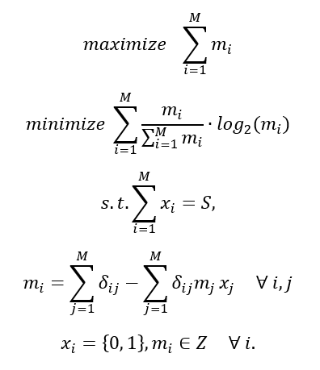
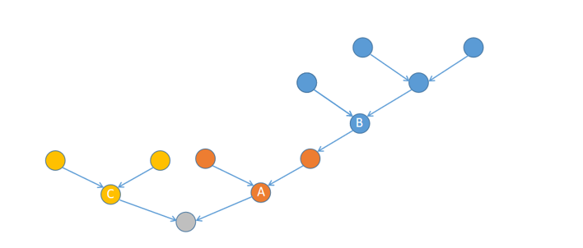



Problem formulation
$$m_{B}=5$$
$$m_{C}=3$$
$$m_{A}=3$$

Slide 2


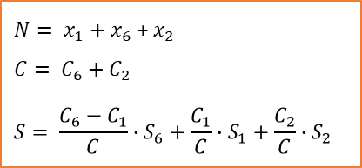

Problem formulation
1
2
1
2
1
2
3
4
5
3
4
5
3
4
5
6
7
6
7
6
7
(a) original graph
(b) sensors placed on the original graph
(c) connectivity check among sensors
1
2
1
($x_{1}, C_{1}, S_{1}$)
2
($x_{2}, C_{2}, S_{2}$)
$N= x_{1}+x_{6}$ + $x_{2}$
$$C= C_{6}+C_{2}$$
$$S= \frac{C_{6}−C_{1}}{C}∙S_{6}+\frac{C_{1}}{C}∙S_{1}+\frac{C_{2}}{C}∙S_{2}$$
6
6
($x_{6}, C_{6}, S_{6}$)
(d) connectivity subgraph
(e) connectivity-based objective evaluation

Slide 3
Problem formulation

Slide 4






$$F_{1}$$
$$F_{2}$$
$$F_{3}$$
$$S_{t}$$
$$S_{t+1}$$
…
$$S_{t_new}$$
Iterate all potential candidate sites
procedure

Slide 5














$$F_{1}$$
$$F_{1}$$
$$F_{2}$$
…
max sensor?
$$F_{1}$$
$$F_{2}$$
$$F_{1}$$
<N?
$$F_{3}$$
…
$$S_{t+1}$$
$$F_{2}$$
$$F_{3}$$
max sensor?
Remove
$$S_{t}$$
$$S_{t}^{′}$$
…
$$S_{t}∪S_{t_new}$$
$$S_{t+1}$$
Notes:
F1加到final solution时，也需要考虑F1中满足constraint的solution的数量和final solution size的关系
N：final solution set的size
Stopping criterion: the solutions in the front 0 of the final solution is n

Slide 6











$$F_{1}$$
max sensor
constraint
Add to final solution
$$F_{2}$$
$$F_{1}$$
$$F_{3}$$
$$F_{2}$$
<N?
$$S_{t+1}$$
…
$$F_{3}$$
max sensor
Remove
$$S_{t}$$
$$S_{t}^{′}$$
…
$$S_{t}∪S_{t_new}$$
$$S_{t+1}$$
procedure
Stopping criterion: the solutions in the front 0 of the final solution is n
Notes:
F1加到final solution时，也需要考虑F1中满足constraint的solution的数量和final solution size的关系
N：final solution set的size

Slide 7
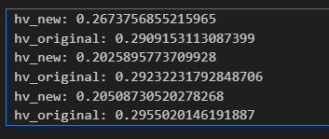
size | OG | NG(5) | NG(10) | NG(15) | NG(20) | NG(25) | NG(30)
100 | 60.69 | 0.61 | 2.28 | 4.06 | 6.92 | 8.21 | 11.89
500 | 13503.35 | 6.71 | 22.33 | 37.65 | 61.53 | 80.04 | 105.42
1000 | 113634.28 | 26.96 | 79.65 | 133.35 | 216.88 | 243.29 | 332.13
1500 | ** | 65.68 | 186.89 | 299.83 | 459.12 | 510.40 | 695.60
2000 | ** | 138.89 | 360.98 | 592.59 | 855.72 | 944.06 | 1320.14
2500 | ** | 238.28 | 615.81 | 974.02 | 1399.72 | 1555.03 | 2051.82
3000 | ** | 394.73 | 953.58 | 1523.87 | 2152.01 | 2467.20 | 3229.90
time
OG和NG(5) HV的对比
Notes:
每个iteration用于sorting的时间大大缩小

Slide 8
size | OG | NG(5) | NG(10) | NG(15) | NG(20) | NG(25) | NG(30)
100 | 0.291 | 0.267 | 0.293 | 0.287 | 0.285 | 0.3 | 0.291
500 | 0.292 | 0.203 | 0.234 | 0.259 | 0.257 | 0.26 | 0.274
1000 | 0.296 | 0.205 | 0.221 | 0.223 | 0.243 | 0.248 | 0.252
1500 | ** | 0.145 | 0.243 | 0.247 | 0.255 | 0.267 | 0.26
2000 | ** | 0.17 | 0.227 | 0.243 | 0.248 | 0.249 | 0.261
2500 | ** | 0.153 | 0.238 | 0.238 | 0.268 | 0.259 | 0.256
3000 | ** | 0.135 | 0.231 | 0.24 | 0.256 | 0.257 | 0.252
HV
Notes:
每个iteration用于sorting的时间大大缩小

Slide 9
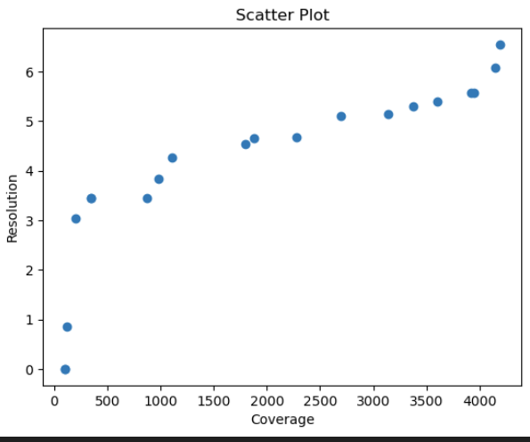
Real-life case
 | NG(5) | NG(10) | NG(15) | NG(20) | NG(25) | NG(30)
Time | 27.59 | 64.56 | 116.71 | 172.19 | 261.45 | 309.94
HV | 0.189 | 0.24 | 0.273 | 0.26 | 0.281 | 0.273
Notes:
Pareto optimal? 保留20个solution
当初nsga时，coverage和resolution的trade-off就没有明显的关系？→ 是否因为这两个是相关的？

Slide 10
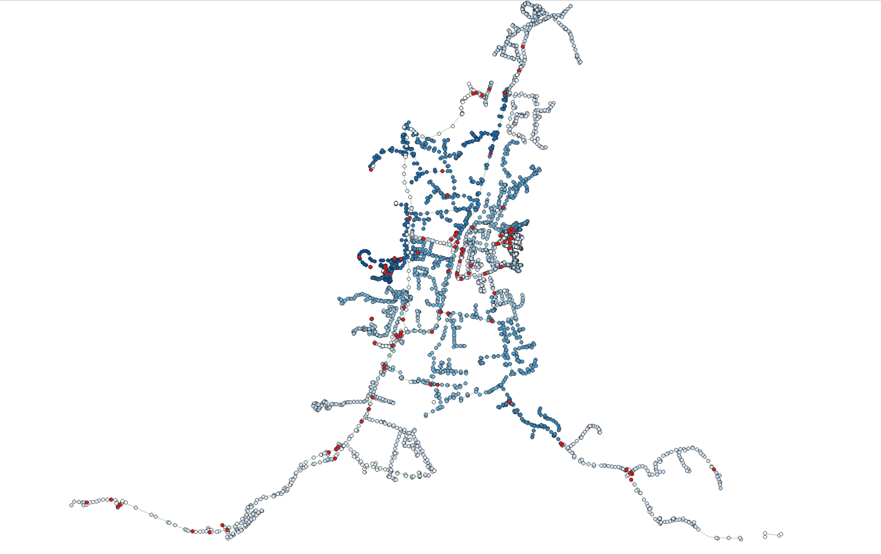

Real-life case
Notes:
Pareto optimal? 保留20个solution
当初nsga时，coverage和resolution的trade-off就没有明显的关系？→ 是否因为这两个是相关的？

Slide 11


