Slide 1
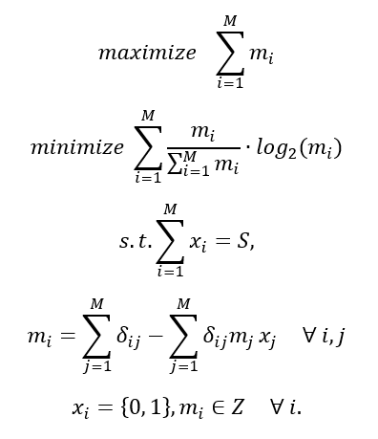
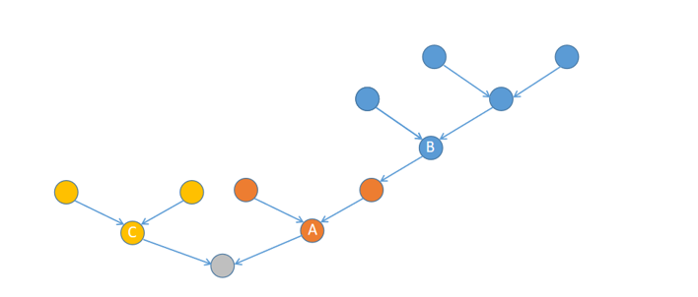



Problem formulation
$$m_{B}=5$$
$$m_{C}=3$$
$$m_{A}=3$$

Slide 2


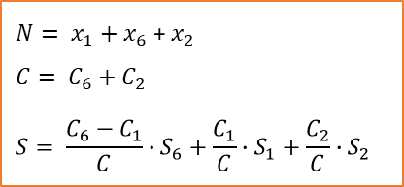

Problem formulation
1
2
1
2
1
2
3
4
5
3
4
5
3
4
5
6
7
6
7
6
7
(a) original graph
(b) sensors placed on the original graph
(c) connectivity check among sensors
1
2
1
($x_{1}, C_{1}, S_{1}$)
2
($x_{2}, C_{2}, S_{2}$)
$N= x_{1}+x_{6}$ + $x_{2}$
$$C= C_{6}+C_{2}$$
$$S= \frac{C_{6}−C_{1}}{C}∙S_{6}+\frac{C_{1}}{C}∙S_{1}+\frac{C_{2}}{C}∙S_{2}$$
6
6
($x_{6}, C_{6}, S_{6}$)
(d) connectivity subgraph
(e) connectivity-based objective evaluation

Slide 3
Problem formulation

Slide 4






$$F_{1}$$
$$F_{2}$$
$$F_{3}$$
$$S_{t}$$
$$S_{t+1}$$
…
$$S_{t_new}$$
Iterate all potential candidate sites
procedure

Slide 5







$$F_{1}$$
constraint
Add to final solution
$$F_{2}$$
$$F_{1}$$
$$F_{3}$$
$$F_{2}$$
<N?
$$S_{t+1}$$
…
$$F_{3}$$
constraint
Remove
$$S_{t}$$
$$S_{t}^{′}$$
…
$$S_{t}∪S_{t_new}$$
$$S_{t+1}$$
Do not iterate all potential candidate sites
procedure
Notes:
F1加到final solution时，也需要考虑F1中满足constraint的solution的数量和final solution size的关系
N：final solution set的size

Slide 6
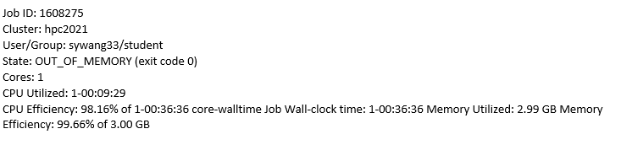
4.13 synthetic case test
original greedy: reserve 20 plans in each step
new greedy: reserve 20 plans, create 5 new plans from one plan in each step
test the code for all synthetic networks with different sizes, but only choose one for one size
Result
original greedy: 100-800 finished, 900 no result.
Out of memory→ 3GB改为6GB

Slide 7
4.16 synthetic case test
Parallel test, original greedy: 1613446

