Slide 1
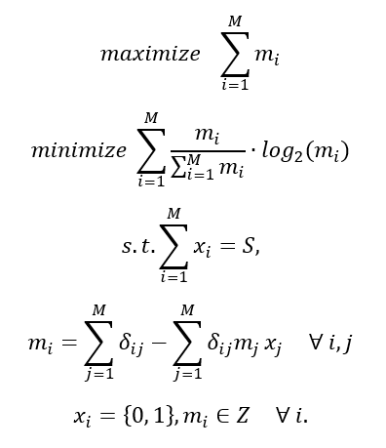
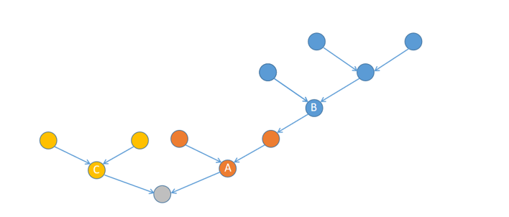



Problem formulation
$$m_{B}=5$$
$$m_{C}=3$$
$$m_{A}=3$$

Slide 2


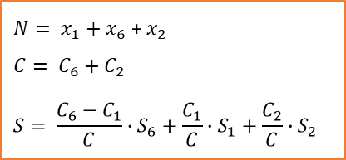

Problem formulation
1
2
1
2
1
2
3
4
5
3
4
5
3
4
5
6
7
6
7
6
7
(a) original graph
(b) sensors placed on the original graph
(c) connectivity check among sensors
1
2
1
($x_{1}, C_{1}, S_{1}$)
2
($x_{2}, C_{2}, S_{2}$)
$N= x_{1}+x_{6}$ + $x_{2}$
$$C= C_{6}+C_{2}$$
$$S= \frac{C_{6}−C_{1}}{C}∙S_{6}+\frac{C_{1}}{C}∙S_{1}+\frac{C_{2}}{C}∙S_{2}$$
6
6
($x_{6}, C_{6}, S_{6}$)
(d) connectivity subgraph
(e) connectivity-based objective evaluation

Slide 3
Problem formulation

Slide 4






$$F_{1}$$
$$F_{2}$$
$$F_{3}$$
$$S_{t}$$
$$S_{t+1}$$
…
$$S_{t_new}$$
Iterate all potential candidate sites
procedure

Slide 5











$$F_{1}$$
max sensor
constraint
Add to final solution
$$F_{2}$$
$$F_{1}$$
$$F_{3}$$
$$F_{2}$$
<N?
$$S_{t+1}$$
…
$$F_{3}$$
max sensor
Remove
$$S_{t}$$
$$S_{t}^{′}$$
…
$$S_{t}∪S_{t_new}$$
$$S_{t+1}$$
procedure
Stopping criterion: the solutions in the front 0 of the final solution is n
Notes:
F1加到final solution时，也需要考虑F1中满足constraint的solution的数量和final solution size的关系
N：final solution set的size

Slide 6














$$F_{1}$$
$$F_{1}$$
$$F_{2}$$
…
max sensor?
$$F_{1}$$
$$F_{2}$$
$$F_{1}$$
<N?
$$F_{3}$$
…
$$F_{2}$$
$$S_{t+1}$$
$$F_{3}$$
max sensor?
Remove
$$S_{t}$$
…
$$S_{t}^{′}$$
$$S_{t}∪S_{t_new}$$
$$S_{t+1}$$
Notes:
F1加到final solution时，也需要考虑F1中满足constraint的solution的数量和final solution size的关系
N：final solution set的size
Stopping criterion: the solutions in the front 0 of the final solution is n

Slide 7













$$F_{1}$$
$$F_{1}$$
$$F_{2}$$
…
Add to final solution
candidate set
$$F_{1}$$
# sensor=S
$$F_{2}$$
$$F_{1}$$
<N?
$$F_{3}$$
…
Remove
$$S_{t+1}$$
$$F_{2}$$
…
$$S_{t}$$
$$S_{t}^{′}$$
$$S_{t}∪S_{t_new}$$
# sensor<S
$$S_{t+1}$$
Notes:
F1加到final solution时，也需要考虑F1中满足constraint的solution的数量和final solution size的关系
N：final solution set的size
Stopping criterion: the solutions in the front 0 of the final solution is n

Slide 8
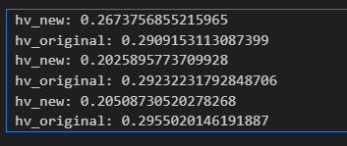
size | OG | NG(5) | NG(10) | NG(15) | NG(20) | NG(25) | NG(30)
100 | 60.69 | 0.61 | 2.28 | 4.06 | 6.92 | 8.21 | 11.89
500 | 13503.35 | 6.71 | 22.33 | 37.65 | 61.53 | 80.04 | 105.42
1000 | 113634.28 | 26.96 | 79.65 | 133.35 | 216.88 | 243.29 | 332.13
1500 | ** | 65.68 | 186.89 | 299.83 | 459.12 | 510.40 | 695.60
2000 | ** | 138.89 | 360.98 | 592.59 | 855.72 | 944.06 | 1320.14
2500 | ** | 238.28 | 615.81 | 974.02 | 1399.72 | 1555.03 | 2051.82
3000 | ** | 394.73 | 953.58 | 1523.87 | 2152.01 | 2467.20 | 3229.90
time
OG和NG(5) HV的对比
Notes:
每个iteration用于sorting的时间大大缩小

Slide 9
size | OG | NG(5) | NG(10) | NG(15) | NG(20) | NG(25) | NG(30)
100 | 0.291 | 0.267 | 0.293 | 0.287 | 0.285 | 0.3 | 0.291
500 | 0.292 | 0.203 | 0.234 | 0.259 | 0.257 | 0.26 | 0.274
1000 | 0.296 | 0.205 | 0.221 | 0.223 | 0.243 | 0.248 | 0.252
1500 | ** | 0.145 | 0.243 | 0.247 | 0.255 | 0.267 | 0.26
2000 | ** | 0.17 | 0.227 | 0.243 | 0.248 | 0.249 | 0.261
2500 | ** | 0.153 | 0.238 | 0.238 | 0.268 | 0.259 | 0.256
3000 | ** | 0.135 | 0.231 | 0.24 | 0.256 | 0.257 | 0.252
HV
Notes:
每个iteration用于sorting的时间大大缩小

Slide 10
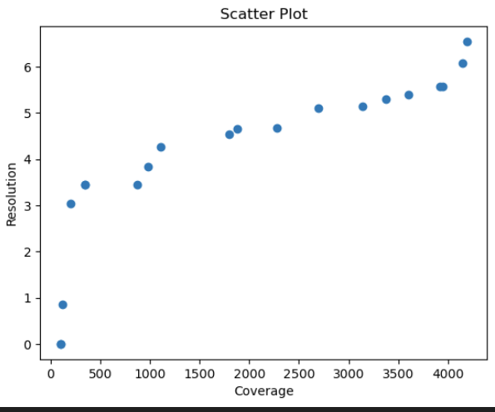
Real-life case
 | NG(5) | NG(10) | NG(15) | NG(20) | NG(25) | NG(30)
Time | 27.59 | 64.56 | 116.71 | 172.19 | 261.45 | 309.94
HV | 0.189 | 0.24 | 0.273 | 0.26 | 0.281 | 0.273
Notes:
Pareto optimal? 保留20个solution
当初nsga时，coverage和resolution的trade-off就没有明显的关系？→ 是否因为这两个是相关的？

Slide 11
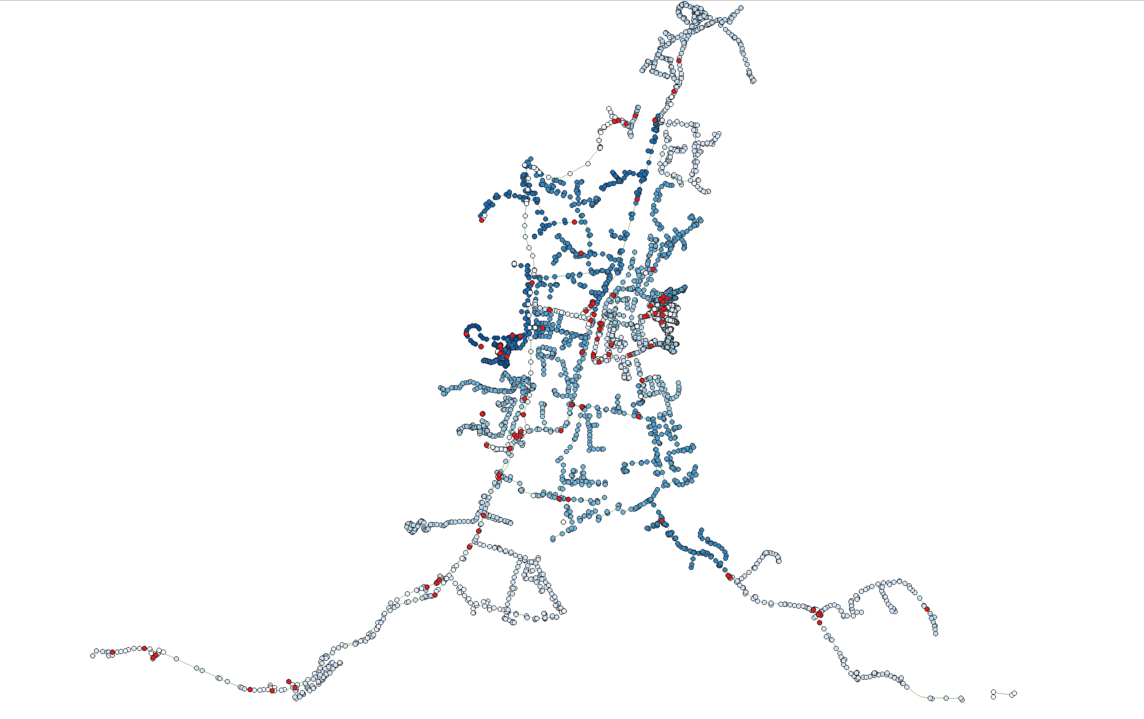

Real-life case
Notes:
Pareto optimal? 保留20个solution
当初nsga时，coverage和resolution的trade-off就没有明显的关系？→ 是否因为这两个是相关的？

Slide 12


Slide 13
Update stopping criteria, new results

Slide 14
size | OG | NG(5) | NG(10) | NG(15) | NG(20) | NG(25) | NG(30)
100 | 60.69 | 0.59 | 1.63 | 3.6 | 5.39 | 6.7 | 9.25
200 | 733.61 | 1.49 | 4.76 | 10.16 | 13.49 | 20.72 | 33.26
300 | 2532.55 | 2.73 | 8.58 | 18.3 | 24.51 | 38.21 | 60.26
400 | 6176.07 | 4.21 | 14.06 | 27.96 | 37.18 | 57.95 | 91.56
500 | 13503.35 | 7.7 | 17.61 | 37.8 | 52.71 | 74.33 | 96.81
600 | 19734.28 | 8.29 | 28.67 | 47.46 | 67.5 | 99.45 | 150.66
700 | 31385.43 | 12.05 | 37.3 | 61.77 | 85.92 | 126.08 | 186.13
800 | 45900.06 | 15.21 | 51.46 | 76.64 | 107.92 | 154.54 | 223.31
900 | 64501.67 | 19.08 | 59.5 | 89.89 | 129.14 | 184.52 | 253.49
1000 | 113634.28 | 28.39 | 66.55 | 132.97 | 183.05 | 230.37 | 330.49
1500 | ** | 65.4 | 162.11 | 288.94 | 400.25 | 482.01 | 685.55
2000 | ** | 137.53 | 316.95 | 540.83 | 738.66 | 900.49 | 1190.3
2500 | ** | 226.56 | 530.0 | 860.05 | 1231.59 | 1466.69 | 1951.67
3000 | ** | 366.28 | 855.06 | 1324.21 | 1929.44 | 2361.41 | 3052.6
time
Notes:
每个iteration用于sorting的时间大大缩小

Slide 15
size | OG | NG(5) | NG(10) | NG(15) | NG(20) | NG(25) | NG(30)
100 | 0.297 | 0.266 | 0.277 | 0.301 | 0.301 | 0.284 | 0.298
200 | 0.287 | 0.255 | 0.24 | 0.275 | 0.277 | 0.277 | 0.284
300 | 0.312 | 0.236 | 0.266 | 0.285 | 0.286 | 0.291 | 0.296
400 | 0.286 | 0.234 | 0.246 | 0.264 | 0.268 | 0.276 | 0.284
500 | 0.339 | 0.212 | 0.294 | 0.309 | 0.32 | 0.31 | 0.322
600 | 0.303 | 0.223 | 0.223 | 0.272 | 0.27 | 0.292 | 0.287
700 | 0.285 | 0.156 | 0.231 | 0.231 | 0.257 | 0.273 | 0.246
800 | 0.287 | 0.184 | 0.235 | 0.234 | 0.259 | 0.257 | 0.251
900 | 0.301 | 0.185 | 0.22 | 0.263 | 0.263 | 0.253 | 0.277
1000 | 0.298 | 0.226 | 0.251 | 0.257 | 0.269 | 0.27 | 0.264
1500 | ** | 0.182 | 0.232 | 0.257 | 0.264 | 0.272 | 0.258
2000 | ** | 0.19 | 0.217 | 0.236 | 0.254 | 0.25 | 0.257
2500 | ** | 0.14 | 0.215 | 0.237 | 0.243 | 0.254 | 0.256
3000 | ** | 0.15 | 0.209 | 0.241 | 0.252 | 0.262 | 0.25
hv

Slide 16
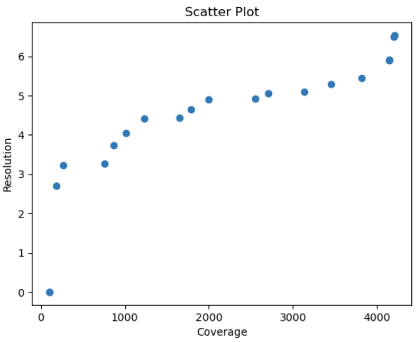
Real-life case
 | NG(5) | NG(10) | NG(15) | NG(20) | NG(25) | NG(30)
Time | 31.07 | 72.55 | 121.49 | 178.7 | 235.17 | 327.76
HV | 0.222 | 0.24 | 0.258 | 0.272 | 0.282 | 0.276
Notes:
Pareto optimal? 保留20个solution
当初nsga时，coverage和resolution的trade-off就没有明显的关系？→ 是否因为这两个是相关的？

Slide 17
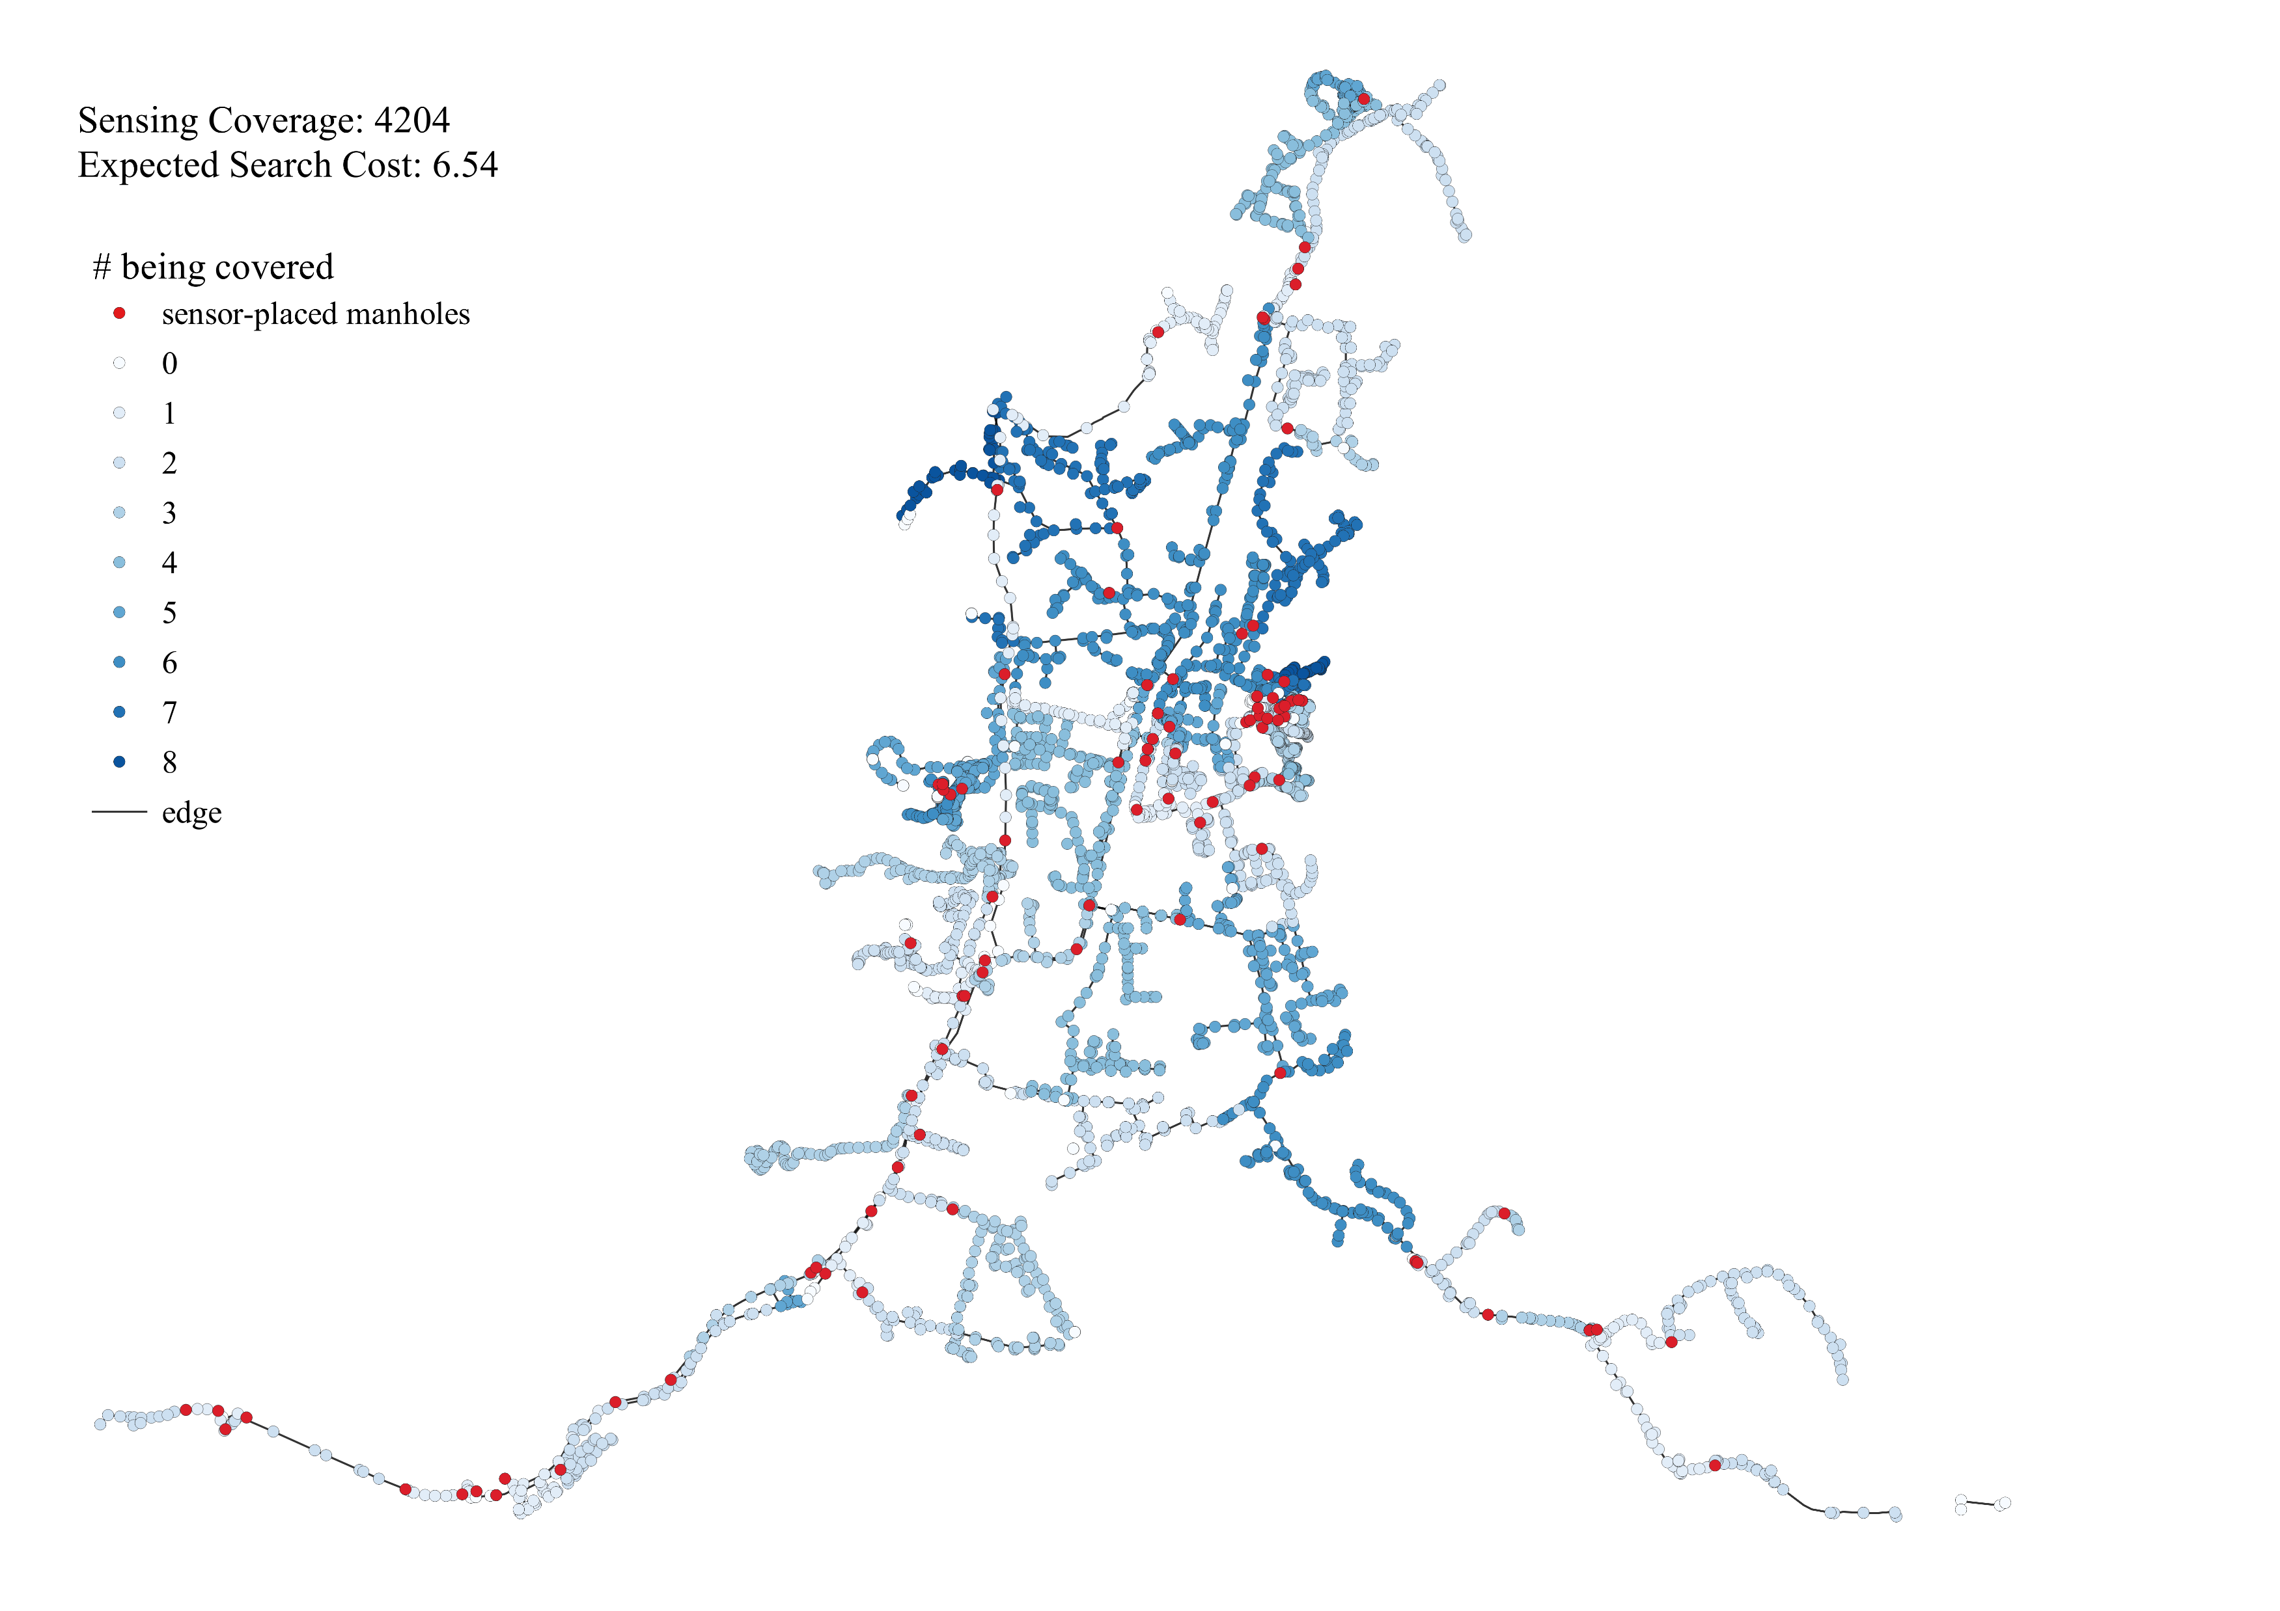
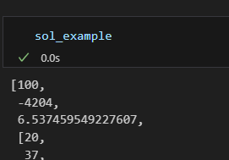
Real-life case
Notes:
Pareto optimal? 保留20个solution
当初nsga时，coverage和resolution的trade-off就没有明显的关系？→ 是否因为这两个是相关的？

Slide 18
New ideas

Slide 19
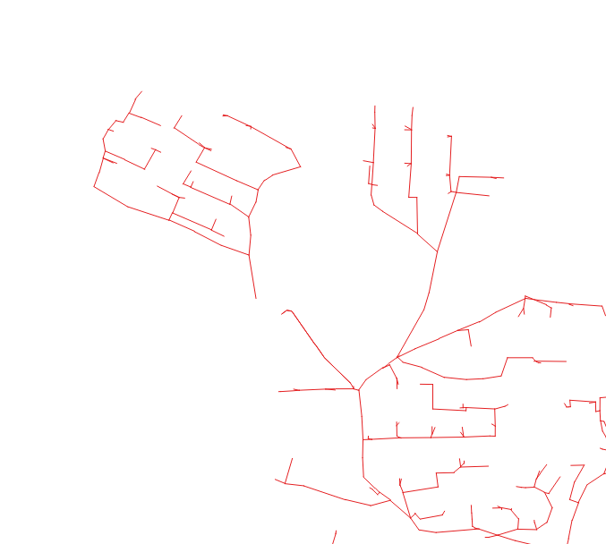
Q: network should be connected?

