Slide 1
Bridge for Beginners
Sin-Yaw Wang for SSC

Slide 2
Syllabus
Brief Overview
Hand Evaluation
Scoring Overview
Basic “Suit Play”
”Natural” concepts
SAYC (Standard American Yellow Card)

Slide 3
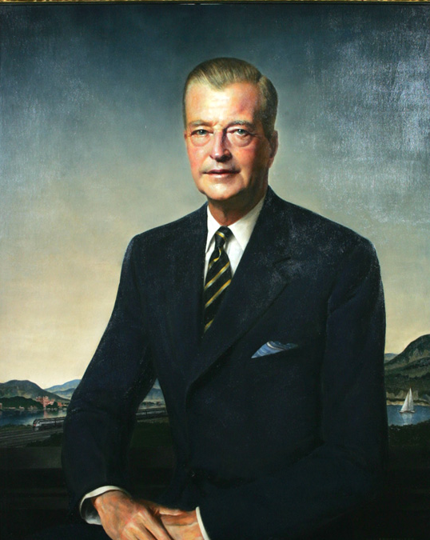
100 Years of Contract Bridge
Evolved from Whist
Harold Venderbilt codified Scoring Rules by 1925
Inventor of Contract Bridge
Reached peak population around 1940s
Rubber, Chicago-style, Duplicate
World Bridge Federation
"The Laws of Duplicate Bridge 2017".
ACBL, “The Laws of Rubber Bridge”
In-person and online games
Bridge Base Online (BBO)

Slide 4
Basic Terms
Deck, suits, and ranking
Bidding box, board, deck, traveler
The Language of Bidding
Very small vocabulary
As the only means for communication, nothing else
No secrets to the opponents
Dealer, Declarer, Dummy, Defenders
Tricks and leads
Open Lead
Dummy’s works
Score and movement

Slide 5
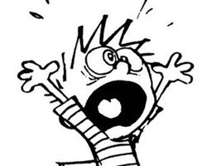
Simply, Bridge Games is about..
Find the best contract to play
Or prevent the opponents doing so
Win as many tricks as possible
Declare or defend
But how!!!

Slide 6
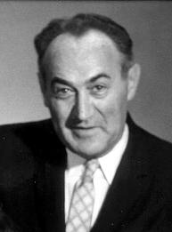
HCP, DP, and TP
High Card Points: Strength (Charles Goren)
Ace = 4, King = 3, Queen = 2, Jack = 1
Distribution Points: Shape
Void = 5, Singleton = 3, Doubleton = 1
1 Point for each of the 5th, 6th, ..., card
Total Points = HCP + DP

Slide 7
Contract Desirability in order Plausibly makable at the time of bidding
Any slam (12 or 13 tricks)
4♠/4❤️, then 3NT, last 5♦️/5♣️
A makable partial
If either way, pick NT over ♠/❤️ , then ♦️/♣️

Slide 8
Plausibility
Combined HCP/DP | Likely achievable
25 | 3
27 | 4
29 | 5
33 | 6
37 | 7

Slide 9
The Bidding Algorithm
Find a major game contract first
Need 8 cards and 27+ TPs.
If not, seek 3NT, even maybe minor suit match
Stoppers in every suits and 25+ HCP (not TP)
If not likely, see if a minor game is achievable
Need 8 cards and 29+ TP
Should we consider slams?
33+ TP?
Partial contract

Slide 10
”Above the Line” scores
Contract Level | No Trump | Major | Minor
1 | 40 | 30 | 20
2 and above | +30 | +30 | +20
Example | Above the line | Below the line | Total
2D+0 | 40 | 0 | 40
1NT+0 | 40 | 0 | 40
3S+0 | 90 | 0 | 90
5D+0 | 100 | 0 | 100
3NT+2 | 100 | 60 | 160
2H+2 | 60 | 60 | 120

Slide 11
Bonuses (below the line)
More than 100 “above the line” is a “game”
Otherwise, a “partial”.
Partial bonus: 50
Game bonus: 300 if not vulnerable, 500 if vulnerable
Board 1/5/9/13 | Board 2/6/10/14 | Board 3/7/11/15 | Board 4/8/12/16
None | NS | EW | Both
NS | EW | Both | None
EW | Both | None | NS
Both | None | NS | EW

Slide 12
Bridge for Beginners
Aug 13, 2025
Sin-Yaw Wang for SSC

Slide 13

You did not get the memo?
https://tinyurl.com/bridge101folder
https://nomadicminds.org/js/bridge101/
syw.cuper@gmail.com
https://www.bridgebase.com/v3/app/lv
Use the website. App pushes ads.
Join the LINE group chat
Or email me

Slide 14
Take-Aways from Last Meeting
Dealer opens bid, Declarer plays, Dummy takes a nap
Left-hand Side (LHS) open-leads
HCP, DP, and TP
Game contracts earn big bonuses
But you must first bid to the level
Slams get even bigger bonuses
The ”Algorithm”
1 | 33+TP | Most makable slam
2 | 27+TP, 8+ cards major | 4S/4H
3 | 25+HCP, stoppers all suits | 3NT
4 | 29+TP, 8+ cards minor | 5D/5C
5 | 22+HCP | Partial

Slide 15
Bonuses for making the contract
Partial bonus: 50
Game bonus: 300 if not vulnerable, 500 if vulnerable
Vulnerability assignments
Board 1/5/9/13 | Board 2/6/10/14 | Board 3/7/11/15 | Board 4/8/12/16
None | NS | EW | Both
NS | EW | Both | None
EW | Both | None | NS
Both | None | NS | EW

Slide 16
Examples
Example | Above the Line | Overtricks | Bonus | Total
2D+0 | 40 | 0 | 50 | 90
1NT | 40 | 0 | 50 | 90
3S | 90 | 0 | 50 | 140
5D | 100 | 0 | 300/500 | 400/600
3NT+2 | 100 | 60 | 300/500 | 460/660
2H+2 | 60 | 60 | 50 | 170

Slide 17
Bidding

Slide 18
“Natural” is a set of logic, not a system (Originally by Charles Goren)
Bid is ”strength and/or length”
Keep the algorithm in mind
“Why didn’t partner bid that?”
New suit means:
“Control and strength”, If trump suit agreed
“2nd best suit” otherwise
Usually forcing (that you cannot pass)
Jump to express extra strength
Usually also forcing
Otherwise, “retreat to same suit or NT”

Slide 19
Opening Bid
#1: 12~21HCP, 5+ cards, bid 1S or 1H
#2: 15~17HCP, “Balanced”, bid 1NT
#2.1 20~21HCP, Balanced, 2NT
#2.2 25~27HCP, Balanced, 3NT
#3: 22+HCP, bid “2C” (Strong 2C convention, not natural)
#4: ”Better minor”
Could be only 3 cards, therefore almost forcing
#5: Preemptive (length against strength)
6+ cards with 1+ honors, 5~11HCP
2D, 2H, 2S if 6 cards
3C, 3D, 3H, 3S if 7+ cards

Slide 20
Practice Open Bid

Slide 21
More on Scoring

Slide 22
Doubled/Redouble
Twice or quadruple the “above the line” score
Game is achieved whenever “above the line” exceed 100
50 points double bonus “for the insult”
Overtrick 100/200 each by vulnerability, twice if redoubled
No effect for game/slam bonuses
Severe penalties for failing the contract

Slide 23
Scoring Practices
Contract | Vul | By | Result | NS | EW
2D | NS | N | +0 | 40+50
1NTXX | EW | N | +2 | 40*4+300+400
3S | None | E | +0 |  | 30*3+50
5D | Both | W | +0
3NT | NS | S | +0 | 40+30*2+500
2HX | EW | W | +2 |  | 60*2+500+400*2
6NT | NS | N | +1 | 40+30*6+500+750
7S | EW | N | 0 | 30*7+300+1000

Slide 24
Penalties (Undertricks)
 | Not Vulnerable |  |  | Vulnerable
Down |  | X | XX |  | X | XX
-1 | -50 | -100 | -200 | -100 | -200 | -400
-2 | -100 | -300 | -600 | -150 | -400 | -600
-3 | -150 | -500 | -1000 | -200 | -600 | -1000
-4 | -200 | -800 | -1600 | -250 | -800 | -1600
-5 | -250 | -1100 | -2200 | -300 | -1100 | -2200

Slide 25
Slam/Grand Slam Bonuses
Slam: bid and made a contract at 6 level (need 12 tricks)
500/750 by vulnerability, in addition to game bonuses
Grand Slam: bid and made at 7 level (need 13 tricks)
1000/1500 by vulnerability, in addition the game

Slide 26
Scoring Summary
In duplicate bridge, the “competitors” are not your “opponents”.
Goal is to outscore the competitors
Sometimes with negative points
Don’t miss game/slam

Slide 27
Balanced Hand
No void, no singleton, no more than 2 doubletons
4333, 4432, 5332
5-card major balanced hands open 1M (preferred) or 1NT (trendy)
12~14 HCP | Open 1x, second bid 1NT
15~17 HCP | Open 1NT
18~19 HCP | Open 1x, second bid 2NT
20~21 HCP | Open 2NT
22~24 HCP | Open 2C, second bid 2NT
25+ HCP | Open 3NT

Slide 28
Invitational, Forcing, Game Forcing
Invitational: I have a good hand, let’s try game
Continue only you are more than a minimal hand
Forcing: I have more information
Do not pass, not matter what.
Game Forcing: We have game level strength
Do not stop before we reach game
Who’s the captain?

Slide 29
What Happens in a Tournament?
Team Tournament:
4-player from a team to play another team
Both tables play the same boards
Score difference convert to “IMP” (International Match Point)
Team with more IMP wins
Pair Tournament:
Two players, as a pair, play against other pairs
All pairs, taking turn, play the same boards against different opponents
MP (Match Point) Tournaments:
Rank each pair’s score, convert rankng to %
Pair with the highest average % wins
IMP Tournaments:
For each board, Pair-wise convert score differences to IMPs, obtain average
Pair with the highest accumulated IMPs wins

Slide 30
First Responses
Weak? (6~10 HCP) | 2x if 3+ support, 1NT otherwise
Inverse Minor | 4+ support 1m-2m is strong hand 1m-3m is weak hand
“Magic 9 card?” | “Limited Raise”: 10~12 HCP “Jacoby 2NT”: 13+ HCP, bid 2NT, Forcing
8+ card? | “Splinter”: 15+TP, bid singleton/void, Forcing “To play”
I have a strong hand | ”Strong Jump Shift”: 17+ HCP, 5+ cards
None of the above | (Ambiguously) bid a new suit (semi-forcing) 1m-1x: 4+ cards 1S-2H: 5+ H, otherwise 4+

Slide 31
Opener’s 2nd Bid
Have we agreed on the trump suit (or to play NT)?
Decide which level to play
Invite, game try, slam try, or pass
Got 17+ HCP
Reverse (5-5), jump rebid (6+), Jump new suit (5+)
2NT
Explore other options
Consider pass
Support partner major first
Bid 2nd suit, seeking NT contract

Slide 32
Respond to Strong 2C Opening
2H | ”Double Negative”, 0~3 HCP
2D | ”Waiting”
Anything else | 8+ HCP, Natural, Game Forcing
Double negative alternative (BBO Robot): 2C-2D-<whatever>-<cheapest next suit>

Slide 33
Suit Contract Slam Exploration
Straight Blackwood
Jump to 4NT after (implicit) trump agreement
0 or 4 Aces: 5C
1 Ace: 5D, 2 Aces: 5H, 3 Aces: 5S
5NT for King ask
Roman Key Card Blackwood (RKCB)
Jump to 4NT after (implicit) trump agreement
Key Card = Aces or Trump King
1430 variation (popular)
5C: 1 or 4 key cards, 5D: 0 or 3
5H: 2 without Trump Q, 5S: 2 With trump Queen
0314 variation (more compatible with straight BW)
5C: 1 or 4 key cards, 5D: 0 or 3
5NT for “other” Kings (reply as straight BW)

Slide 34
Gerber
Ace ask for NT contracts
Jump to 4C
4D: 0 or 4
4H: 1 Ace, 4S: 2 Aces, 4NT: 3 Aces
5C for King ask

Slide 35
Responses to NT
It better for stronger hand not to reveal.
Making the opener the declarer
Many well-known conventions to help
Slam exploration
Gerber instead of Blackwood (RKCB requires trump suit agreement first)
Quantitative Invite
Stayman
Seek 4-4 Major
Use Smolen to seek 5-3 Major
Revert to NT
Jacoby Transfers
Make opener to bid your (one) long major suit
Minor?
SAYC has no standard way
Minor transfer and/or Minor Stayman

Slide 36
NT Response Selections
If you have .. | Do this
Lots of HCP | Slam exploration: Gerber 4C
One or two 4+ Major | Stayman 2C, Jacoby Transfer 2D/2H
One or two 6+ Major | Texas Transfer 4D/4H
Long minor with honors | 3NT?
Otherwise | Minor transfer or minor Stayman
Strength requirements based on bridge logic.

Slide 37
NT Response Conventions
Situation | Use this convention
Have one 4-card Major | Stayman
Have 5-4 Majors | Stayman followed by Smolen
Have a 5+ Major | Jacoby Transfer
Have a 6+ Major and 10 TP | Texas Transfer
Have 10 HCP | Invitation to 3NT (may not be possible)
Slam interest | Gerber, Quantitative Invite, Jump new suit
Explore minor contract | With prior agreement, Minor transfer/Minor Stayman

Slide 38
Partials win or lose a tournament
Be aggressive in competitive bidding
At least to disturb their flow
Always consider the consequence of getting doubled
To bid or not to bid...
Bid a contract that we can score positively
Sacrifice by bidding a contract to score least negatively
Letting opponents play a contract for optimal score for us
Doubling the stake
Consider vulnerability and likelihood of we/they making/failing the contract

