Slide 1
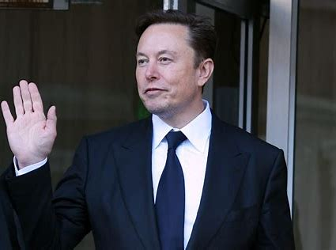
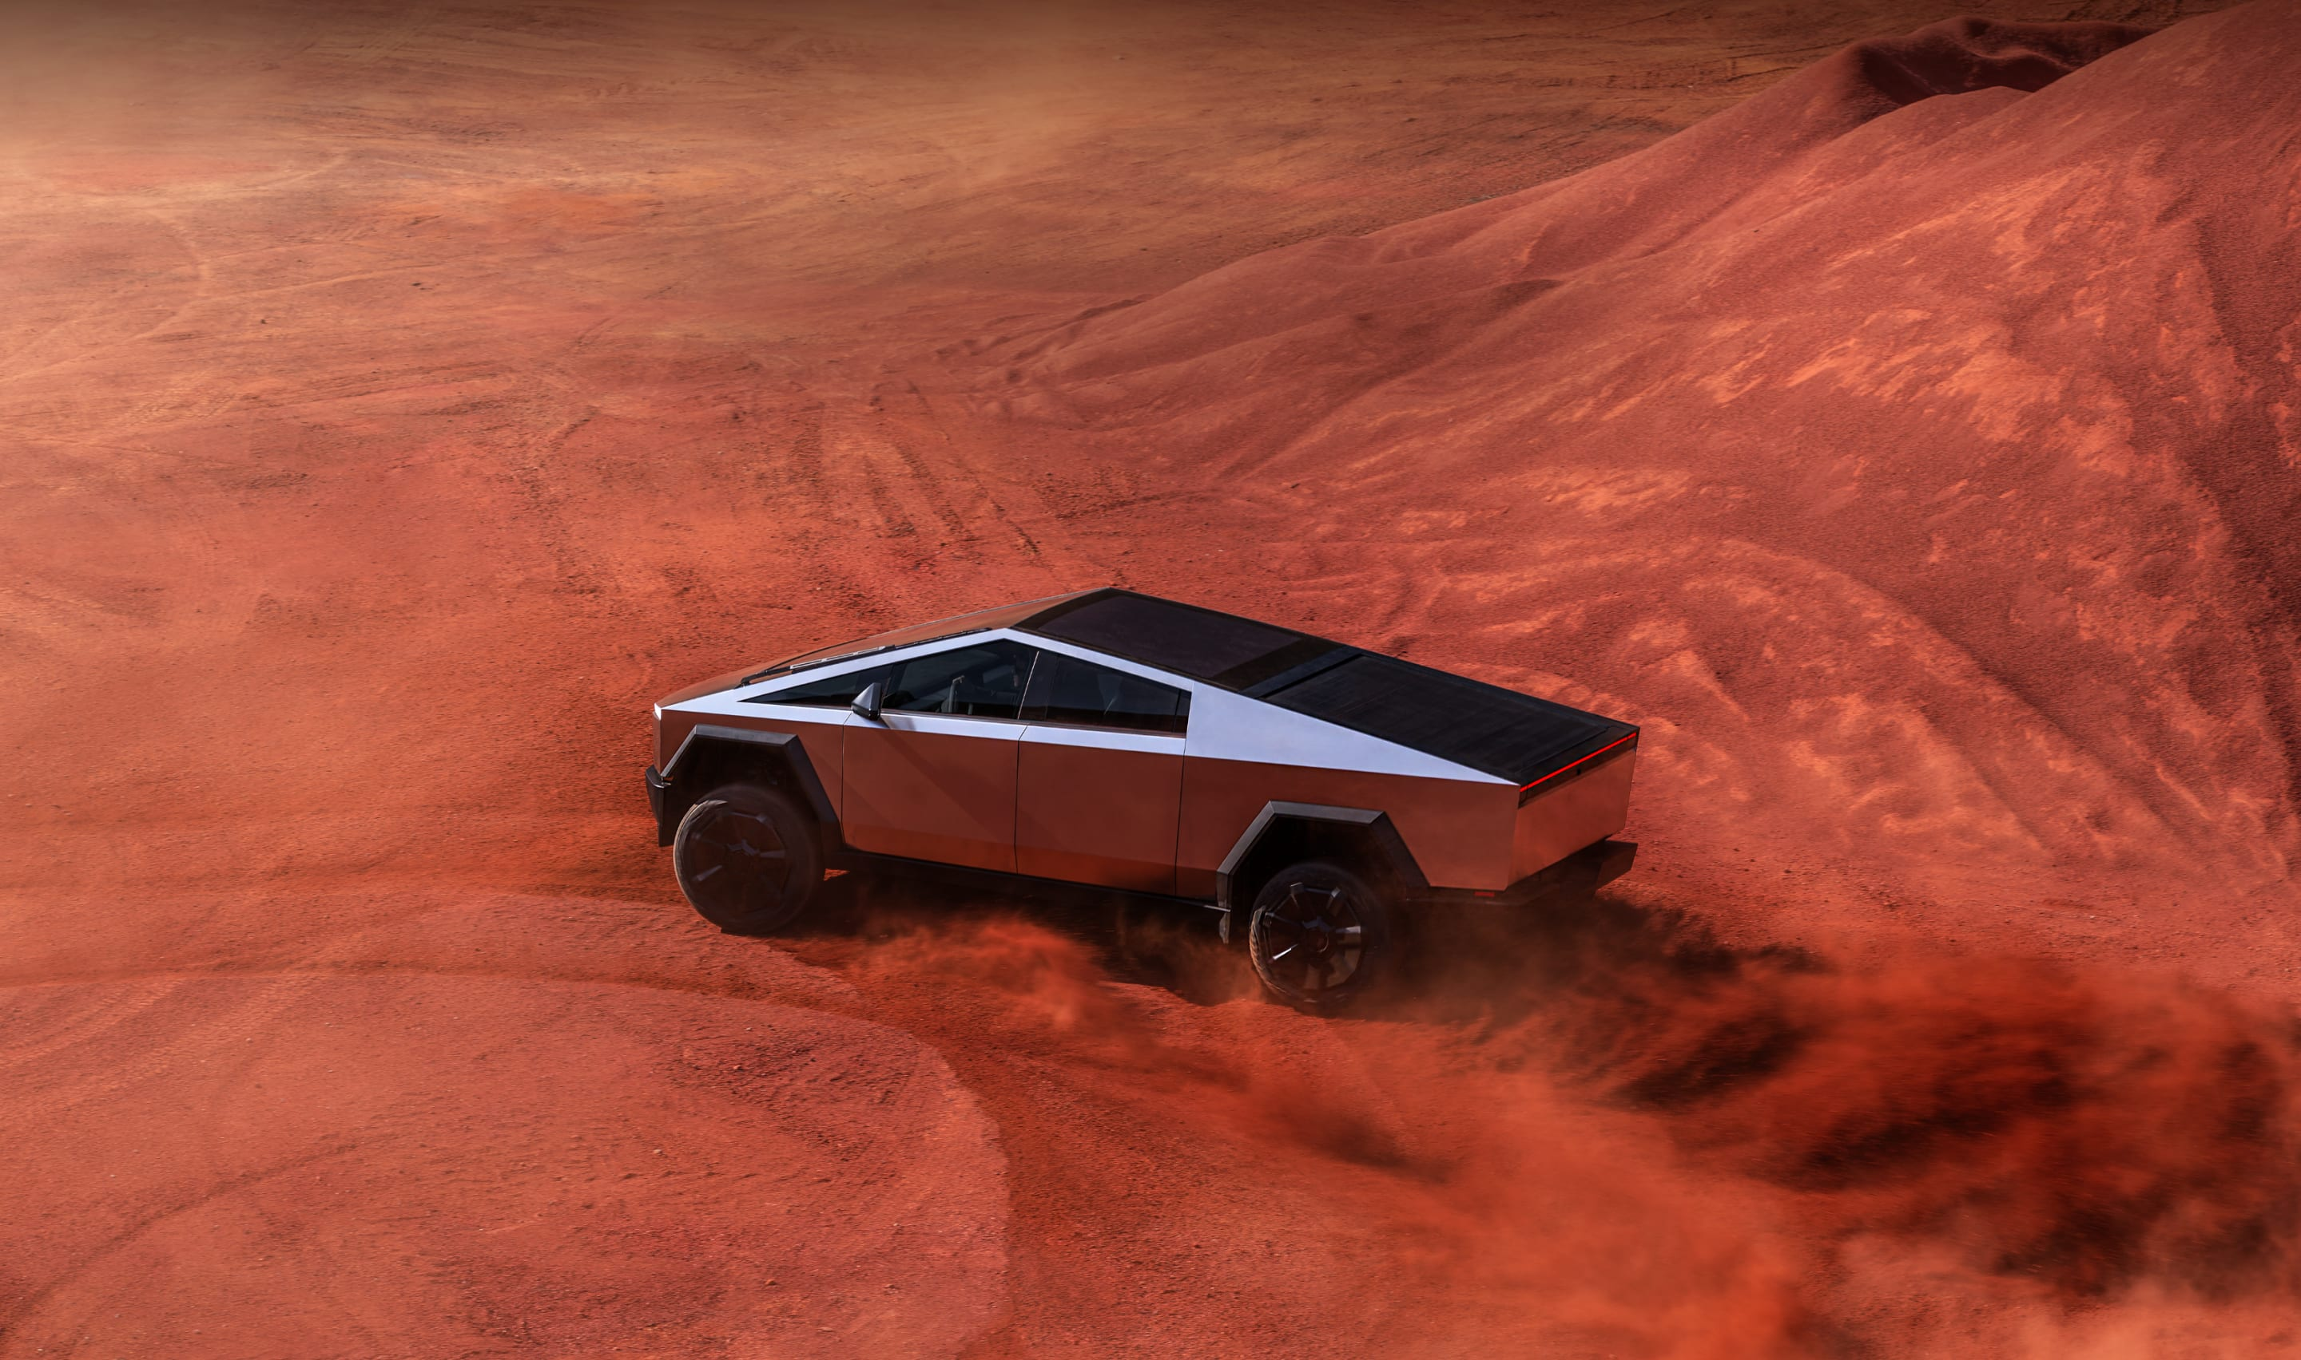
Do you know him?
Do you know this car?

Slide 2
The Celebrity（名人）
I Admire: Elon Musk
By Song Yongxian

Slide 3
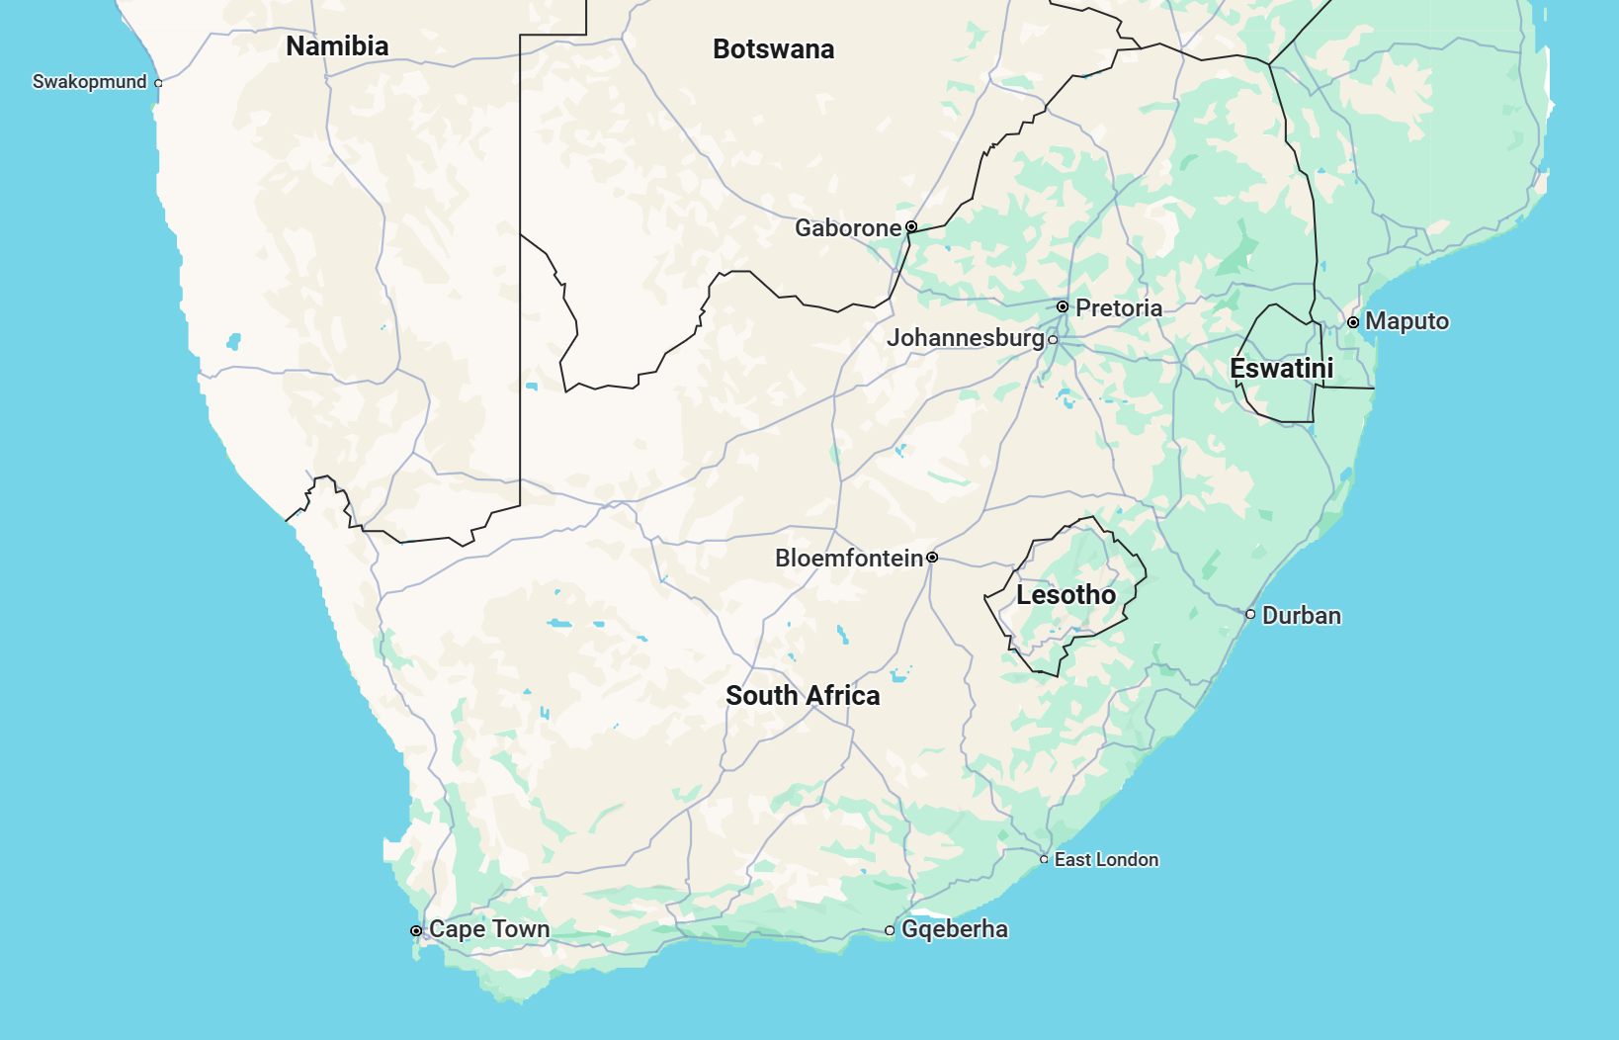

Basic Information
Birthplace: South Africa
Birthdate: June 28, 1971
Occupation: Inventor, Businessman(企业家), Engineer（工程师）

Slide 4

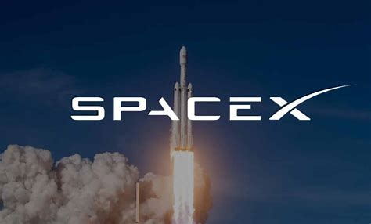
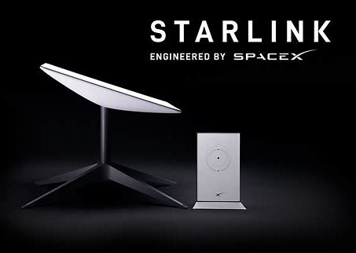
Experiences and Works
1.Tesla /特斯拉:
He is Leader in electric vehicles, aiming to reduce
carbon emissions.
电动汽车领导者，致力于减少碳排放。
2.SpaceX /太空探索技术公司:
Making space travel affordable, with the goal of sending humans to Mars.
降低太空旅行成本，目标是将人类送上火星。
3.Starlink /星链:
Providing global satellite internet, especially in remote areas.
提供全球卫星互联网服务，特别是在偏远地区。
SpaceX
Starlink

Slide 5
Experiences and Works
He is the CEO(首席执行官) of the company Tesla (特斯拉). Tesla is the leader of electric（电动的） cars, aiming to reduce carbon emissions（减少碳排放）.
He started the company SpaceX (太空探索技术公司).
His company is making space travel possible individually(个人),not by the country ,with the goal(目标) of sending humans to Mars（将人类送上火星）.
He launched Starlink satellites发射星链卫星
Providing global satellite internet(全球卫星互联网服务).
SpaceX
Starlink

Slide 6
Evaluation and Achievements
Achievements /成就:
He is the richest (富裕的)man in the world.
He bought Twitter, now X ，推特（现为X）a famous global social platform (全球社交平台)
Overall Evaluation /总体评价:
He proves(证明)that vision（远见）and persistence（坚持）can change the world.
His innovative spirit(创新精神)inspires millions to chase(追求) their dreams.

Slide 7
"When something is important enough, you do it even if the odds are not in your favor."
“当某件事足够重要时，即使胜算不大，你也会去做。”
"The future belongs to those who believe in the beauty of their dreams."
“未来属于那些相信自己梦想之美的人。”

Slide 8
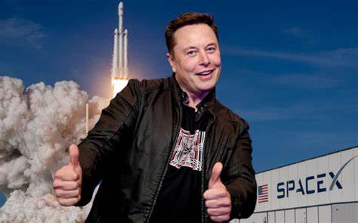
Thank you for listening!
Let’s chase our dreams together!

