Slide 1


MIMIC – ML/DL
Syyad Ali
26 MARCH 2025

Slide 2
Predicting Hospital-Acquired Infections (HAIs) Using MIMIC-III
Goal:
Predict whether an ICU patient will develop a hospital-acquired infection
(HAI) using lab tests, microbiology reports, and antibiotic prescriptions.

Slide 3
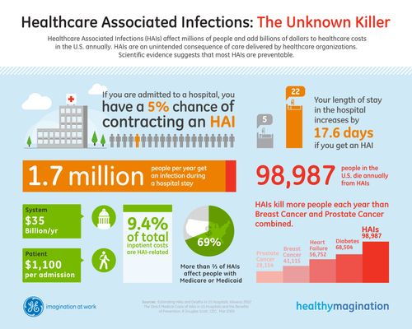
HAIs – The unknown Killer
Hospital-acquired infections (HAIs) are a major healthcare concern due to their significant impact on patient health, costs, and hospital systems.
They lead to prolonged illness, increased mortality, and drive-up healthcare costs by requiring longer stays and intensive treatments.
Despite their severity, a large portion of HAIs are preventable, which makes early prediction and prevention—like with AI-based models—critically important for improving patient outcomes and reducing system-wide burdens.
Source : https://participatorymedicine.org/epatients/2011/07/healthcare-associated-infections-whats-an-infographic-got-to-do-with-it.html

Slide 4
Resources
Full MIMIC-3 DB
Computer with Nvidia GPU
Visual Studio Code Application

Slide 5
Data Sources Used (MIMIC-III CSV Files)
LABEVENTS.csv – White blood cell count, inflammatory markers (CRP, Procalcitonin). MICROBIOLOGYEVENTS.csv – Bacterial cultures, pathogen identifications. PRESCRIPTIONS.csv – Use of antibiotics (vancomycin, ceftriaxone, piperacillin). ICUSTAYS.csv – ICU length of stay (LOS), patient’s ICU unit type. ADMISSIONS.csv – Admission type (elective/emergency), initial diagnoses.
Machine Learning Models Used
Random Forest Classifier for tabular data prediction. Logistic Regression as a baseline model. LSTM (Recurrent Neural Networks) for time-series infection trends.

Slide 6
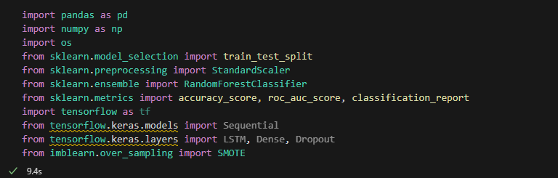
Step 1: Install Required Packages
Step 2: Import Required Libraries

Slide 7

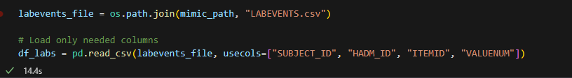
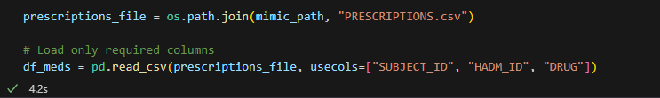
Step 3: Load MIMIC-III CSV Files

Slide 8
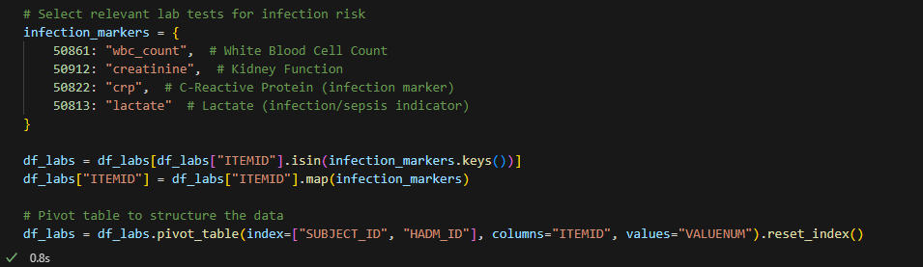
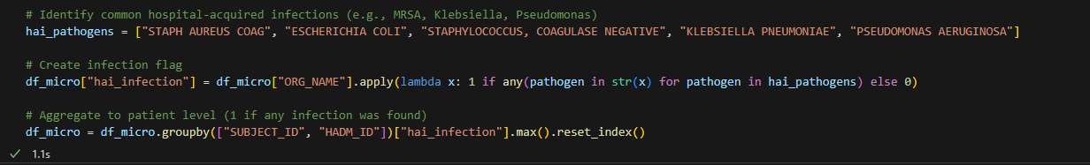
Step 4: Select relevant data for infection risk
Step 5: Load Microbiology Reports from MICROBIOLOGYEVENTS.csv

Slide 9
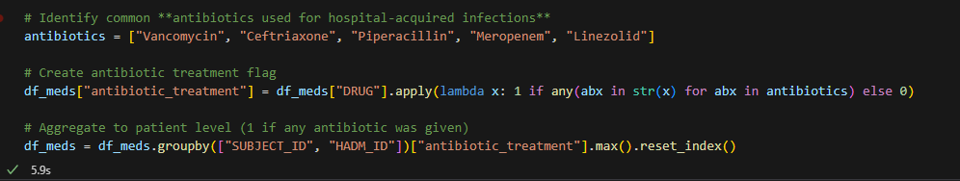
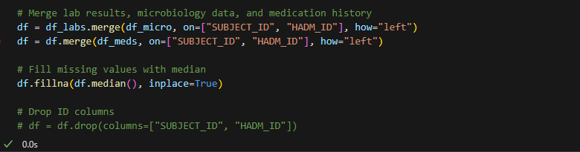
Step 6: Load Antibiotic Usage from PRESCRIPTIONS.csv
Step 7: Merge All Data Sources

Slide 10
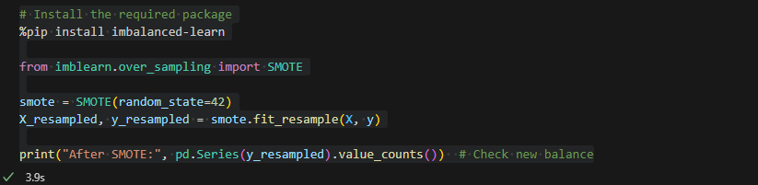
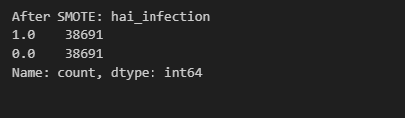
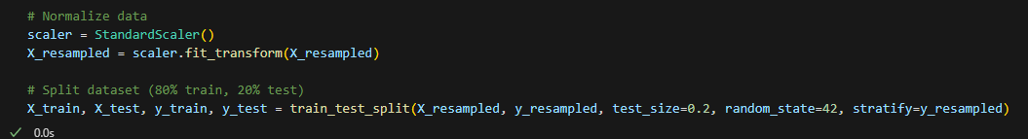
Step 8: Fix data imbalance
It is found that filtered data has very few patients with HAI infection compared to patients without the infection. To Balance the dataset, I have used SMOTE Oversampling.
Step 9: Train-Test Split

Slide 11
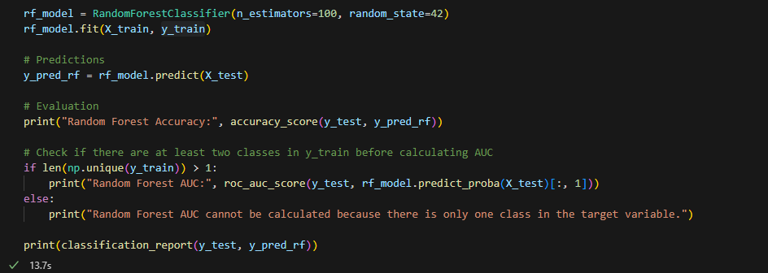
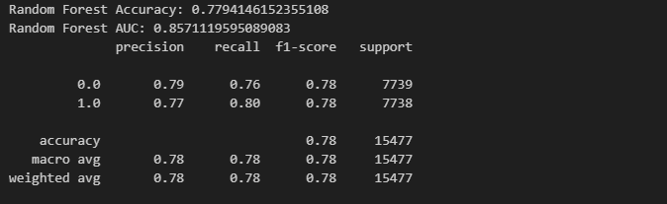
Step 10: Train a Random Forest Model
Model Accuracy: Close to 78%

Slide 12
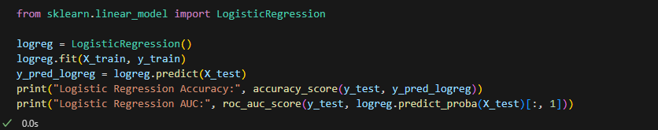
Step 11: Logistic Regression Model
For comparison with Random Forest Model, results are also analyzed with Logistic Regression Model.
LR Model Accuracy: Close to 68%. Random Forest performed better compared to LR Model.

Slide 13
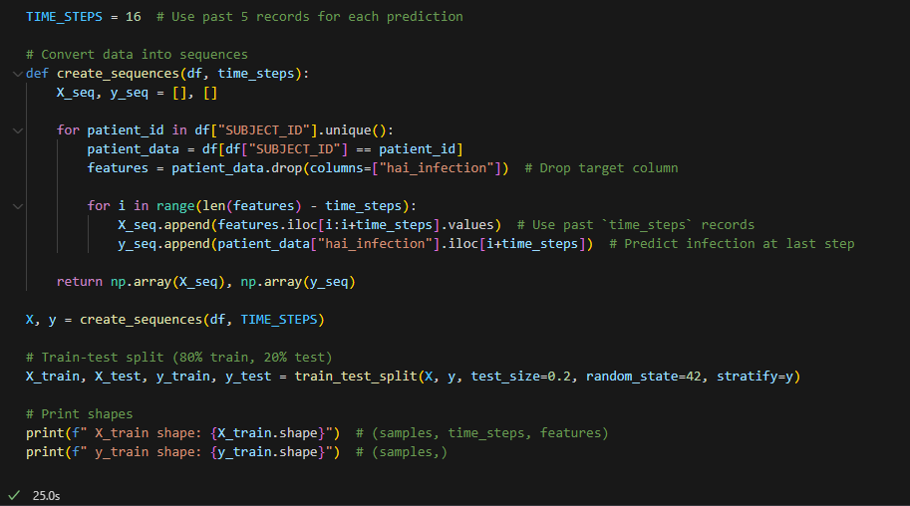

Step 12: Created a Deep Learning LSTM Model to observe if it can perform better than the Random Forest Model.

Slide 14
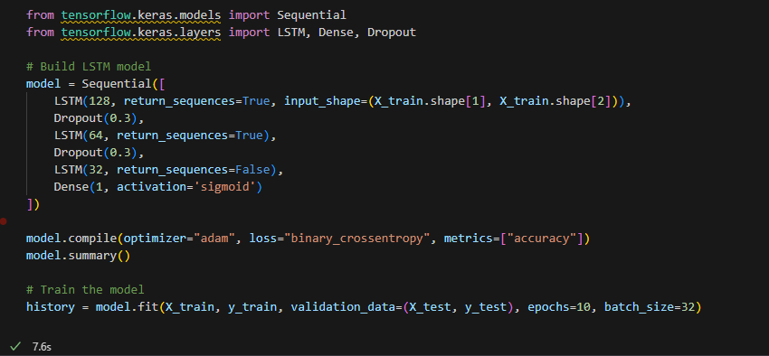
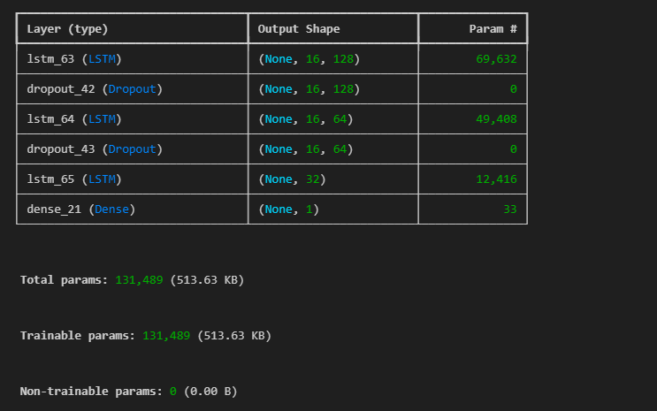
Step 12 (continued) : Created a Deep Learning LSTM Model to observe if it can perform better than the Random Forest Model.

Slide 15
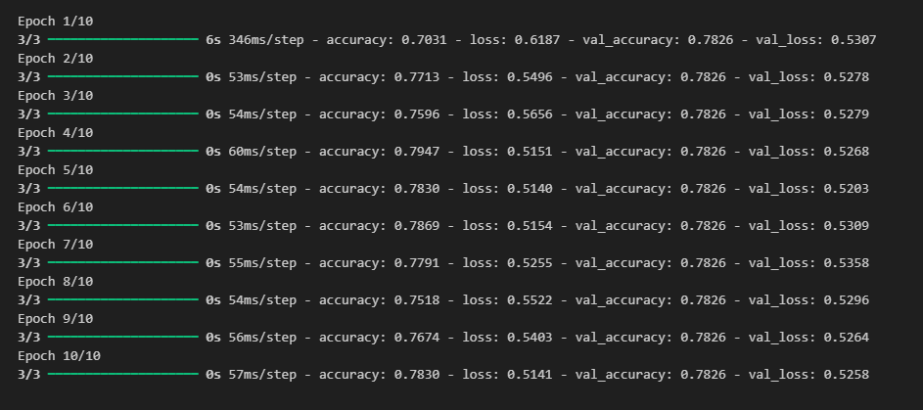
Step 12 (continued) : Performance of Deep Learning Model was only slightly better than Randon Forest in this case..
Step 13: Model Comparison
Metric | Random Forest | LSTM | Notes
Accuracy | 0.779 | 0.783 | Very close performance
Training Time | Fast | Slow | LSTM is computationally heavier

Slide 16
Thanks
Syyad Ali

